Slide 1
WELCOME
To
Bhabanipur Sefatia kamil Madrasah
Online Class
Notes:
Teacher can say it orally.

Slide 3
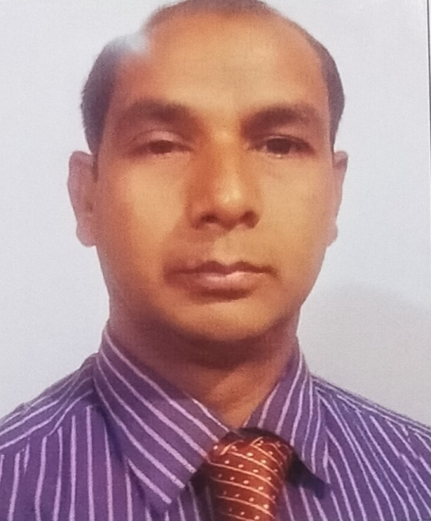
IDENTITY
Md. Moksed Ali
Assistant Teacher (English)
Bhabanipur Sefatia Kamil Madrasah,
Hatibandha, Lalmonirhat.
Mobile: 01717292475
Email:moksedali1980@gmail.com
Topic
ENGLISH GRAMMAR.
Class : Six- Ten
Past Indefinite Tense
Notes:
Teacher can hide this slide.

Slide 4
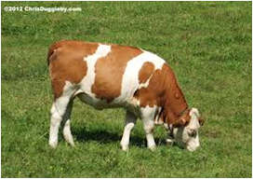
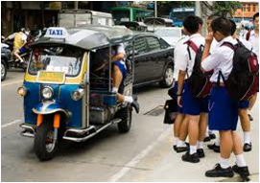
Mind set up : Can you speak in English about the following pictures ?
The cow lived on grass
The sun rose in the east.
They went to school everyday.
T. You were right. Thanked a lot. Everybody claped for him
T. Can you say what kind of tense are those ?
S. Sir, They are present Indefinite tense.
Notes:
At first pictures will be shown. Teacher can try to elicit the answer from the students. Then he/she can give feedback by clicking.

Slide 5
Lesson Declaration
Today’s Topic
Past Indefinite Tense

Slide 6
LEARNING OUTCONES
After completing this lesson students will be able to
say how many kinds of Tense.
Write the structure of Present Indefinite Tense
Make correct sentence according to Present Indefinite Tense.
Re-write in Present Indefinite Tense.

Slide 7
Past Tense
Past Tense Has four types. Such as-

Slide 8
Past Indefinite Tense
Past Continuous Tense
Past Perfect Tense
Past Perfect Continuous Tense

Slide 9
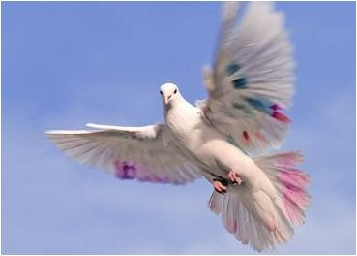
Past Indefinite Tense
Could anyone say the definition of Past Indefinite Tense.
Definition:
Past Indefinite Tense denoted an action in the past time of habitual event, historical events in past.
Notes:
At first pictures will be shown. Teacher can try to elicit the answer from the students. Then he/she can give feedback by clicking.

Slide 10
Past Indefinite Tense
Could anyone say the structure of Past Indefinite Tense
Aff : Sub + V2 + obj.
Neg : Sub + did not+ V1 + obj.
Intre : Did + Sub + V1 + obj ?
Notes:
Teacher can try to elicit the answer from the students. Then he/she can give feedback by clicking.

Slide 11
Past Indefinite Tense
Past Indefinite Tense is used when the work was done in the past times.
কোন কাজ অতীতে সম্পন্ন হয়েছিল এরুপ বুঝালে তাকে Past Indefinite Tense বলে।
চিনিবার উপায়ঃ-
বাংলায় ক্রিয়ার শেষে ইয়াছিল, ইয়াছিলা, ইয়াছিলেন ইত্যাদি ক্রিয়া বিভক্তি থাকে।
যেমনঃ সে স্কুলে গিয়াছিল। =He went school.
আমি একটি পাখি দেখিয়াছিলাম।= I saw a bird.
তোমরা কাজটি করিয়া্রালে। = You did the work
Notes:
Teacher can try to elicit the answer from the students. Then he/she can give feedback by clicking.

Slide 12
Past Indefinite Tense
If in the sentence there was someday / recently/ past times/
Sometimes/ even/ the sentence will be Past Indefinite tense.
Example : Mother read the Quran oneday.
Yesterday I paid my tuition fees. etc.
Notes:
Teacher can try to elicit the answer from the students. Then he/she can give feedback by clicking.

Slide 13
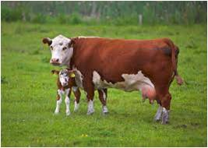
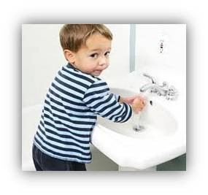
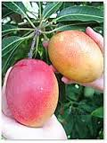
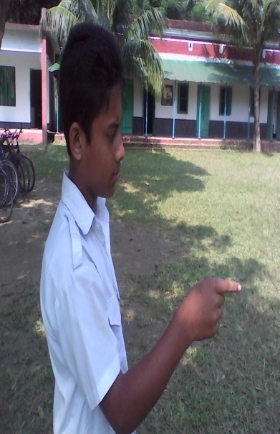
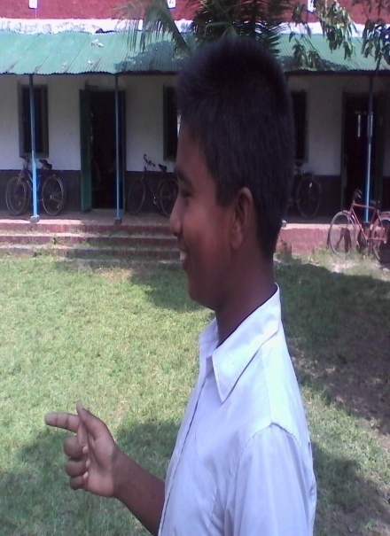
Pair work: Ask and answer - Follow the conversation
Yes, he did.
Do you like mango?
Yes, I do.
Mainly, what does the cow give us?
Mainly, The cow gives us milk?
Does he wash his hands before eating?
Now any two boys came to near my desk and made a dialogue using did /didn`t.
Notes:
At first pictures will be shown. Teacher can try to elicit the answer from the students. Then he/she can give feedback by clicking.

Slide 14
INDEVETUAL WORK
Fill in the gaps with the right form of verbs that given in the box.
We (a) ---------- to school everyday but Rana (b) -------- not to go school everyday. He (c) ---------- football with his friends. (d) ---------- you go to school everyday ? What class did he (e) ----------- in ? Rina (f) ---------- in Dhaka with his family. Do you (g) ------------ your school ? Sabina (h) ---------- a song. The sun (i) --------- in the east. A good teacher (j) ------------ his class interesting.
Play | Rise | Live | Do | Read
Sing | Catch | Make | Love | go
went
did
played
Did
read
lived
loved
sang
rose
made
Notes:
At first pictures will be shown. Teacher can try to elicit the answer from the students. Then he/she can give feedback by clicking.

Slide 15
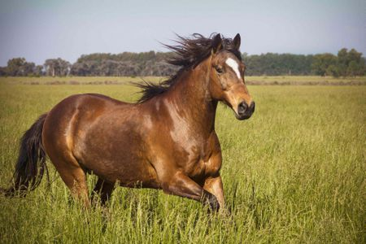
Group works
Write three sentences (affirmative, negative and Interrogative) about the above picture according to the rules of Present Indefinite Tense.
Notes:
At first pictures will be shown. Teacher can try to elicit the answer from the students. Then he/she can give feedback by clicking.

Slide 16
HOME WORK
Write down five sentences that you and your sister did at your house. Using Past Indefinite Tense.
Notes:
Teacher can give some instructions to do the home work.

Slide 17
Allah Hafez
Notes:
Teacher can say another language.

