Slide 1
Welcome

Slide 2
Introduction
Mostafizur Rahman
Assistant Teacher ( English)
Chunarughat Pilot Girls High School
Chunarughat, Habigonj
E-mail: mostafiz01papon@gmail.com

Slide 3
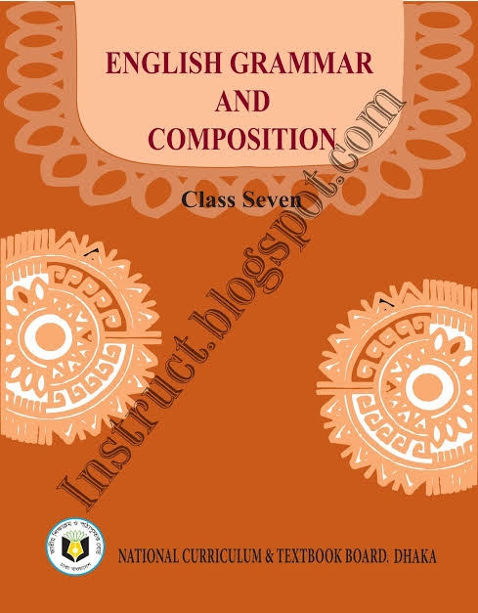
Classes 6-7
Subject: English 2nd Paper
Topic: Present Continuous Tense
Time:50 minutes

Slide 4
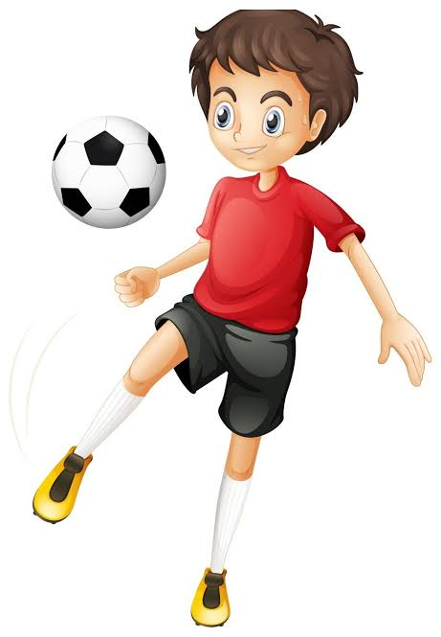
Look at the sentenses below
She is eating rice.
They are going to school.
I am playing football.
These sentences are Present Continuous Tense

Slide 5
So, today we shall discuss about
Present Continuous Tense

Slide 6
Learning outcome
After end of the lesson, students will be able to
1.write the structure of present continuous tense.
2.Make sentences according to present continuous tense.

Slide 7
Can you say what’s the definition of Present Continuous Tense

Slide 8
Structure Of Present Continuous Tense
Am I eating rice?

Slide 9
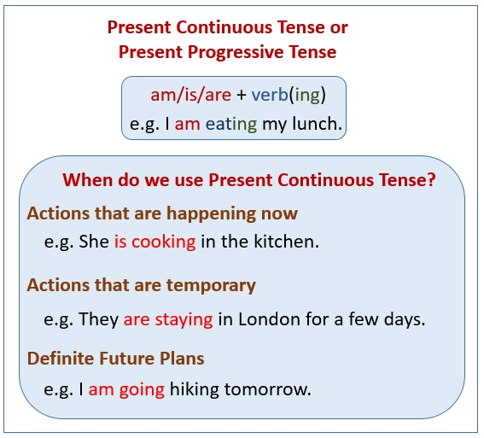

Slide 10
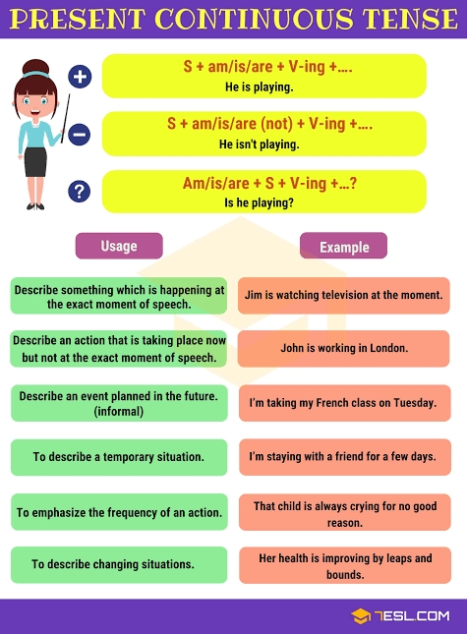

Slide 11
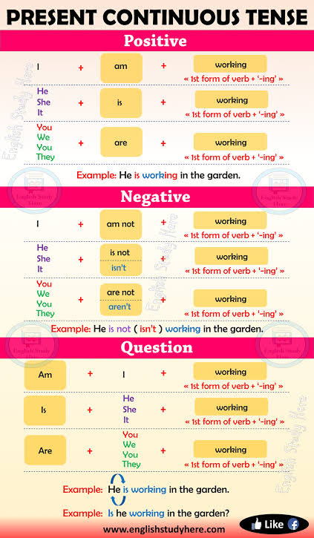

Slide 12
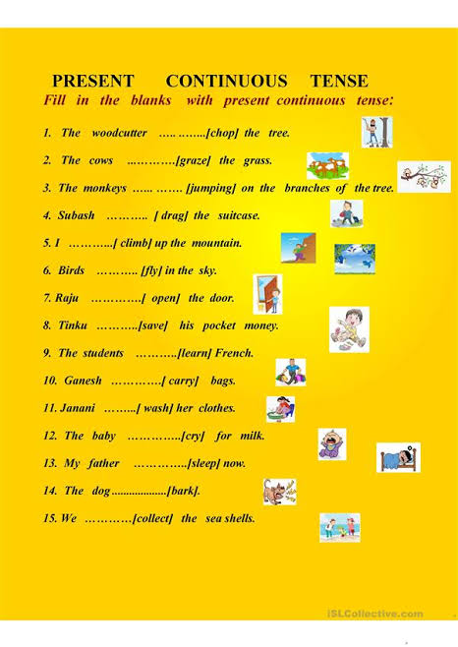
Pair work
10 minutes

Slide 13
Evaluation
6 minutes
Using above picture write three sentences ( affirmative, negative and interrogative) of present continuous tense.

Slide 14
Home Work
What is present continuous tense ?
What is the structure of present continuous tense?

Slide 15
Thank you

