Slide 1
Welcome

Slide 3
INTRODUCTION
Md. Moksed Ali
Assistant Teacher (English)
Bhabanipur Sefatia Kamil Madrasah,
Hatibandha, Lalmonirhat.
Mobile: 01717292475
Email:mmali2023782@gmail.com
CLASS : SEVEN
SUBJECT : ENGLISH SECOND PAPER
UNIT : ONE
LESSON : THIRTEEN
TOPIC : PAST CONTINUOS TENSE

Slide 4
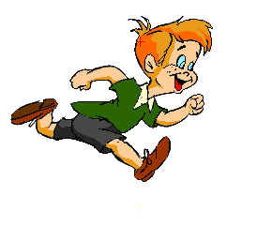
What is the boy doing?
The boy was running.
What was the bird doing?
The bird was flying.

Slide 5
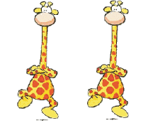
What are werethe giraffes doing?
The giraffes were dancing.

Slide 6
Today’s Topic
Past Continuous Tense
The past continuous tense is used for something happening in the past. The action is finished.

Slide 7
LEARNING OUTCOMES
By the end of the lesson the students will be able to
give questions’ answer using past continuous tense.
identify past continuous tense.
make sentences with past continuous tense .

Slide 8
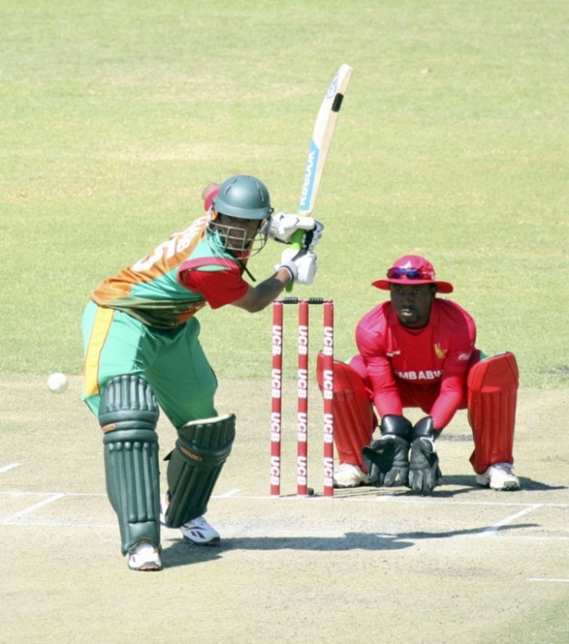
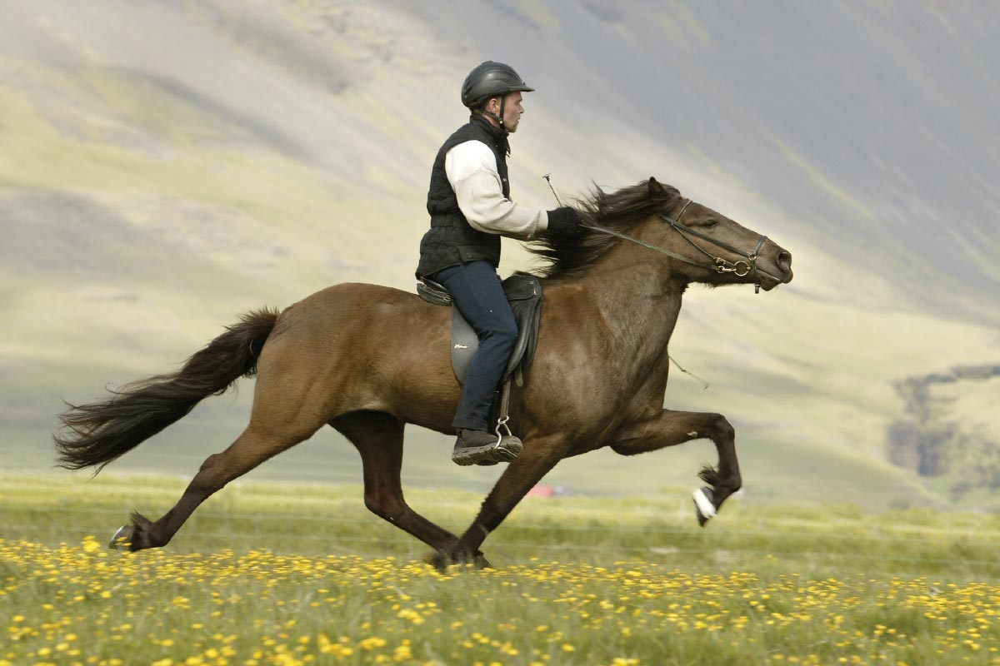
Answer the questions and notice the red colored words
What were they doing?
They were playing cricket.
Was the man riding a bicycle?
No, the man was not riding a bicycle?
What was the man doing?
The man was riding a horse.

Slide 9
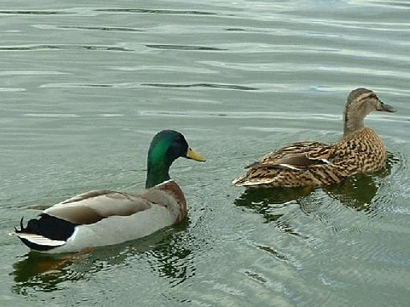
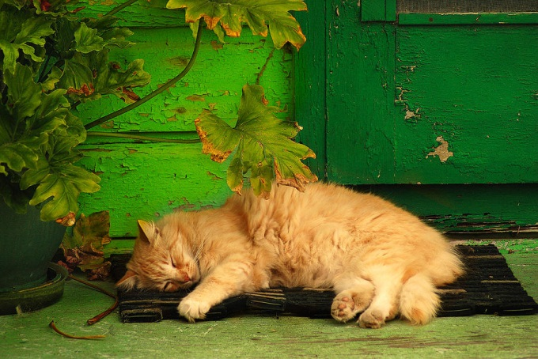
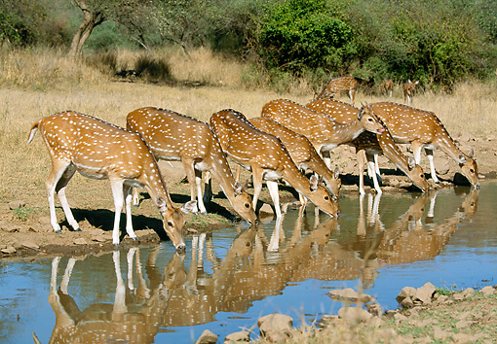
What were two ducks doing in the water?
Two ducks were swimming in the water.
What was the cat doing?
The cat was sleeping .
What were deer doing?
Deer were drinking water.

Slide 10
Structure Of past Continuous Tense
Affirm | Sub | was/were | verb | ing | Others
I am doing my homework.
Neg | Sub | was not / were not | verb | ing | others
I am not doing my homework.
Int | Was / were | Sub | verb | ing | Others+ ?
Was I doing my homework?

Slide 11
Where were these used?
was
I
was
He, She, 3rd person singular number, It, That
were
We, You, They, 3rd person plural number

Slide 12
Make sentences from the jumble words. (pair works)
I
were
taking my bath.
was
Mangoes
looking green.

Slide 13
Read all the sentences first and find out which sentences are present continuous tense say tick for them if not say cross for them. (Pair work)
1. They was going to school everyday.
x
2. Shila was making a cup of tea.
_/
3. Arpon was playing badminton yesterday.
x
_/
4. It was not raining now.

Slide 14
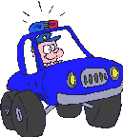
Look at the pictures and write what they were doing in each picture. Write them in 3 structures of past continuous tense(affirmative, negative and interrogative) for each picture. (Pair work)
1
2
3

Slide 15
Answer
A police wasdriving a car.
A police was not driving a car.
Was a police driving a car?
A man was digging soil.
A man was not digging soil.
Was a man digging soil?
The were eating.
The chickens were not eating.
Were the chickens eating?

Slide 16
Homework
At your home look around and write what the people awere doing. Write 10 sentences with past continuous tense.

Slide 17
Acknowledgement
MoE, DSHE, NCTB & A2I respective of officials
And the editors panel: Ranjit Poddar, Associate Professor (English) TTC, Dhaka, Md. Jahangir Hasan (English), Assistant Professor TTC, Rangpur and Urmila Khaled Assistant Professor (English) TTC, Dhaka.
Their direction, valuable suggestions and intensive supervision have enriched the model contents.

Slide 18
THANK YOU ALL

