Slide 1
Chapter - 4
Economy of Bangladesh
SA Asha

Slide 2
Topics discussed in the chapter
The informal economic activities of villages and towns of Bangladesh
The contribution of different industries in the economy of Bangladesh
The main export and import items of Bangladesh
The system of processing industries and agro-products of Bangladesh
Problems with the solution during agro-product processing
SA Asha

Slide 3
Lesson - 1
Informal Economic Activities of Villages and Towns of Bangladesh
SA Asha

Slide 4
Economic activity
*Any work,service,transaction
* has economic value
Formal
* under taxation
* regulated by the government
Ex.- people working in civil service, public sector units, government service,defence, etc.
Informal
* do not have fixed wages (মজুরি,বেতন)
* difficult to bring under taxation
* not regulated by the government
Ex.- work in own land, work in shops, household works, etc.
* Also called traditional sector of economy- ancient period
SA Asha

Slide 5
Informal Economic Activities of Villages/Rural Areas
SA Asha

Slide 6
Informal Economic Activities of Villages/Rural Areas (Cont. …)
Informal economic activities –
Role: constitute the main role of the economy of Bangladesh
How: Ex. : A farmer and his family work in their field and produces crops. They do not get salary for their work. Also they are not only the persons who took the food. These crops/foods are supplied in the cities and whole country as well. So, basically a large portion of our food demand is fulfilled by their production. This way our farmer are contributing to the national economy.
Likewise the works of blacksmiths (কামার) and potters (কুমার), cottage industries, shops and other small business enterprises (উদ্যোগ).
Though modern technology is used in agriculture and other sectors, the informal activities playing a main role in our economy.
SA Asha

Slide 7
Informal Economic Activities of Towns
Urban population made up of high, middle, low classes and destitute (নিঃস্ব, সর্বস্বান্ত) people
Most of destitute people do not have permanent dwelling (স্থায়ী বাসস্থান) – regarded as floating or temporary
High and middle income people engage in formal economic activities – public/private jobs, trade and commerce
Lower income and destitute people engage in informal economic activities – hawking goods on the streets, pulling rickshaws, porters, technicians etc.
SA Asha

Slide 8
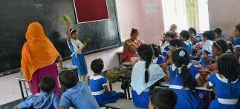
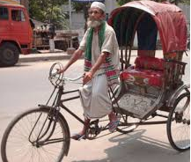
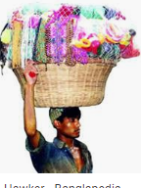
Informal Economic Activities of Towns (Cont. ….)
High and Middle income people (formal) | Low income and Destitute people (informal)
SA Asha

Slide 9
Contribution of Informal Economic Activities to Economy
Village people most of them producing crops sell them in the markets
Cities and Towns people low, middle, even high class doing informal activities
Thus, from the beginning our economy depends on informal activities.
Earn their livelihood
Running the country economy
SA Asha

Slide 10
Quick Test - 1
Read the following passage and answer question no. 1 and 2
Mr. Lutfur is a rickshaw puller. His family runs with his income. His income is not under taxation.
1. What kind of activity Mr. Lutfur is doing?
a. formal b. informal
c. governmental service d. household
2. The above mentioned activity -
i. fulfilled the demand of the family ii. help the national economy
iii. do not need to give the tax
Which of the following is correct?
a. i & ii b. i & iii
c. ii & iii d. i, ii & iii
SA Asha

Slide 11
Thank you for attending the class
Stay Safe, Stay at Home
SA Asha

