Slide 1
WELCOME

Slide 2
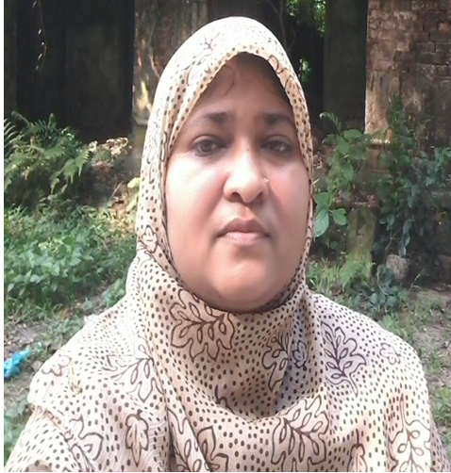
Teacher’s Introduction
Zannaton Nahar
Head Teacher
Teknogopara Govt. Primary School
Gazipur citycorporation, Gazipur.

Slide 3
SUBJECT IDENTITY
Subject: English
Class: Five
Time: 20 mins.

Slide 4
Learning outcomes
Students will be able to-
4.2.1 understand and enjoy the story.
3.1.1 write answer questions.
5.1.2 read with correct pronunciation.
8.1.1 make sentences using words
given from the textbook.

Slide 5
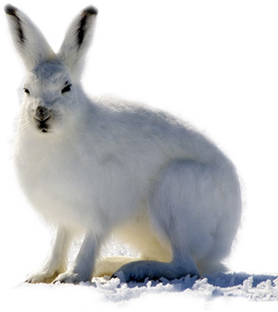
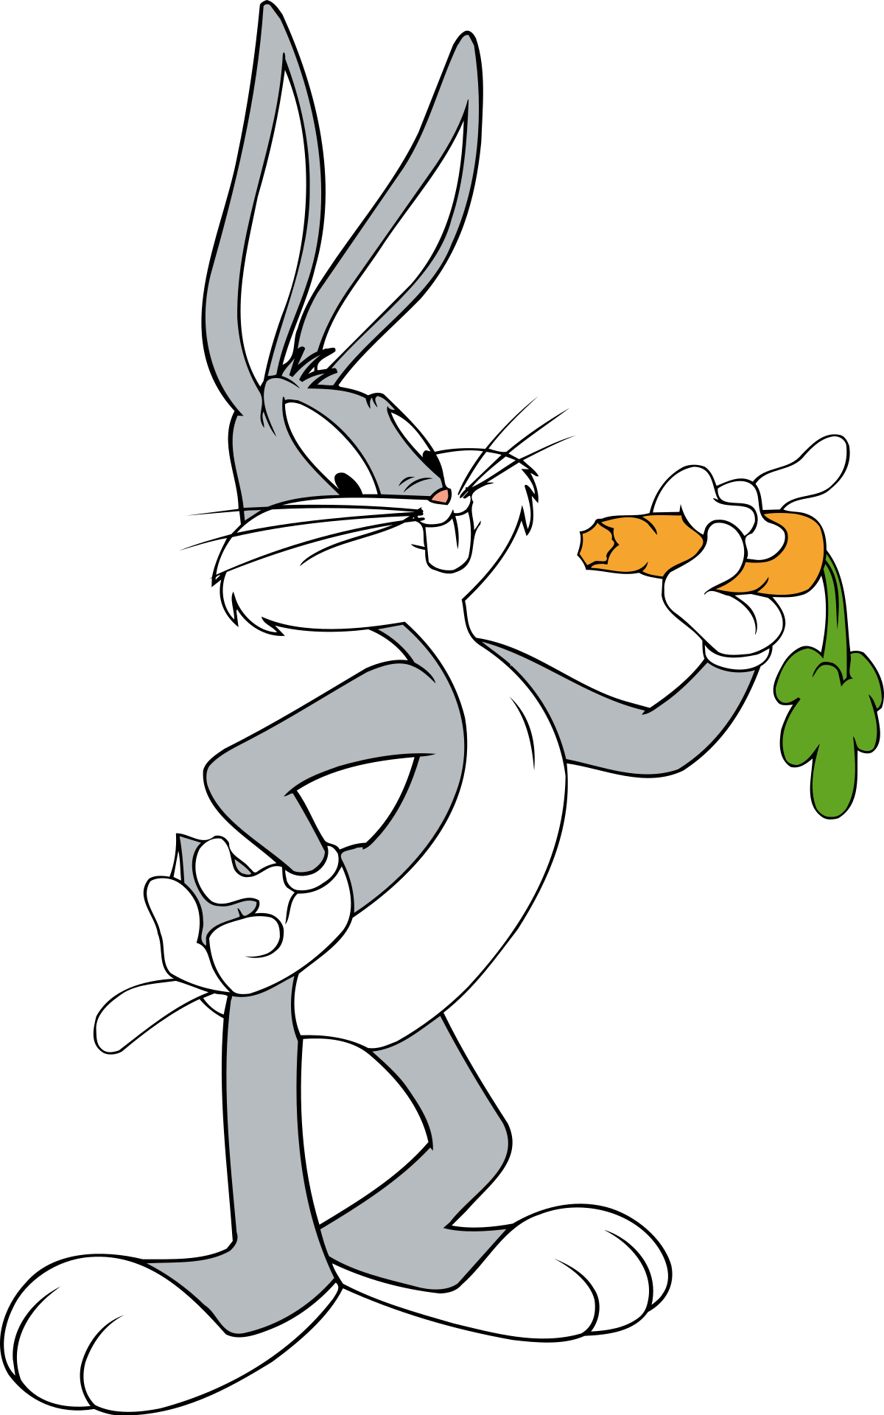

Slide 6
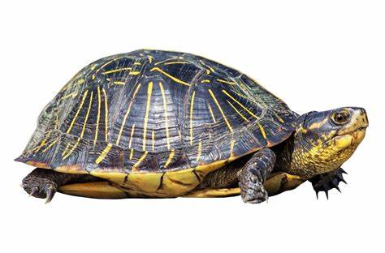
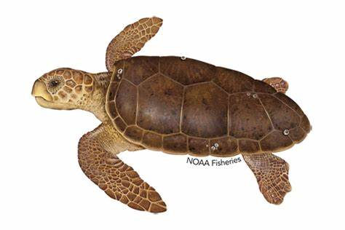
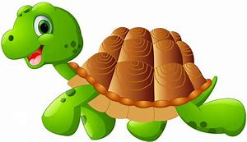

Slide 8
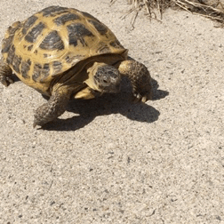

Slide 9
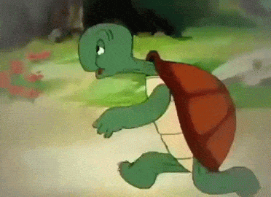

Slide 10
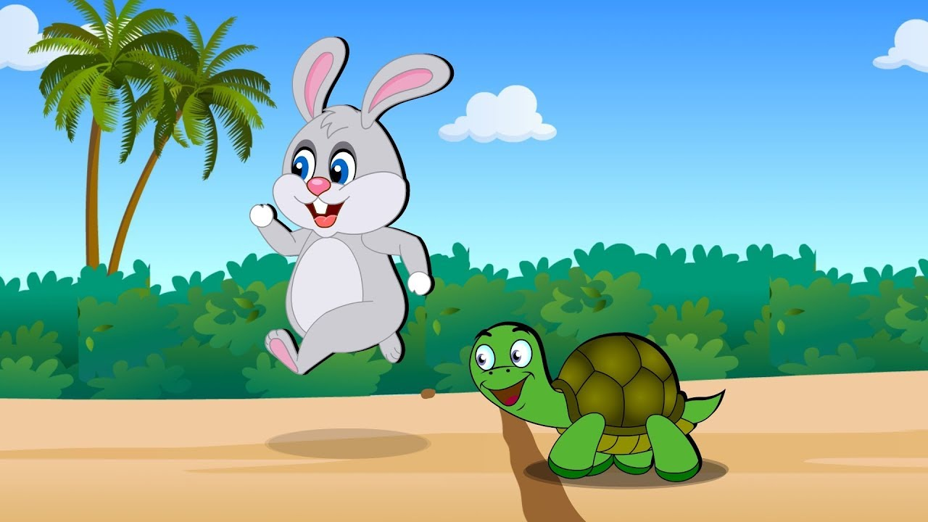
Lesson declaration
Unit:14
Lesson: 1
The hare and the tortoise
Page: 54

Slide 11
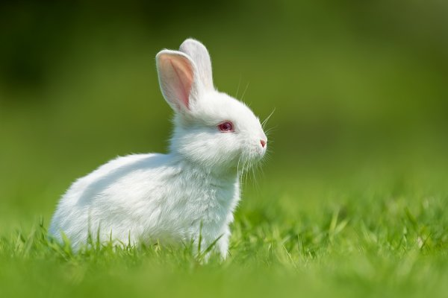
Discussing words
Hare- swift, large eared mamma animal.
Tortoise- a reptile with a hard round shell.

Slide 12
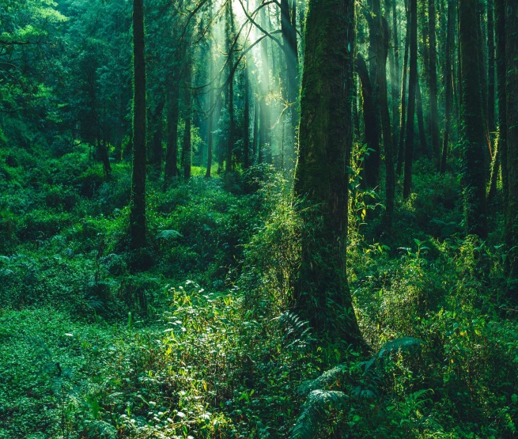
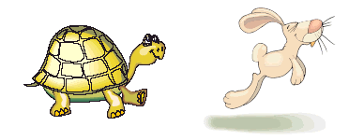
Forest- a large densely wooded area.
Fastest- most quickly.
Slowly- not fast or quick.

Slide 13
Animal- living organism.
Angry- feeling or showing anger/ feeling annoyed.

Slide 14
Race- a competition
of moving fast / a
contest of speed.
Agree- consent to a condition.

Slide 15
Open your EFT book at page 54.

Slide 16
Answer the questions in PEER
1. Where was the hare walking?
Answer:
The hare was walking in the forest.

Slide 17
2. What did the hare see?
Answer:
The hare saw a tortoise.

Slide 18
3. How was the tortoise?
Answer:
The tortoise was very slow.

Slide 19
4. Where did they start their race?
Answer:
They started their race next to
a big tree.

Slide 20
5. Where did they finish their race?
Answer:
They finished their race at the river.

Slide 21
Group work
Rose group- 1. Where was the hare walking?
2. What did the hare see?
Lily group- 1. How was the tortoise?
2. Where did they start their race?
Tulip group- 1. Where did they finish their race?
2. Who was the slowest animal?

Slide 22
EVALUATION
Answer the following questions:
1. Where was the hare walking?
2. How was the tortoise?
3. Where did they start their race?

Slide 23
Home work
Write five sentences about the hare & the tortoise.

Slide 24
ONE DAY ONE WORD
Forest-
বন/ জংগল

Slide 25
THANKS TO ALL

