Slide 1
WELCOME

Slide 2
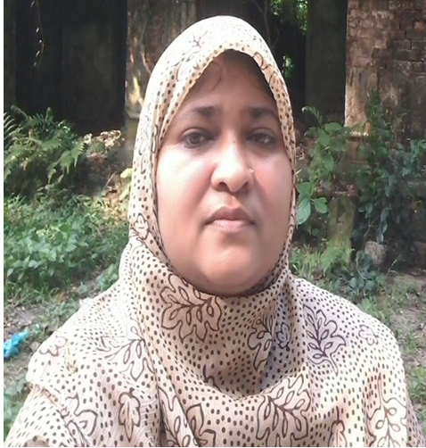
Teacher’s Introduction
Zannaton Nahar
Head Teacher
Teknogopara Govt. Primary School
Gazipur citycorporation, Gazipur.

Slide 3
SUBJECT IDENTITY
Subject: English
Class: Five
Time: 40 mins.

Slide 4
Learning outcomes
Students will be able to-
4.2.1 understand and enjoy the story.
3.1.1 write answer questions.
5.1.2 read with correct pronunciation.
8.1.1 make sentences using words
given from the textbook.

Slide 5
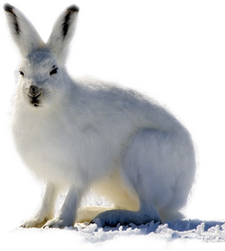
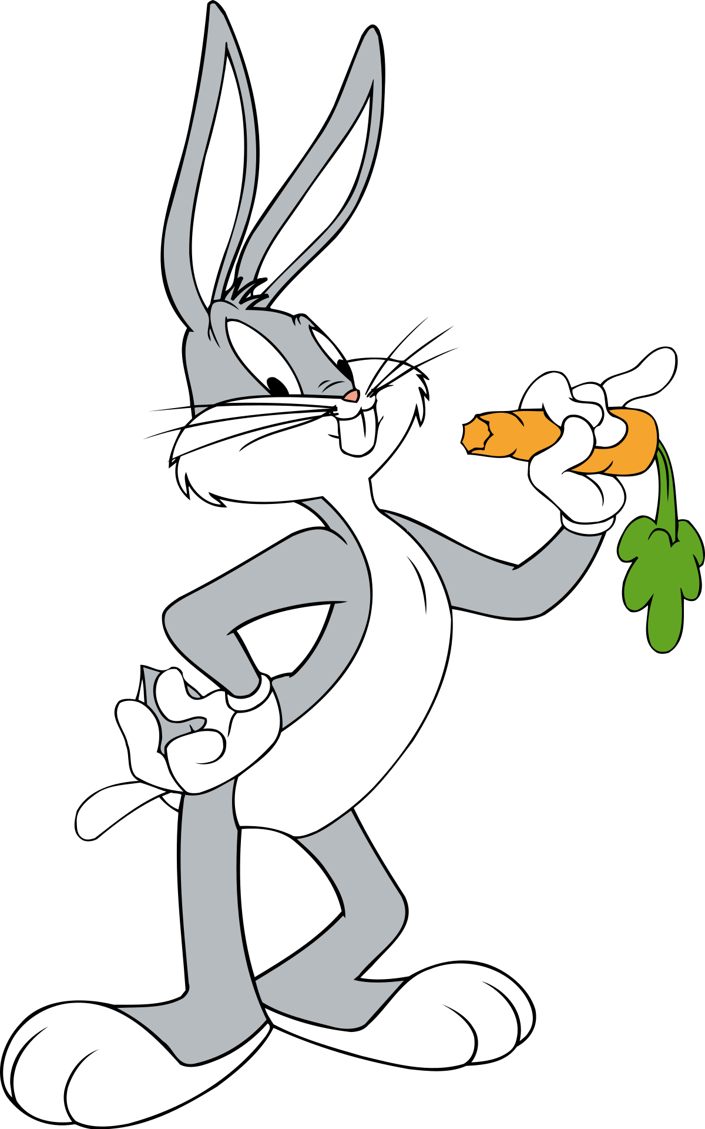

Slide 6
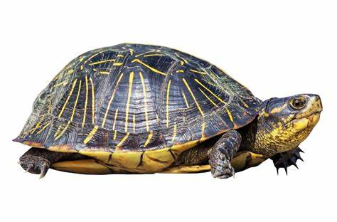

Slide 8
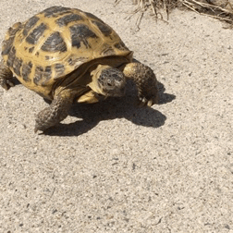

Slide 9
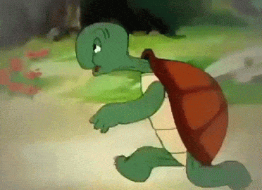

Slide 10
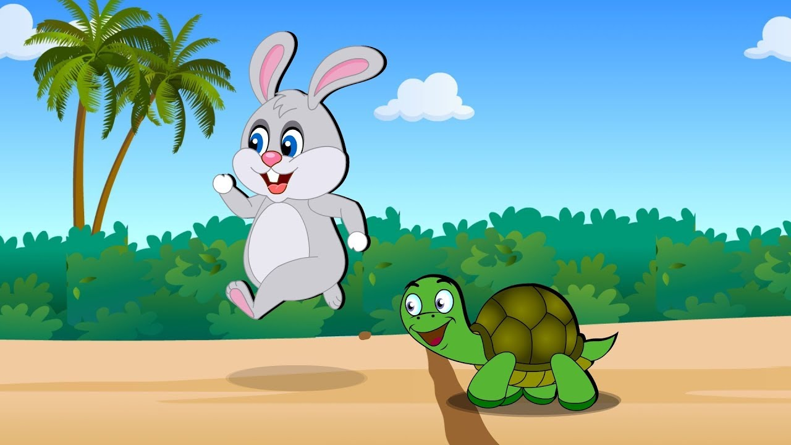
Lesson declaration
Unit:14
Lesson: 2
The hare and the tortoise
Page: 55

Slide 11
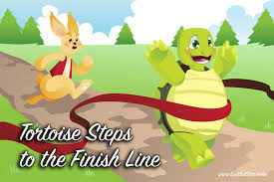
Discussing words
Finish- bring to an end.
Quickly-with rapid movements.

Slide 12
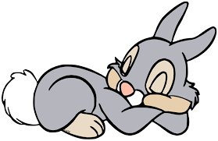
Path- line of travel.
Asleep- in a state of sleep.

Slide 13
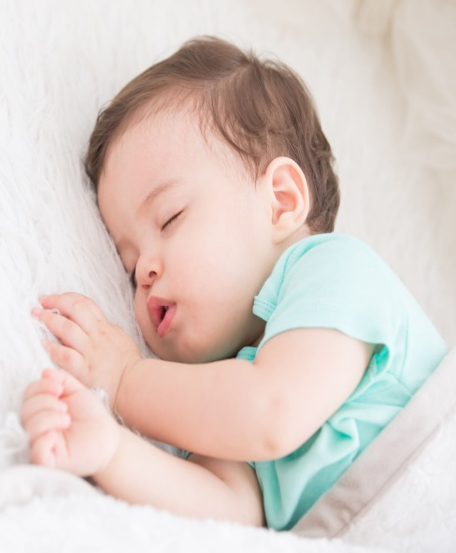
Nap- a short sleep at day.
Sight- faculty of seeing.

Slide 14
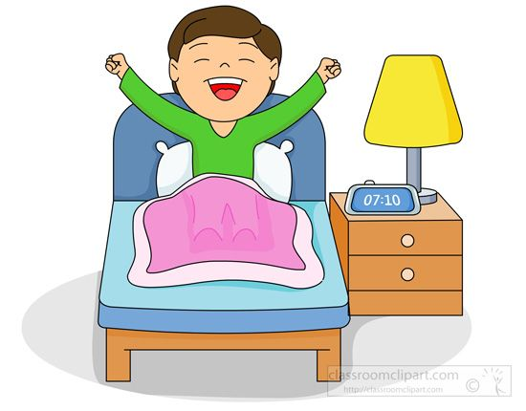
Finally- at the end.
Wake up- getting up / stop sleeping.
Believe- accept of true.

Slide 15
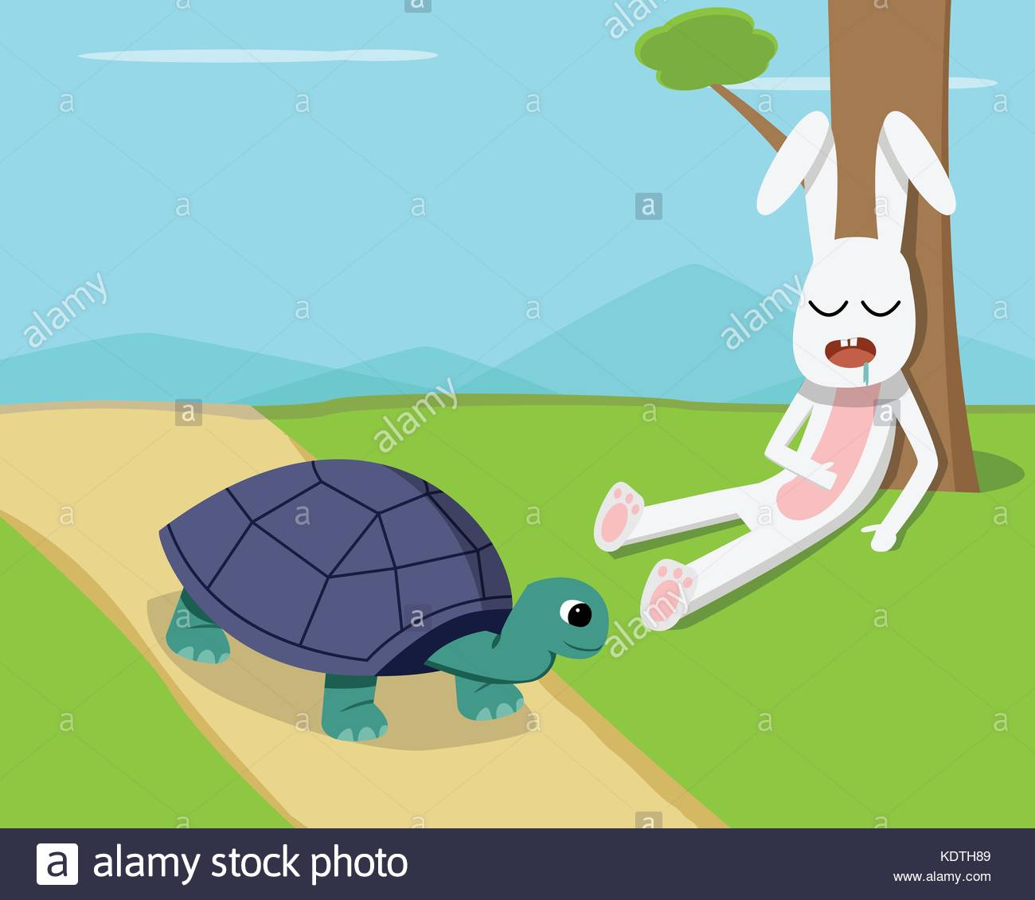
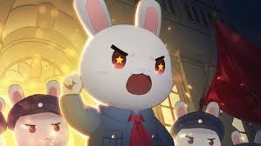
Cross- pass over.
Furious- feeling or showing extreme anger.

Slide 16
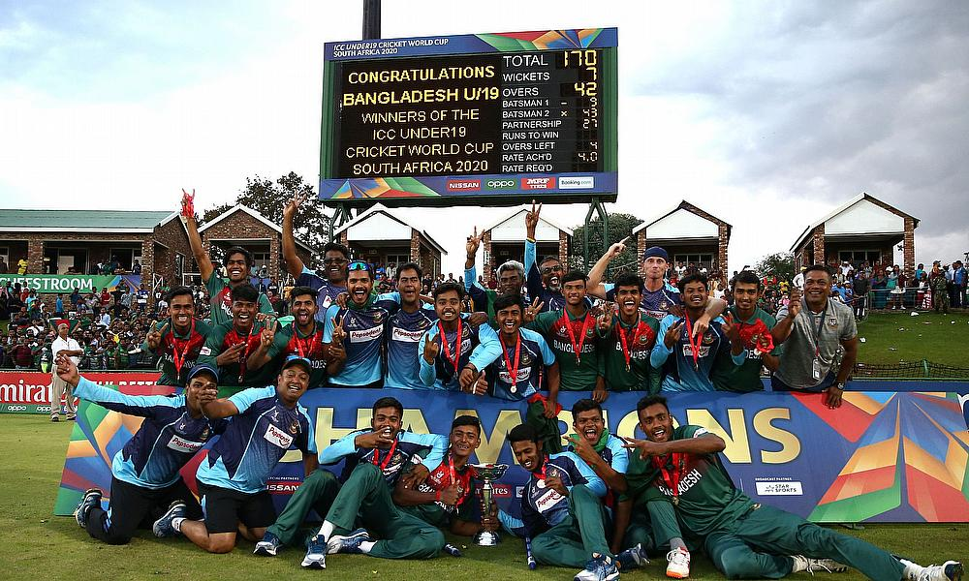
Win- achieve victory.

Slide 17
Open your EFT book at page 54.

Slide 18
Answer the questions in PEER
1. Who went to sleep?
Answer:
The hare went to sleep.

Slide 19
2. How long did he sleep?
Answer:
The hare slept for an hour.

Slide 20
3. When did he wake up?
Answer:
The hare woke up when the tortoise almost at the finish line.

Slide 21
4. Who won the race?
Answer:
The tortoise won the race.

Slide 22
5. What is the moral of the story?
Answer:
The moral of the story is “ Slow but steady wins the race”.

Slide 23
Group work
Rose group- 1. Who went to sleep?
2. When did he wake up?
Lily group- 1. How long did he sleep?
2.What did he see after getting up from sleep?
Tulip group- 1. Who won the race?
2. What is the moral of the story?

Slide 24
EVALUATION
Answer the following questions:
1. Where was the hare walking?
2. How long did he sleep?
3.What did he see after getting up from sleep?
4. Who won the race?
5. What is the moral of the story?

Slide 25
Home work
Activity C and E.

Slide 26
ONE DAY ONE WORD
Race-
দৌড় প্রতিযোগিতা

Slide 27
THANKS TO ALL

