Slide 1
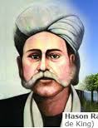
GOOD MORNING

Slide 2
Identity
MD Shafiqul islam
Assistant Teacher
Sonatan Darussannat Dakhil Madrasha , Kawnia, Rangpur.
Mail:shafiqulislam42347@gmail.com
English 1st Paper
Class: Six
Lesson: 22
Date: 29/01/2021

Slide 3
Let’s enjoy a video---

Slide 4
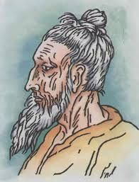
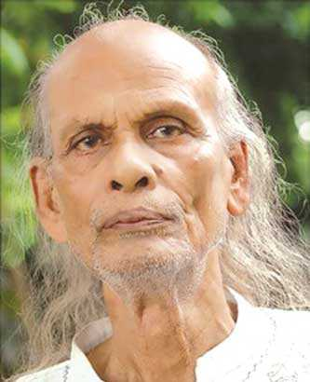
Look at the picture
Lalon Shah
Shah Abdul Karim
Hason Raja

Slide 5
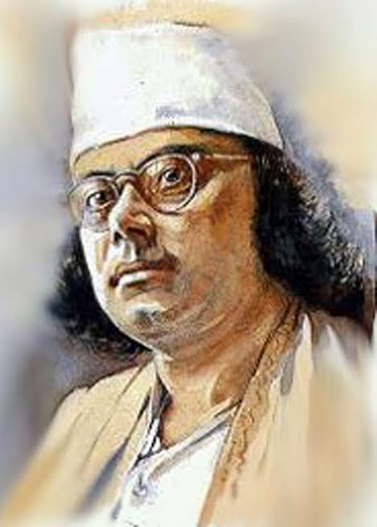
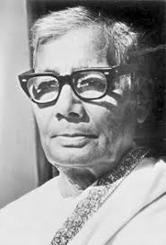
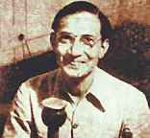
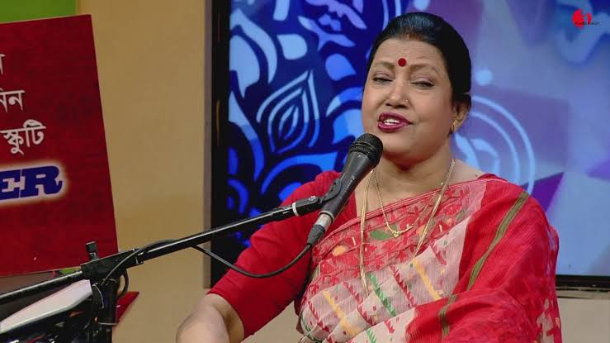

Slide 6
Todays Lesson-
Hason Raja : The mystic bard of Bangladesh

Slide 7
Learning Outcome
Read and understand texts.
Lesson information.
Word meaning.
Ask and answer questions.
Choose the correct answer from the alternative.
Fill in each gaps with suitable words from the text.

Slide 8
Word Meaning
Wealthy ----------- বিত্তশালী
Luxury ------------- বিলাসিতা
Comfort ----------- আরাম
Meaningless ------ অর্থহীন
Property ----------- সম্পতি
Deeply ------------- গভীরভাবে
Creator ------------- সৃষ্টিকর্তা
Mankind ----------- মানবজাতি
Published ----------- প্রকাশিত হয়েছিল
Crazy ----------------- পাগল
Volume -------------- খন্ড
Contained ----------- ধারন করেছিল
Eminent -------------- বিশিষ্ট
Mystic -----------------আধ্যাত্নিক

Slide 9
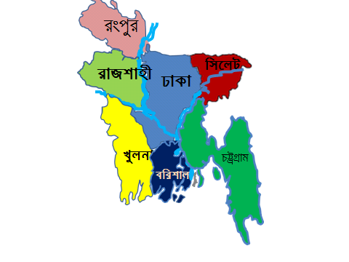
Describing Lesson
Hason Raja was born in 1854 in a wealthy landlord’s family in Sylhet.

Slide 10
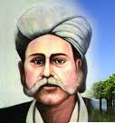
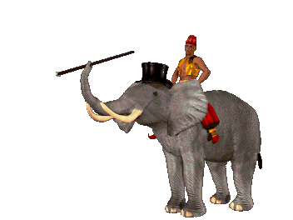
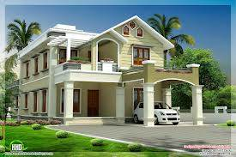
His previous life style
In his youth , he led a life of luxury. He had everything – money comfort and pleasure. At stage, everything became meaningless to him. He gave away all of his properties.

Slide 11
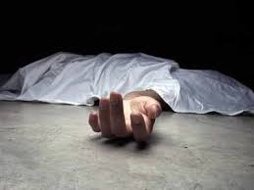
He started to think deeply about the Creator, about life , death and mankind.

Slide 12
Hason Raja wrote a lot of songs , perhaps about a thousand in number.

Slide 13
His book called ‘’Hason Udash was published 1906. the book had 206 songs in it.

Slide 14
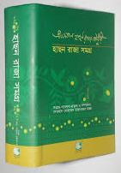
The book contained 500 poems and songs. Some of the songs were written by the poet in Hindi.

Slide 15
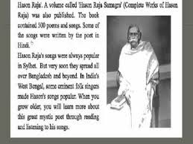

Slide 16
Silent Reading

Slide 17
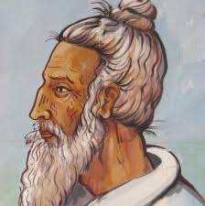
Individual Work
When was Hason Raja born?

Slide 18
Group Work
Choose the correct answer from the alternative:
Hason Raja did not have-----------------------------------------------.
(a) money (b) comport (c ) pleasure (d) much formal education
Hason Raja’s songs were always popular in Sylhet. Here the word ‘always’ is a/an------------------------.
(a) verb (b) adjective (c ) adverb (d ) noun
There were 206 songs in-------------------------------.
(a) Crazy Hason Raja (b) Hason Udash (c ) Pagla Hason Raja (d) Hason Raja Samagra
The word ‘volume’ means------------------------------------.
(a) sound (b) book (c) noise (d) temperature
The word ‘eminent’ means----------------------------.
(a) imminent (b) famous (c ) noble (d) reliable

Slide 19
Evaluation
Answer the following questions from reading of the above text:
Where was Hason Raja born?
What type of life did Hason Raja lead in his youth ?
Why did Hason Raja leave the life of comfort and joy ?
How many songs did Hason Raja write ?
When did Hason Raja lead a life of luxury ?

Slide 20
Home Work
Read the following text and fill in the gaps with appropriate words:
But March is also a month of sad --------------------for us. On the 25th ----------------,the Pakistani army swooped upon the Bangalees. They killed many unarmed and innocent men, women and children in -------------------. The Bangalees did not let it go ----------------------. They started resisting the-----------------army and the war of liberation began.

Slide 21
Thank you all student

