Slide 1
Welcome to my presentation

Slide 2
Introduction of the teacher
Dewan Rezaul Hassan
(Assistant Teacher)
Baropakhia Rothindrapara Government Primary School
Delduar, Tangail.
E-mail:drezaulhassan@gmail.com

Slide 3
Introduction of the lesson
Sub: English
Class: Five
Unit: 2, Sound practice 1
Lessons: 7
Page No: 9

Slide 4
Learning outcomes:
Listening:
1.1.1. recognize sound differences in the context of words.
1.2.1 recognize which syllable in a word is stressed.
Speaking:
1.1.1 say words, phrases and sentences with proper sounds and stress.
Reading:
1.5.1 read words, phrases and sentences in the text with proper
pronunciation, stress and intonation.

Slide 5
Let’s listen and do the song

Slide 6
Look at the picture and say what are in the picture

Slide 7
Fan
Van
শব্দ দুটি minimal pair কারণ শুধু প্রথম বর্নটি আলাদা

Slide 8
F- ফ
V- ভ

Slide 9
Look at the picture and say what are in the picture

Slide 10
Vine
Grape

Slide 11
Look at the picture and say what are in the picture

Slide 12
Vine
Fine

Slide 13
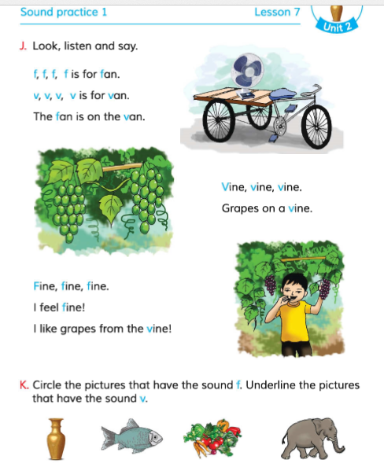
Open your book at pate 9 and listen the audio and repeat after the audio carefully

Slide 14
Group reading

Slide 15
Individual reading

Slide 16
Do you know any other word that starts with f or v?

Slide 17
Lets remind the pronunciation of f and v once again

Slide 18
Fan, flower, floor , fruit, vase, veranda, village, class, five, van, fine, van, fan, fat, vote etc.

Slide 19
Find the sound that starts with f or v sound

Slide 20
Thanks
for
watching?

