Slide 1
welcome
Class ---6
English 2nd paper

Slide 2
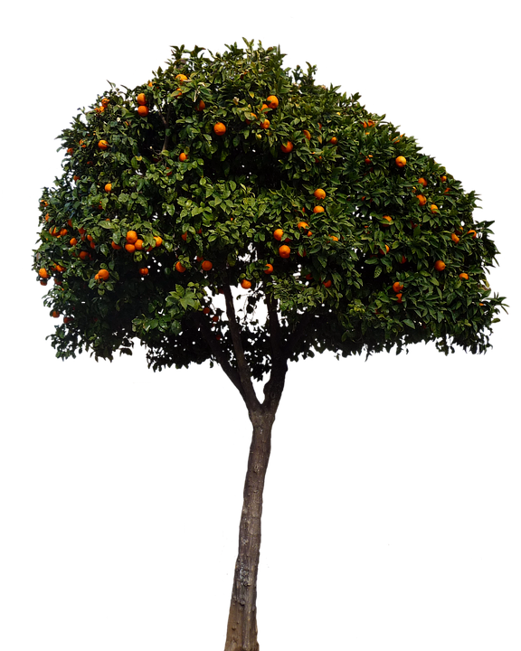
Md Moqbul Hossain Bulbul Al haj Dhanai Bepari Memorial High School, Sreepur, Gazipur.
This is a tree

Slide 3
Look at the sentence.
It has three parts.
So we can say that this is a tree is the parts of the sentence.
This
Is
A tree

Slide 4
Parts of speech is the parts of sentence.
There are eight kinds of parts of speech

Slide 5
(1) Noun is a naming word

Slide 6
Noun is the main part of any sentence

