Slide 1
WELCOME

Slide 2
PRESENT BY
Mohammad Mohasin hossain
Assistant Teacher
Chapulia Model Govt. Primary School

Slide 3
Lesson identify
Subject: English
Class: Two
Unit:11, Lesson :1
Parts of the body.
(Head,Nose,Hand,Eye, Leg)

Slide 4
Learning out come
Students will be able to-
Ask and answer questions about familiar object.

Slide 5
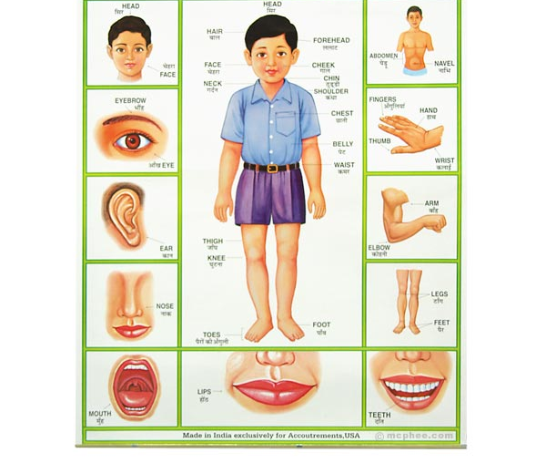

Slide 6
Declaration of the lesson
Parts of the body

Slide 7
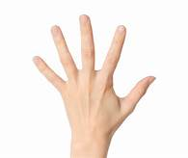
Finger

Slide 8
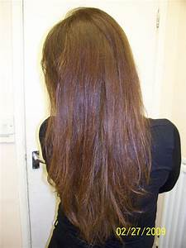
Hair

Slide 9
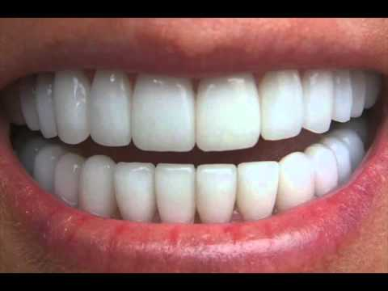
Teeth

Slide 10
Hand

Slide 11
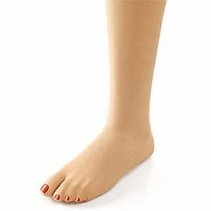
Leg

Slide 12
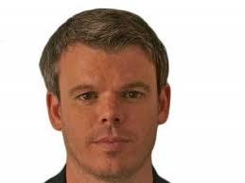
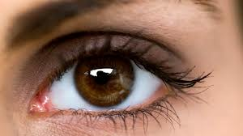
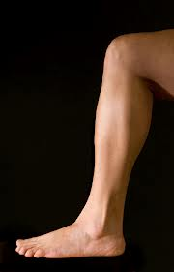
Head
Eye
Nose
Hand
Leg

Slide 13
Group works

Slide 14
Game: Symon says -Touch your…(head /nose/eye/hand/leg)

Slide 15
Head
Eye
Nose
Hand
Leg

Slide 16
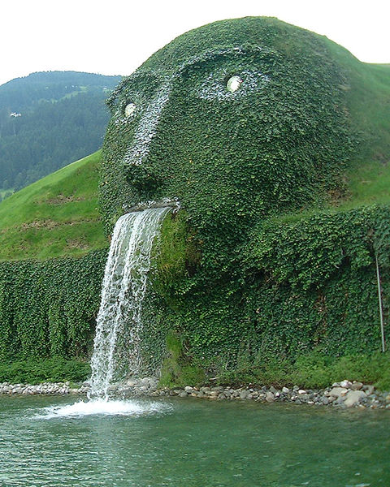
Thanks

