Slide 1
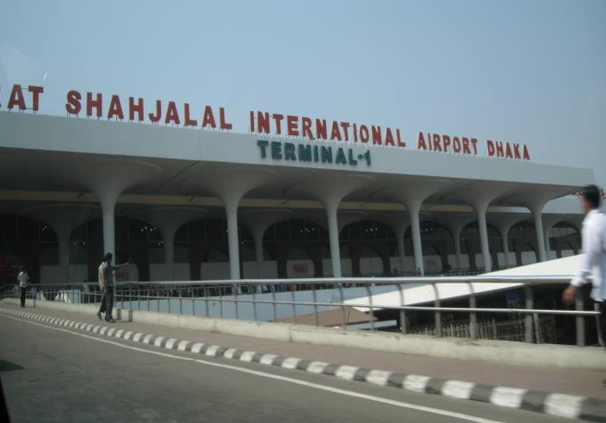
GOOD MORNING

Slide 2
Identity
Md Shafiqul Islam
Assistant Teacher
Sonatan darussannat dakhil Madrasha
Kawnia, Rangpur.
Mail: shafiqulislam42347@gmail.com
English 1st paper
Class: Eight
Lesson: (1) (2) and (3)
Date: 04/01/2021

Slide 3
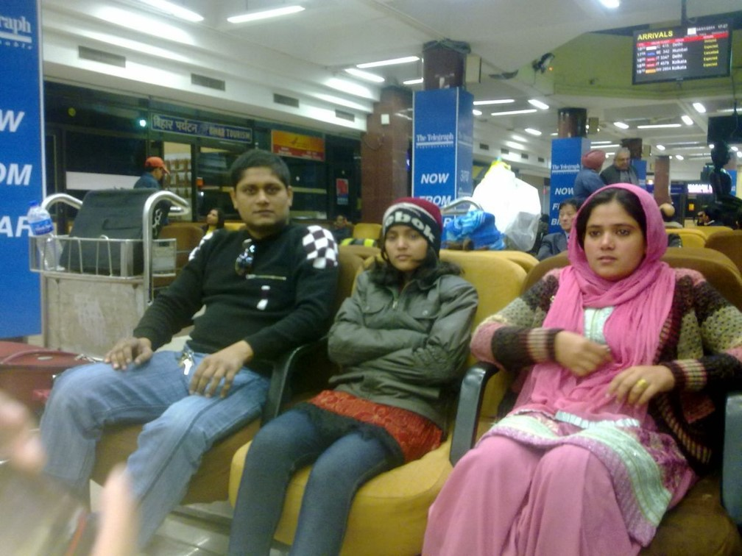
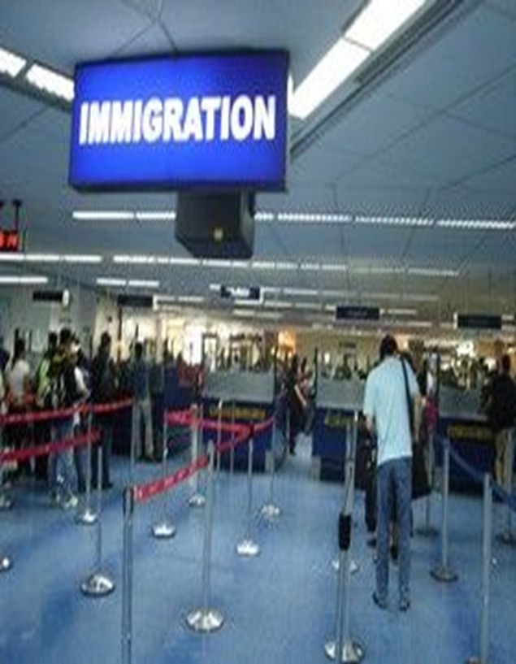
LOOK AT THE PICTURE

Slide 4
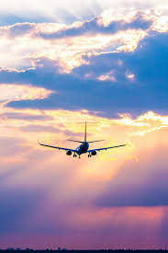
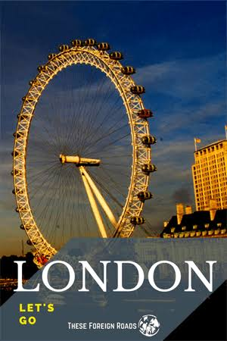
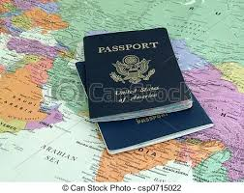
Look at more picture

Slide 5
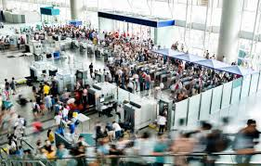
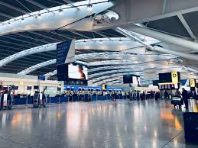
TODAYS TOPIC
GOING ON A FOREIGN Trip
Lesson-(1) at the airport (2) filling in a from (3) going through immigration.

Slide 6
Learning outcome
By the end of the lessons the learners will be able to---
Listen for information.
Read and understand text.
Word meaning.
Choose the best answer from the alternative.
Read the lesson and answer the question.
Fill in each gaps with suitable words from the text.

Slide 7
Word meaning
Lounge -----------বসার জন্য আরামদায়ক কক্ষ
Immigration -----অভিবাসন
Board --------------আরোহন করা
Information -------তথ্য
Passport -----------বিদেশ ভ্রমন করার অনুমতি পত্র
Travel ---------------ভ্রমন করা
Embassy------------দূতাবাস
Allow ----------------অনুমতি দেওয়া
Tourist ---------------পর্যটক
Visa -------------------ছাড়পত্র
Departure -----------বহির্গমন
Towards --------------প্রতি
Stamp -----------------ছাপ দেওয়া
Journey ---------------ভ্রমন
booth--------------------চালাঘর,

Slide 8
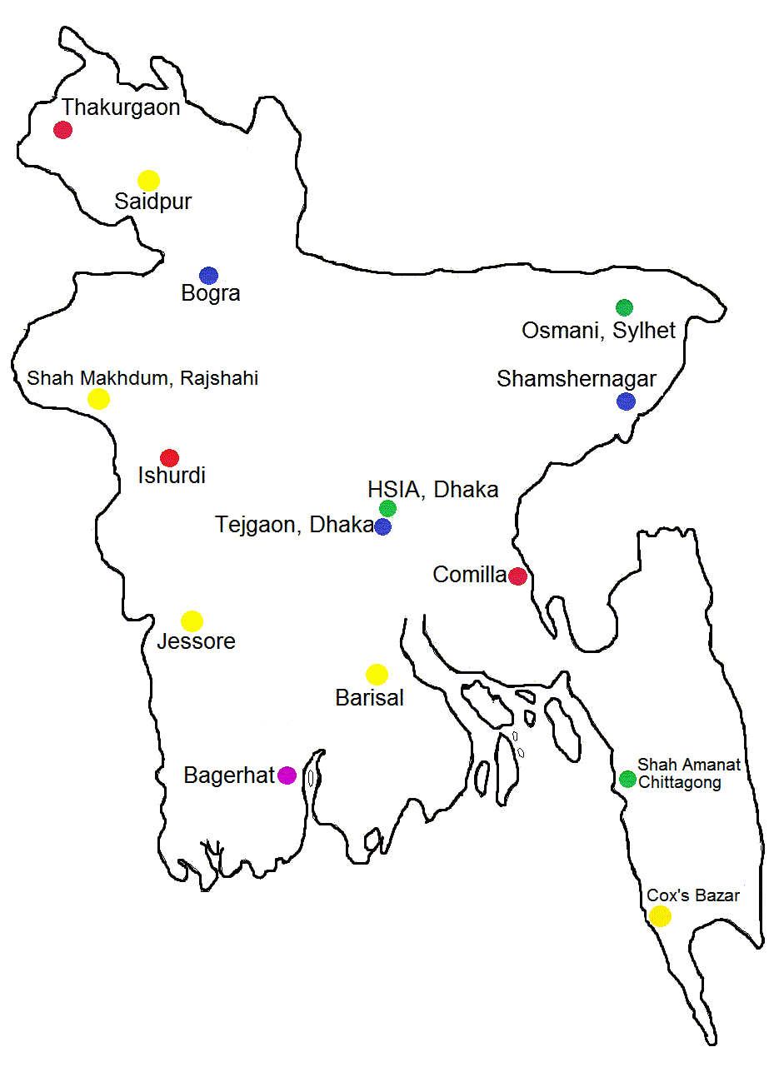
Describing Text
Zara lives with her parents in London. They have come to Bangladesh to visit Zara’s aunt and uncle.. She is very close to her cousin Mita. Both the families have visited many interesting places together in Bangladesh.

Slide 9
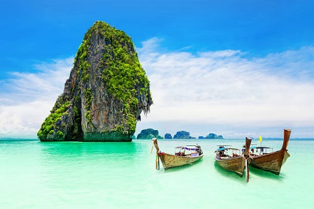
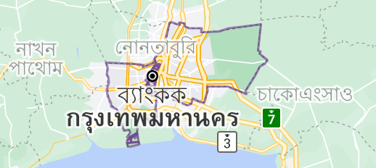
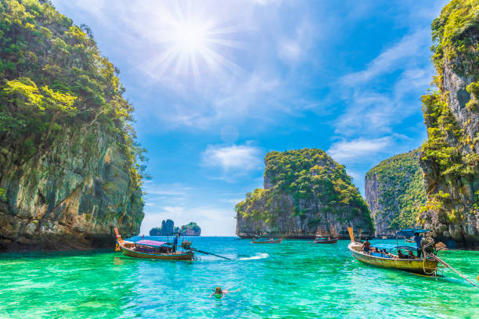
Describing text
They decided to go to Thailand. But Mita’s parents were too busy with their work, so they could not go. However , Mita was going with them.

Slide 10
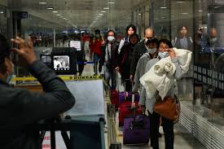
Listen for information
Mita , Zara and her parents are at Hazrat Shahjalal International Airport. They are waiting in the lounge.

Slide 11
They are flying by Bangladesh Biman . Mita is hoping to have a great time in Thailand.

Slide 12
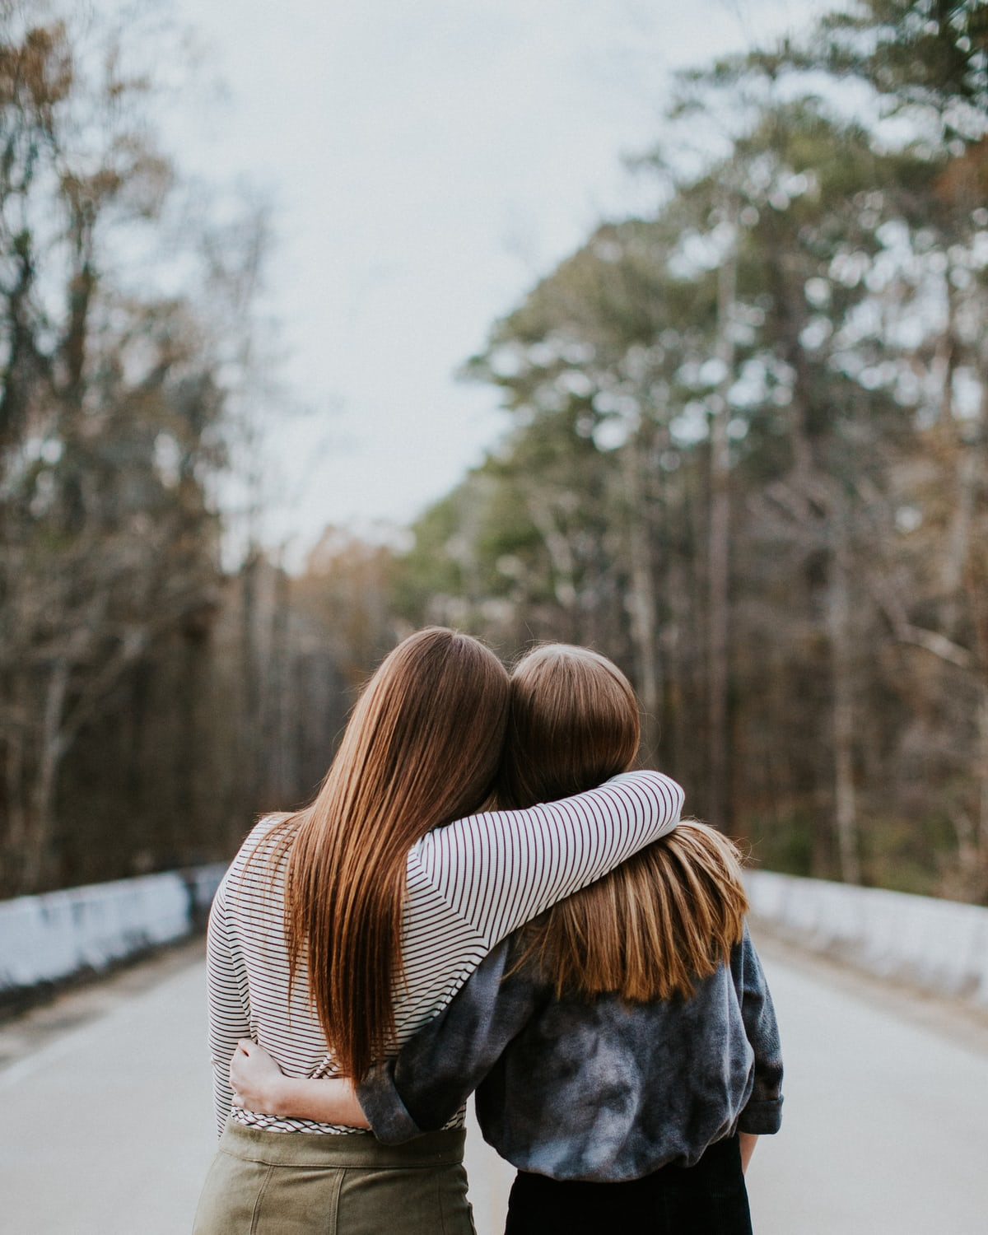
As they wait, the two cousins start planning what they would do once they reach Bangkok.

Slide 13
The immigration officer will check your passport and stamp it. And then you are ready to travel. Mita , Zara and her parents start filling in the from.

Slide 14
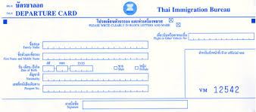
Filling in a form
Mita got her visa from the Royal Thai Embassy in Dhaka. Her visa number is T 9115138. the visa was issued in Dhaka on 29 June 2012.

Slide 15
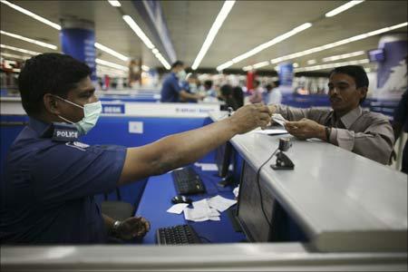
Immigration officer
Zara’s parents Mrs Jhuma Islam, Mr Mazharul Islam, Zara and Mita , fill in their departure cards and move towards the immigration counter. Mita stands in front of one of the booths. She hands in her passport and the departure card to the officer.

Slide 16
Silent Reading

Slide 17
Individual Work
Why does a person need a passport?
What does an immigration officer do at the airport?

Slide 18
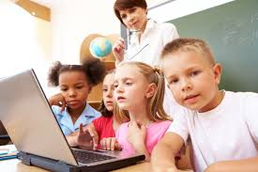
Group Work
Choose the correct answer to each question from the alternatives:-
Where do Zara and her parents live?
(a) in the U.S.A (b) in the U.K (c ) in Canada (d) In France
2. Who are going to Thailand?
(a) Mita and her uncle (b) Zara and her parents (c ) Mita and her parents (d) mita as wellas Zara and her parents.
Royal Thai Embassy-------------------her visa.
(a) issued (b) wrote (c ) allowed (D) permitted
4. The immigration officer-------------------Mita’s paper.
(a) certifies (b ) examines (c ) cancels (d) copies
5. They are going to--------Thailand.
(a) study in (b) live in (c ) stay in (d) visit

Slide 19
EVALUATION
Read the text and answer the question:
Why have zara’s family come to Bangladesh ?
What is necessary to fill up the form?
When did she get passport?
What are the names of Zara’s parents?
Where does Mita stand after filling in her departure card?

Slide 20
HOME WORK
Fill in each gaps with suitable words from the text:
Most of these ethnic people (a)------------live in Bangladesh have their own lifestyles. They (b)------------build their houses on bamboo or wooden platforms called ‘ machang’. They take rice(c )----------their staple food. They eat vegetables, maize and fish, poultry and meat with rice. Clothes are(d)----------by women. Ethnic people(e) -----------hunting, fishing, song, music, dances, theatre and fairs.

Slide 21
THANK YOU ALL STUDENT

