Slide 1
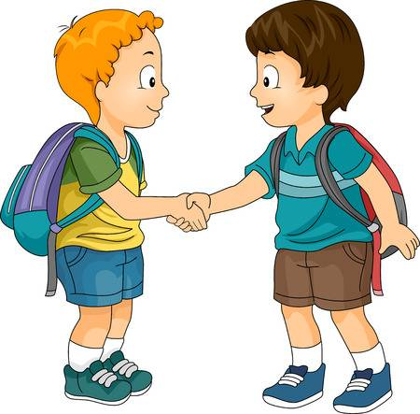

Slide 2
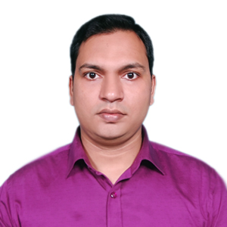
Sub: English
Class: Two
Mahmud Sarif Molla
Asisstant Teacher
Uttar Poschim Char Martin Govt. Primary School
Komolnogor, Laxmipur.
Lesson : Greetings and Introductions
Parts of the lesson: Activity-A
Page No-2

Slide 3
Students will be able to..
Listening:
1.1.1 becme familiar with English sounds by listening to common English words.
3.1.1 Understand simple questions and statements about them.
3.1.2 Understand simple question and statements about familiar objects.
Speaking:
1.1.1 repeat after the teacher simple words and phrases with proper sounds and stress.
1.1.2 say simple words and phrases with proper sounds and stress.
2.1.2 say Good morning, Hi, Hello.
3.1.1 ask and answer questions about themselves.

Slide 4
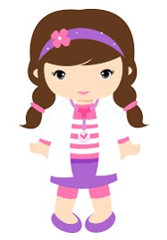
Safety environment by greetings song.
Hello! Hello! How are you?
I’m well, I’m good.
I’m great, I’m wonderful.
Hello! Hello! How are you?
I’m fine! I’m great today.

Slide 5
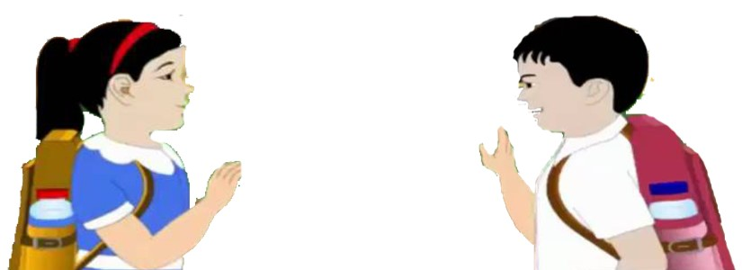
What can you see in the picture?
Two children are greetings each other.
Dear students now try to say-
What can be the topic of our today’s lesson?

Slide 6
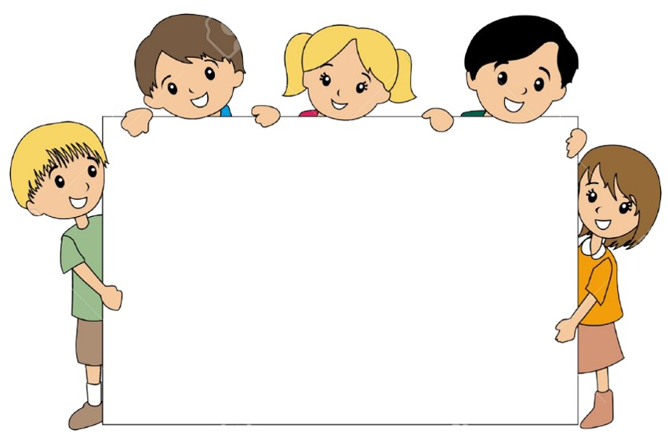
Our today’s lesson is--
Greetings and Introductions
Activity-A

Slide 7
LEARNING OUTCOMES
By end of the lesson students will be able to-------
Listening: 1.1.1 become familiar with English sounds by listening to
common English words
3.1.1 understand simple questions and statements about them.
3.1.2 understand simple questions and statements about familiar objects.
Speaking: 1.1.1 repeat after the teacher simple words and phrases with proper
sounds and stress.
1.1.2 say simple words and phrases with proper sounds and stress.
3.1.1 ask and answer questions about themselves.

Slide 8
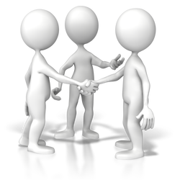
To be known and greetings with each other.
Notes:
Teacher show up in reality

Slide 9
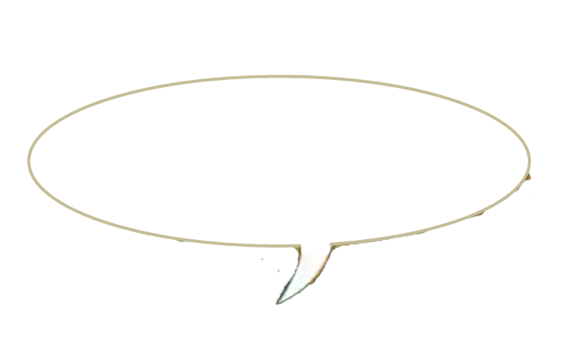
Open your English book at page-2 and see the Activity- A
Look, listen and say.
Hello. I’m Shuva
Hi, Shuva.
What’s your name?
I’m Rafi
Reading- SGW

Slide 10
Pair work
Shuva
Rafi
One more

Slide 11
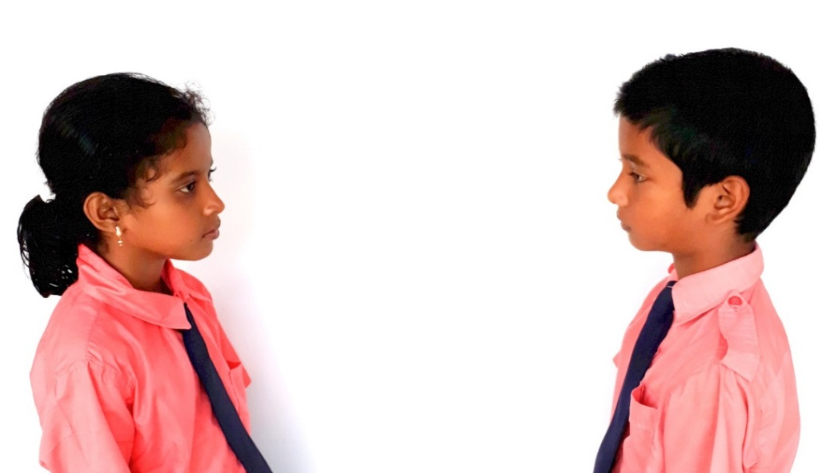
Pair work
Sumya
Mustakim
One more

Slide 12
Chain drill
Hello. I’m --------------. What’s your name?

Slide 13
Read and say.
Hello, I’m Shuva.
What’s your name?
Hi, Shuva, I’m Rafi.
Identifying weak students and taking to cure.

Slide 14
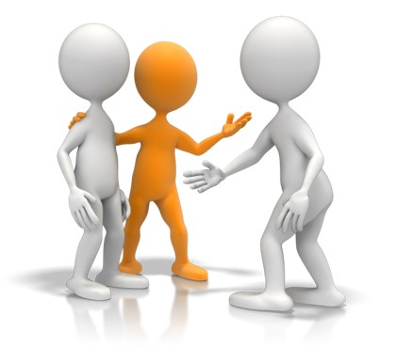
One day one word
Do you understand the picture?
introduction
পরিচয়
Spell out the word - SGW

Slide 15
Find out the letters that are made by the word -----------.
i
n
w
d
r
a
c
t
e
o
t
k
o
n
i
u
Find out the right word-------.
Introduce
Introduction
Induction
Internal

Slide 16
Say the missing letter.
Introdu--tion
Int--oduction
Intr--duction
Introd--ction
Write the word to your notebook.
Date-
/ /20
introduction
ইন্ট্রোডাকশন
পরিচয়

Slide 17
Home work
Activity-A will be practice your family members and written.

Slide 18
That’s all for today. Goodbye. See you tomorrow.

