Slide 1
Welcome Everybody
To
Rangpur Online School

Slide 2
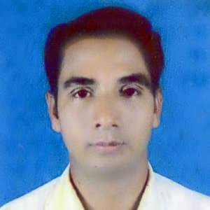
Introductions
Md. Moksed Ali
Assistant Teacher(English)
Bhabanipur Sefatia Kamil Madrasah,
Hatibandha, Lalmonirhat.
Mobile: 01717292475
Email:moksedali1980@
gmail.com

Slide 3
More Informations
Subject
Class
Six,Seven,
Eight,Nine& Ten
English 2nd Paper
Topic: Changing Sentence
Part : Three
Date : September, 2020

Slide 4
Let’s Start Our
Today’s Lesson

Slide 5
To day’s Topic
Changing Sentence (Affirmative into Negative)
Rule - 5 & 6

Slide 6
As soon as
the man went home,
he felt away on the ground.
No sooner had
the man gone home
than
he felt down on the ground.

Slide 7
Rule -5:
If there is
As soon as
1.As soon as
No sooner had
2.Comma
than
3.Other parts
Are same

Slide 8
As soon as
I took the pen,
It broke down.
No sooner had
I took the pen
than
it broke down.

Slide 9
Rule-6:
If there is
Less+adj /adv+than
not as
a.less/More
given
b. adj/adv
c. than
as
d.Other
parts
Are same

Slide 10
Examples:
Mim is
Less/More
good
than
Kamal.
Mim is
not as
good
as
Kamal.

Slide 11
Exercise:
1. As soon as Mina came here,
she saw me.
2.As soon as Jim took the pencil,
he broke it.
3. They have less goats than us.
4.The boy is less smart than the girl.
5.He has less book than me.

Slide 12
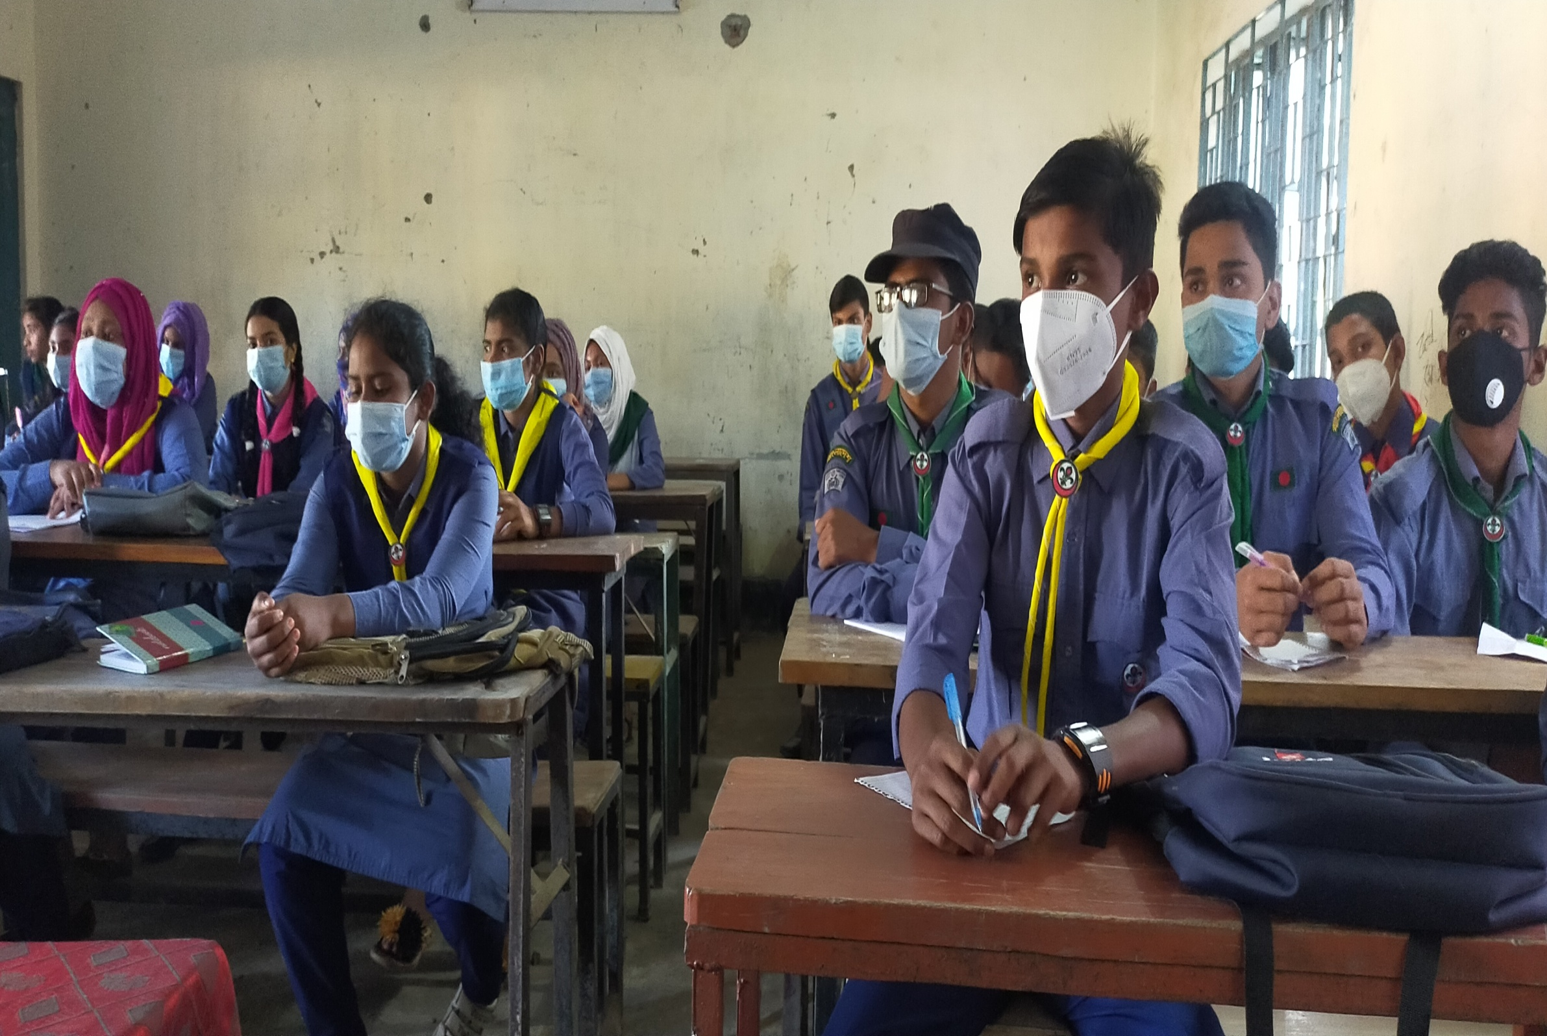
GOOD BYE TO EVERYBODY

