Slide 1
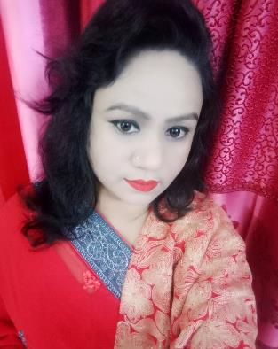
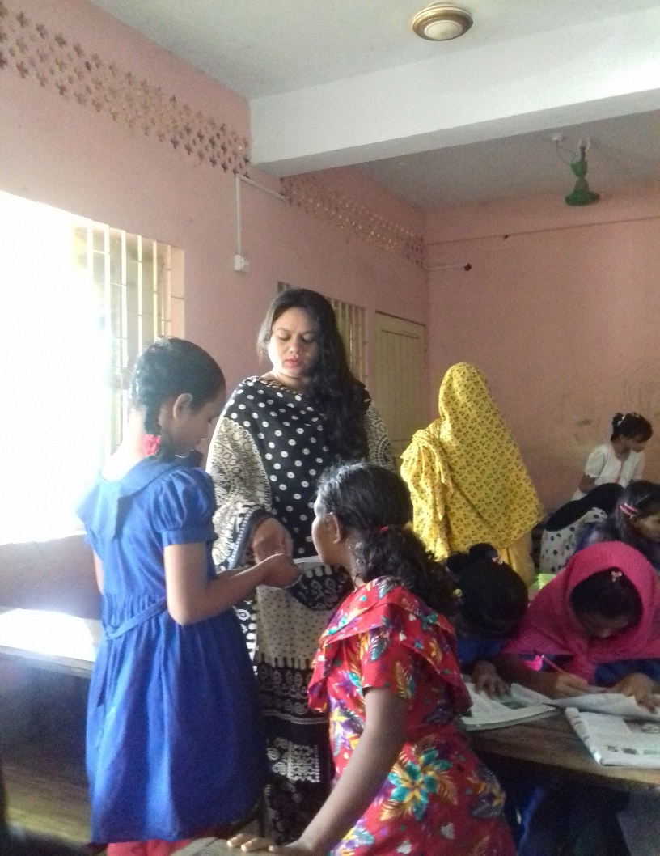
Welcome to
my online class
Class : Five
Subject : English
Unit : 1 - Hello
Lesson : 4-5
Page : 2,3
Nahid Akhtar parvin
Jagodishpur government
primary school.
Ekarchali,taragong,
rangpur

Slide 2
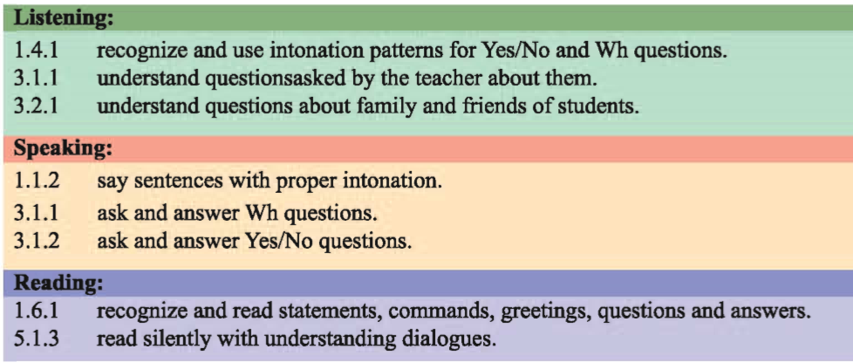
Learning outcomes
By the end of the lesson the students will be able to -

Slide 3
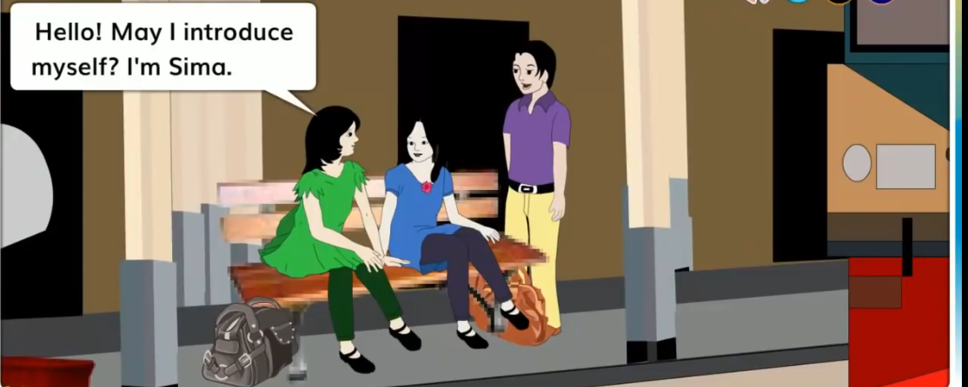
In the previous class, we learned about sima and Jessica answer the following question..
Look at the picture.
( a) Where are Sima and Jessica ?
( a ) Answer : Sima and Jessica are
at a railway station .
( b ) Where is Sima going ?
( b ) Answer : Sima is going to Sylhet .

Slide 4
What can you see in this picture?
They introduce themselve .
and they are saying HI/HELLO.ISN’T THEY?

Slide 5
Our Today’s Lesson is
Hello !

Slide 6
New words
Practice
চর্চা করা
Meet
সাক্ষাত করা
Language
ভাষা
Club
সংঘ

Slide 7
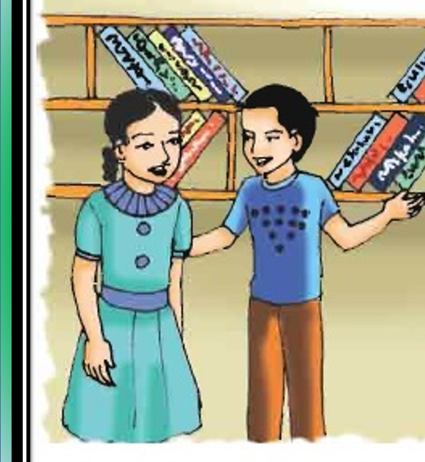
Who are they ?
can anyone say?
And where are they?

Slide 8
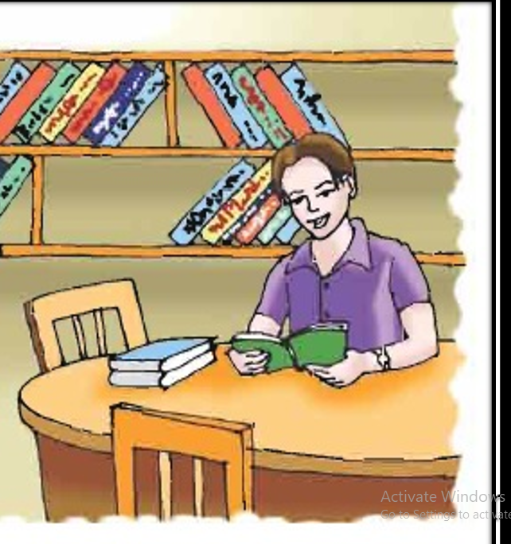
Who is he?Can anyone say?
May be His name is ………..we will know later.

Slide 9
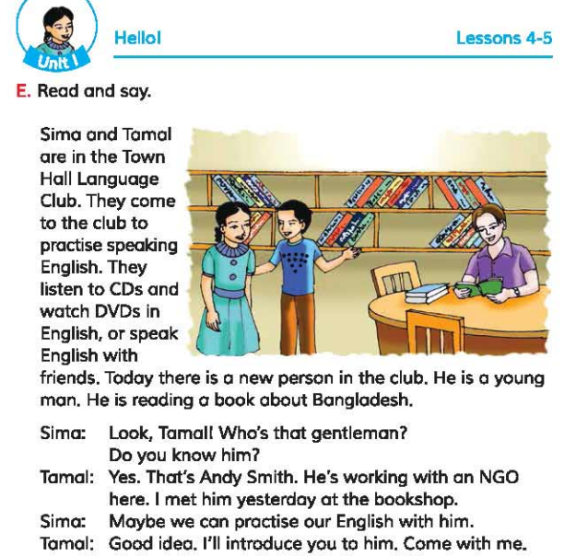
Open your Book point to the page No.04

Slide 10
Sima and tamal are in the town hall language clab.They come to club to practice speaking English.They listen to CD’s and watch DVD’s in English, or speak English with friends.

Slide 11
Today there is a new person in the club.He is a young man.He is reading a book about Bangladesh.

Slide 12
Sima:Look, tamal!Who’s that gentle man? Do you know him?
Tamal:Yes.That’s Andy smith.He’s working with an NGO here.I met him yesterday at the bookshop.
Sima: May be we can practise our English with him.
Tamal:Good idea.I’ll introduce you to hom.Come with me.

Slide 13
Pronunciation
Today
To
day
Today
Yesterday
yes
ter
day
Yesterday

Slide 14
come
club
Language
ge
Language
Bingo
book
book
Bangladesh
person
persrson
Lets play a bingo game

Slide 15
Pair work
Everyone make pair with your friends and do the activity-
One will ask the question and another will give the answer.
Where are shima and tamal?
Ans:Sima and tamal are in the Town Hall Language Clab

Slide 16
Group work
Make sentences with the words:
speak
come
person
listen

Slide 17
Evaluation
Who is the new person there?
Ans:Andy smith is the new person there.
What is he reading?
Ans:He is reading a book about Bangladesh
Where did tamalmeet the new person?
Ans:Tamal met him at the bookshop.

Slide 18
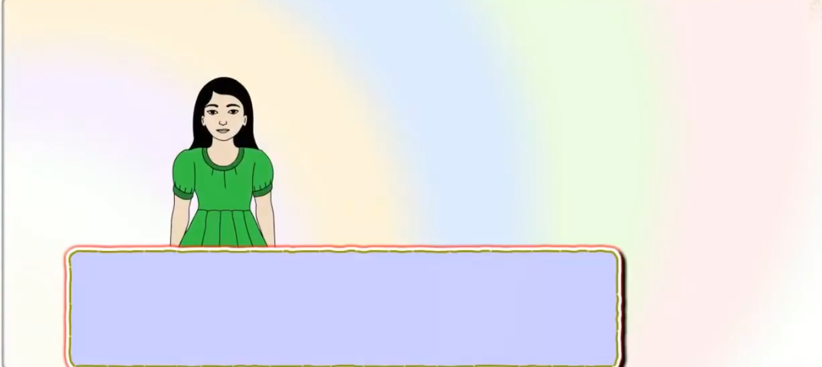
Home work.
Suppose its you.
Write the answer.
1)Do you like to practice speaking English?
write one sentence.
2)Do you want to open a Language club?
write YES or NO.
Ans:
Ans:

Slide 19
One day one word
Read
পড়া
I like to read English book.

Slide 20
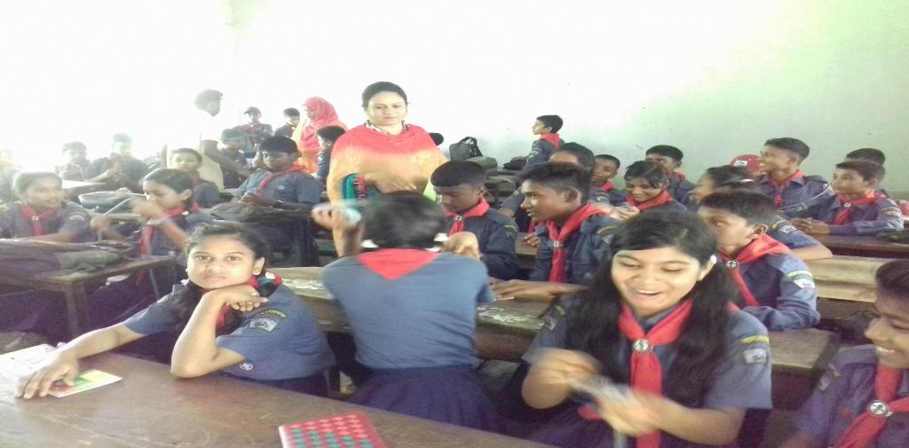
THINK
P
O
S
I
T
I
VE
THANKS ALL
BE
P
O
S
I
T
I
VE.
Thanks be with me.See you next class.

