Slide 2
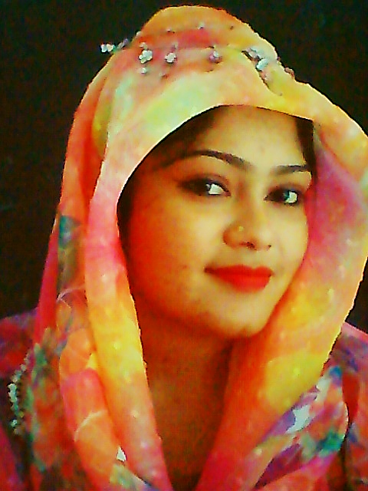
Presented by
Hafiza Khanam. Assistant teacher.
99 No. Nilokhi Govt. Primary School.
Gopalganj Sadar,
Gopalganj.
Class: Four Subject: English
Unite :22.
Tune up.
Lesson:1-2,
Page : 44

Slide 3
Lets watch the video
We were watching a video.
Now tell me what about the video is?

Slide 4
Today’s lesson
Tune up

Slide 5
Learning outcomes
By end of the lesson students will be able---
Listening:
1.1.1 recognize English sound differences in the context of words.
Speaking:
4.1.1 repeat after the teacher and say words, phrases and sentences with proper sounds, stress and intonation.
Reading:
1.5.1 read words, phrases and sentences in the text.

Slide 6
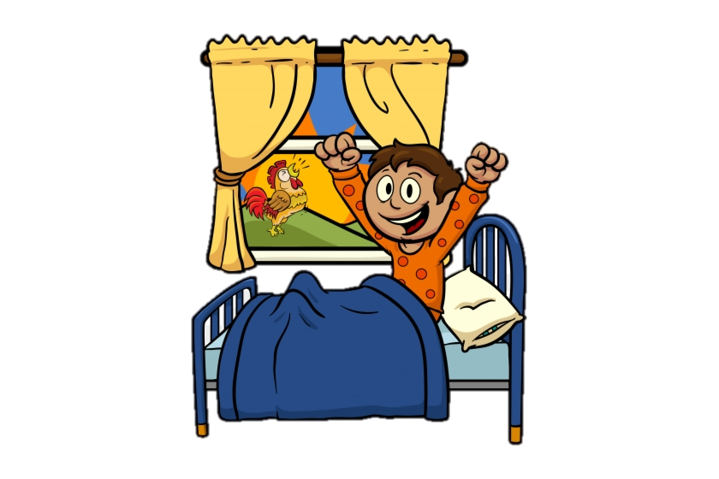
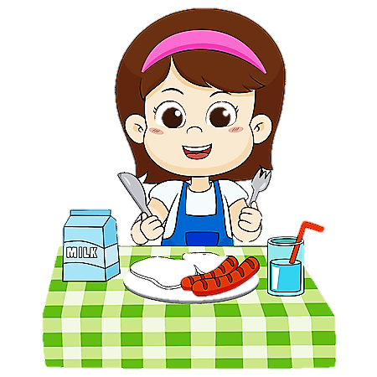
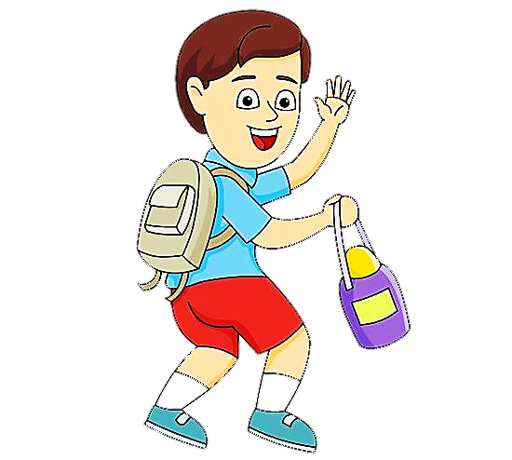
When do you get up?
When do you have breakfast?
When do you leave for school?

Slide 7
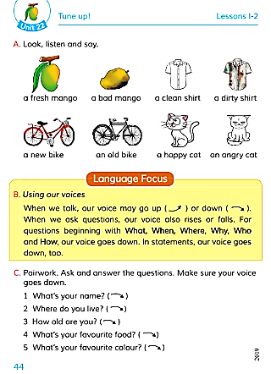
Open at page 44

Slide 8
Look at the picture carefully?
What do you see in the picture?
There are two types of pictures of the same pair in the pictures?

Slide 9
New words
Fresh = Pure (টাটকা)
Dirty = Unclean (অপরিচ্ছন্ন)
Old = Aged (পুরাতন)
Angry = Grumpy(ক্রুদ্ধ)

Slide 10
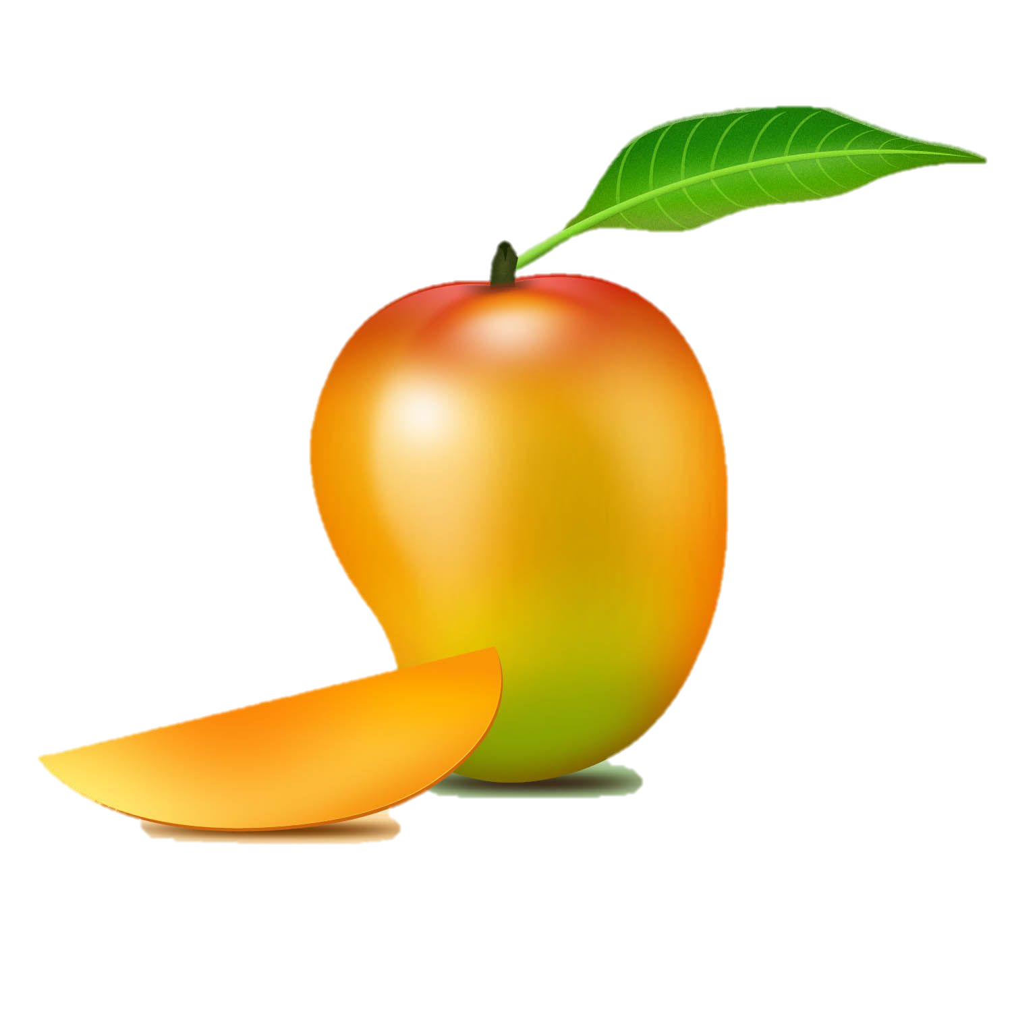
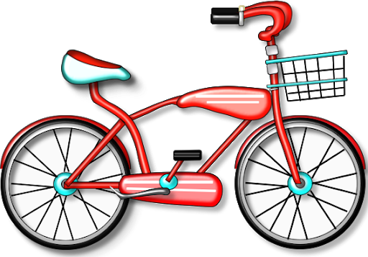
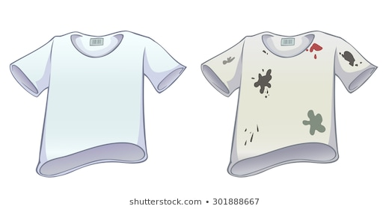
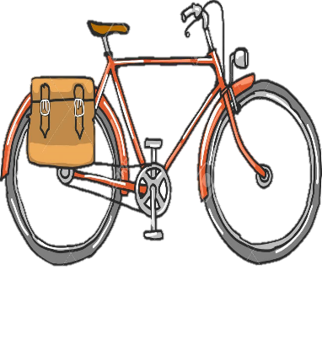
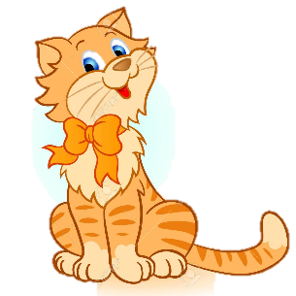
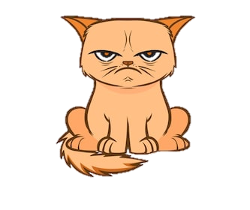
There are two of pictures of the same pair in the pictures.
Listen carefully to the audio.
Notice the pictures.
A old bike
A happy cat
An angry cat
A bad mango
A clean shirt
A dirty shirt
A new bike
A fresh mango

Slide 11
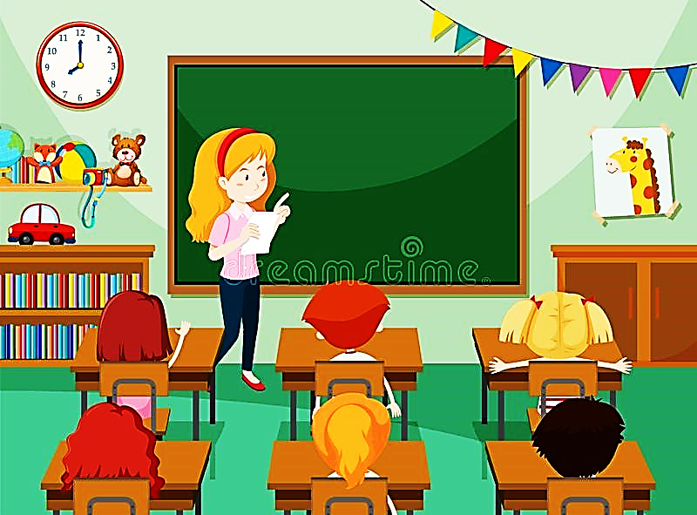
Students now I will read this words and you follow me.

Slide 12
Pair Work
Sit in pair and read the words to each other.

Slide 13
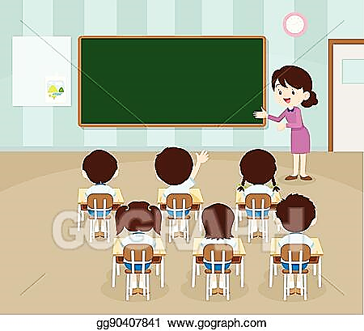
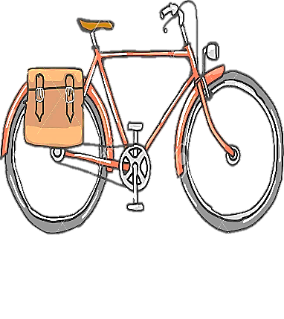
Say the words by looking at the picture.
A new bike
A fresh mango
A bad mango
A clean shirt
A dirty shirt
A happy cat
An angry cat
A old bike

Slide 14
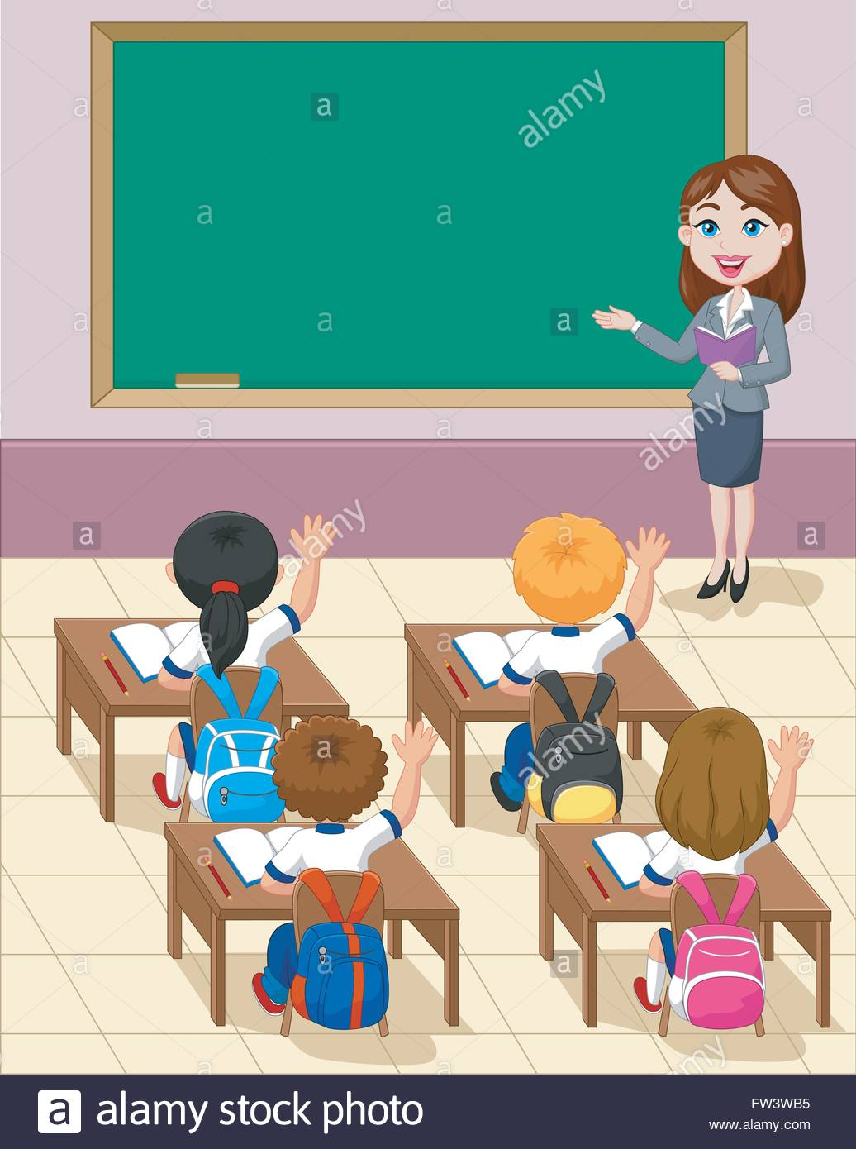
Do you like the clean shirt or the dirty shirt?
Do you like the new bike or the old bike?
Do you want to play with the happy cat or the angry cat?
Do you want to eat the fresh mango or the bad mango?
Now answer me.

Slide 15
ONE DAY WORD
Old =
Aged (পুরাতন)
This shirt is old.
Thank you all for the nice participation.

Slide 16
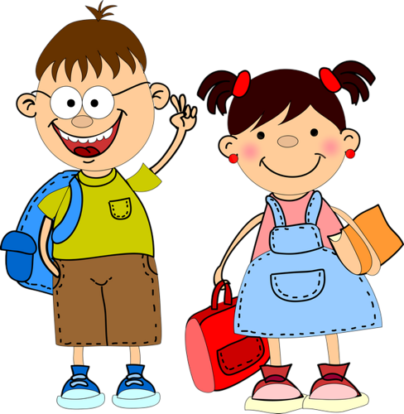
Good
Bye

