Slide 2
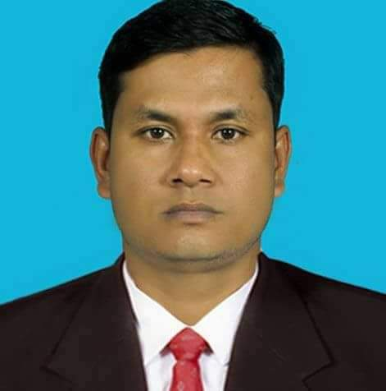
Teacher’s Identity
Md Sazzadur Rahman
Assistant Teacher
Jaliarpar government primary school
Companiganj,Sylhet.
Email:mdsazzadur13@gmail.com

Slide 3
Lesson’s introduction
Subject : English
Unit :01
Lesson :1-3
Lesson’s name : Greetings and introductions
Activity : B

Slide 4
Learning outcomes
Students will be able to
Listening:
1.1.1 Become familiar with English sounds by listening to common English words.
3.1.2 Understand simple questions and statements about familiar object.
Speaking:
1.1.1 Repeat after the teacher simple words and phrases with proper sounds and stress.
1.1.2 Say simple words and phrases with proper sounds and stress.
2.1.2 Say good morning,Hi,Hello.

Slide 5
Safety environment by greetings song.
Hello! Hello! How are you?
I’m well, I’m good.
I’m great, I’m wonderful.
Hello! Hello! How are you?
I’m fine! I’m great today.

Slide 6
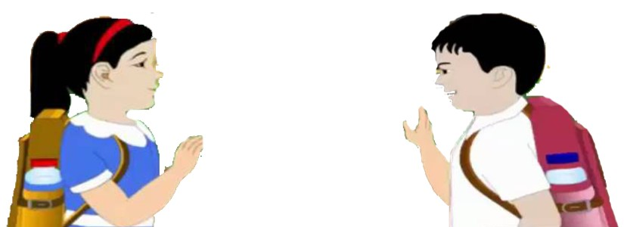
What can you see in the picture?
Two children are greetings each other.
Dear students now try to say-
What can be the topic of our today’s lesson?

Slide 7
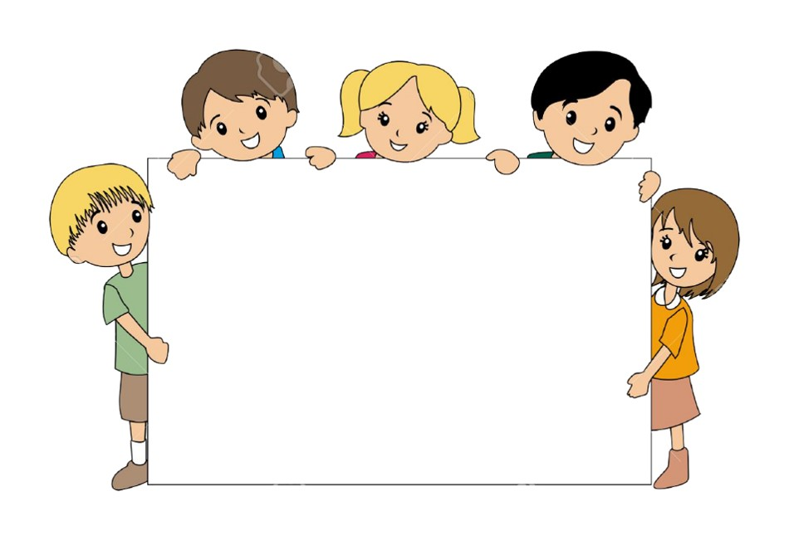
Lesson declaration
Our today’s lesson is---
Greetings and Introductions

Slide 8
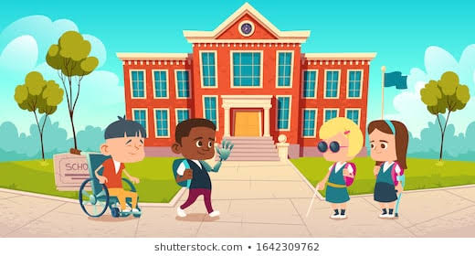
Look at the picture and think what are they doing?
They are
Greetings and Introductions
To each others

Slide 9
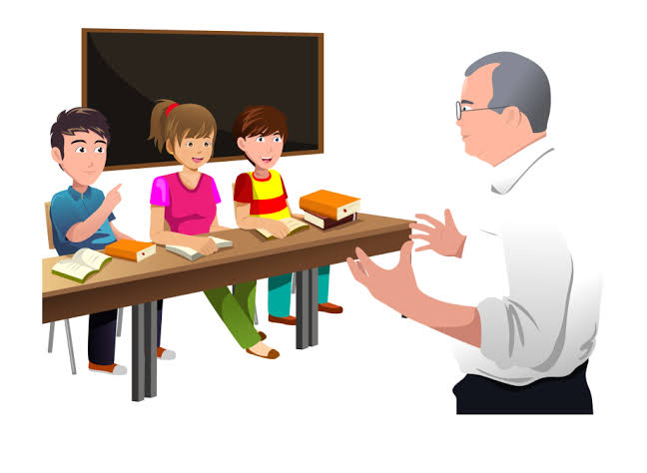
They are introduce between Teacher and Students
I’m Fine.Thanks and you?
How are you Shuva?
Fine.Thanks

Slide 10
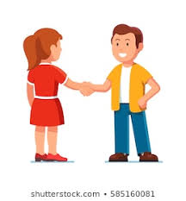
Look, how they are introducing each other.
How are you,Rony?
I’m fine,thanks.And you?
Fine,thanks.Bye!
Bye!

Slide 11
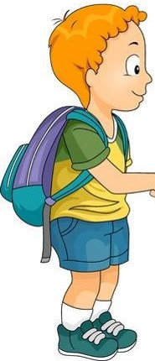
Read and Say
How are you, Rafi?
I’m fine, thanks.
And you?
I’m fine. Bye!
Bye!

Slide 12
Chain drill
How are you,Rafi?
……..……
……..……
…….…….
……….Bye!

Slide 13
Word Meaning with Sentences
How-কেমন
Are-হওয়া
You-তুমি
Fine-ভালো
Thanks-ধন্যবাদ
And-এবং
Bye-বিদায়
How are you, Rafi?
তুমি কেমন আছ,রাফি?
I’m fine,thanks.And you?
আমি ভালো আছি,তোমাকে ধন্যবাদ।আর তুমি?
Fine,thanks.Bye!
ভালো,ধন্যবাদ।বিদায়!
Bye!
বিদায়!

Slide 14
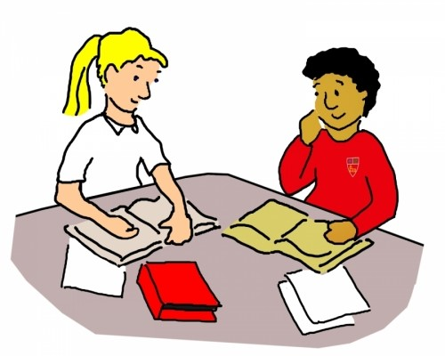
Pair work
Students will be devided in pair.Every pair will practice this greetings and introductions with each other.

Slide 15
Group work
All the students will be divided in the Groups:
They will practice this greetings and introductions with each other.

Slide 16
Evaluation
Fill in the blanks:
Shuva:How are…….,Rafi?
Rafi:I’m ……,thanks.And you?
Shuva:Fine,thanks…….!
Answer
a. You
b. Fine
c. bye

Slide 17
One day one word
Look at the picture attentively.
What’s this?
Cup
পেয়ালা
Spell the word - SGW

Slide 18
Home work
Practise this greetings and introductions with your family members according to your lesson.

Slide 19
No more today.See you again tomorrow.

