Slide 1
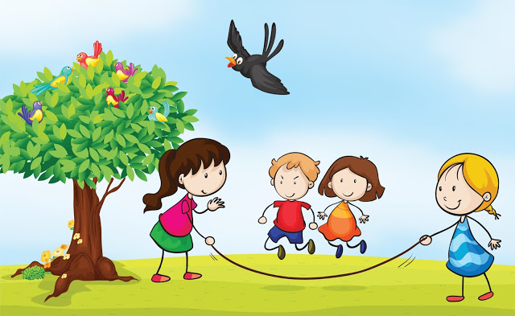
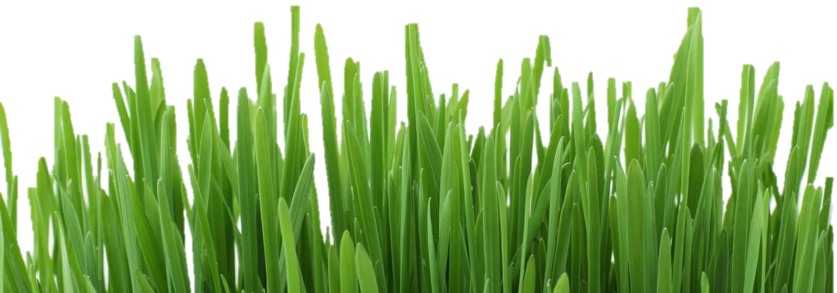
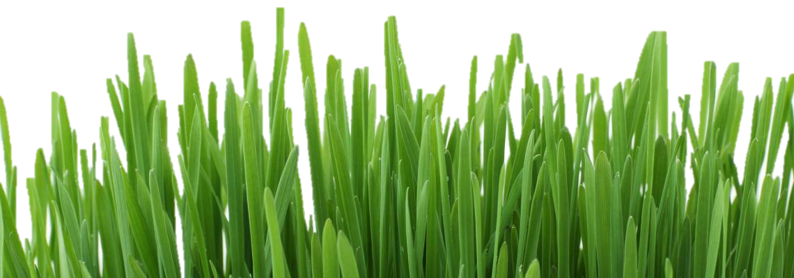
Most Welcome

Slide 2
Md. Reajul Islam
Assistant teacher
Araji Niamot Government Primary school,
Gangachara, Rangpur.
Email : reajatgps1992@gmail.com
English
Class:- v
Unit: 17
Lesson: 5-6
Page:68
Date: 07.07.2020

Slide 3
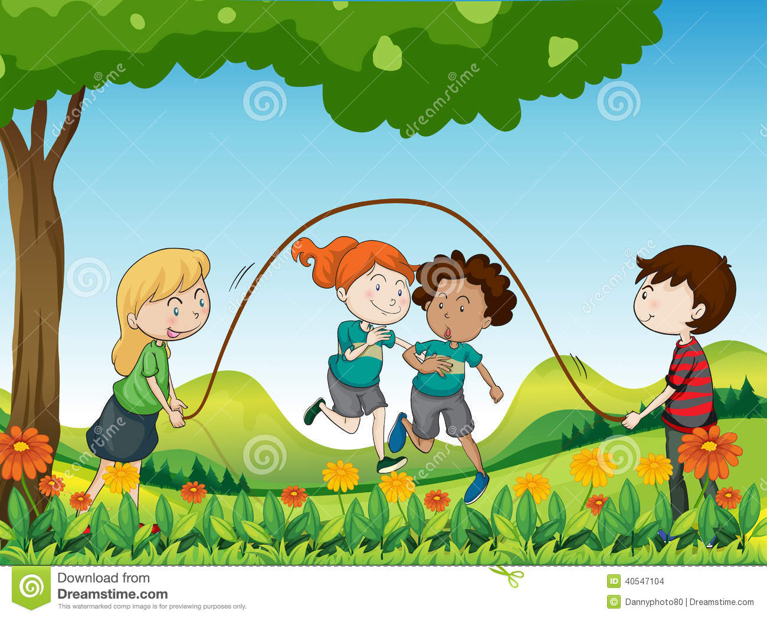
What do you see in the video?
Let’s watch a video clip--
Videos

Slide 4
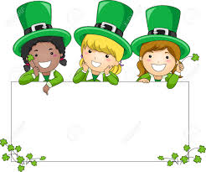
Learners will be able to-
1.5.1 read words, phrases and sentences in the text with proper pronunciation, stress and intonation.
8.1.1 make sentences using words and phrases
given in the textbook.

Slide 5
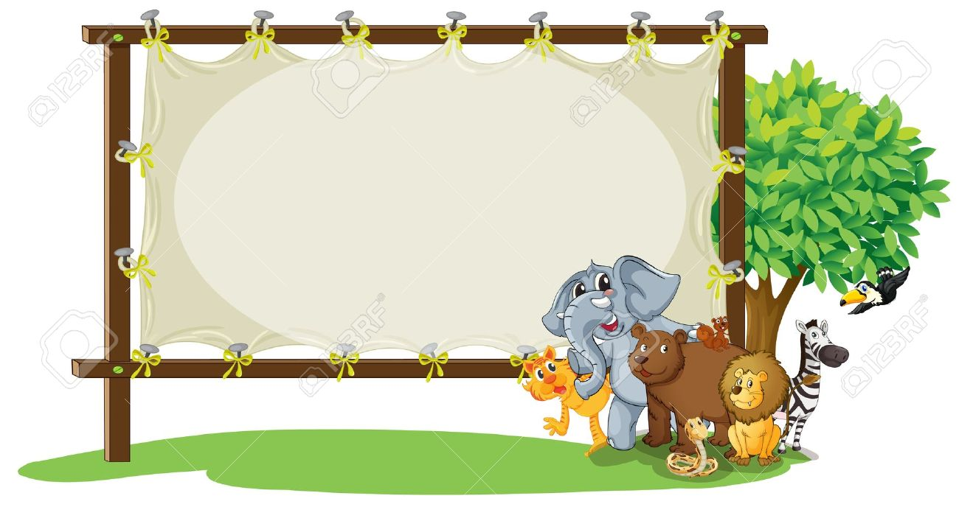
Sport
Our Today’s Lesson

Slide 6
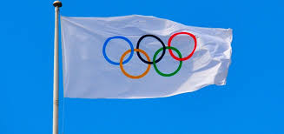
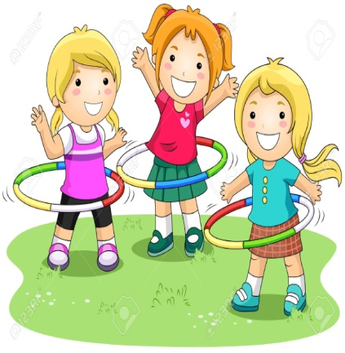
Olympic Games
The biggest sports name.
The Olympic Games is the biggest sports competition in the world.

Slide 7
World
Earth
The Olympic Games is the biggest sports competition in the world.

Slide 8
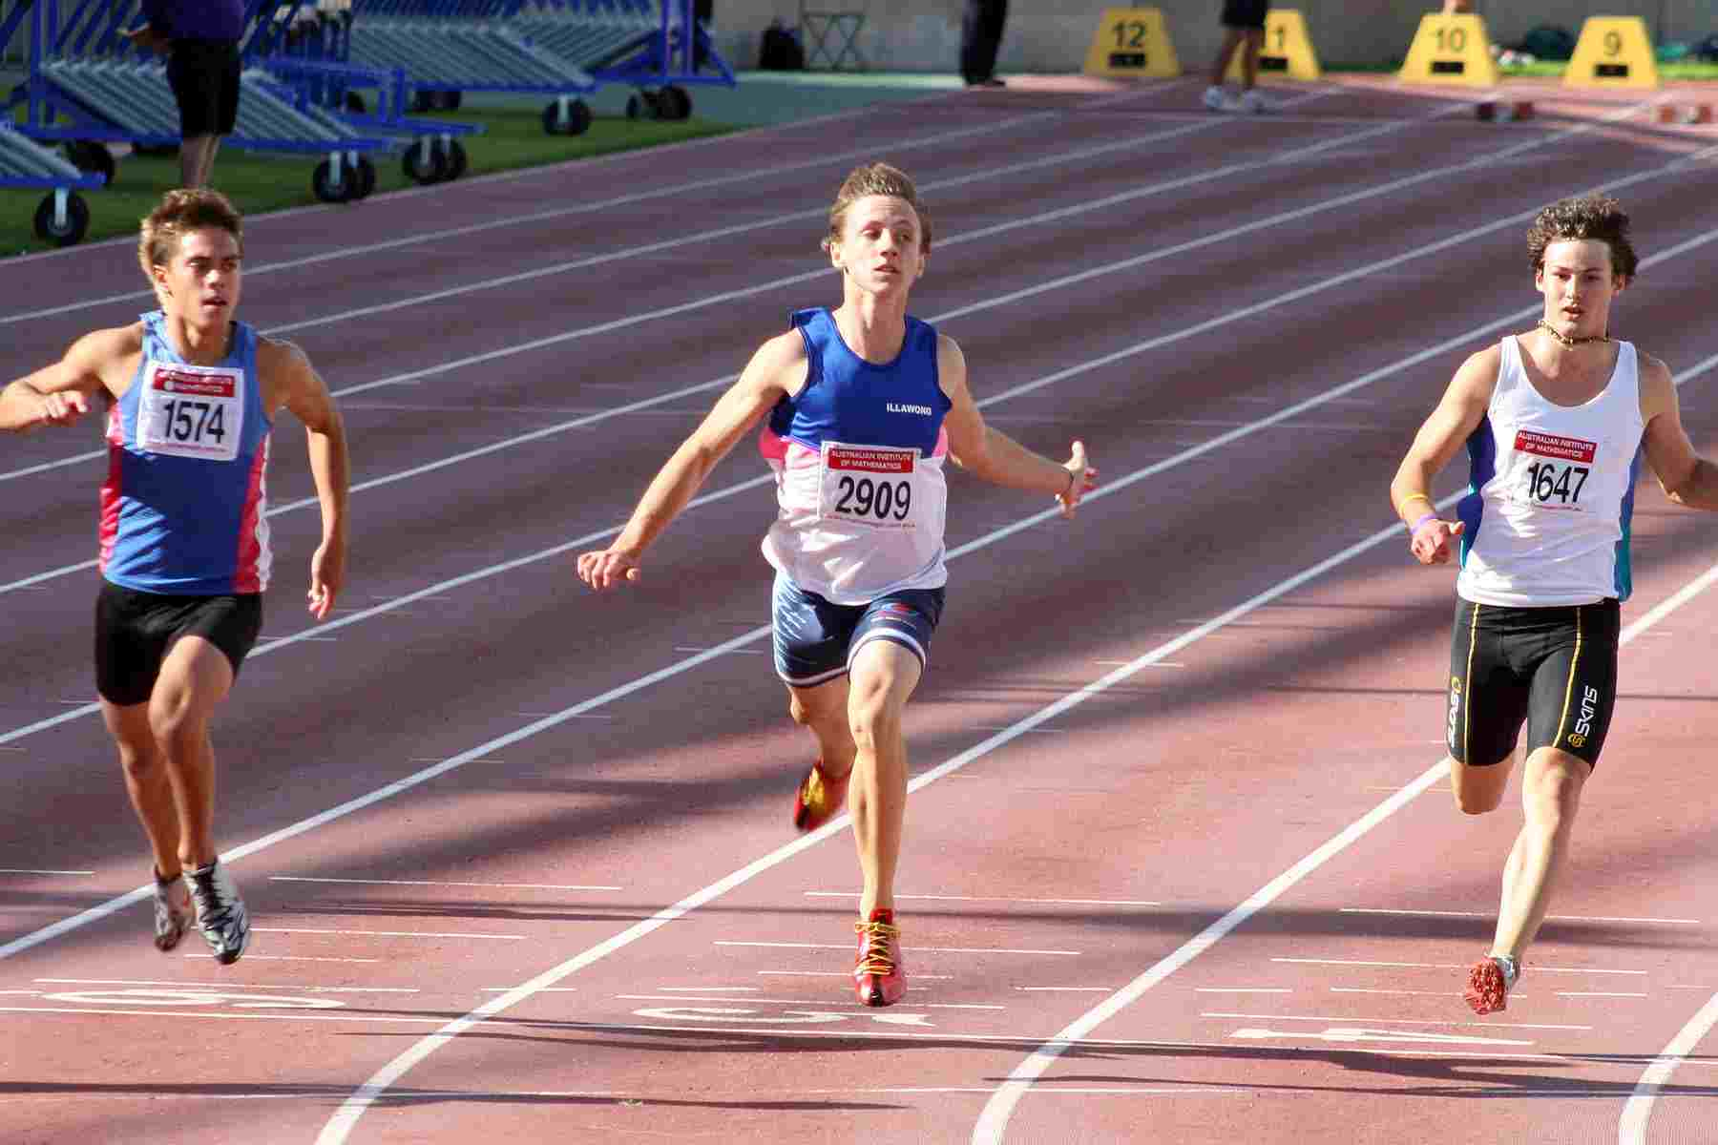
Competetion
A contest among many persons.
There have been 31 competitions since 1896.

Slide 9
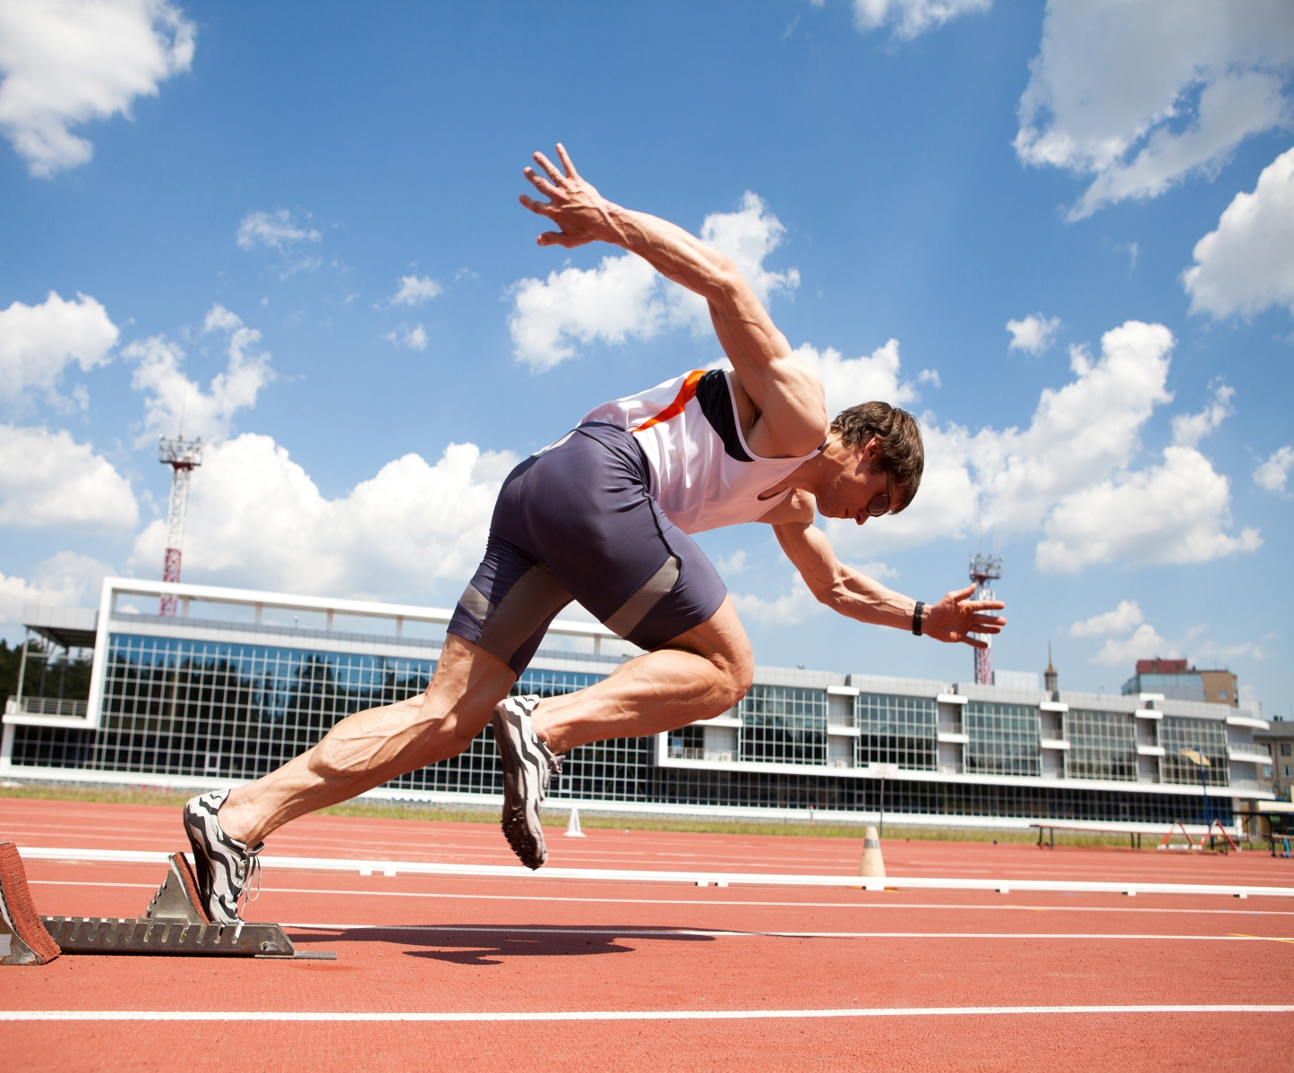
Athlete
Sportsman
About 13000 athletes compete in the Olympics.

Slide 10
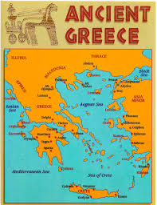
Greece
It’s a country name.
The first Olympic Games held in Greece.

Slide 11
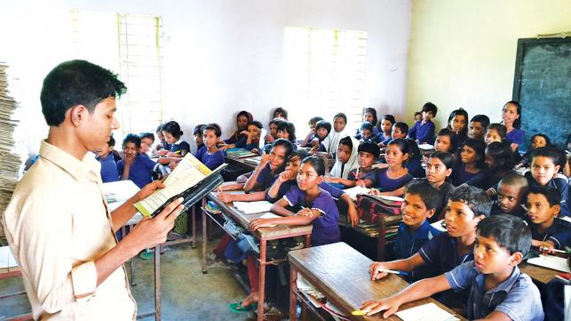
Teacher’s Reading
Open at page 68

Slide 13
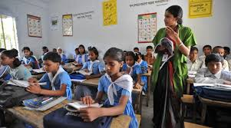
Student’s Reading

Slide 14
I.W.
Missing letter write on the khata:
Athlete
Competetion
Earth

Slide 15
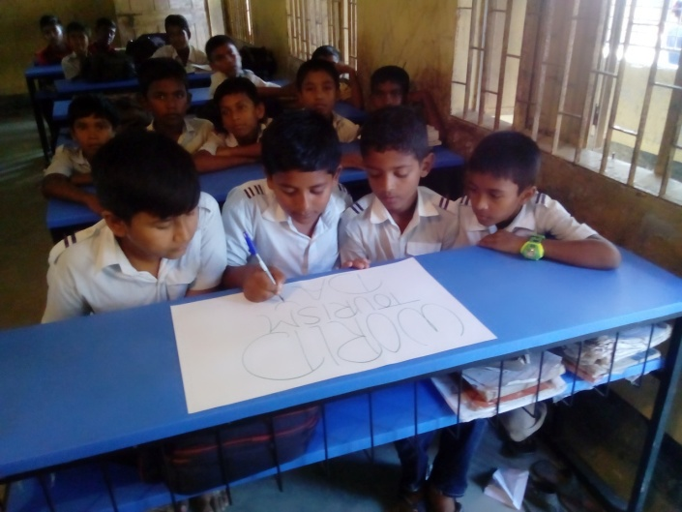
Let’s do group work
Read the text silently and write the answer
1.How often are the Olympics held?
The Olympics are held every four years.
2.When did the modern Olympics begin ?
The modern Olympics began in 1896.
3.How many countries compete in the Olympics?
More than 200 countries compete in the Olympics.

Slide 16
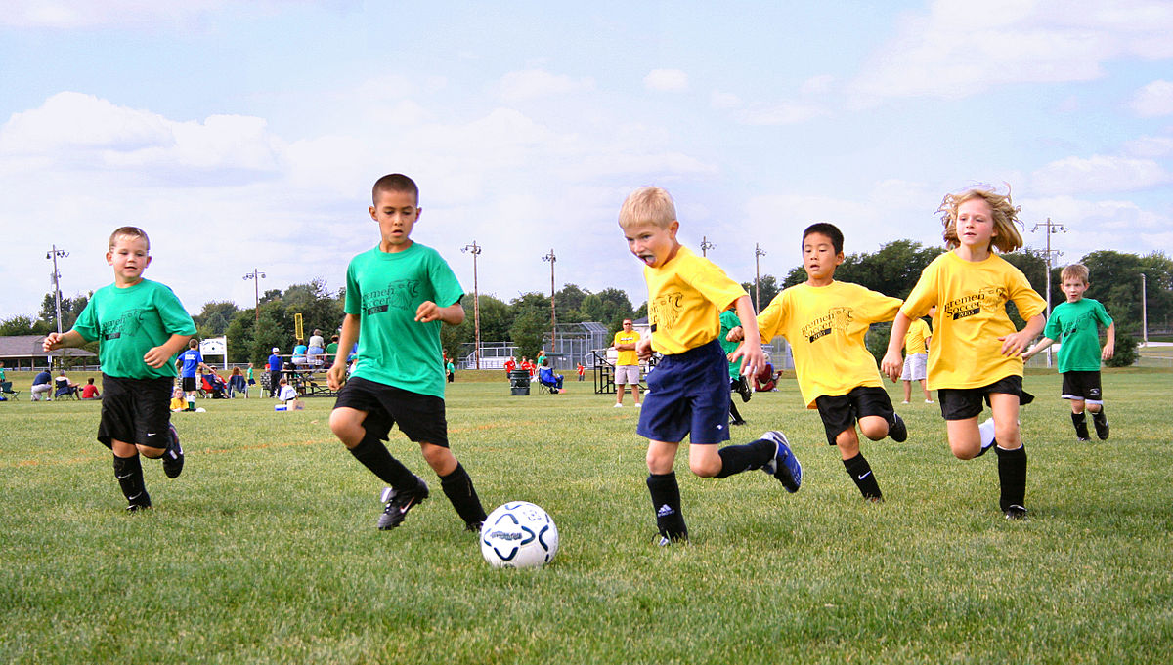
Make WH questions:
Let’s do pair work
1.TheOlympics are held every four years.
How often are the Olympics held ?
2.The modern Olympic Games began in 1896.
When did the modern Olympic Games begin ?
3.The first Olympic Games were held in Greece.
Where was the first Olympic Games held ?

Slide 17
Evaluation
Match with their meaning :
a person who compete in sports.
Compete
a countries , a city that arrange a special events.
Athlete
Host
to take part in a contest.

Slide 18
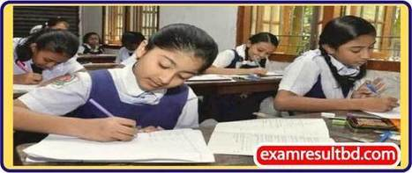
One day one word
Sport
খেলাধুলা
Game
We like to play sport.

Slide 19
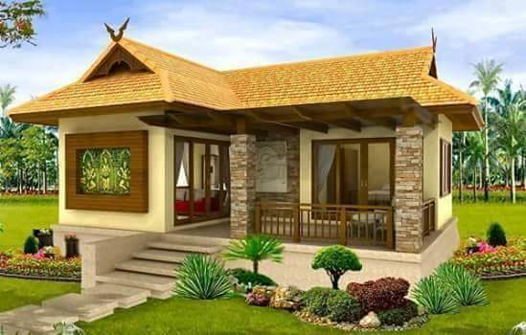
Home work
You will write five sentences about ‘Your Favorite Sport’.

Slide 20
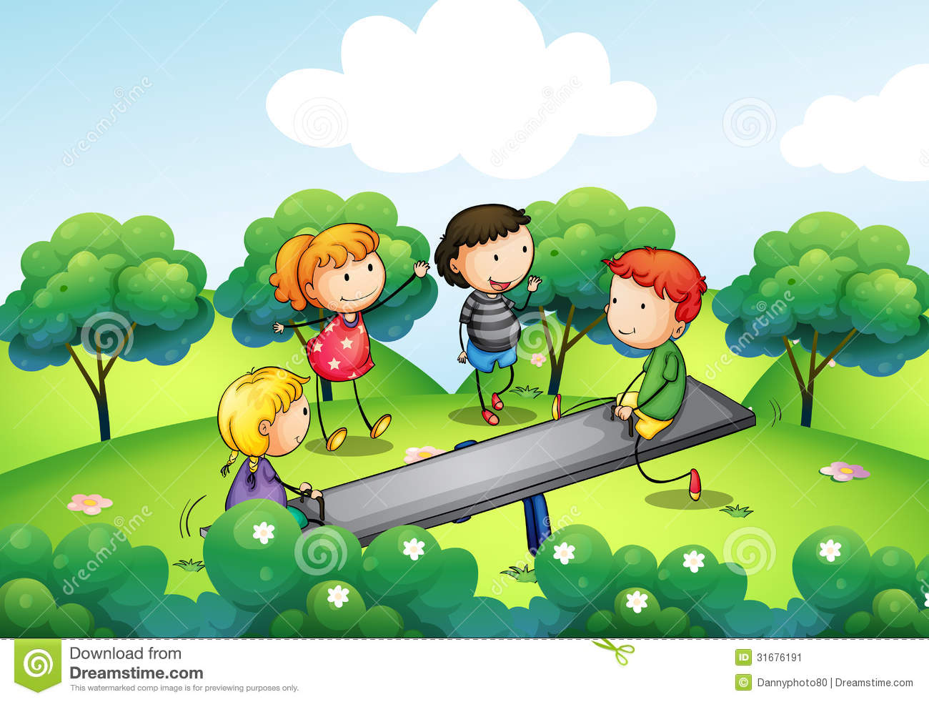
See you
soon

