Slide 1


Welcome

Slide 2
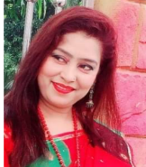
Identity
Subject : English
Class : Two
Unit : 4
Lesson : 1-3
Lesson Tittle: Numbers
Time : 40 minutes.
Nasrin Sultana
Head Teacher
pachuria gps
Muksedpur, gopalgong

Slide 3
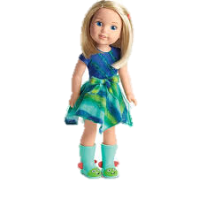
Let’s enjoy a video.
https://www.youtube.com/watch?v=ad1h8fSqSzw
Discuss
about the video.

Slide 4


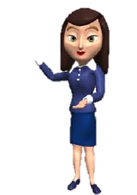
Today’s lesson
Numbers
5,6,7

Slide 5
Learning outcomes.
Students will be able to—
Repeat after the teacher simple words and phrases with Proper sounds and stress.(Speaking : 1.1.1)
Recognize and read cardinal numbers up to 30.(Reading : 2.1.1)
Write numbers up to 10 in figures and in words.(Reading : 2.1.1)

Slide 6
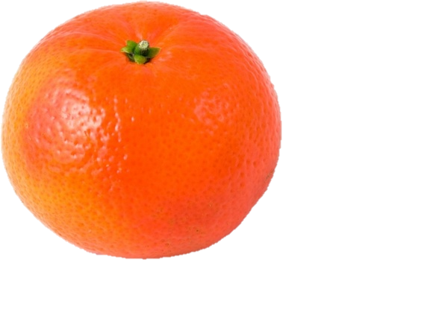
Look and say.
How many orange?
What is this?
1
Orange
one

Slide 7
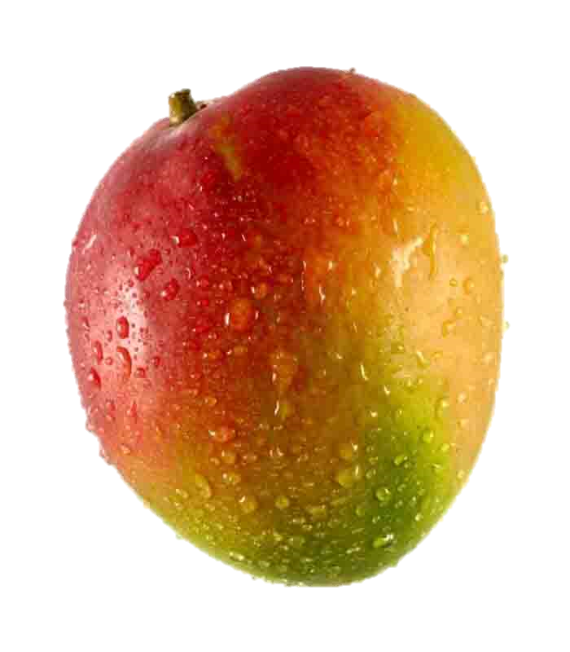
Look and say.
How many mangoes?
What is this?
2
two
Mangoes

Slide 8
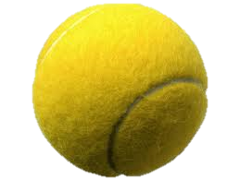
Look and say.
How many balls?
What is this?
3
three
balls

Slide 9
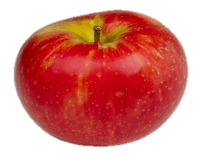
Look and say.
How many apples?
What is this?
4
four
Apples

Slide 10
Look and say.
How many stars?
What is this?
5
five
stars

Slide 11
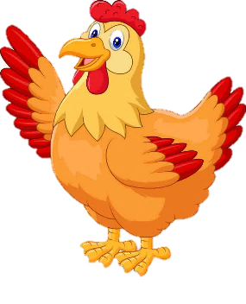
Look and say.
How many hens?
What is this?
6
hens
six

Slide 12
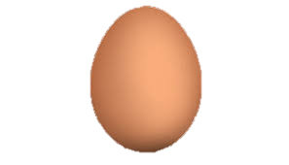
Look and say.
How many eggs?
What is this?
7
seven
eggs

Slide 13
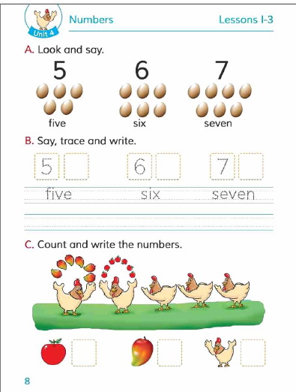
Open your book at page 8.

Slide 14
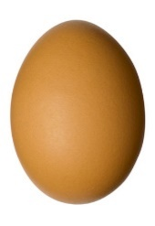
Look Listen and say.
Picture
Figure
Word
5
five
6
six
7
seven

Slide 15
Reading practice.
Wcw
seven
six
five
7
5
6

Slide 16

Pair work
Count the eggs.
5
five
6
7
six
seven

Slide 17
Say, trace and write
IW
5
6
7
5
6
7
f
ive
six
seven
five
six
seven

Slide 18
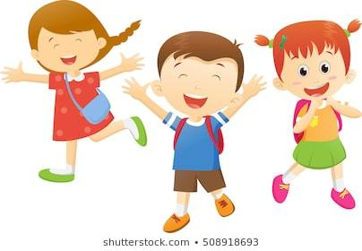

Group work
Match correctly.
7
6
5

Slide 19
Pw
Match the numbers with the words.
6
seven
5
six
7
five

Slide 20

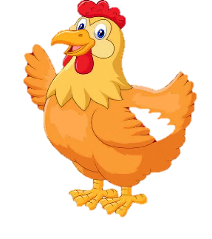
Evaluation
How many cups are there ?
How many hens are there ?
7
6

Slide 21
A
Write the missing number.
5
6
7

Slide 22
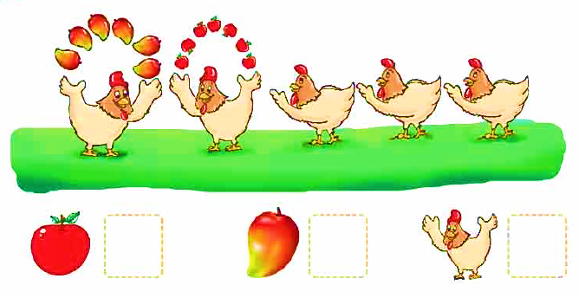
A
Count and write the numbers.
6
5
7

Slide 23

Thank you.

