Slide 1
WELCOME

Slide 2
Teacher’s Identity
Ali Masuma Abeda Hasnat
Head Teacher,
Jummapara GPS,
Rangpur sadar, Rangpur

Slide 3
Lessons Identity
English
Grade 5
Unit 8/ Sima....these things.

Slide 4
Learning outcomes
2.1 to carry out simple commands and instructions.
3.1 to ask answer Wh – and Yes/No questions
1.7 to read paragraphs, dialogues, stories, letters and other texts
8.1 to make sentences using words and phrases following instructions

Slide 5
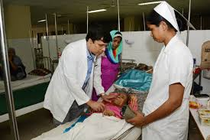
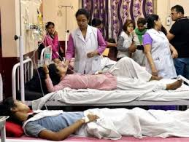

Slide 6
Todays lesson
Write to me soon

Slide 7
Finding new words
because, throat, sore, fever, flu, need, medicine,
also, order, energy, hungry, strong, stay, strong,
better, rest, coughing, wash, catch, people,
sneezing, illness, soft.

Slide 8
Teachers model reading

Slide 9
Word meaning
words
meaning
flu
visit
energy
rest
viral fever
arrive
spirit
leisure

Slide 10
Students loud reading

Slide 11
Healthy foods
Unhealthy foods
Vegetables
Fish
Meat
Rice
Dal
Fruits
Egg
Ice cream
Chips
Chocolates
Burger
Sandwich
Cold drinks

Slide 12
Pair work
Make sentence:
today, school, cough, doctor, medicine,

Slide 13
Group works
Write true/ false:
Raka is at home.
Doctor advised her not to drink water and juice.
Sometimes wash your hands.
Use your own cup, plate, glass.
Do not cover your mouth and nose while sneezing.

Slide 14
Summary
Raka is at home because she has the flu. The doctor visited
Sima last night and gave her advice:
1. Try to eat, even aren’t hungry.
2. Take rest.
3. Drink a lot of water or juce.
4. Cover your mouth and nose.
5. Wash your hands regularly.
6. Use your own plate and glass.

Slide 15
Student’s silent reading

Slide 16
Answer the following questions:
Where is Raka?
2. What happened Raka?
3. What was the doctor’s advice?

Slide 17
One day one word
Cover/ ঢেকে রাখা

Slide 18
Home work
Write 5 sentence about doctor’s advice.

Slide 19
Goodbye

