Slide 1
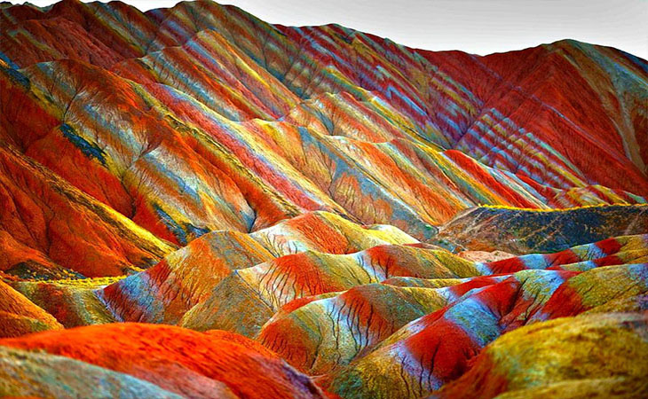

Slide 2
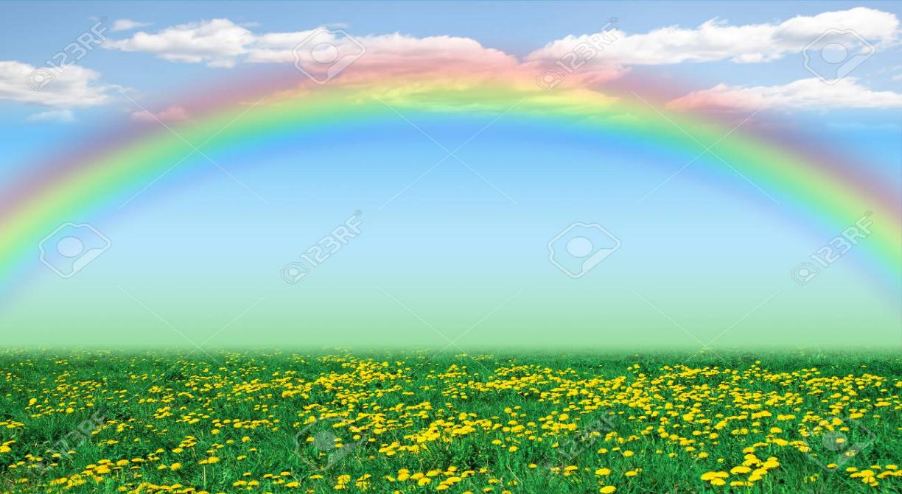
Good morning students
Welcome to my class

Slide 3
Identity
Nasrin Sultana
Head Teacher
8 no. pachuria gps
Muksedpur, gopalgong

Slide 4
Lesson’s identity
Class-Two
Subject- English
Lesson 4-5
Unite-16
Time: 45 minutes

Slide 5
Let’s watch a video
https://www.youtube.com/watch?v=AhGwVUrKkaw
Link click
Discuss the video

Slide 6
Today’s lesson is
Rainbow

Slide 7
Learning outcomes
Students will be able to…
1.1.1 become familiar with English sounds by listening to common English words,
1.1. 2 say simple words and phreses with proper sounds and stress,
4. 1. 2 recite rhyme independently.

Slide 8
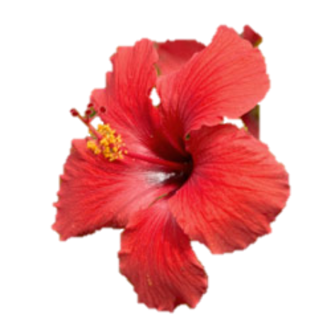
Look at the picture
What can you see in the pictures?
Red flowers and card.
red

Slide 9
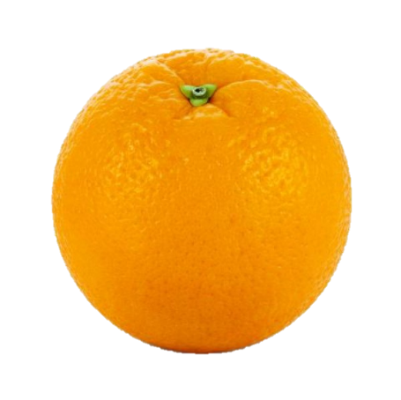
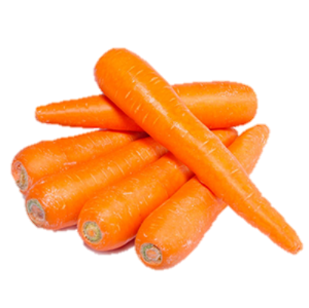
Look at the picture
What colour is this?
orange
orange

Slide 10
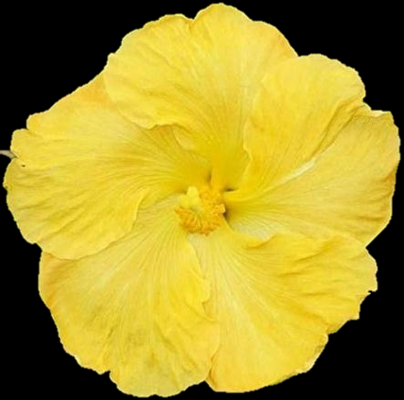
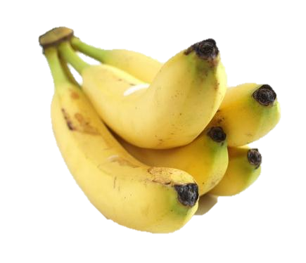
What colour is this?
yellow
yellow

Slide 11
What colour is this?
This is green colour.

Slide 12
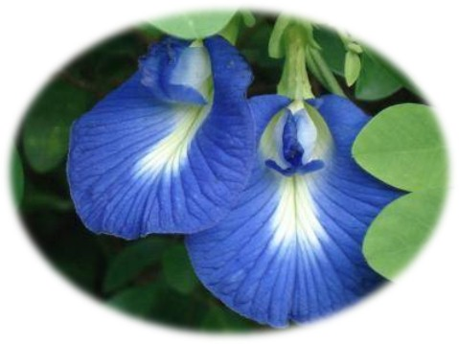
What colour is this?
blue

Slide 13
What colour is this?
indigo

Slide 14
What colour is this?
violet

Slide 15
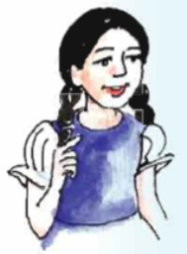
Individual work
Say the name of the colours
Matching
red, orange, yellow, green, blue,indigo,and violet.

Slide 16
Look at the picture
Today we will say the rhyme.
Would you like to say it with me?
What is this?
This is rainbow.

Slide 17
Listen to the rhyme attentively
Listen
Rainbow, rainbow,
I see you!
Red and orange,
Yellow, green and blue,
Indigo and violet, too!

Slide 18
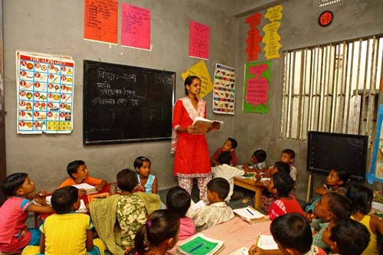
Look, listen and say

Slide 19
Pair work
Say the rhyme (two line)

Slide 20
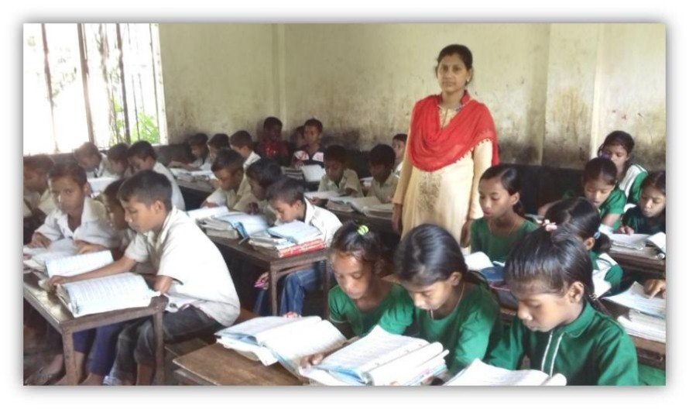
Student’s reading
Open your book at page 33.

Slide 21
Evaluation
Say the rhyme (one by one)

Slide 22
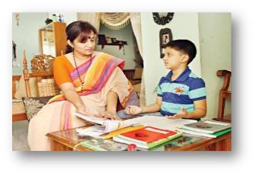
Home work
Tomorrow you will be bring write rhyme on your note book.

Slide 23
