Slide 1
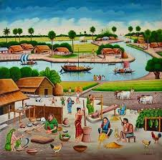
Welcome

Slide 2

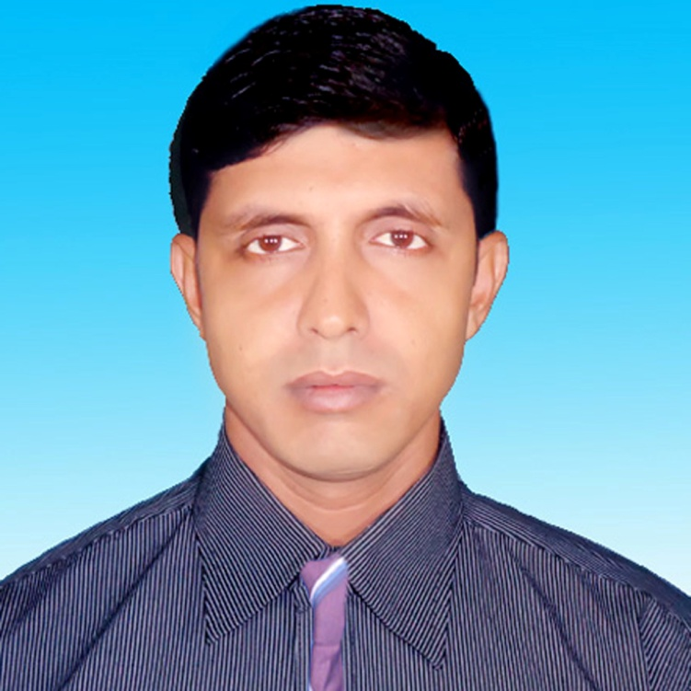

Ujjal Kumar Ghosh
Assistant Teacher (English)
Chuadanga Krishnanagor High school
Panjia Keshabpur jessore
Email-ujjalkumar106@gmail.com

Slide 3
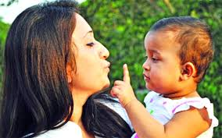
What do you see in the picture?
Affection and love

Slide 4
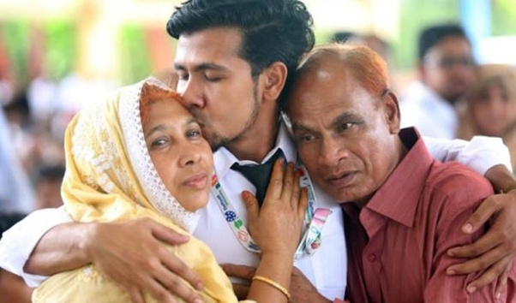
What are you looking in the picture?
Affection and tenderness

Slide 5
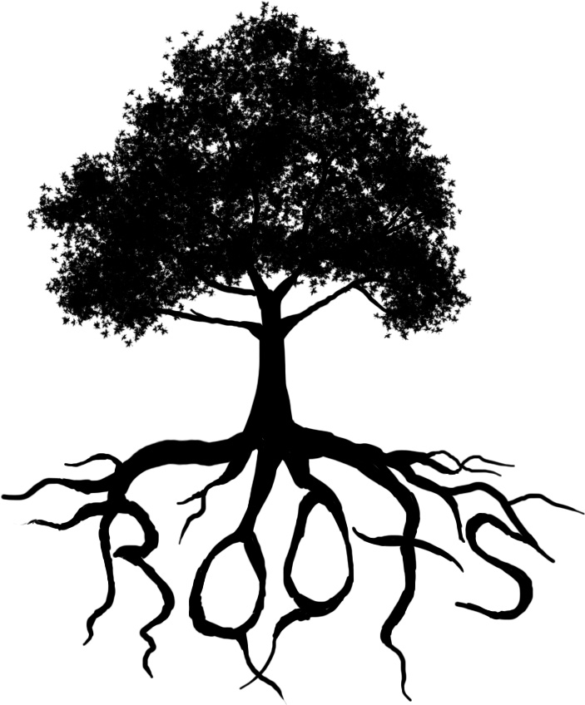
Roots of tree
What is it?

Slide 6
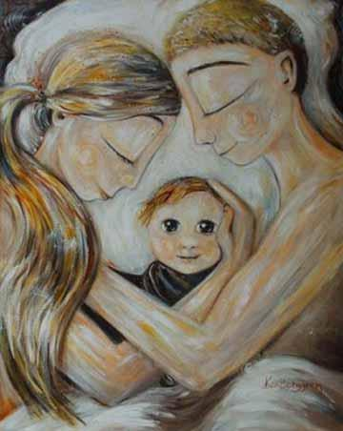
Do human beings have roots like the trees?
Yes, they lie in our minds.
In that sense our families, land of birth, relatives, our culture, traditions, or surroundings are our roots.

Slide 7
Today’s Lesson is
My roots
Unit Twelve
Lesson 1:
Page Number- 172

Slide 8
Learning Outcome
By the end of the lesson learners will be able to:
talk about picture.
use new words.
present own ideas, give and ask for information.
Make question from information.
Fill in the grid with appropriate information from the text above.
Write a dialogue between two friends about Rode accident.

Slide 9
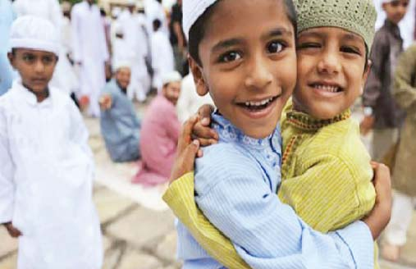
Happiness
Happiness means bliss, comfort, enjoyment
Eid means happiness

Slide 10
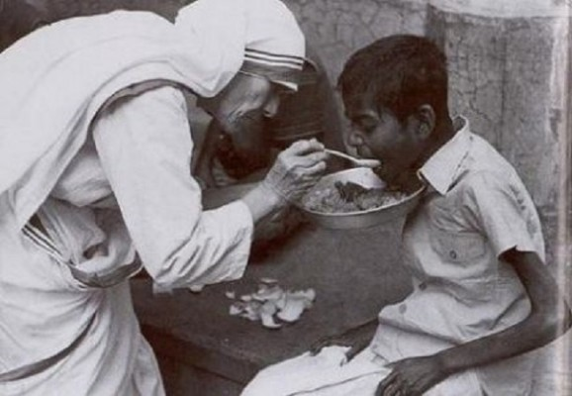
humanity
Humanity means the quality of being human
Mother Teresa was a symbol of humanity

Slide 11
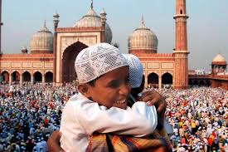
Reading Test

Slide 12
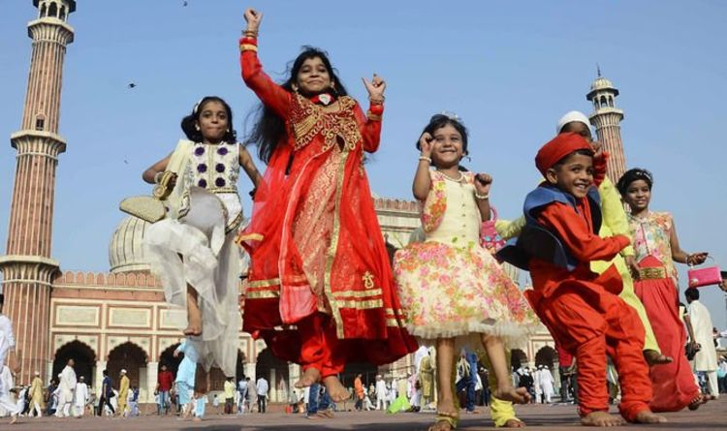

Slide 13
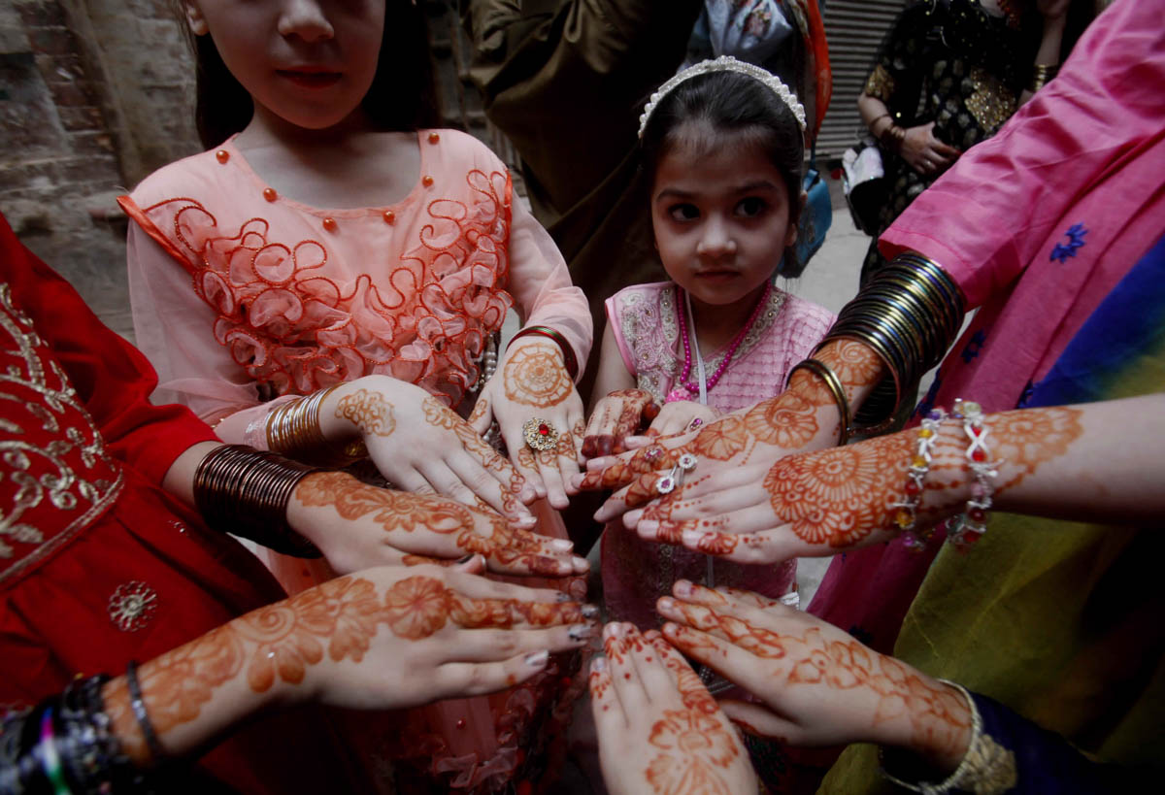

Slide 14
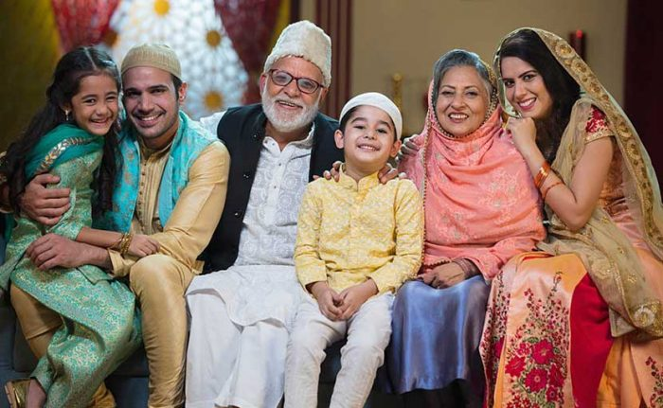

Slide 15
Please open your text book .page number- 172
Eid is the main religious festival of the Muslims in Bangladeh. Eid means happiness. Eveyone wants to share this happiness with their near and dear ones. So most of the people, who are living outside their home for different reasons have a strong desire to get back home during the Eid vacations.

Slide 16
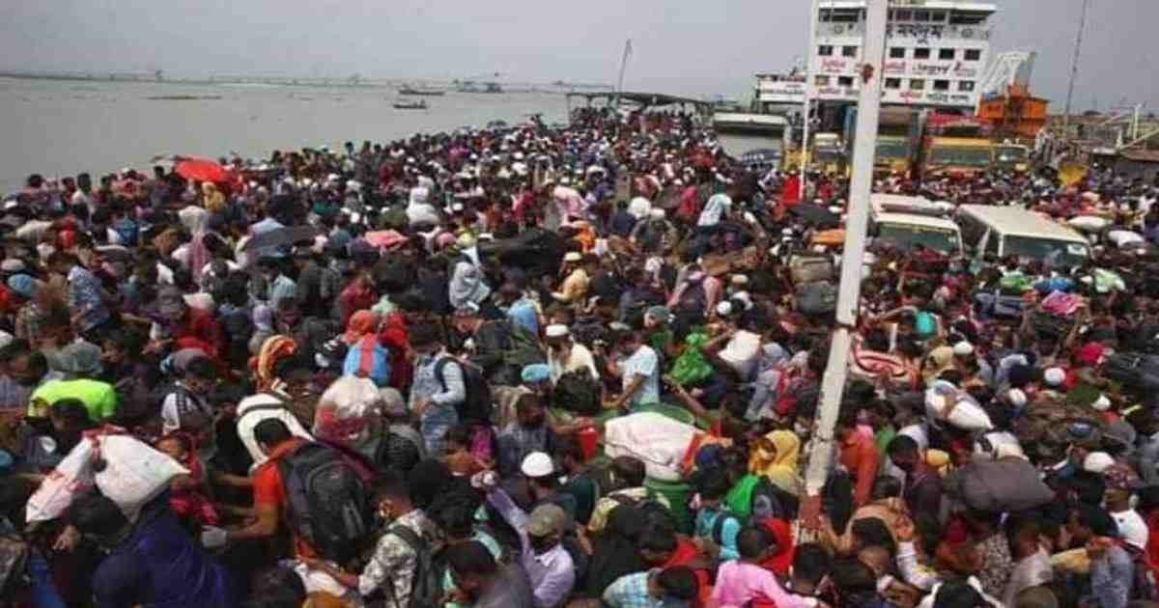

Slide 17
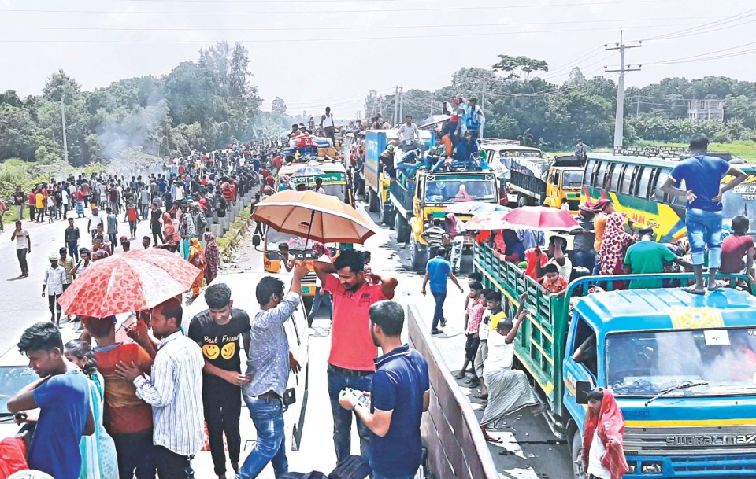

Slide 18
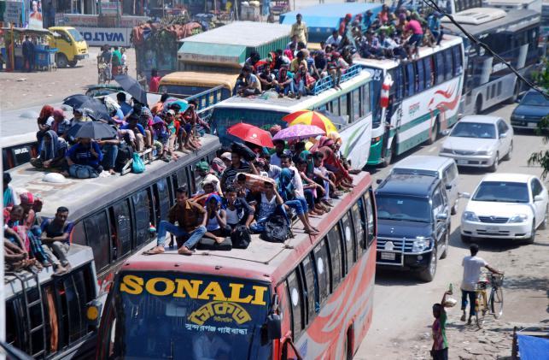

Slide 19
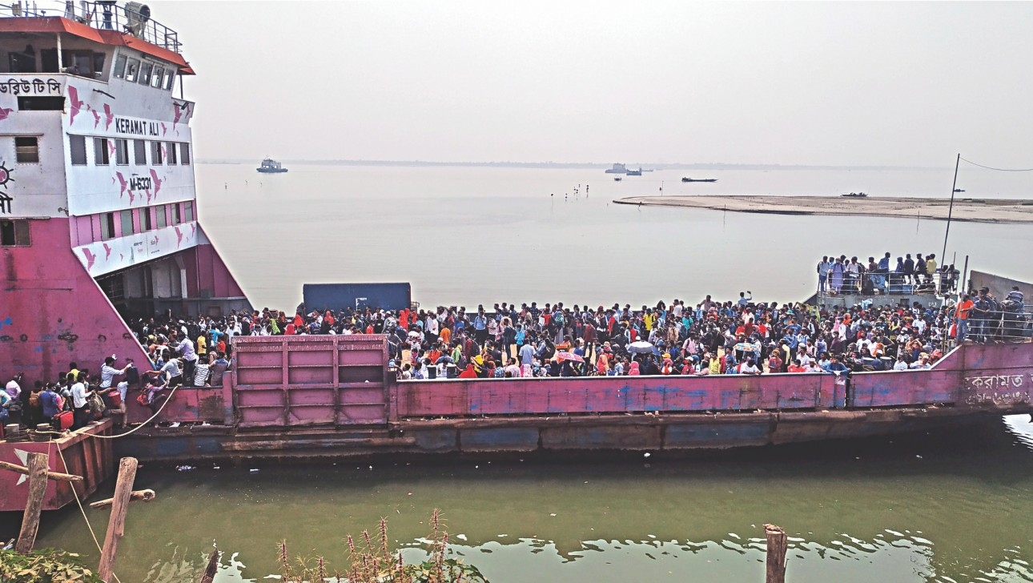

Slide 20
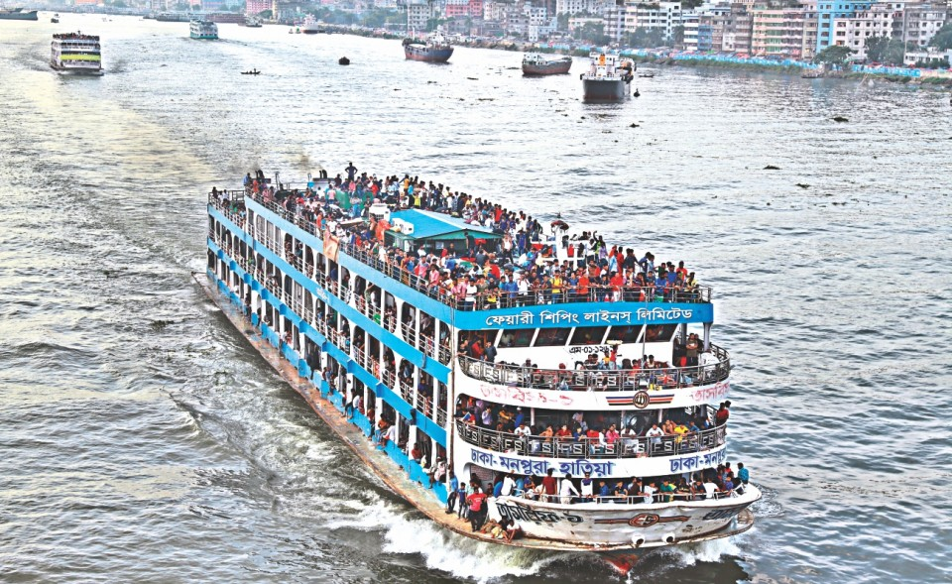

Slide 21
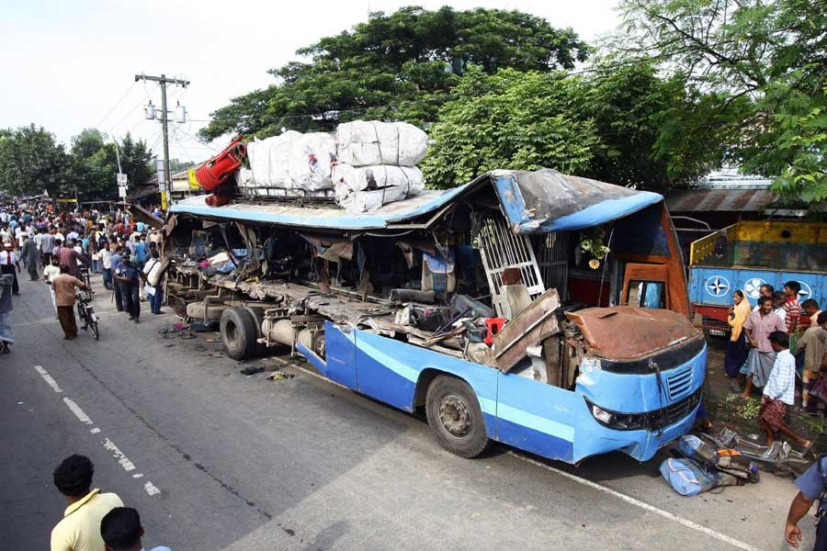

Slide 22
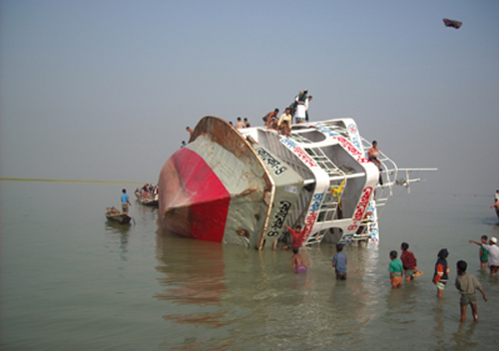

Slide 23
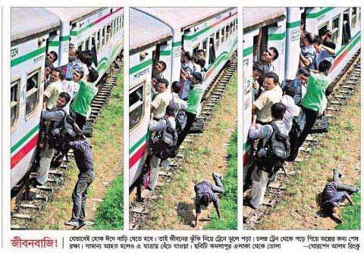

Slide 24
As a result, there is a mad rush in the buses, trains, or launches for the home-bound people. This often causes transport accidents that take away many lives. However, it cannot stop people’s desire to meet their family, in-laws, or friends. What makes people rush for their homes in spite of serious hazards? This is the pull of the roots.

Slide 25
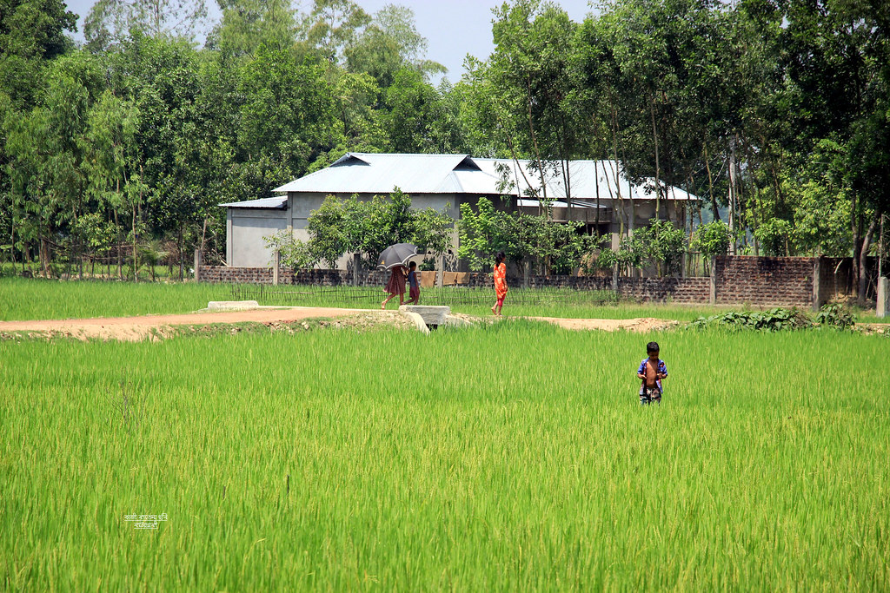

Slide 26
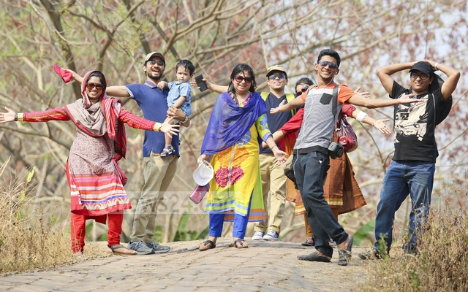

Slide 27
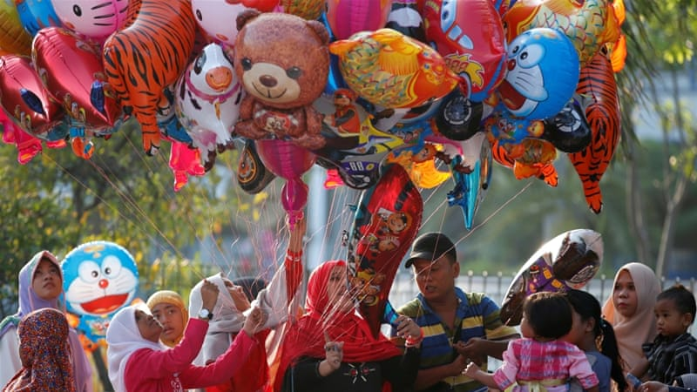

Slide 28
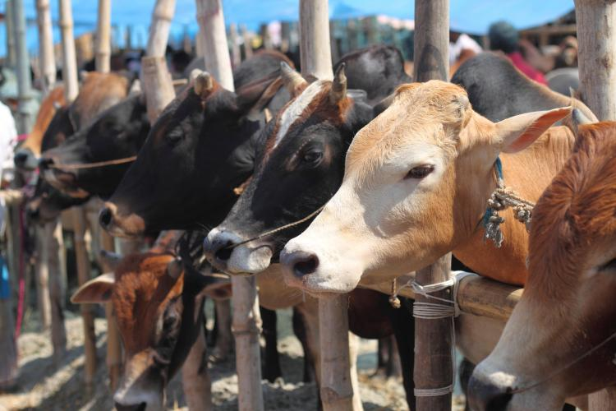

Slide 29
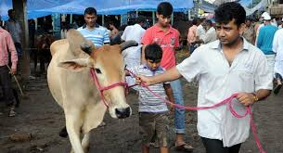

Slide 30
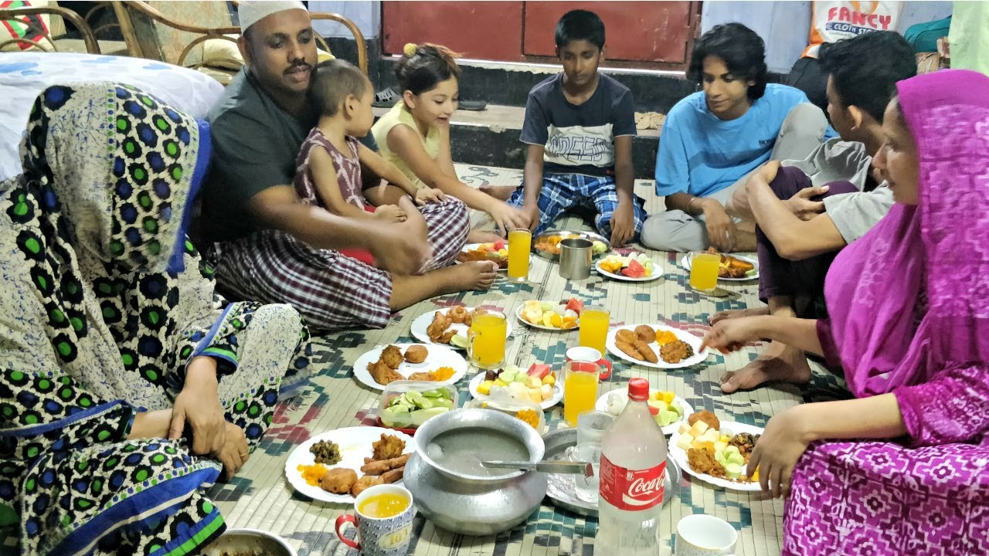

Slide 31
Do human beings have roots like the trees? The answer is ‘yes’ but unlike the roots of the trees they are invisible, they lie in our minds. It’s these roots that make a bond between us and family members, in laws, friends, neighbours or even between us and the land where we were born and grew up. In that sense our families, land of birth, relatives, our culture, traditions, or surroundings are our roots. And whereever we stay, we have a continuous pull of our roots.

Slide 32
It’s our roots that develop our identity making us what we are. When we lose that bond, we become rootless. Human beings who do not have any root or contexts, are non entity. In other words, they do not have their own identity. Such persons are devoid of values, humanity, and social responsibilities. They don’t know where they are from, and/or where they are heading towards. This often makes them feel empty and lost.

Slide 33
C Read the text in the speech bubbles. Make questions for them and then compare in pairs.
Eid is the main
religious festival of
the Muslims in
Bangladeh.
Eid means
happiness.
What is the main religious festival of the Muslims in Bangladesh ?
What does Eid mean?

Slide 34
In that sense our families,
land of birth, relatives,
our culture, traditions, or
surroundings are our
roots.
It’s our root
that develops our
identity making us
what we are.
What are our roots?
What does our root do to us?

Slide 35
E Work in pairs. Talk about these questions.
1. Do you have any root other than the place where you are living now? If yes, where is it and who are there? If not, why not?
2. How do you label your roots?
3 Do you feel any attraction or pull of your roots?
4 How do you nourish your roots?
5 What, according to you, are the reasons why people become rootless?

Slide 36
Answer:
1.Yes, I have.It is pabna.My grandparents and uncles live there.
2.I label my native village as an extreme rural village.I love this beautiful village very much as it is my birth place.
3.yes,I obviously feel a great pull of my roots.
4.I nourish my roots by keeping communication with my beloved persons living in my village.I also celebrate the festivals with them.
5.I think, People become rootless for lack of communication. The disintegration of joint families and their comeing to cities for jobs and their self centered outlook are responsible for it. It some cases poverty is responsible for it.

Slide 37
Group Work
D Fill in the grid with appropriate information from the text above.
That makes our roots | The problems of a rootless person
……………………………………… ……………………………………… ………………………………………… 4. ……………………………….......... 5. ………………………………………… | ………………………………………. ……………………………………… ……………………………………….. ………………………………………… ……………………………………………
Family bondage
No entity
Love to friends
Devoid of values
Love to in laws
Devoid of humanity
Love to neighbours
Devoid of social responsibility
Our birth and growing land
Feeling of emptiness

Slide 38

HomeWork
Write a dialogue between two friends about rode accident

Slide 39
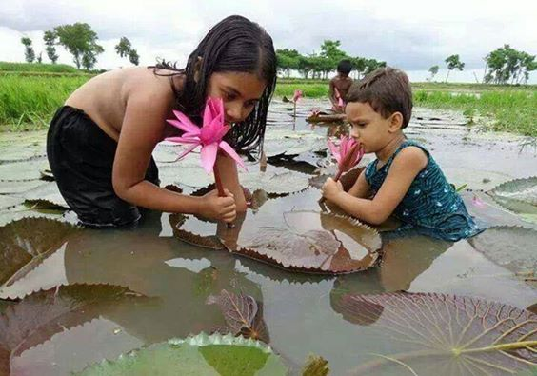
Goodbye

