Slide 1
Welcome to Today’s Class

Slide 2
Teacher
Mosammat Nelufa Afrose Bithi
Lecturer in English
Khilbaisa Rahmania Fazil Madrasah
Sadar, Lakshmipur
E-mail:nelufa.afrose@gmail.com

Slide 3
Lesson
Class- Alim/ xi/xii
Subject-English 2nd paper

Slide 4
Our today’s topic is-
Grammar practice from the ‘Luncheon’ short story.

Slide 5
Learning Outcomes
Learn Phrase and idioms.
Change the voice.
Changing speech .

Slide 6
Find out the meanings of the following idioms-
Beyond one’s means-
more than one’s budget or income.
Take someone to task-
criticize someone severely for mistake.
In answer to-
give answer to somebody’s signal using his/her finger.or hand,
Caught sight of-
to notice something only for a moment.
To keep body and soul together-
to be able to pay food, clothing, and somewhere to live.

Slide 7
Re-write the following passage in the reported speech:
I never drink anything for luncheon," she said.
"Neither do I," I answered promptly.
"Except white wine," she proceeded as though I had not spoken.
"These French white wines are so light. They're wonderful for the digestion."
Indirect Speech: She said that she never drank anything for luncheon. I answer promptly that also drank anything for luncheon. She proceeded as though I had not spoken that she never drank anything for luncheon expect white wine. She added that those French white wines were so light. She further added that they were wonderful for the digestion.

Slide 8
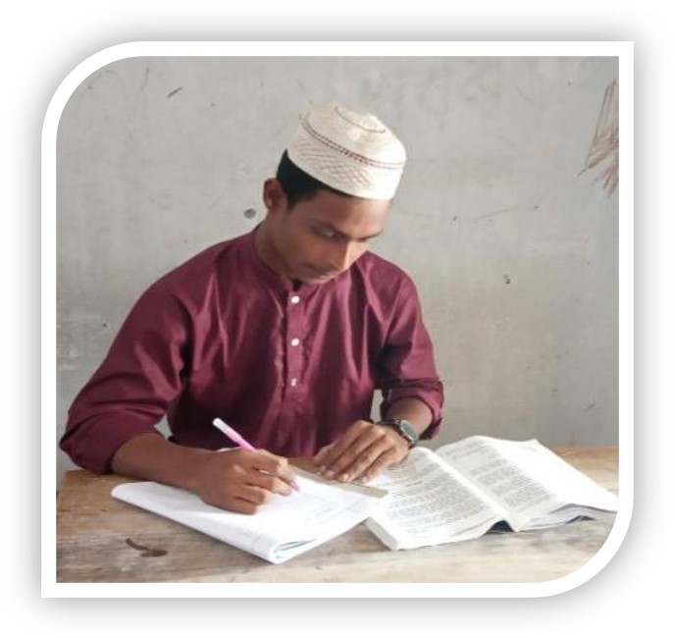
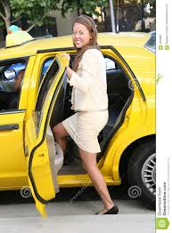
Individual Work
Re-write the following passage in the reported speech:
"Follow my example," she said as we shook hand, "and never eat more than one thing for luncheon."
"I'll do better than that," I retorted. "I'll eat nothing for dinner to-night."
"Humorist!" she cried gaily, jumping into a cab, "you're quite a humorist!"
Answer:

Slide 9
Change the Voice
1.Active voice: She addressed me brightly.
Passive voice: I was addressed brightly by her.
2.Active Voice: I gave her a lunch at Foyots.
Passive Voice: A Lunch was given at Foyots by me.
3.Active Voice: Panic seized me.
Passive voice: I was seized with Panic.

Slide 10
4.Active Voice: I never eat more than one thing.
Passive Voice: More than one thing is never eaten by me.
5.Active Voice: The smell of the melted butter tickled my nostrils.
Passive Voice: My nostrils were tickled by the smell of the melted butter.
6.Passive Voice :But I was flattered.
Active Voice : But someone flattered me.

Slide 11
Evaluation
Check the answers.
Find out the meanings of the following idioms-
By all means-
By any way.
Went over -
move forward to someone.
Cut out -
leave out.
Beyond one’s means -
Far beyond one means -

Slide 12
Pair Work
Change the Voice the following sentence:
1.Active voice: She addressed me brightly.
Passive voice:
2.Active Voice: I gave her a lunch at Foyots.
Passive Voice: .
3.Active Voice: Panic seized me.
Passive voice:.

Slide 13
Home Work
Re-write the following passage in the reported speech:
"I see that you're in the habit of eating a heavy luncheon. I'm sure it's a mistake. Why don't you follow my example and just eat one thing? I'm sure you'd feel ever so much better for it.“
"I am only going to eat one thing." I said, as the waiter came again with the bill of fare.

Slide 14
Thank You

