Slide 1
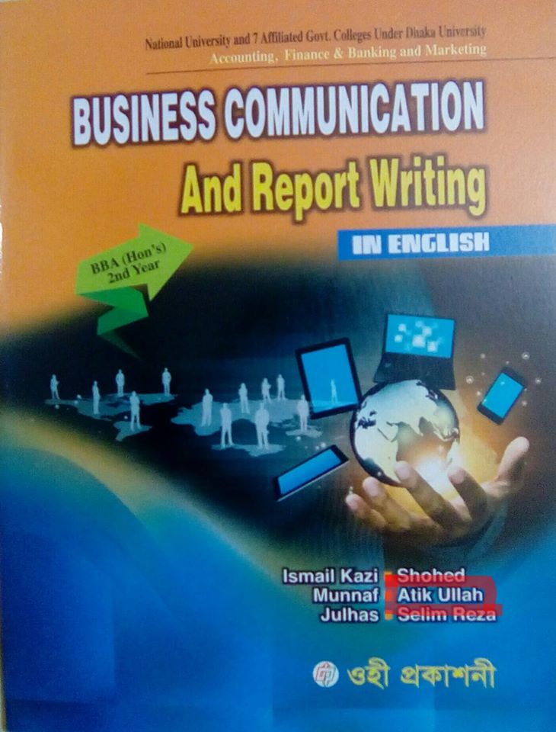
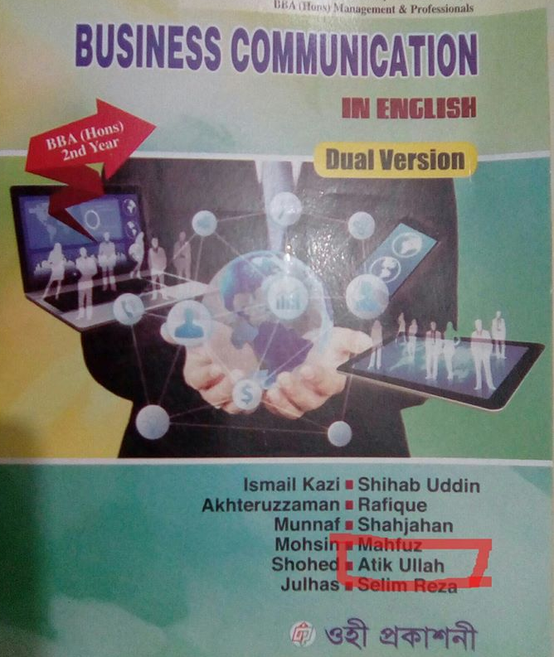
Welcome

Slide 2
Raozan Govt. College
Online Class Room
Md. Atik Ullah Chowdhury
Lecturer, Management
Co-Ordinator, Honours Course
Raozan Govt. College.

Slide 3
Business Communication
For Honours Second Year Accounting,
Management and
Twelve(BS_ Business Mgt. & Org.)
Duration : 30 Minutes
Date : 12/07/2021

Slide 4
Communication Skills (Chapter-08)
Effective listening
Reading skills
Effective writing
Writing techniques

Slide 5
listening
Listening is the ability to accurately receive and interpret messages in the communication process.
If there is one communication skill you should aim to master, then listening is it.
Listening is so important that many top employers provide listening skills training for their employees.

Slide 6
Active listening
Active listening means paying close attention to the person who is speaking to you.
Active listening is the ability to focus completely on a speaker, understand their message, comprehend the information and respond thoughtfully.
Active listeners use verbal and non-verbal techniques to show and keep their attention on the speaker.

Slide 7
Effective listening
Effective listening is much more than just hearing words. It involves understanding the full meaning of what is being said and communicating that understanding to the other person.
Effective listening means fewer errors and less wasted time.
Effective listening requires concentration and the use of your other senses - not just hearing the words spoken.

Slide 8
Effective listening Skills
Effective listening skills are the ability to actively understand information provided by the speaker, and display interest in the topic discussed.
কার্যকর শ্রোতা দক্ষতা হ'ল স্পিকারের দ্বারা প্রদত্ত তথ্যগুলি সক্রিয়ভাবে বোঝার এবং আলোচিত বিষয়ে আগ্রহ প্রকাশ করার ক্ষমতা।

Slide 9
10 Steps To Effective Listening
Step 1: Face the speaker and maintain eye contact
Step 2: Be attentive, but relaxed.
Step 3: Keep an open mind
Step 4: Listen to the words and try to picture what the speaker is saying.
Step 5: Don't interrupt and don't impose your "solutions."

Slide 10
10 Steps To Effective Listening
Step 6: Wait for the speaker to pause to ask clarifying questions.
Step 7: Ask questions only to ensure understanding
Step 8: Try to feel what the speaker is feeling
Step 9: Give the speaker regular feedback
Step 10: Pay attention to what isn't said—to nonverbal cues

Slide 11
Reading Skills
Reading skills are abilities that pertain to a person's capacity to read, comprehend, interpret and decode written language and texts.
Reading skills is the ability of an individual to read, comprehend and interpret written words on a page of an article or any other reading material.

Slide 12
How to improve your reading skills
There are a variety of ways you might improve your reading skills. You might practice speed reading to improve your fluency or make notes each time you encounter unfamiliar vocabulary. The following steps also help outline what you might do to improve and further develop your reading skills.
Set aside time to read each day.
Set reading goals.
Preview the texts you read.
Determine the purpose.
Apply key reading strategies.
Take notes while you read.
Apply what you read by summarizing.

Slide 13
6 Essential Skills for Reading Success
Here are six essential skills what can help to improve reading skill.
Decoding. Decoding is a vital step in the reading process. ...
Fluency. ...
Vocabulary. ...
Sentence construction and cohesion
Reasoning and background knowledge
Working memory and attention.

Slide 14
6 Essential Skills for Reading Success
Here are six essential skills what can help to improve reading skill.
Decoding. Decoding is a vital step in the reading process. ...
Fluency. ...
Vocabulary. ...
Sentence construction and cohesion
Reasoning and background knowledge
Working memory and attention.

Slide 15
Effective writing
Effective writing is readable — that is, clear, accurate, and concise. When you are writing a paper, try to get your ideas across in such a way that the audience will understand them effortlessly, unambiguously, and rapidly.

Slide 16
Effective writing
Effective writing is readable — that is, clear, accurate, and concise. When you are writing a paper, try to get your ideas across in such a way that the audience will understand them effortlessly, unambiguously, and rapidly.
Effective writing is clear, accurate, and concise.
The ability to express oneself well in writing that is effective writing.

Slide 17
Strategies for effective writing
Read
Target your audience
Use an outline
Open strong
Answer the 5 Ws & H
Be simple and direct
Choose strong verbs
Limit your adjectives and adverbs
Understand the three appeals
Consider using literary devices
Revise, edit and proofread

Slide 18
Achievement Test অর্জন যাচাই
What is reading?
What is writing?

Slide 19
Home Work
Difference between the following Questions:
Basic reading skill and Essential reading skill
Effective writing and good writing

