Slide 2
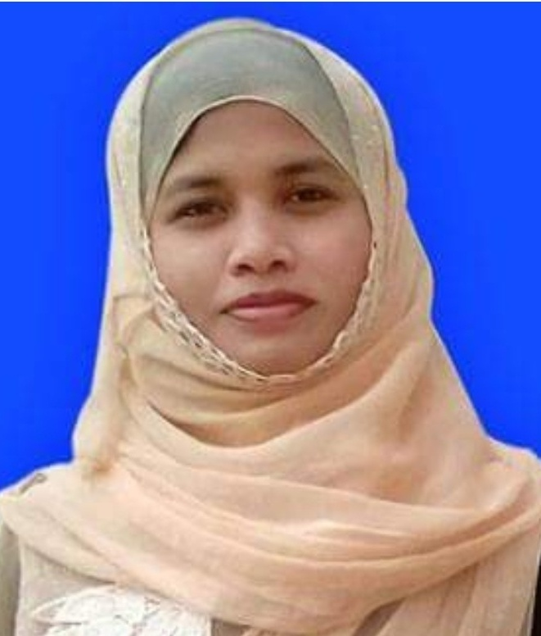
Kuhinur Jannat
Assistant Teacher
Fakirakata Govt.
Primary School
Moheshkhali, Cox’sbazar
Teachers Introduction

Slide 3
English For Today
Unit : 7
Lessons : 1-2
Activity : B
Title : Be healthy
Lesson Introduction

Slide 4
Learning Outcomes
At the end of the lesson students will be able to
Speaking :
1.1.1 say words, phrases and sentences with proper sounds and stress.
1.1.2 say sentences with proper intonation.
Reading :
1.5.1 read words, phrases and sentences in the text with proper pronunciation, stress and intonation.
1.6.1 recognize and read statements, commands, greetings, questions and answers.
1.7.1 read paragraphs, dialogues stories, letters and other texts.
5.1.3 read silently with understanding dialogues.

Slide 5
Who were talking about ice-cream?
Who was eating the ice-cream?
Which food melts quickly?
Answer the questions:

Slide 6
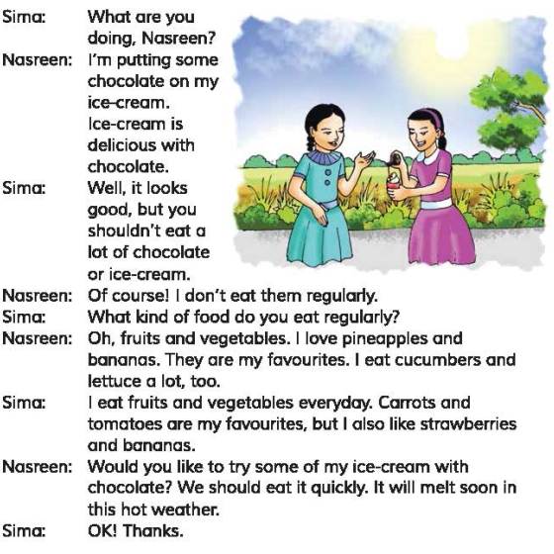
Students silent reading

Slide 7
Tell the name of the food in Activity A
Underline the foods in the dialogues in Activity A

Slide 8
Pair Work
Exchange book with your friend and look his/her book.

Slide 9
What have we learnt from the lesson?
“We’ve learnt about different food.”

