Slide 1
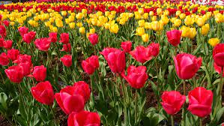
Welcome
to this
class

Slide 2
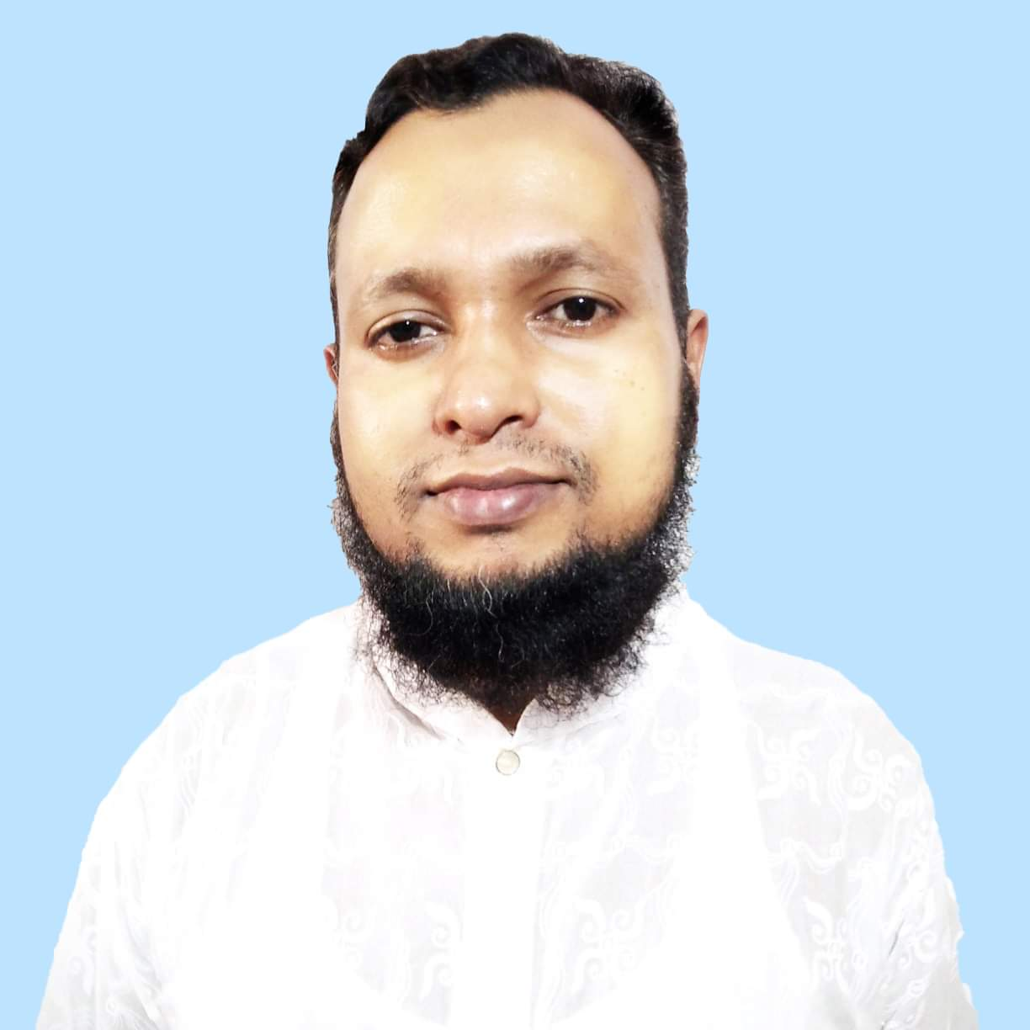
INTRODUCTION
MD. Habibur Rahman
Assistant teacher
Tilsindur Dakhil Madrasah
Barhatta-Netrakona
habib523277@gmail.com
Class: Eight
Sub:English
First-paper
Unit-5..Lesson-6

Slide 3
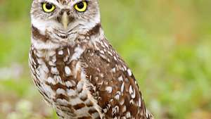
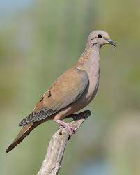
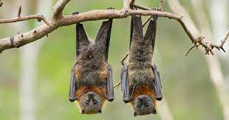
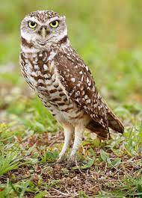
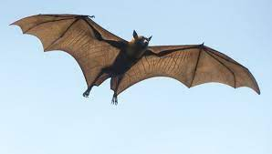
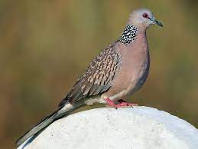
LOOK AT THE PICTURES
You said the pictures matched any text in your textbook

Slide 4
Today’s topic is
The truthful dove (2)
Unit-5-Lesson-6

Slide 5
Learning Outcomes
By the end of the lesson the learners
will be able to……..
talk about pictures
describe a situation
ask and answer questions
say/write the statements true or false

Slide 6
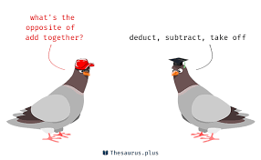
Key words
Wondering(adj)
surprising
The two birds are talking to each other in surprise

Slide 7
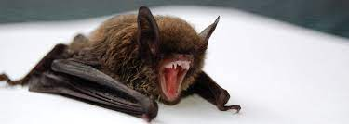
Insincere (adj)
untruthful
Bat is a liar and oppressive bird.

Slide 8
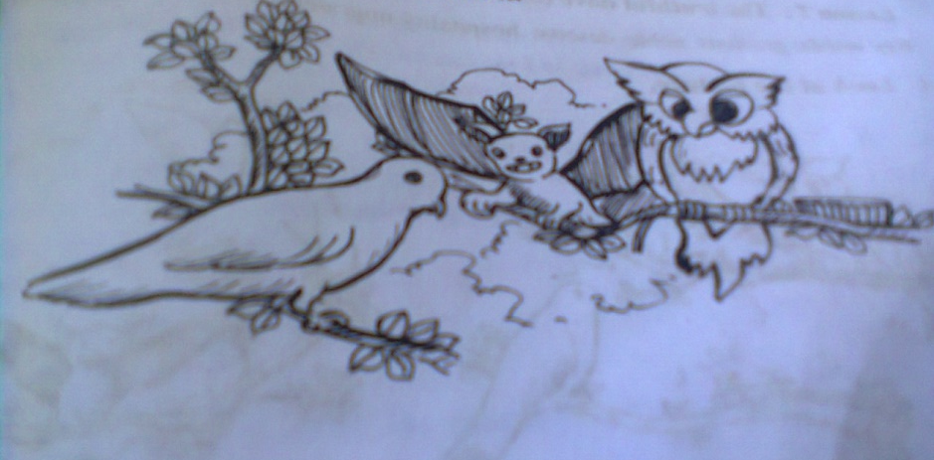
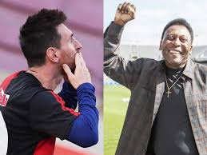
dialogue
Speech
admire
Praise(verb)

Slide 9
Pair Work: Look at the picture and talk about it .
1.What are the names of the three pictures?
2.What kind of bird is Badur?
3.What kind of bird is Gugu?

Slide 10
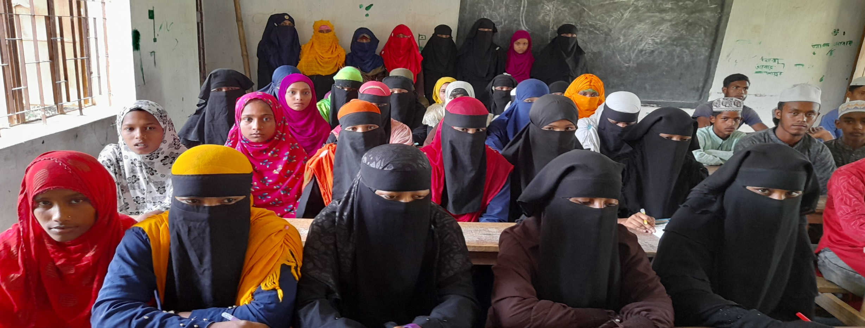
Read the text carefully in 5 minutes to your text book.

Slide 11
Group Work: look at the picture and describe the situation
The dove lifted her head slowly and said,
“Master owl, thank you
very much for the shelter you have given me, thank you for the food you have offered me . I will remain ever grateful for this.”

Slide 12
As the owl eagerly wanted to hear some admiring utterance from the dove, in this situation, the truthful dove raising its head slowly,
expressed its gratitude to the owl because it had given it the shelter and food at the time of danger.

Slide 13
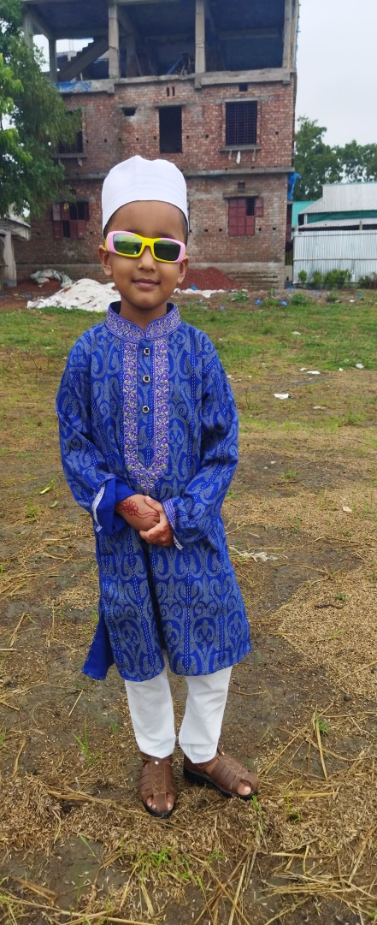
Individual Work:
Answer the following questions
1.What does the word ‘insincere’ mean in the story?
2.Why did the dove think that the bat is insincere?
3.What made the owl impatient?
4.Why was the dove ashamed of her friend?

Slide 15
a
Evaluation
True/false. If false give the correct information.
The bat was very sincere when he praised the owl.
The owl wanted to hear some good things about himself.
The dove was very harsh to the owl.

Slide 16
a
Home Work
Write a paragraph about
truthfulness

Slide 17
Thanks all

