Slide 1
To
My multimedia class

Slide 2
Introduction
Class: Five
Subject: English
Caption of the lesson: Eat healthy.
Today`s Lesson: Lessons: 4-5
Md. Faruq Hossain
Assistant teacher
Anandabash Govt. primary school.
Mujibnagar, Meherpur.
Mobile no- 01717406029
E-mail- faruqbd01@gmail.com

Slide 3
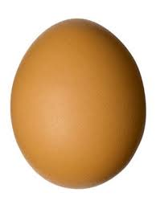
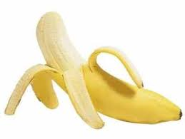
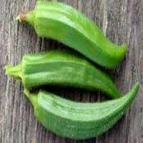
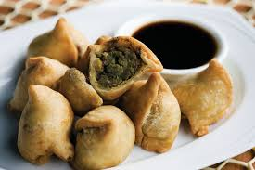
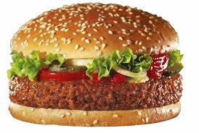
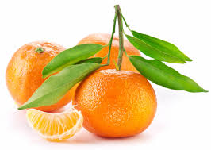
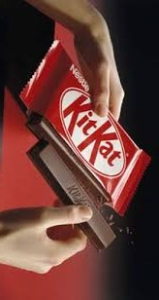
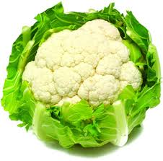
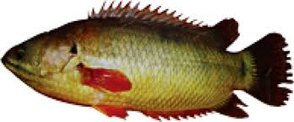
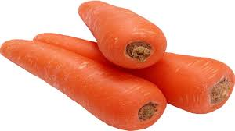
Do you know these foods?
Which foods are healthy?
Healthy foods are good for our health.

Slide 4
Today`s lesson
Eat healthy
Lessons 4-5

Slide 5
Learning outcomes
Students will be able to--

Slide 6
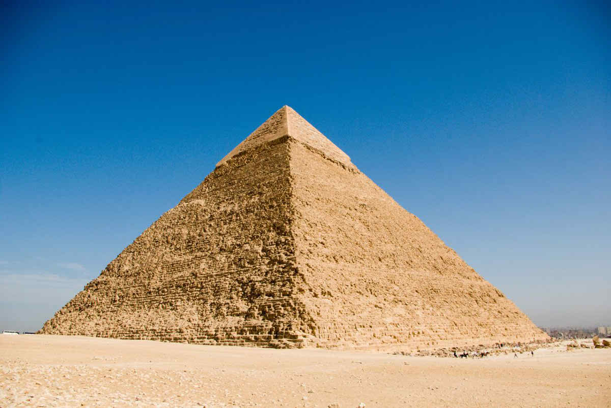
Think about the picture
What is it?
Pyramid
A solid shape standing on triangular base and ending in a point.

Slide 7
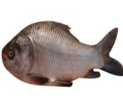
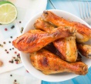
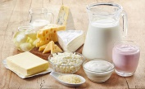
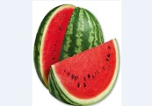
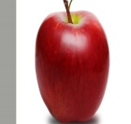
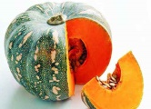
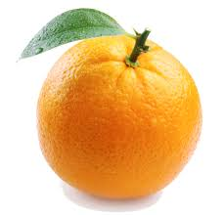
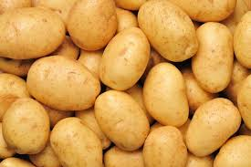
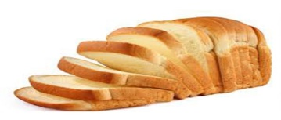
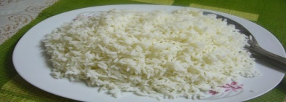
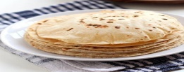
What are the name of the foods?
What is it?
fat,oil
Fish,meat,dairy,beans,lentils
fruits
vegetables
grains
The Food Pyramid

Slide 8
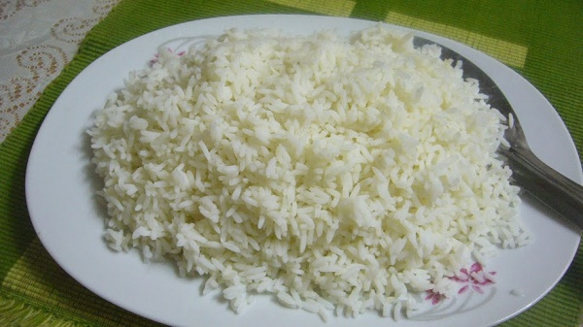
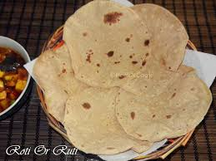
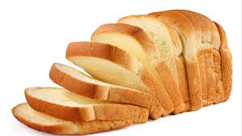
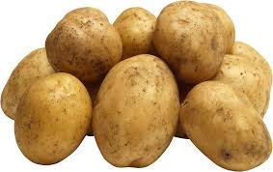
Think about the picture
What are the name of these foods?
Rice
Ruti
Bread
These are things made from grain. Grains give us energy.
Potatoes

Slide 9
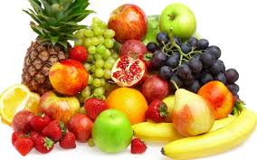
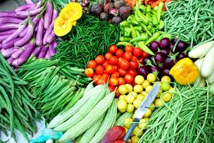
Think about the picture
What are these?
Fruits
Vegetables
Fruits and vegetables have vitamins. They help our eyes and our health

Slide 10
Group work
Answer the following questions.
Group-A: Write the name of two food items made of grain?
Group-B: Which food can help our eyes and our health?
Ans: Rice and bread are the two food items made of grain
Ans: Fruit and vegetables can help our eyes and our health.

Slide 11
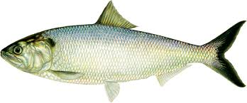
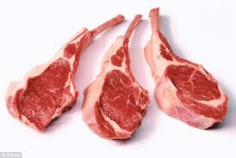
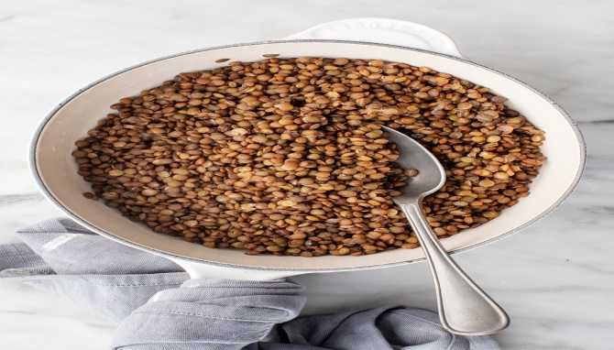
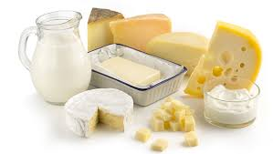
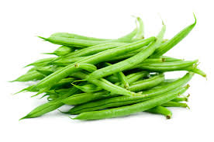
Think about the picture
What are the name of these foods?
Fish
Meat
Lentils
They have protein
Dairy products
Bean

Slide 12
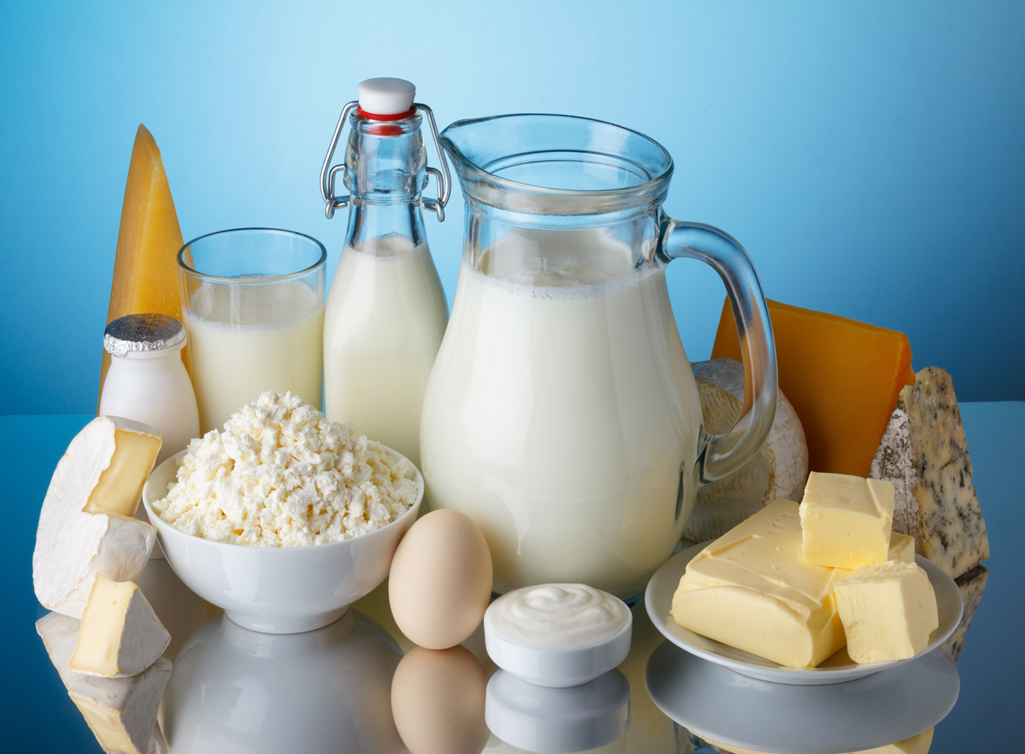
What are these called?
Think about the picture
Dairy products
They help our teeth and bones.

Slide 13
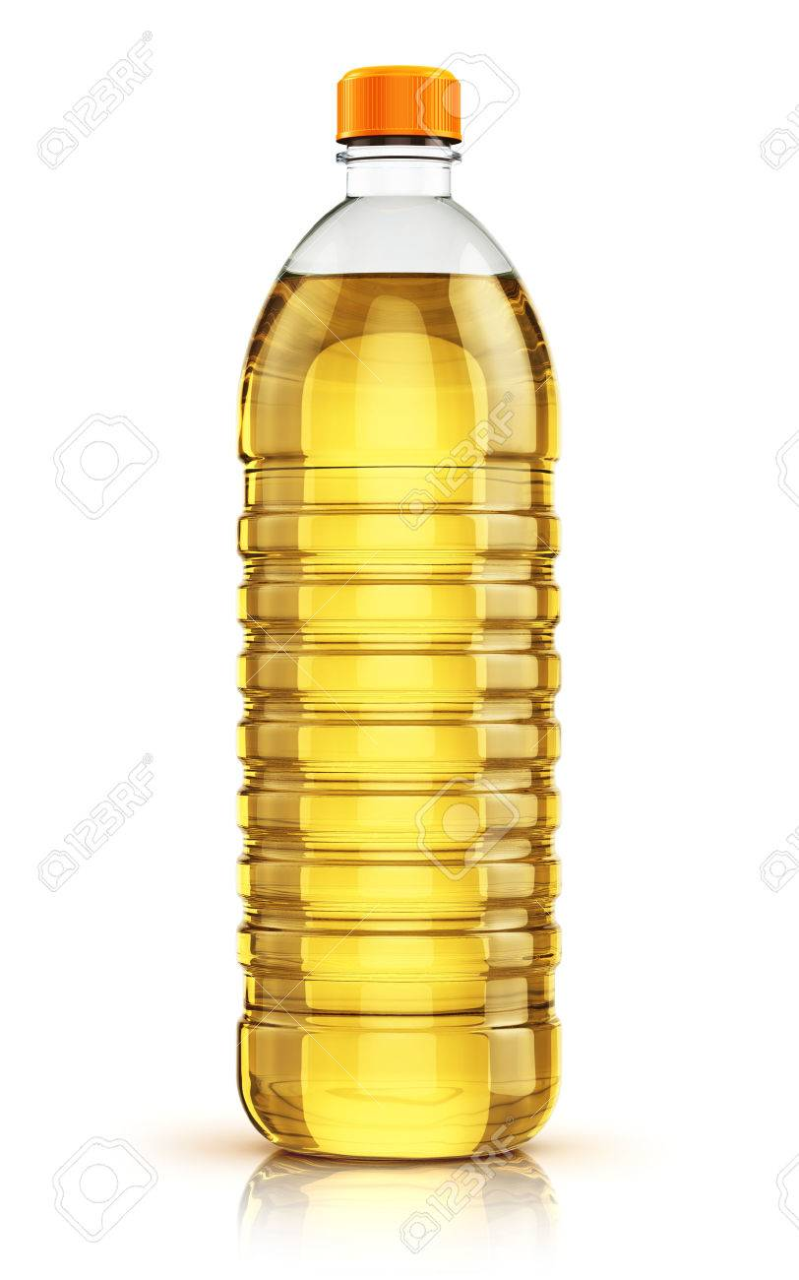
Think about the picture
What are these?
Fat
Oil
These make food delicious.

Slide 14
Pair work
Answer the following questions.
1. Which foods help our bones and teeth?
Ans: Dairy products like milk and eggs help our bones and teeth.

Slide 15
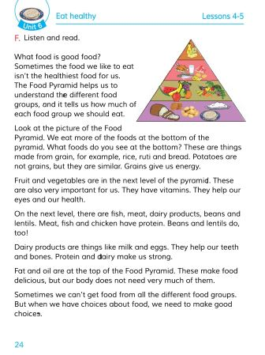
Open your english book at the page no-24.

Slide 16
Some word meanings
Picture
Next
Bread
Important
Strong
Fat
Dairy
Delicious
Choice
ছবি
পরবর্তি
পাউরুটি
গুরুত্বপূর্ণ
শক্তিশালী
চর্বি
দুগ্ধ জাতীয়
সুস্বাদু
পছন্দ/ বাছাই

Slide 17
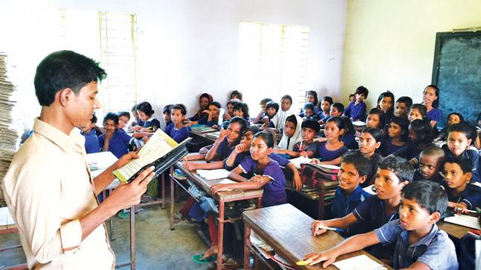
Loud reading

Slide 18
EVALUATION
Write “T” for correct statement or “F” for false statement.
1. There are four levels in the food Pyramid.
2. Eggs help our eyes.
3. Our bodies need a lot of fat and oil.
B. Answer the following questions.
1. Why should we make good choice of food?
T
F
F
Ans: We should make good choice of food because good foods contain vitamins, protein and minerals. .

Slide 19
Home work
Write a short composition on “The Food Pyramid”.

Slide 20
GOOD BYE

