Slide 1
WELCOME
WELLCOME

Slide 2
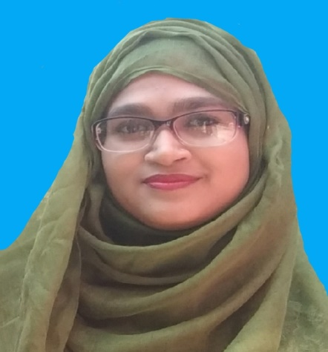
INTRODUCE
UMME SARMIN
ASSISTANT TEACHER
CORDICREE GOVT. PRIMARY SCHOOL
MULADI, BARISHAL

Slide 3
LESSON
CLASS: 1
SUBJECT: ENGLISH
UNIT: 9
LESSON: 4-6

Slide 4
LEARNING OUTCOMES
Student will be able to-
Listening:
1.1.1. beacome familiar with English sounds by listening to common English word.
Speaking:
1.1.1. repeat words, phrases and sentences after the teachers with proper sounds and stress.
1.1.2. say words, phrases and sentences with proper sound and stress.
Reading:
1.2.1. recognize and read the alphabet both small and capita. (non-cursive)
Writing:
1.1.1. to practice letter shapes/simple writing patterns, etc
1.2.1. write non-cursive capital and small letters.

Slide 5
CREATING EMOTION
LET’S ENJOY A SONG

Slide 6
PREVIOUS LESSON

Slide 7
PREVIOUS LESSON

Slide 8
TODAY’S LESSON

Slide 9
OPEN YOUR BOOK
Page no. 19

Slide 10
GOAT

Slide 11
WRITE ON YOUR BOOK WITH PENCIL

Slide 12
WRITE ON YOUR EXERCISE BOOK

Slide 13
WRITE ON YOUR EXERCISE BOOK

Slide 14
HOMEWORK
Part of the lesson will be practiced well at home

Slide 15
GOODBYE

