Slide 1
Welcome

Slide 2
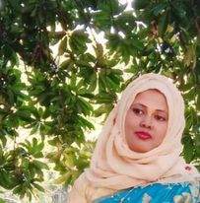
Teacher’s Introduction
Mst.Sharmin Akter
Assistant teacher
Matain Govt. Primary School
Hajiganj, Chandpur
E-mail:
mstsharminakter1985@gmail.com

Slide 3
Lesson Identity
Class : Five
Subject : English
Lesson :4-5
Unit:6
Activity : F(On…..
choice.)
Time : 40 min
A
e
r
G

Slide 4
Learning Outcomes
Student’s will be able to-
Listening:1.3.1-recognize which words in a sentence are stressed.
Speaking:1.1.1-say words and phrases and sentences with proper sounds and stress.
Reading:1.5.1-read words , phrases and sentences with proper pronunciation , stress and intonation.

Slide 5
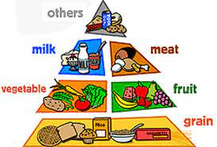
We can see here the food pyramid.
What can you see in the picture ?

Slide 6
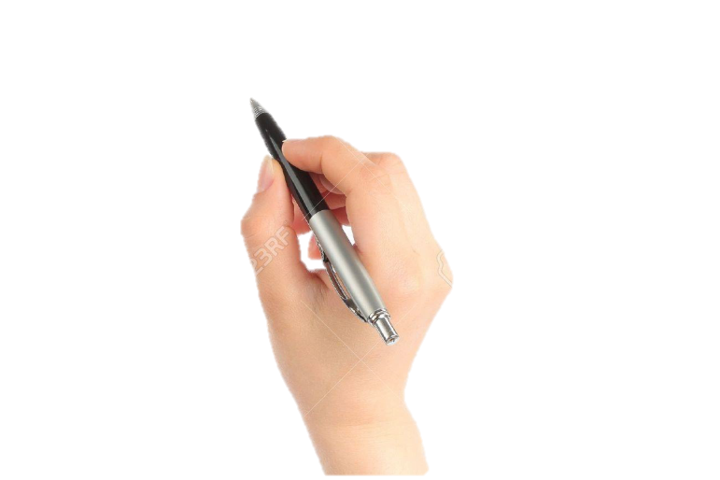
Lesson declaration
Our todays lesson is Eat healthy

Slide 7
dairy
bone
New word
product
protein
meat

Slide 8
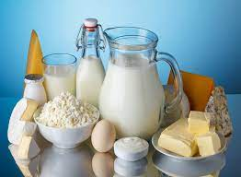
dairy
containing of milk
Dairy products are healthiest food for us.

Slide 9
product
production
Dairy products are healthiest food for us.

Slide 10
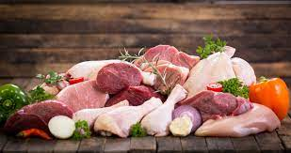
meat
flesh
Meat also a healthiest food for us.

Slide 11
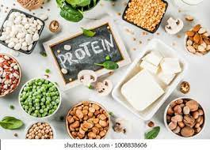
protein
albumin
Protein is good for health.

Slide 12
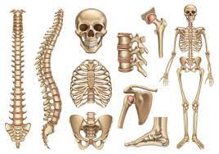
bone
skeleton
Dairy products helps our teeth and bones.

Slide 13
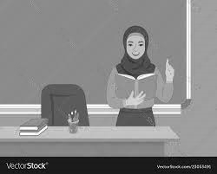
Teacher’s Reading

Slide 14
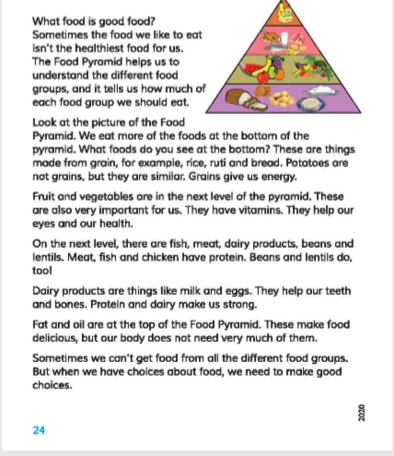
Open your book at page 24.

Slide 15
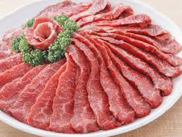
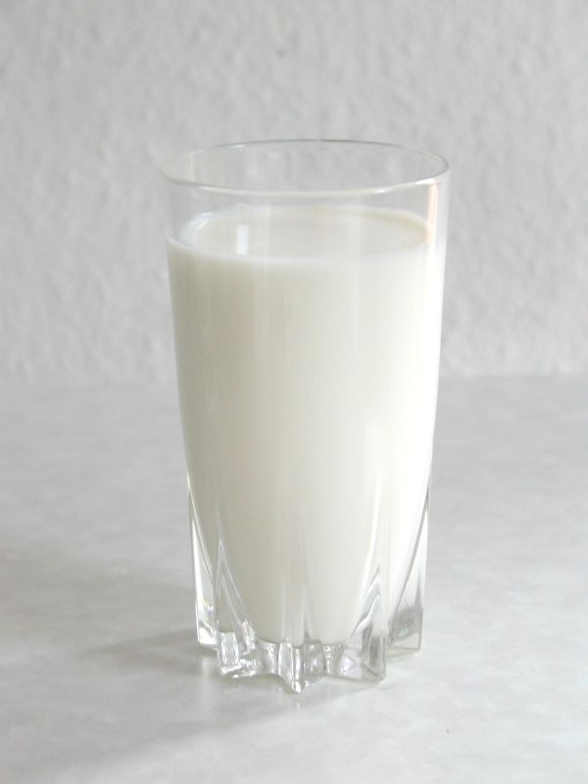
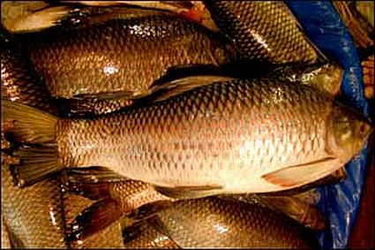
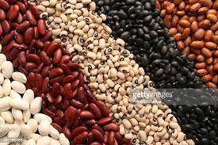
On the next level, there are fish, meat , dairy products ,beans and lentils.
Meat , fish and chicken have protein . Beans and lentils do , too!

Slide 16
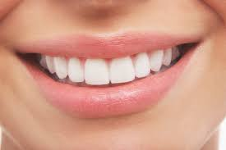
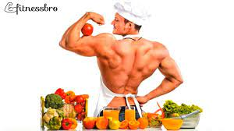
Dairy products are things like milk and eggs.
They help our teeth and bones.
Protein and dairy make us strong.

Slide 17
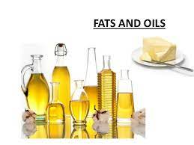
Fat and oil are at the top of the pyramid. These make food delicious, but our body does not need very much of them .

Slide 18
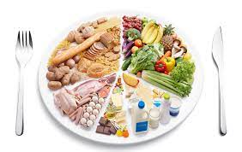
Sometimes we can’t get food all different food groups. But when we have choice about food , we need to make good choice .

Slide 19
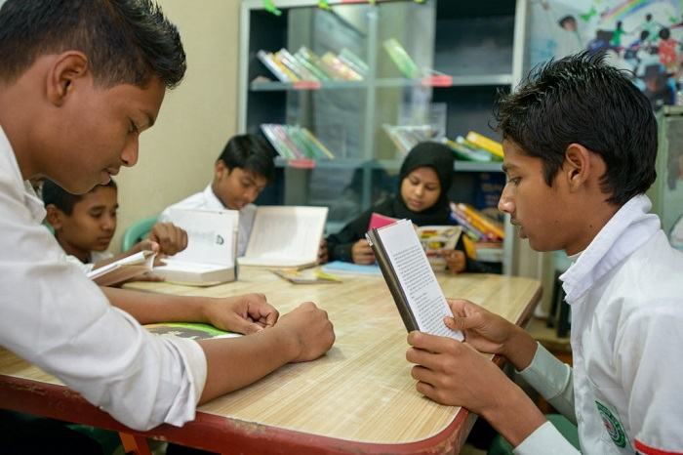
Group reading

Slide 20
Read in pair

Slide 21
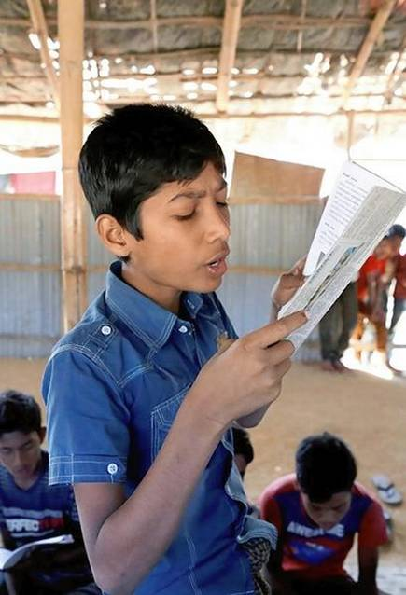
IW
Student’s reading

Slide 22
evaluation
Questions:
1.What food have protein ?
2. Why are fat and oil at the top of the pyramid ?
3. How can protein helps us ?

Slide 23
Gw.
Answers:
1.Fish , meat, dairy product , beans and lentils have protein .
2. Because our bod does not need very much of them .
3. Protein make us strong.

Slide 24
Bingo game
energy
healthiest
pyramid
meat
dairy
protein
fat
health
level
lentil

Slide 25
One day one word
product-পণ্য

Slide 26
Goodbye

