Slide 1
Welcome to my new English class

Slide 2
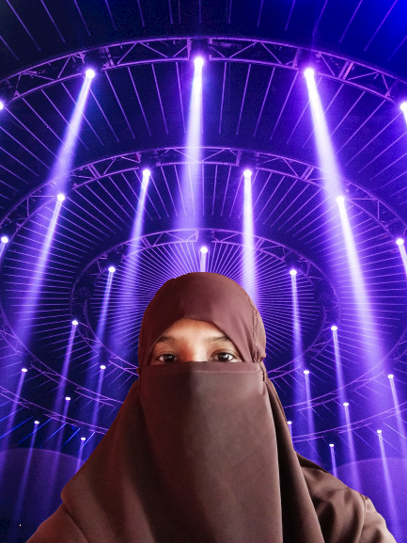
Identity
Mst. Nurani Begum
Assistant teacher
Tarapur Govt.Primary School
Sundarganj,Gaibandha.
E-mail:nuranigps88@gmail.com

Slide 3
Our today’s topic is….
Telling the time
lessons : 3-4, Act: ABC

Slide 4
Learning outcomes:
Speaking:
5.1.1 tell the time ( hours only) and mention a.m/p.m
Reading:
3.2.1 read the clock ( hours only) and mention a.m/p.m
Writing:
7.2.1 write the time ( hours only) and mention a.m/p.m

Slide 5
Word meaning
Morning
সকাল
Noon
দুপুর
Afternoon
বিকেল
Evening
সন্ধ্যা

Slide 6
Word meaning
Night
রাত
Midnight
মধ্যরাত্রি/ রাত দুপুর
Midday
দিনের মধ্যভাগ/মধ্যাহ্ন
All day
সারাদিন

Slide 7
Make sentences
Morning
I get up early in the morning
Noon
I take rest at noon
Evening
I do my homework in the evening
Midday
Do not go out at midday.
Midnight
Midnight is very dark.

Slide 8
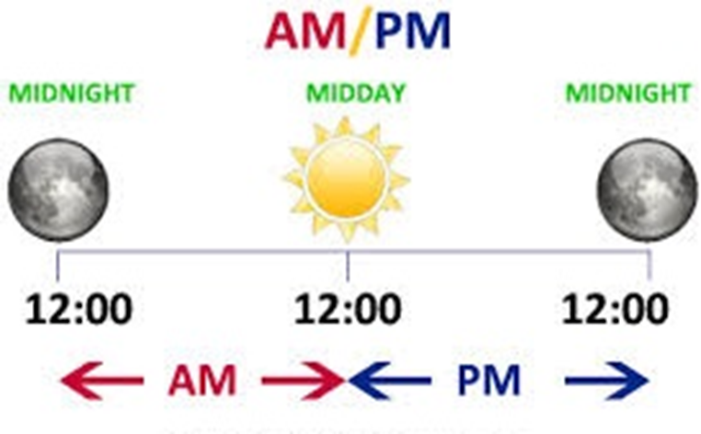
From midnight until midday, we use a.m.
From midday until midnight, we use p.m.

Slide 9
Ante meridiem
(দুপুরের পূর্বে)
AM
PM
Post meridiem
(দুপুরের পরে)

Slide 10
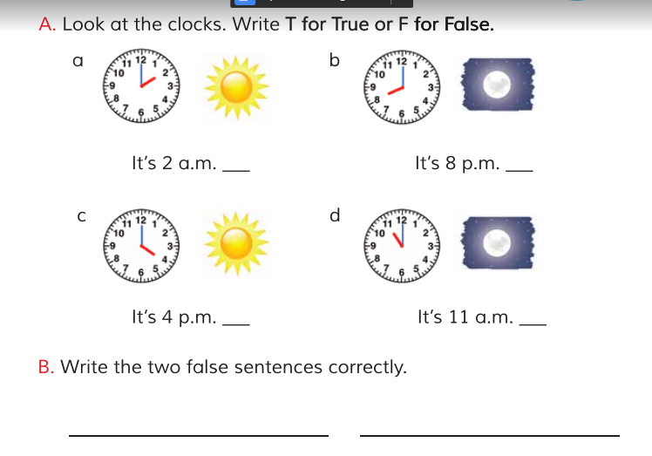
F
T
T
F
It’s 2 p.m.
It’s 11 p.m.

Slide 11
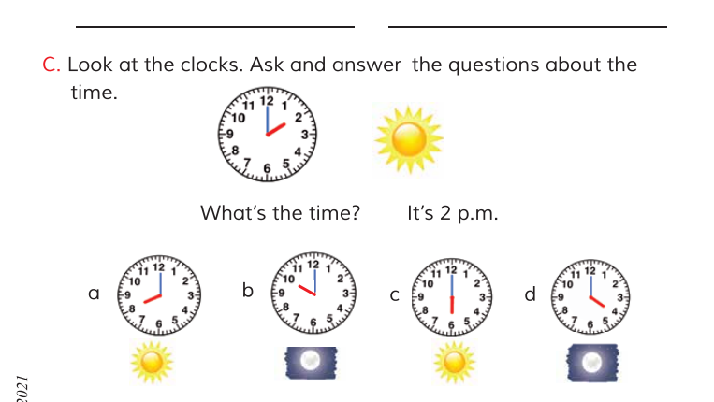
It’s 8 a.m.
It’s 10 p.m.
It’s 6 p.m.
It’s 4 a.m.

Slide 12
Answer the questions
When do you get up?
I get up at 6 a.m.
When do you have breakfast ?
I have my breakfast at 7 a.m.
When do you go to school ?
I go to school at 10 a.m.

Slide 13
Answer the questions
When do you come back home ?
I come back home at 4 p.m.
When do you do your homework?
I do my homework at 7 p.m.
When do you go to bed ?
I go to bed at 10 p.m.

Slide 14
Good bye for today

