Slide 1
WELCOME

Slide 2
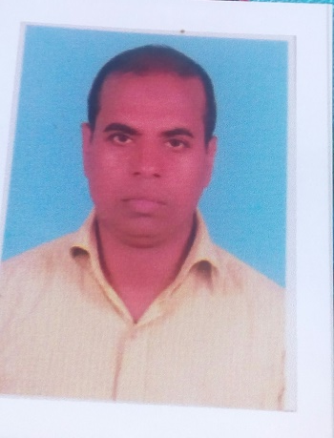
IDENTITY
Mohammad Shafiqul Islam
Lecturer in English
Sreechail Mohammad pur Islamia Alim Madrasha
Daudkandi,Cumilla
Sub-English Grammar and Composition
Class-Alim

Slide 3
WARMING UP
Read the following words-
Allow Permit
Happy Glad
Honest Just
What type of grammatical item is indicated by the above words?

Slide 4
So, today’s topic name-
Use of ‘Synonym’

Slide 5
LEARNING OUTCOME
In this lesson the students will be able-
To say the rules of ‘Synonym’
To use the uses of ‘Synonym’

Slide 6
*Synonym is a word or expression that has the same or almost the same meaning as another.The parts of speech of the synonym words must be
same.
See the following examples-
Noun | Belly-stomach | Disaster- catastrophe | Present-gift | Sunrise-dawn
Verb | Buy-purchase | Answer-reply | Speak-talk | Provide-supply
Adjective | Big-large | Correct-right | ill-sick | Stable-steady
Adverb | Quickly-speedily | Abroad- overseas | Fast-quickly | Highly-extreamly
Preposition | On-upon | Above-over | Below-under | With-including
Conjunction | And-plus | Because-since | But-yet | If-provided
Interjection | Hello-hi | No-nope | Yes-yeah | Hurrah-hooray

Slide 7
Synonym will be determined according to the definite meaning of a word.Synonym has to be used according to the type of a sentence.Forexample,pupil has two meaneaning.Such as-
1.Star(the part of eye)
2.Student

Slide 8
EVALUATION
Write the synonyms of the following word-
1.Accept 2.Acquire 3.Beautiful 4.Benefit 5.Capture 6.Choose 7.Close 8.Debt 9.Employ 10.Fear
ANSWER
1.Receive/take 2.Achieve/gain 3.Nice/handsome 4.Profit/help 5.Arrest/catch 6.Select/pickup 7.Stop/shut 8.Due/liability 9.Engage/hire 10.Fright/panic

Slide 9
HOME WORK
Write the synonyms of the following words-
1.Assist 2.Ancient 3.Ban 4.Battle 5.Chief 6.Clear 7.
Dialogue 8.Displease 9.Eager 10.Err 11.Fate 12.Fun-
Mental 13.Glad 14.Glee 15.Hope 16.Hear 17.Idle 18.
Imperial 19.Importance 20.Just 21.Joke 22.Justice
23.Kidnap 24.Kind 25.Labour 26.Less 27.Legal 28.
Make 29.Might 30.Need

Slide 10
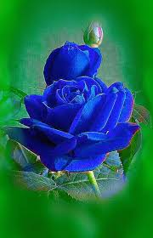
THANK YOU ALL

