Slide 1
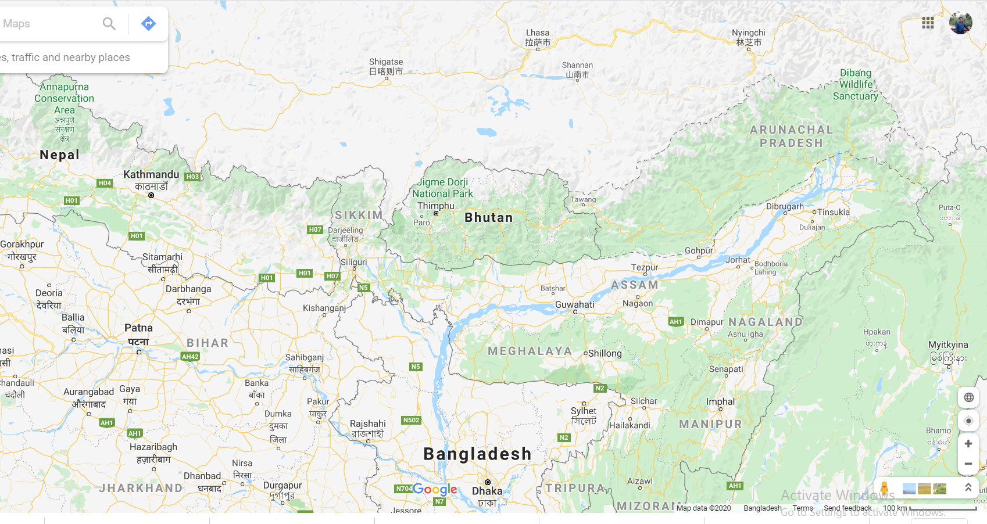

Slide 2
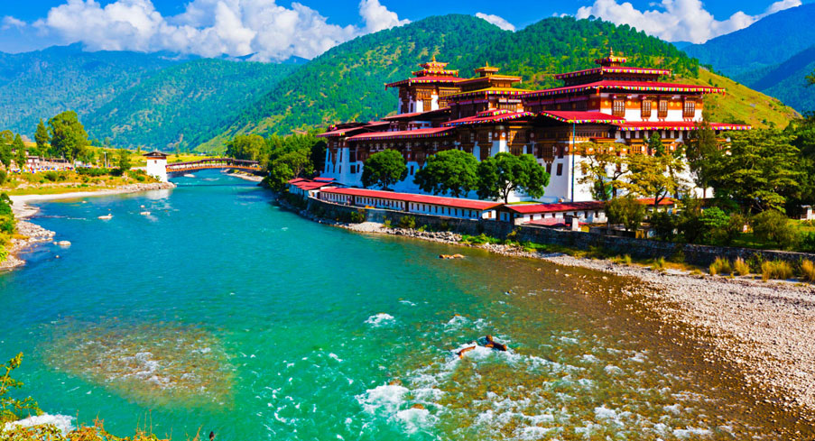
You are welcome.

Slide 3
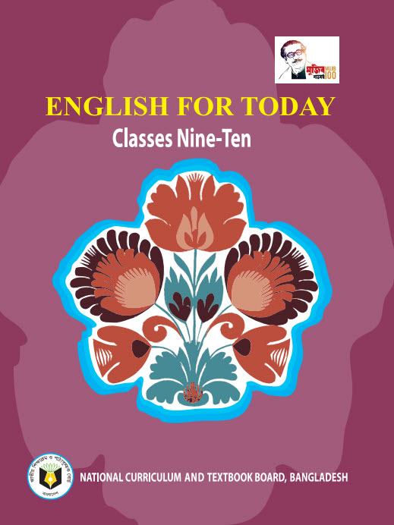
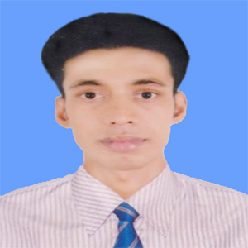
INTRODUCTION
Swandip Banerjee
Assistant Teacher (English)
Pallimangal Secondary School, Khulna.
swandipb1@gmail.com
Mobile: 01718-503573

Slide 4
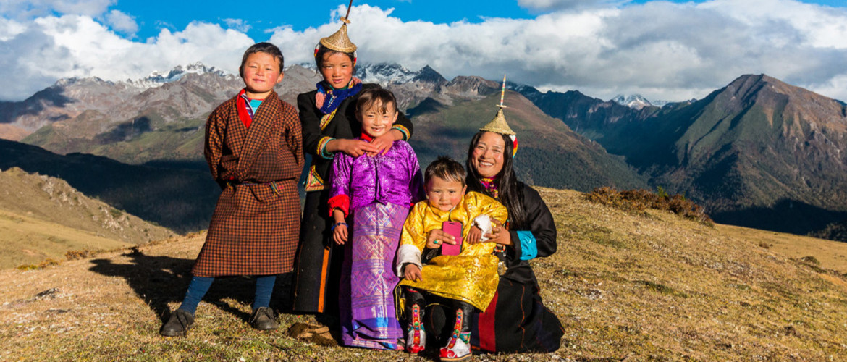
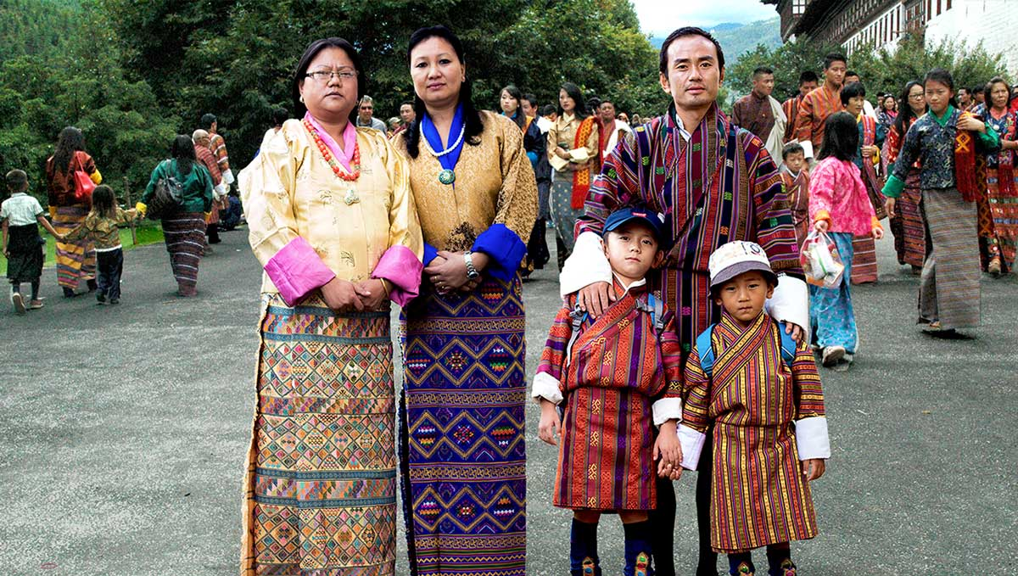
A: Look at the pictures.

Slide 5
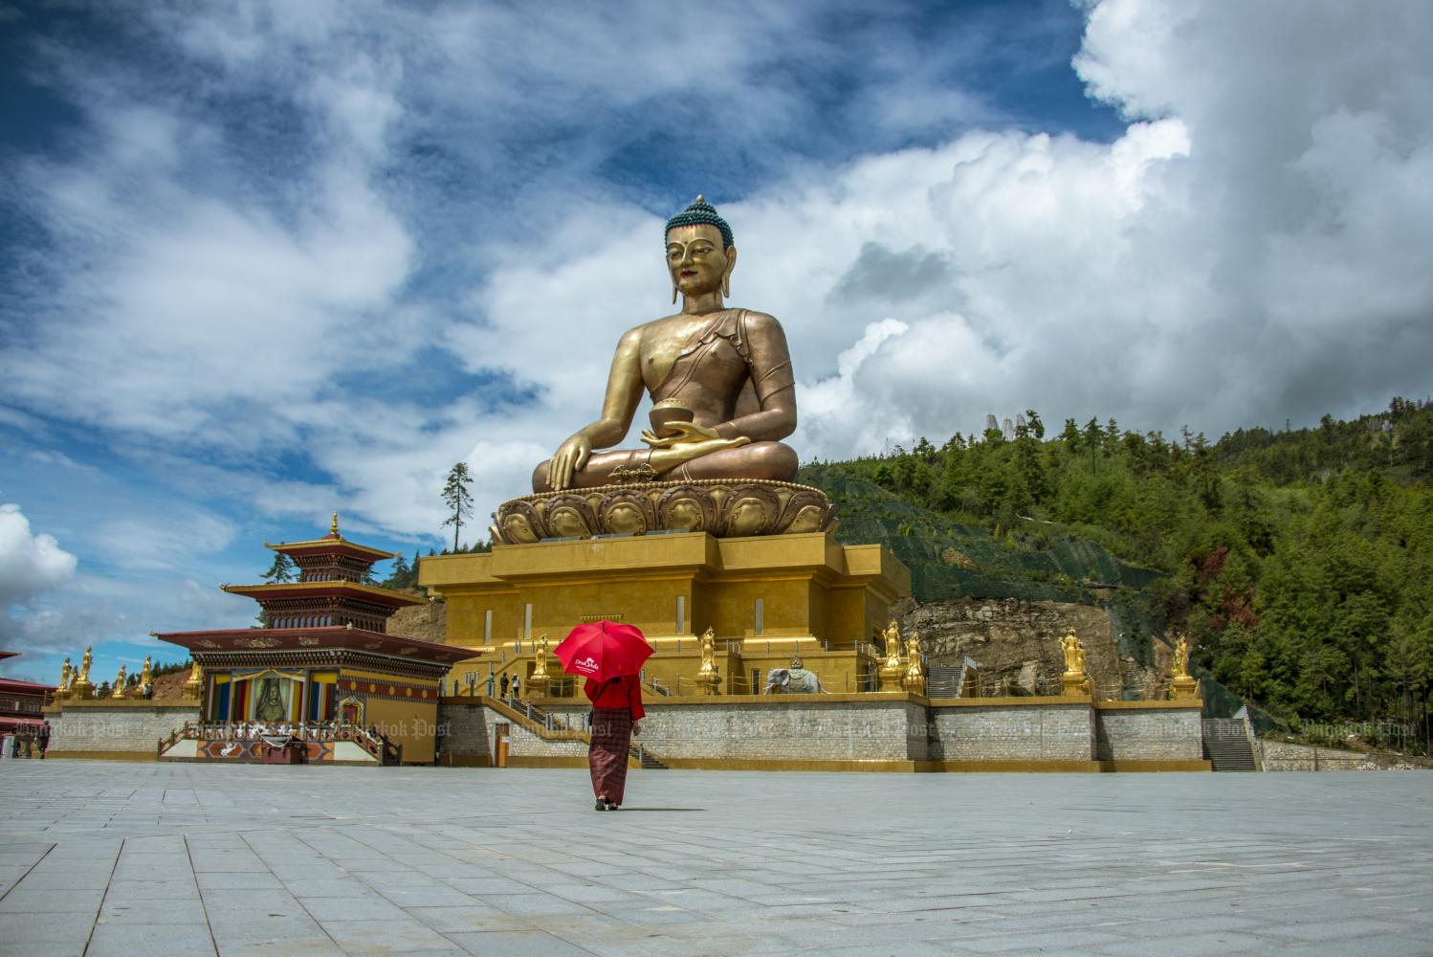
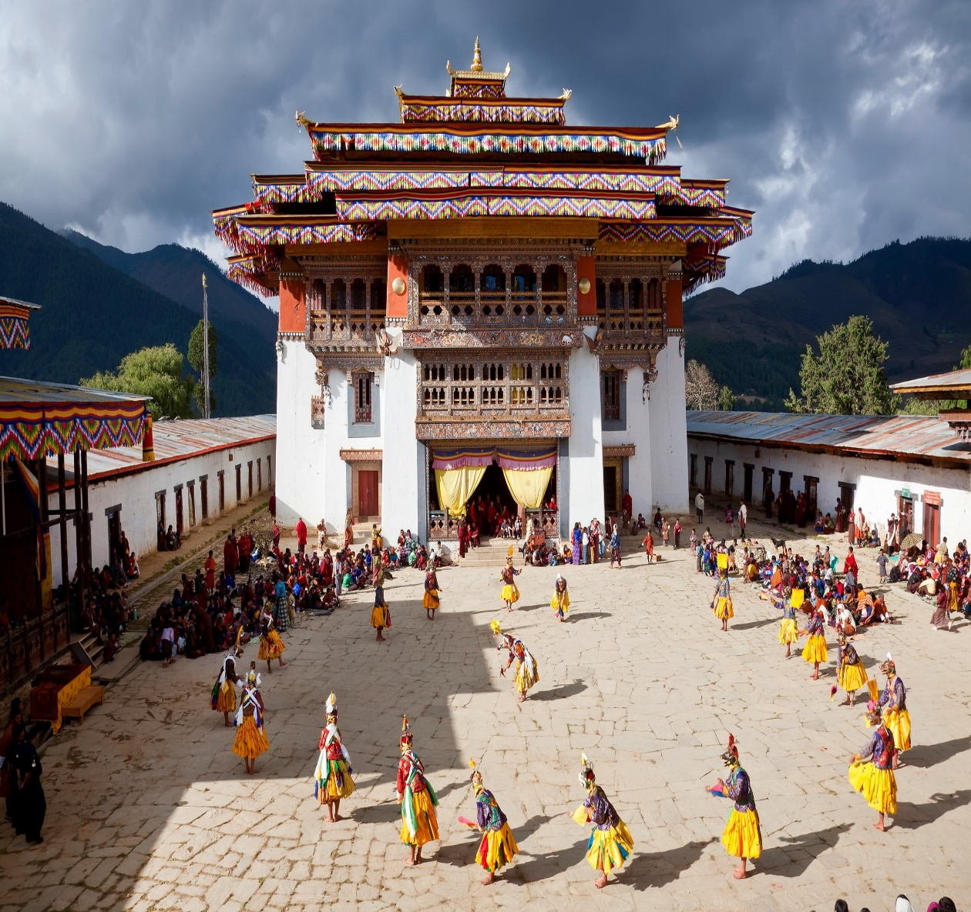
A: Look at the pictures.

Slide 6
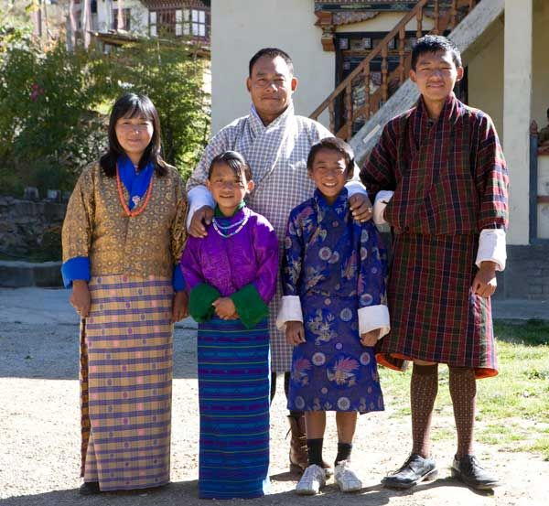
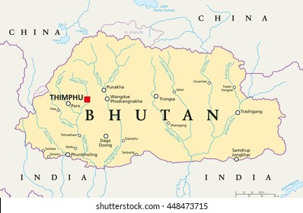
A: Look at the pictures.

Slide 7
Bhutan : The Land of Happiness
Our today’s topic of the class is………..???
Unit : Six
[ Our Neighbours ]
Lesson : 05

Slide 8
Learning outcomes
After we have studied this lesson, we will be able to……
read, comprehend and summerise texts.
ask and answer questions.

Slide 9
New word
Thunder
The loud noise that follows a flash of lightning.

Slide 10
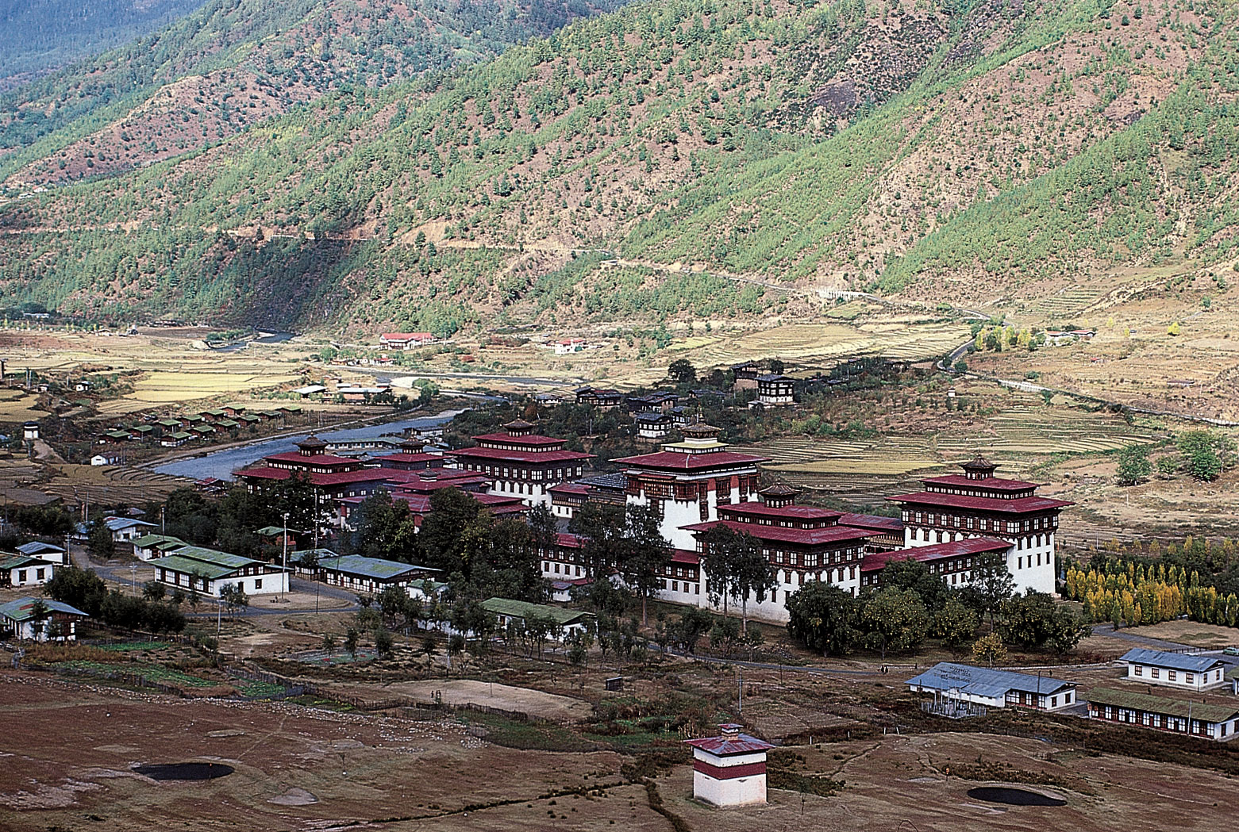
New word
Slope
Side of hill or mountain or a surface or piece of land that is high at one end and low at the other.

Slide 11
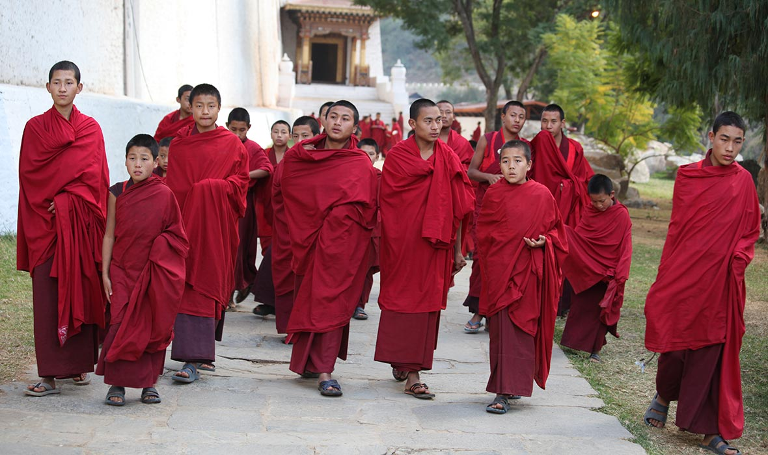
New word
Monk
A member of a group of religious men living apart from other people

Slide 12
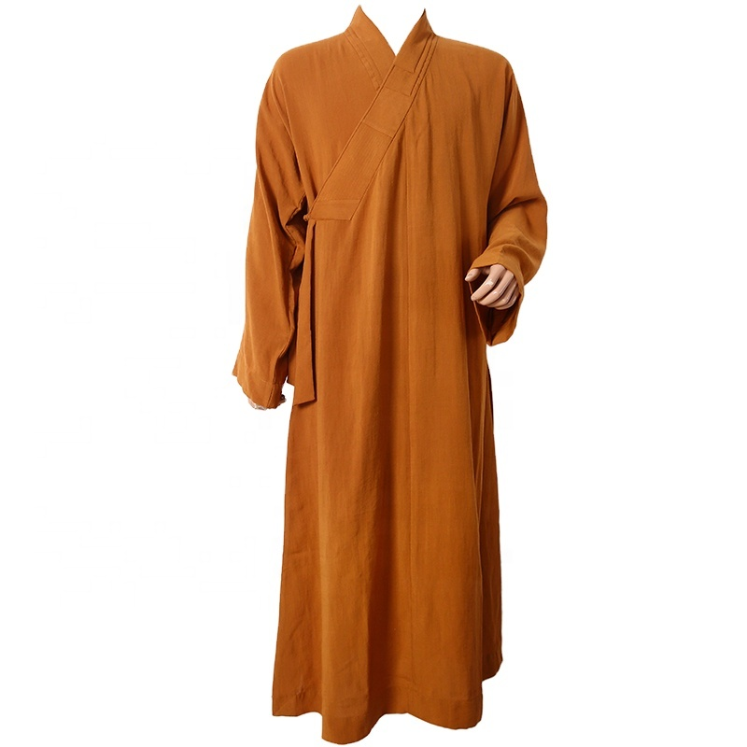
New word
Robe
A long loose outer garment.

Slide 13
A. Read the following text and answer the questions.
Bhutan is called the Jewel of the Eastern Himalayas. This small, landlocked country is located along the southern slopes of the Himalayan range, bounded by Tibet in the North and India from the other sides. The official name of Bhutan is Druk-yul which means ‘land of the thunder dragon’. It earned this name because of the fierce storms that often roll in from the Himalayas. The country has an area of 38,394 and a population of 716,896. Since it is cut off from the rest of the world by the Great Himalayas, a unique culture and tradition based on gentle Buddhist beliefs have evolved over time. Bhutanese men wear Gho-a knee length robe - and women wear Kira - a sheet like cloth piece. Bhutanese houses are built from mud and stone, with wooden shingle roof.

Slide 14
The Bhutanese never use iron nails in their buildings. Usually, the Bhutanese build each other's houses by exchanging labour within the community. Different Festivals are celebrated all year round in Bhutan. The festivals reflect colourful masks and the rich Bhutanese culture. Dances are performed by the Buddhist monks to protect the valleys and ward off evil spirits. The main religious festival is called Tshechus. The teachings of Lord Buddha are enacted through mask dances for threefive days in the courtyard of the monasteries. People attend these events in their best clothes, with picnic baskets. Another major festival is called Losar. It is celebrated on Lunar New Year. People cook special dishes and wear new clothes. It is a time for family get together. Men play archery or darts while women sing and dance.

Slide 15
Pure mountain air, crystal blue skies and pristine vegetation cover have made this small country an ideal destination for the environment lovers. The ecosystem of this small nation supports the existence of rich flora and fauna which are protected by strict laws. Even, anyone found guilty of killing a black-necked crane could be sentenced to life in prison. The government of Bhutan has taken a number of steps to protect its biodiversity. Bhutan is the first country in the world with specific constitutional obligations on its people to protect the environment. As per the constitution, at least 60 percent of the country must remain under forest cover at all times. Efforts are also taken to protect the nation against the intrusion of foreign cultures and values. The first foreign tourists were allowed into Bhutan in 1974. Now, tourism is encouraged but is controlled and limited to about 6,000 visitors a year.

Slide 16
Bhutan is one of the last countries in the world to introduce television and the Internet to its people. The government lifted a ban on TV and the Internet only in 1999. The Bhutanese government has made it mandatory for all Bhutanese to wear only their national dress in public.
Finally, the most interesting fact about Bhutan is that they are the only country that measures success in Gross National Happiness rather than Gross National Product! In 2006, Business Week rated Bhutan as the happiest country in Asia and the eighth happiest country in the world.

Slide 17
B: Choose the most suitable answer for each of the questions below.
1. A unique culture and tradition has evolved in Bhutan because
a) fierce Himalayan storms often hit the country.
b) it is cut off from the other parts of the world.
c) it has a very small area.
d) it is called the Jewel of the Eastern Himalayas.
2. Bhutanese houses are built from
a) mud, stone, woods with iron nails.
b) a sheet of cloth and wooden roof.
c) mud and stone with wooden roof.
d) bamboo and wood.
b) it is cut off from the other parts of the world.
c) mud and stone with wooden roof.

Slide 18
3. Which of the following activities is mentioned as a way of celebrating Losar.
a) cooking special dishes and wearing new clothes
b) playing chess and badminton
c) having a trip to the neighbouring households
d) harvesting crops
4. As per the constitutional obligation imposed by the Bhutanese government,
a) 60% of the country must remain under forest cover.
b) foreign nationals are not allowed to visit Bhutan still now.
c) no citizen can use the Internet in their houses.
d) people must always wear traditional Bhutanese clothes.
a) cooking special dishes and wearing new clothes
a) 60% of the country must remain under forest cover.

Slide 19
5. The progress of Bhutan as a nation is measured by
a) Gross National Income.
b) Gross National Happiness.
c) Gross National Product.
d) Per Capita Income.
b) Gross National Happiness.

Slide 20
Evaluation
C: Answer the following questions.
What is Gho?
2. What is the main religious festival of Bhutan?
When is Losar celebrated?
4. What do the people of Bhutan do during Losar?

Slide 21
Home Work
C. You read about some countries. Which one do you like? Make a chart adding more information to it.

Slide 22
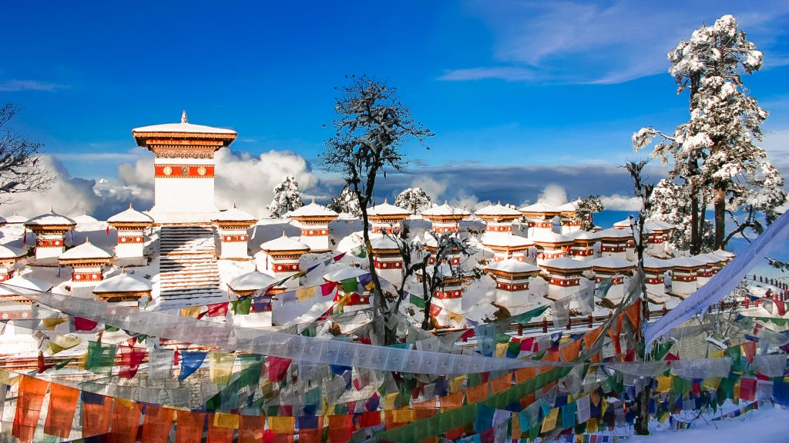
Thank you all.

