Slide 1
Welcome to Multimedia Class

Slide 2
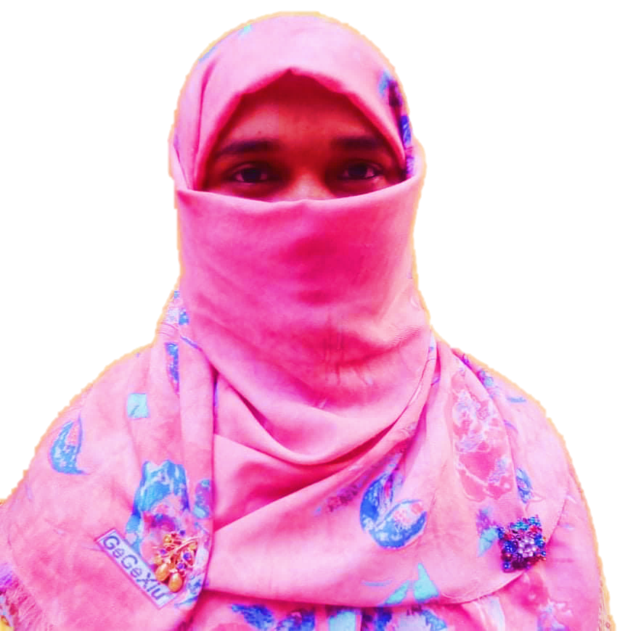
Mosammat Nelufa Afrose Bithi
Lecturer in English
Khilbaisa Rahmania Fazil Madrasah
Sadar, Lakshmipur
E-mail:nelufa.afrose@gmail.com
Class- Alim/ xi/xii
Subject- English For Today
(English 1st paper)

Slide 3
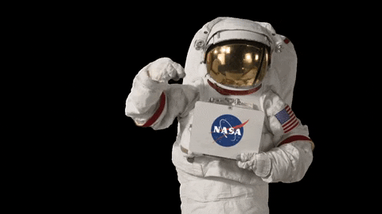
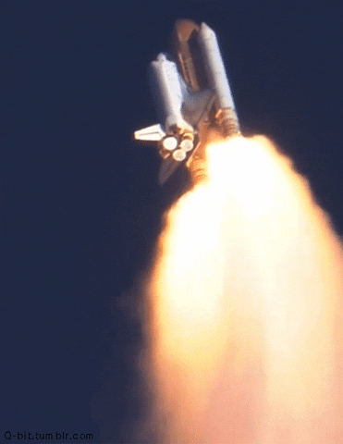
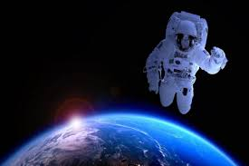
Look at the Pictures below -
The pictures are about space and astronauts.
What are the pictures?

Slide 4
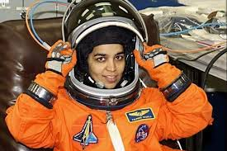
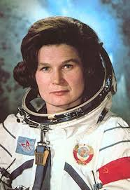
Let's watch another two pictures-
Who are they?
Do you Know them?
Valentina Tereshkova
Kalpana Chawla

Slide 5
Our today’s topic is-
Can you guess what may be the topic today?
Two Women
Part-2
Kalpana Chawla.
Unit-1:People or Institutions Making History
Lesson: Three.

Slide 6
Learning Outcomes
After finishing the lesson, the students will be able to -
Learn new words from the text.
Know about the biography of astronaut Kalpana Chawla.
Understand the lesson.
Write about Kalpana Chawal by questions and answer.

Slide 7
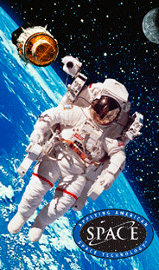
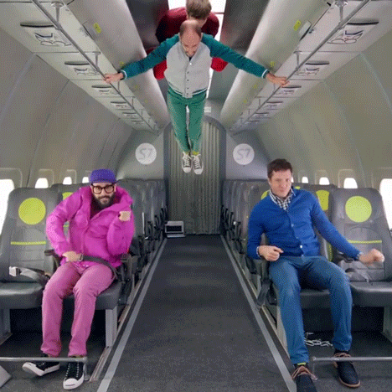
New words from the text.
Astronaut-
Cosmonaut. A person who has been trained for travelling in space.
Weightless-
the state of having no weight.
New words

Slide 8
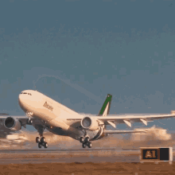
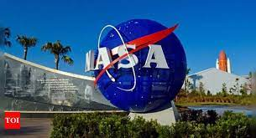
Take-off-
the movement when an aircraft leaves the ground and begins to fly.
NASA-
NASA stands for National Aeronautics and Space Administer. It was started in1958. It is a USA government agency that works for the civilian space program as well as aeronautics , scientific discovery, Earth and aerospace research.
New words

Slide 9
Disaster- Misfortune.
Ill-fated-Unlucky.
Fatal-very serious.
Intense-very strong.
Sub-continent – a large area of land that is part of a continent.
Malfunction- inability to work or operate correctly.
Penetrate- to move into or through something.
Launch- an event to celebrate something new.
New words

Slide 10
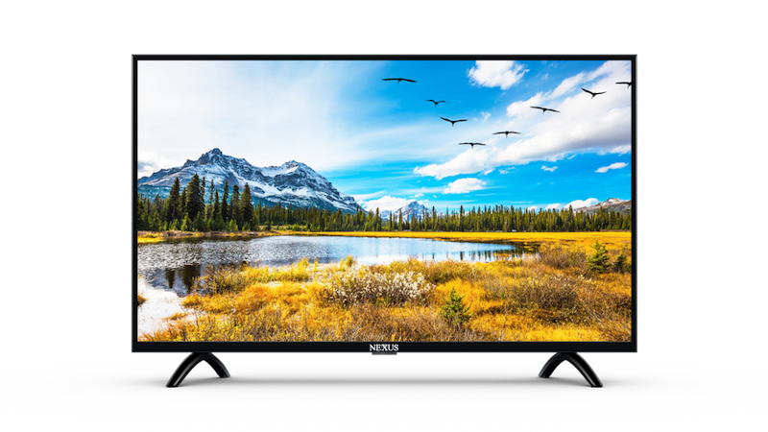
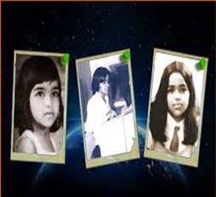
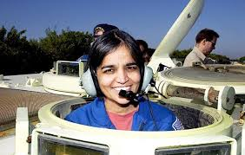
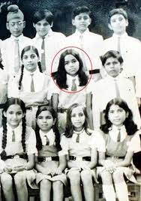
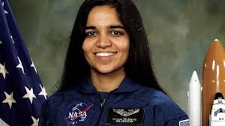
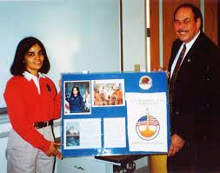
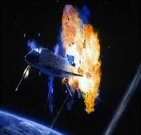
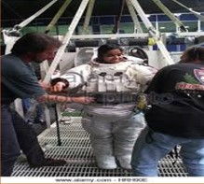
Biography of Kalpana Chawla
Kalpana Chawla 17 March 1962- 1 February 2003.
Biography

Slide 11
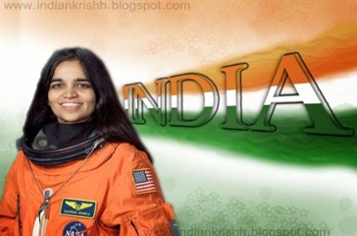
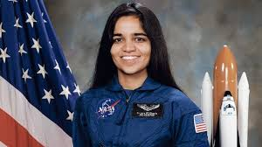
Nationality
Chawla was born in Karna, India.
In 1982 Chawal moved to the United State. In 1991 she got U.S. Citizenship.
She is the first Indian-born woman and the second person in space from this sub-continent.
Biography

Slide 12
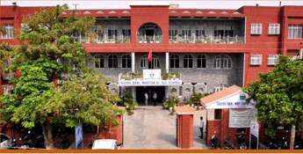
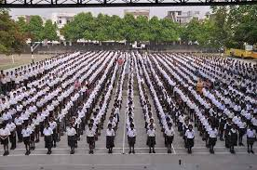
Chawal’s Education
Tagore Baal Niketan Senior Secondary School
Kalpana Chawla completed her early schooling at Tagore Baal Niketan Senior Secondary School, Karnal.
Biography

Slide 13
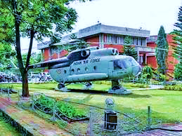
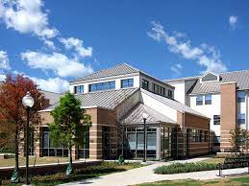
Chawal’s Education
Panjab Engineering College
University of Texas
In 1982, Kalpana Chawla graduated in Aeronautical Engineering from Panjab Engineering College, India.
Kalpana Chawla obtained her Master’s degree in Aerospace Engineering from the University of Texas in 1984.
Biography

Slide 14
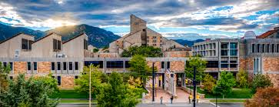
Chawal’s Education
University of Texas
Kalpana Chawla did her Ph.D. in Aerospace Engineering in 1988 from the University of Colorado.
Biography

Slide 15
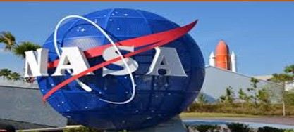
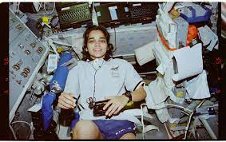
Chawla’s Career.
Determined to became an astronaut, Chawla joined NASA as vice president in 1988.
She started her career as a NASA astronaut in 1995.
Biography

Slide 16
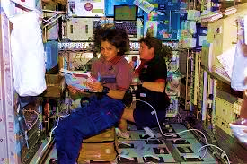
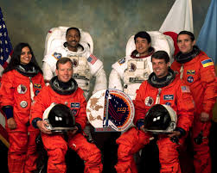
Chawla’s Career.
Kalpana Chawla was selected for her first flight in 1996.
Her first space mission began on 19 November 1997 with six other astronauts on the space Shuttle Columbia and this mission lasted for 15 days, 16 hours, 34 minutes and 4 second.
She travelled 6.5 million miles as many as 252 times around the earth.
Biography

Slide 17
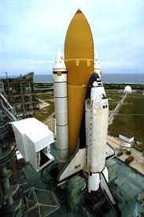
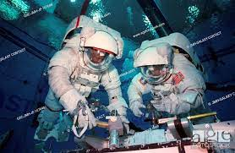
Chawla’s Career.
In her first space mission Chawla’s responsible was to deploy the Spartan Satellite but she failed to do it successfully.
Winston Scott and Tako Doi had a spacewalk to retrieve the Spartan Satellite.
Biography

Slide 18
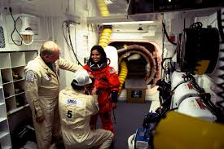
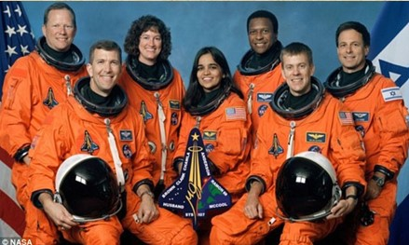
Chawla’s Career.
In 2000 Kalpana Chawla was selected for her second space mission STS 107.
On 16 January 2003, Kalpana finally started her new mission with six other space crew on the ill-fated space shuttle Columbia.
Biography

Slide 19
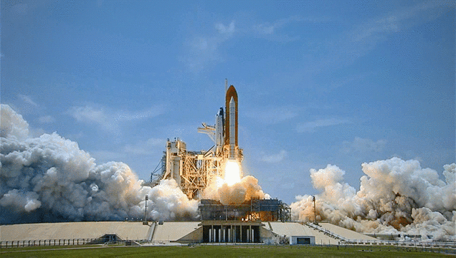
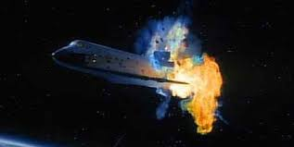
Disaster
Accident happened because of the damage in one of Columbia’s wings caused by a piece of insulating foam the external fuel tank peeling off during the launch.
Biography

Slide 20
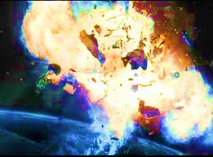
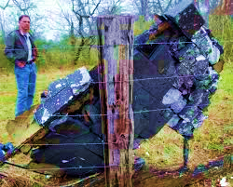
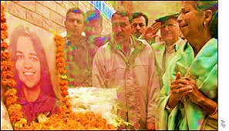
Death
All the crew in Columbia including Chawla died only 16 minutes prior to their schedule landing.

Slide 21
Individual Work
Write five events what is happening in Chawla’s life.

Slide 22
Kalpana Chawla (17 March 1962 - 1 February 2003)
Chawla was born in Karnal, India. She completed her earlier schooling at Tagore Baal Niketan Senior Secondary School, Karnal. She is the first Indian-born woman and the second person in space from this sub-continent. After graduating in Aeronautical Engineering from Punjab Engineering College, India, in 1982, Chawla moved to the United States the same year. She obtained her Masters degree in Aerospace Engineering from the University
of Texas in 1984. Later she did her Ph.D. in Aerospace Engineering in 1988 from the University of Colorado.
Determined to become an astronaut even in the face of the Challenger disaster 1986 that broke apart 73 seconds into its flight, leading to the deaths of its seven crew members, Chawla joined NASA in 1988. She began working as a Vice President where she did Computational Fluid Dynamics (CFD) research on vertical take-off and landing.
In 1991 she got U.S. citizenship and started her career as a NASA astronaut in 1995. She was selected for her first flight in 1996. She spoke the following words while travelling in the weightlessness of space. You are just your intelligence”. She had travelled 10.67 million miles, as many as 252 times around the Earth.
Read from the textbook.

Slide 23
Choose the best answer from the alternative-
i) Shuttle” means-----
a) bus b) space-ship c) truck d) steamed
ii) “Scheduled” stands for ----
a. routine b. programmed c. routineness d. program
iii) “Retrieve” denotes-----
a. regain b. remark c. remorse d. regain
iv) The term “external” refers to
a. exterior b. internal c. interior d. important
v) What is meant by “launch”--- .
a. sending a spaceship into space b. sending a launce into space
c. launching weapons d. launching boat
Ans. b) space-ship
Evaluation
Ans. a) routine
Ans. d) regain
Ans. a) exterior
Ans. a) sending a spaceship into space.

Slide 24
Answer the following questions.
a)What happened to the fate of Kalpana Chawla ?
b)What was the cause behind the accident?
c)Who died in that mishap?
d) Why has the space shuttle Colombia been called ill-fated?
e) What is the duration of Kalpana’s first mission in space?
Pair Work

Slide 25
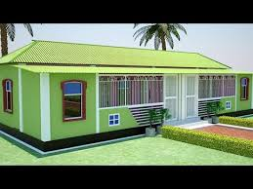
Home Work
Write a summary of the passage “Kalpana Chawla”

Slide 26
Thank you

