Slide 1
গ
ত
স্বা
ম

Slide 3
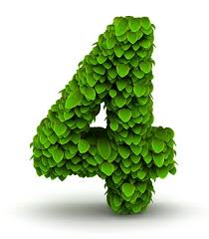
5m
25$m^{2}$
16

Slide 7
$$a^{2}$$
×
=
$$a$$
$$a$$
2cm
$${2cm}^{2}$$
2 cm
2 cm
×
$${4cm}^{2}$$
=
1 cm

Slide 8
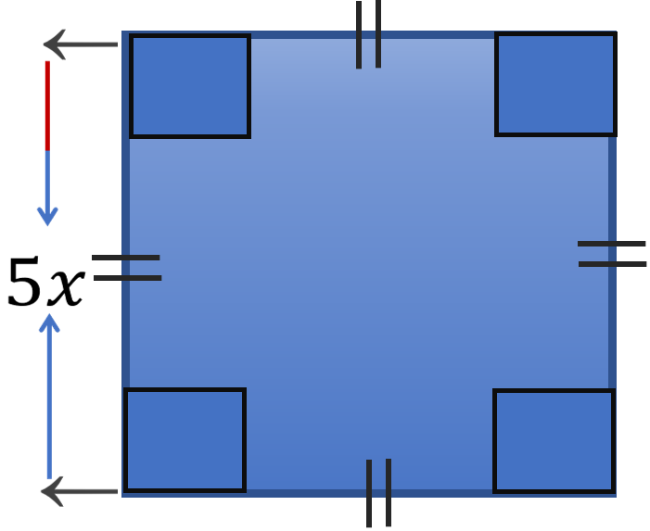

Slide 9
=${\left(5x\right)}^{2}cm$
=${25x}^{2}cm$
(Ans)

Slide 10
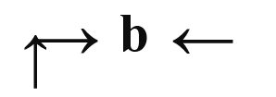
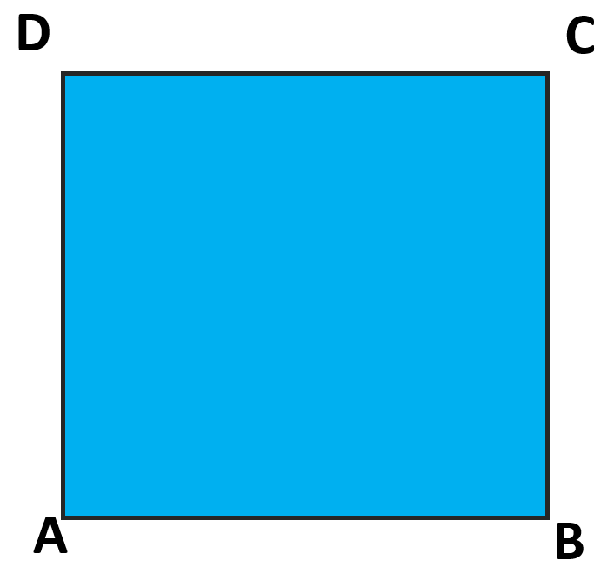
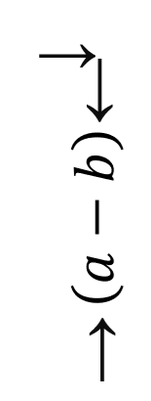
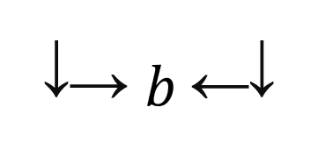
$$F$$
$$F$$
T
T
S
$$O$$
$$P$$
R
$$E$$

Slide 11
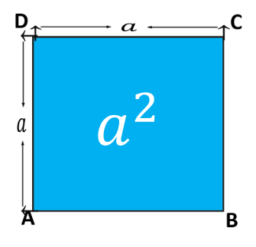
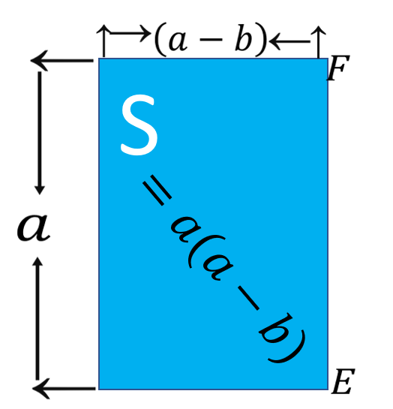
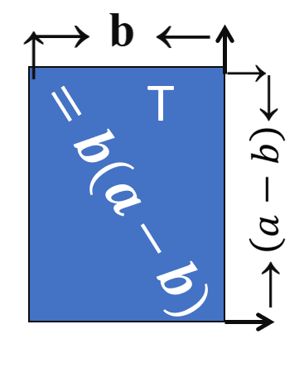
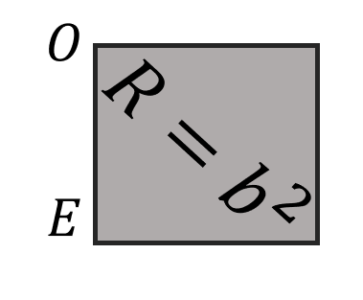
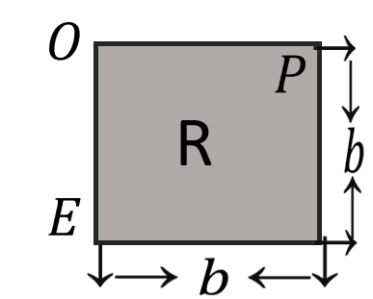
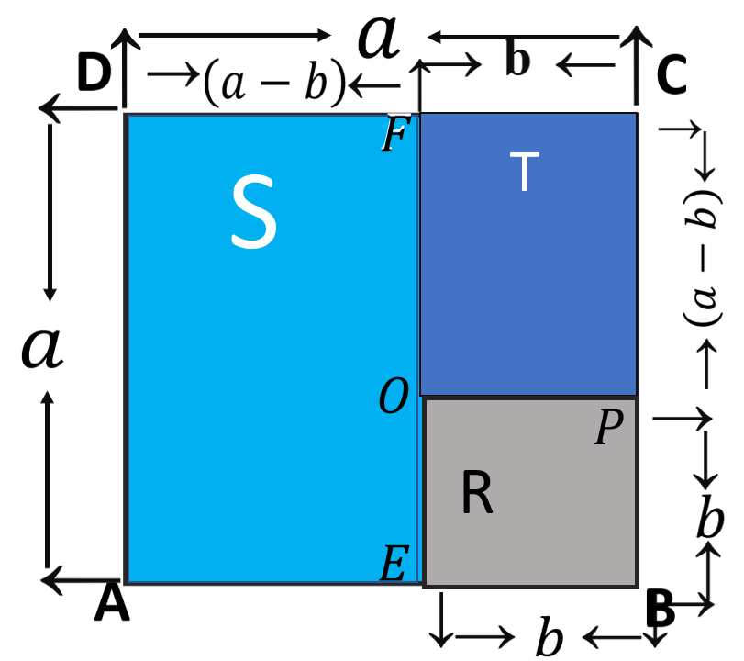
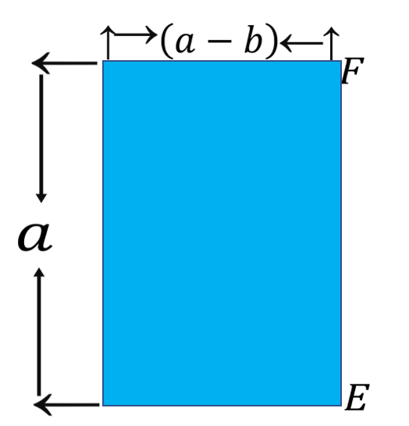
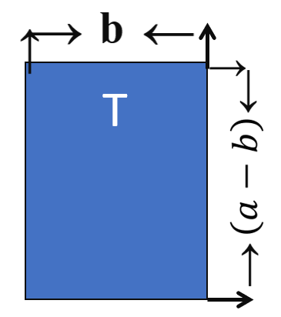
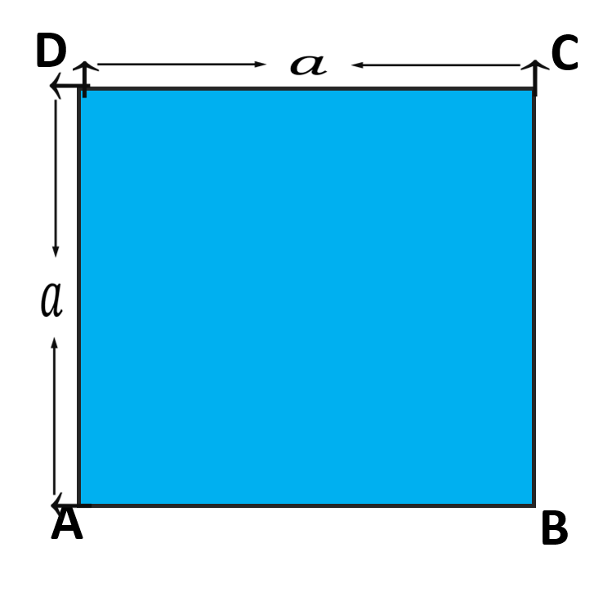
T
$${⸫a}^{2}−b^{2}=a\left(a−b\right)+b(a−b)$$
$$a^{2}−b^{2}=\left(a−b\right)(a+b)$$
$$=b(a−b)$$
$$a^{2}$$
$$=a(a−b)$$
Notes:
এই স্লাইডটি এ্যানিমেশনে দেখতে হবে।

Slide 13
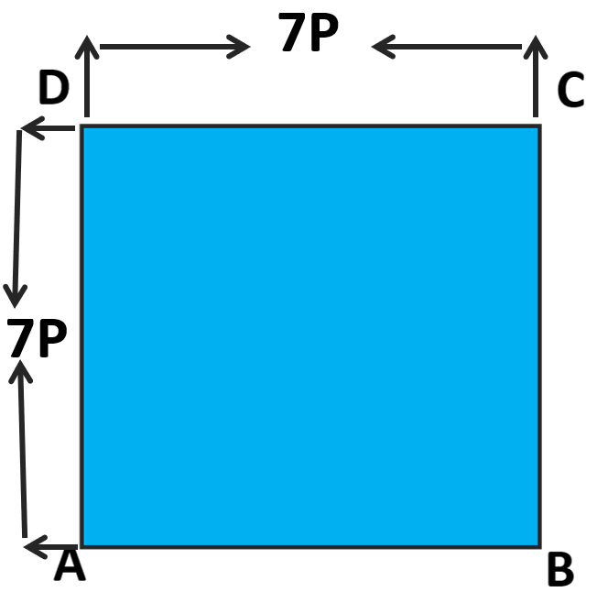
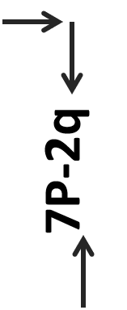
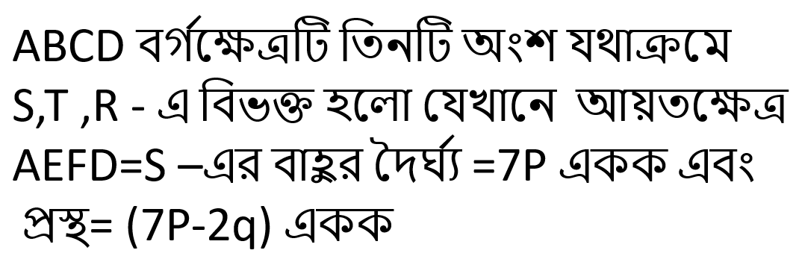
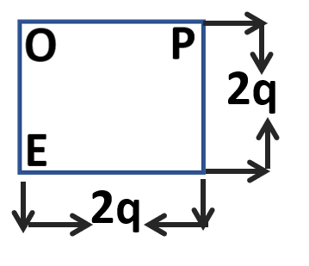
T
S
R

Slide 14
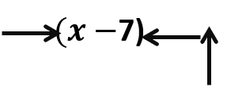
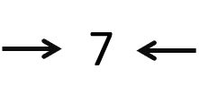
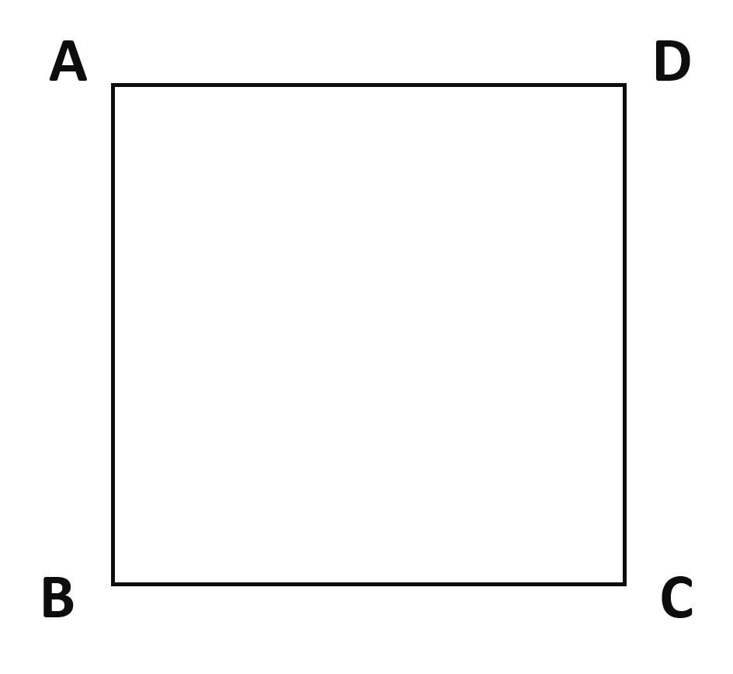
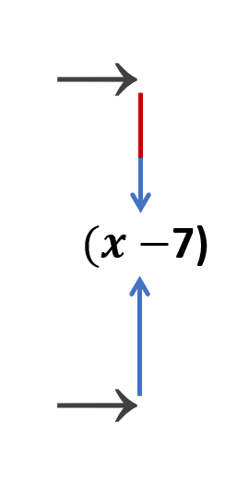
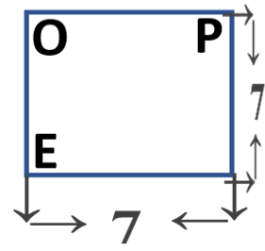
S
T
S
R

Slide 15
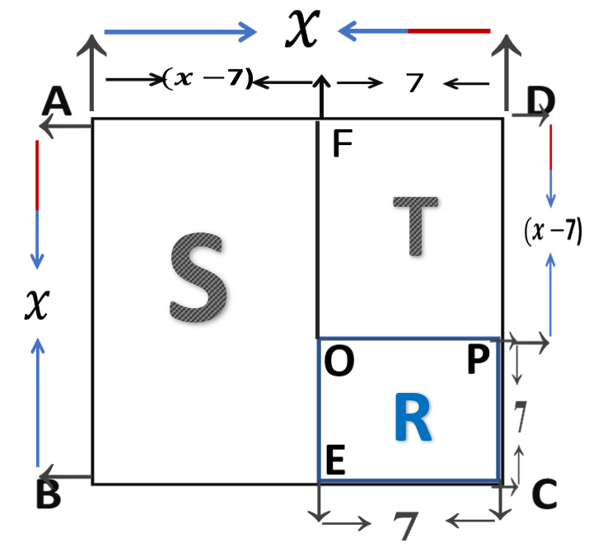
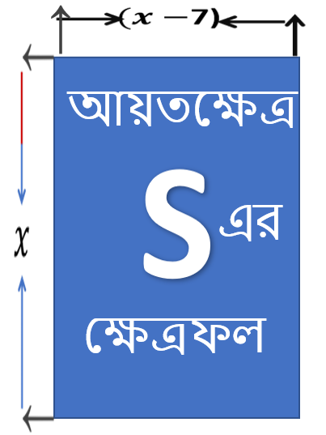
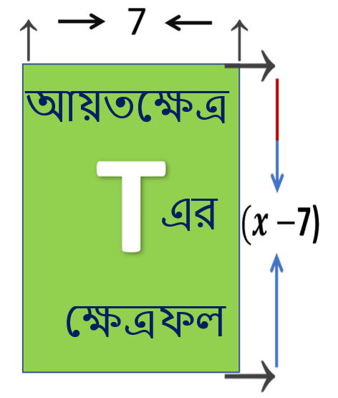
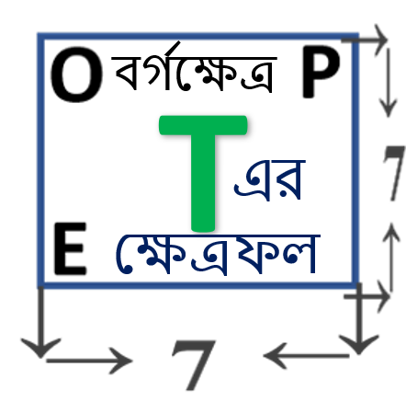
$$=x(x−7)$$
$$=7(x−7)$$
$$=7(x−7)$$
$$=x(x−7)$$
এর ক্ষেত্রফল =$x^{2}$
$${=7}^{2}$$
$${=7}^{2}$$

Slide 16
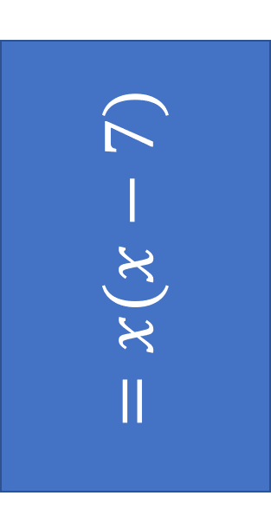
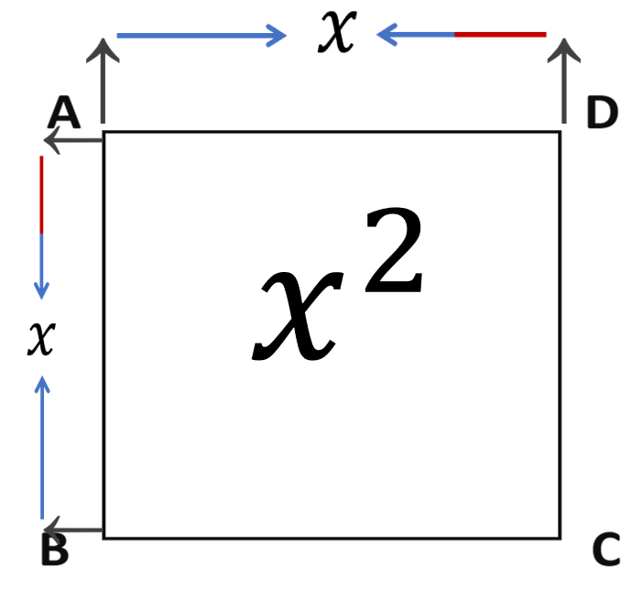
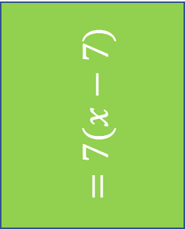
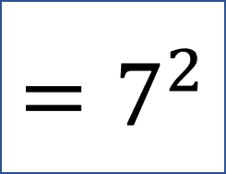
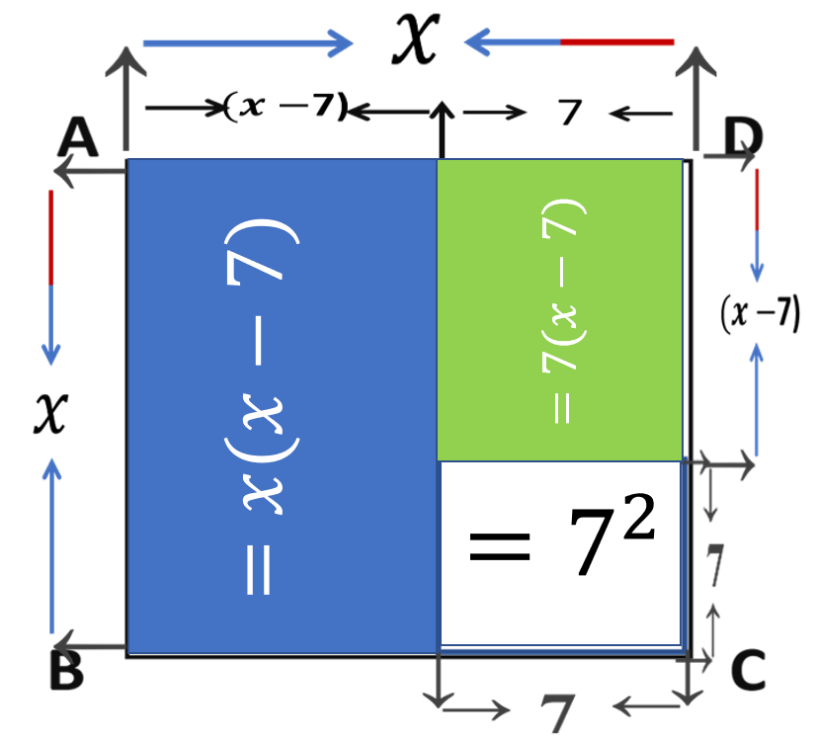
$${⸫ x}^{2}−7^{2}=x\left(x−7\right)+7(x−7)$$
$$x^{2}−7^{2}=(x−7)(x+7)$$
সুতরাং,
$$x^{2}−7^{2}=(x+7)(x−7)$$

Slide 17
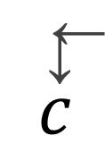
P
Q
R

Slide 18
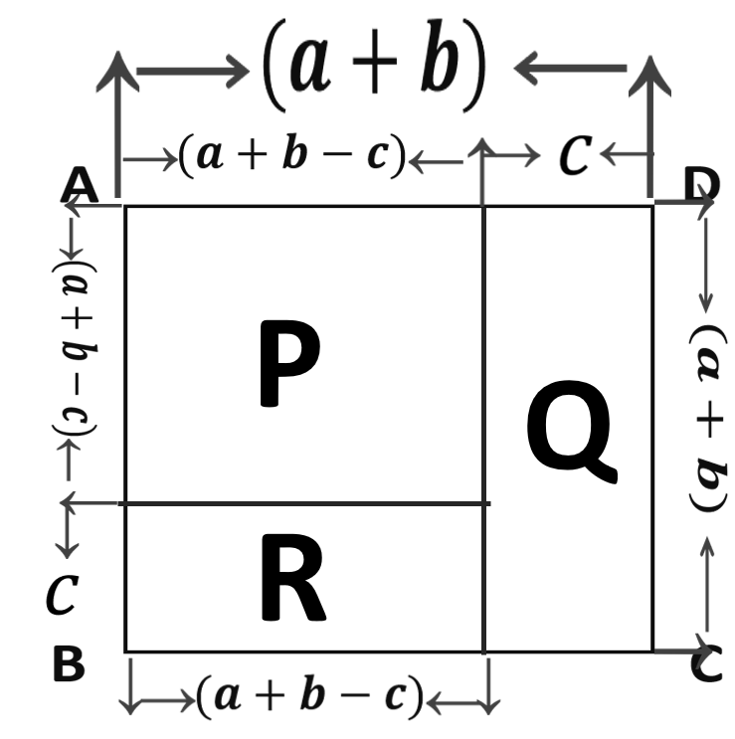
P
Q
A$={(a+b−C)}^{2}$
A$=C(a+b)$
R
A$=C\left(a+b −C\right)$

Slide 19
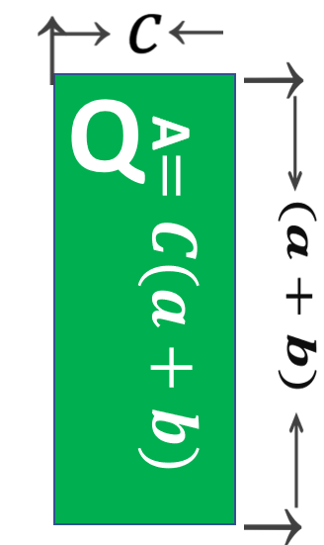
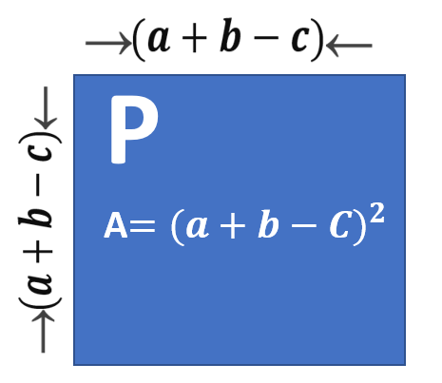
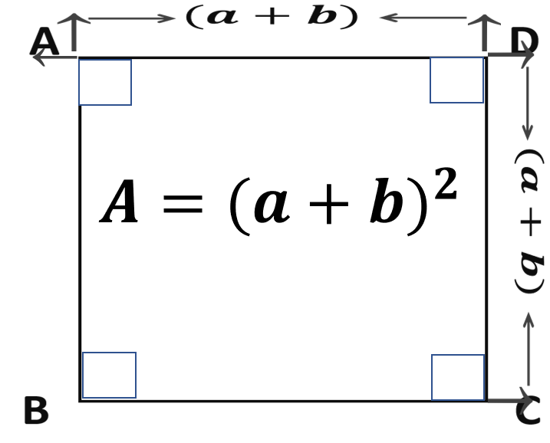
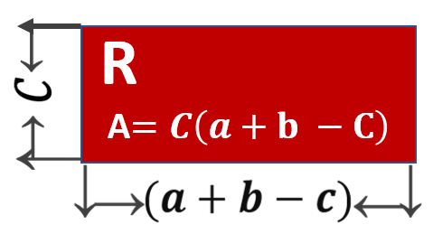
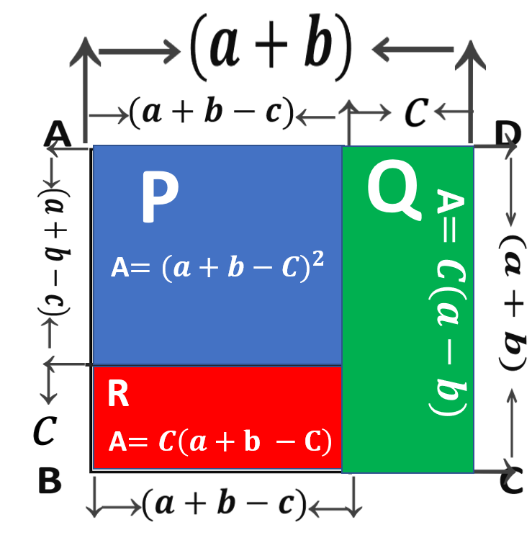
{
}
⸫ ${(a+b−C)}^{2}={(a+b)}^{2}−\{C\left(a+b\right)+C(a+b−c)\}$
$$=a^{2}+2ab+b^{2}−\{ca+bc+ca+bc−c^{2}\}$$
$$=a^{2}+2ab+b^{2}−ca−bc−ca−bc+c^{2}$$
$${(a+b−c)}^{2}$$
$$=a^{2}+b^{2}+c^{2}+2ab−2bc−2ca$$

Slide 20
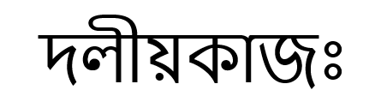

Slide 21
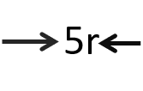
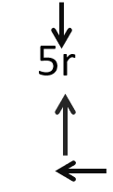
P
Q
R

Slide 22
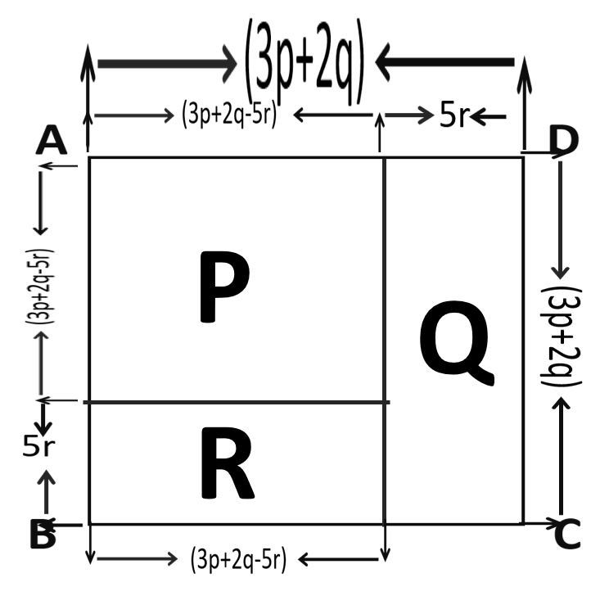
P
Q
A$={(3p+2q−5r)}^{2}$
A$=5r(3P+2q)$
R
A$=$
$\left(3P+2q−5r\right)5$r

Slide 23
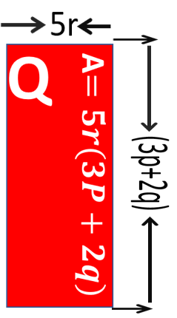
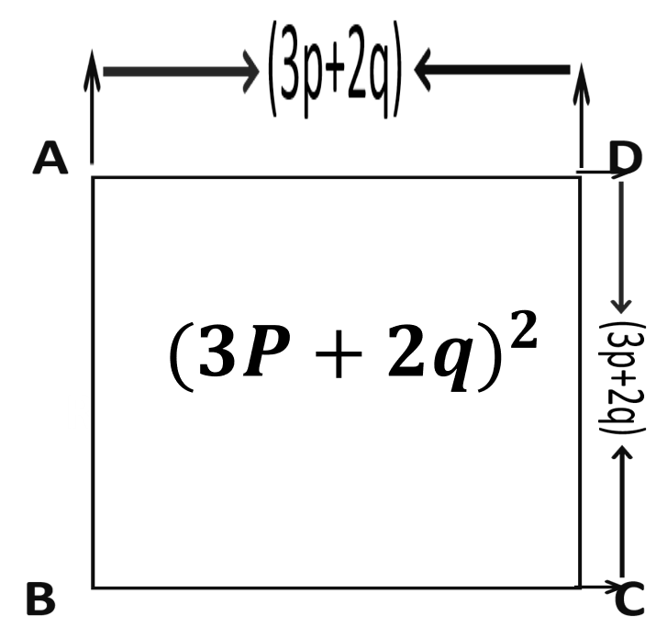
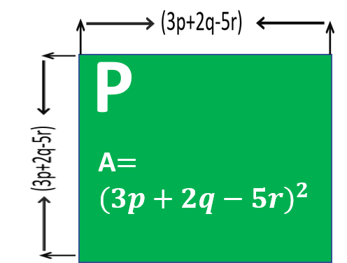
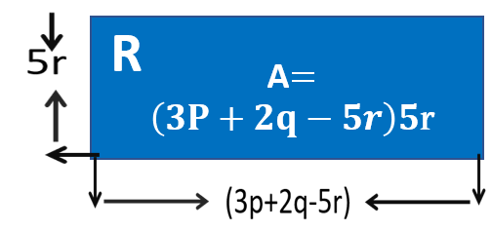
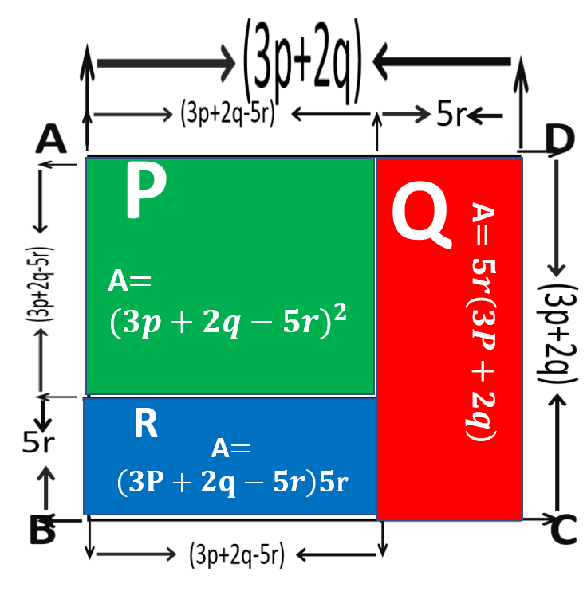
{
}
⸫ ${(3P+2q−5r)}^{2}={(3P+2q)}^{2}−\{5r\left(3P+2q\right)+5r(3p+2q−5r)\}$
$$={(3p)}^{2}+2.3p.2q+{(2q)}^{2}−\{5r.3p+5r.2q+5r.3p+5r.2q−5r.5r\}$$
$$={9p}^{2}+12pq+{4q}^{2}−15pr−10qr−15pr−10pr+{25r}^{2}$$
$${(3p+2q−3r)}^{2}$$
$$={9p}^{2}+{4q}^{2}+{25r}^{2}+12pq−10qr−30pr$$

Slide 24
$$\left(01\right) { p}^{2}−q^{2}=?$$
(Ans ) $\left(P+q\right) \left(p−Q\right)$
$$\left(02\right) m^{2}−n^{2}=?$$
(Ans ) $\left(m+n\right) \left(m−n\right)$
$$\left(03\right) {(a+b−c)}^{2}=?$$
(Ans : $a^{2}+b^{2}+c^{2}+2ab−2bc−2ca$
Ans:
49
$${5x}^{2}$$
$$x^{2}−7x$$
$7x$-49
$$a^{2}−ab$$
$${49p}^{2}−14pq$$

Slide 25
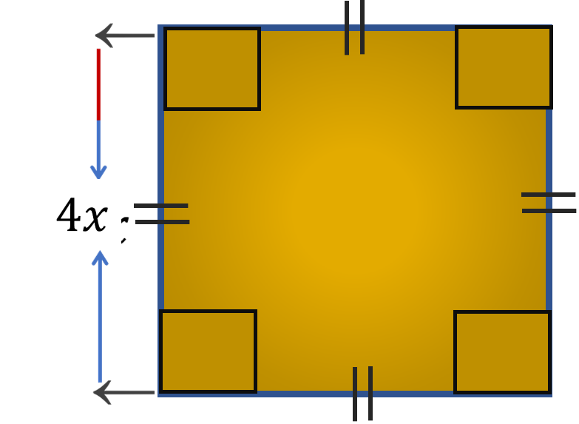

Slide 26
ধ
ন্য
বা
দ

