Slide 2
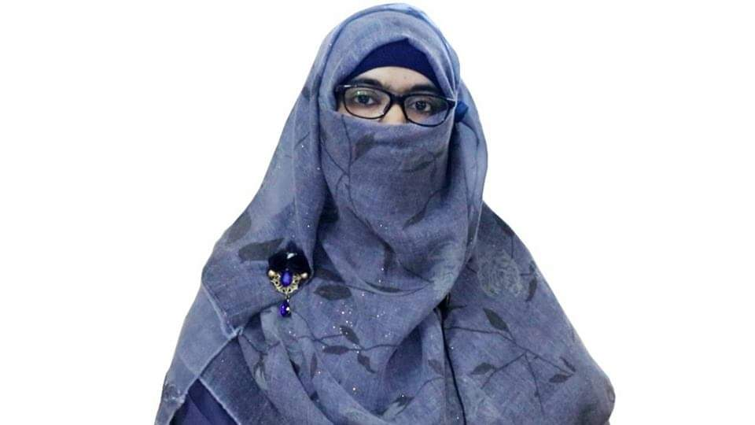
Identity
Sabina Yeasmin
Lecturer in English
Baridhara Nazmul Ulum Alim Madrasah
Badda, Dhaka

Slide 3
Class : Alim /HSC
Subject : English 1st Paper

Slide 4
Let’s enjoy the video
Fetching...
https://www.youtube.com/watch?v=ZsQfqlkayJ4

Slide 5
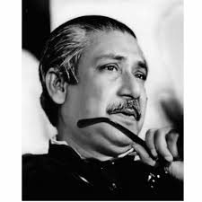
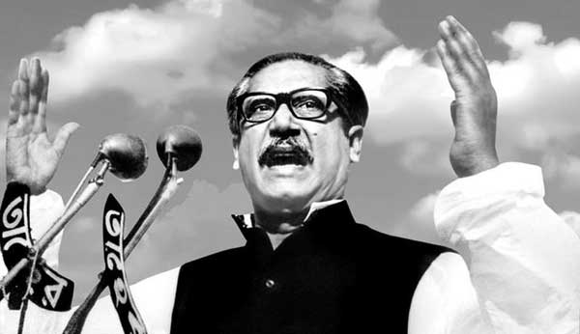
Let’s watch some images attentively

Slide 6
Can you guess what’s the today’s topic by watching the video & these images?
Part-2
Exactly today’s topic is-
Unit:1, Lesson: 1
The Unforgettable History

Slide 7
Learning outcome
At the end of the lesson, students will be able to-
Increase vocabulary
1
2
Achieve the reading skill.
Answer the questions easily.
3
Fill in the blanks without clues spontaneously.
4

Slide 8
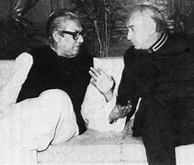
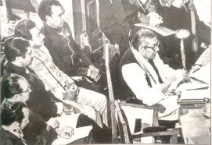
negotiations
Vocabulary
Mean: discussion aimed at reaching an agreement
Syn: Discussion, interlocution
Ant: Provocation
Ex: Mr. Bhutto said that the doors of negotiations had not been shut.

Slide 9
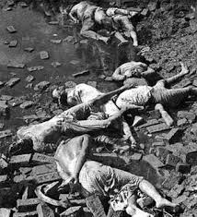
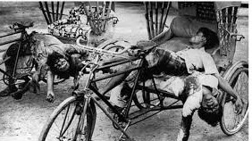
slaughterhouse
Vocabulary
Mean: a place where animals/humans are killed
Syn: butchery, abattoir
Ex: Mr. Bhutto said that if anyone joined the Assembly, it would be a slaughterhouse.

Slide 10
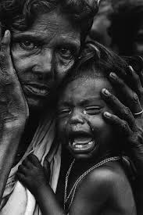
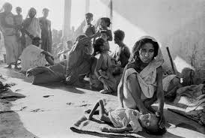
wretched
Vocabulary
Mean: A person, in a very unhappy or unfortunate state
Syn: unlucky, woeful
Ant: happy, noble
Ex: The Pakistani Army were using bullets on the wretched people.

Slide 11
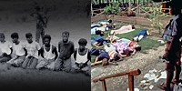
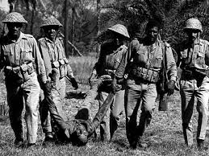
massacred
Vocabulary
Mean: an indiscriminate and brutal slaughter of people
Syn: slaughtered, killed
Ant: escaped, revived
Ex: The Pakistany Army massacred on us brutally.

Slide 12
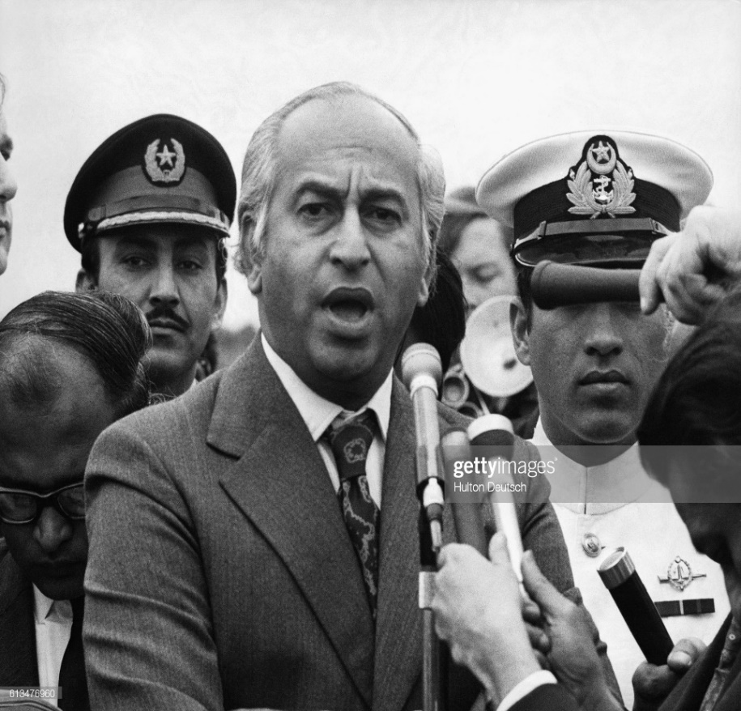
Now read the text.
Mr. Bhutto came here; he carried out discussions with us; he had said that the doors of negotiations had not been shut and that there would be further negotiations.
Mr. Bhutto
Mujib & Bhutto

Slide 13
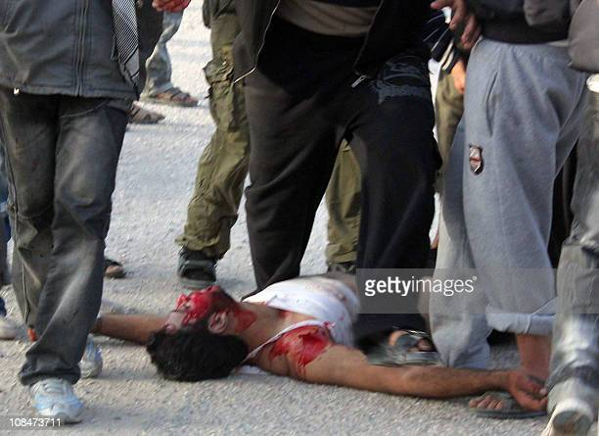
I then had talks with other leaders; I say to them, “Come and sit down with us; Let’s create a constitution for ourselves through discussions.” But Mr. Bhutto declared that if West Pakistani members came here the Assembly would end up as a slaughterhouse.
Slaughterhouse
Bloodshed

Slide 14
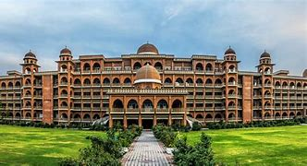
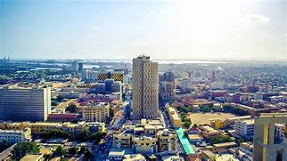
He claimed that whoever came here would be slaughtered. He said that if any one showed up here all shops from Peshawar to Karachi would be shut down.
Peshawar City
Karachi City

Slide 15
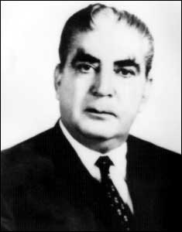
I declared that the Assembly would continue to meet. But suddenly on the 1st of March the Assembly was shut down. Mr. Yahya khan called the session of the Assembly in his capacity as the president and I declared I would be attending it.
Mujib
Yahya Khan

Slide 16
Mr. Bhutto said he would not be part of it. Thirty-five members of the Assembly came from West Pakistan to take part in its proceeding. But it was dissolved all of a sudden. The blame was put on the people of Bengal, the finger was wanted at me!
Mujib
pointing

Slide 17
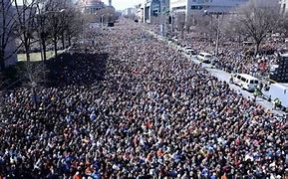
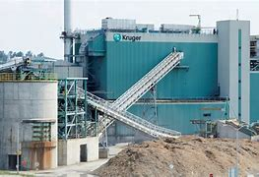
After the Assembly’s session was prorogued, the people of this country protested. I told them, “Observe the general strike we have called peacefully”. I told them, “Shut down all mills and factories”.
Procession
Shut down

Slide 18
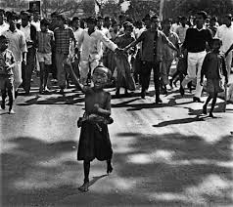
Our people responded to my call. They came to the streets spontaneously. They expressed their firm determination to carry out the struggle peacefully.
processions

Slide 19
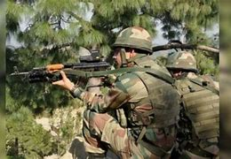
What have we got in return those who brought arms with our money to defend us from external enemies are now using those arms on the poor, the wretched, the downtrodden people of the land. Bullets are being aimed at their hearts.
killed

Slide 20
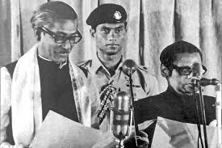
We constitute the majority in Pakistan; but whenever we Bengalis have tried to assume power they have used force on us.
Assembly

Slide 21
I have had a talk with Mr. Yahya khan. I told him, “Mr. Yahya, you are the president of Pakistan come and observe how the poor people of my country are being mowed down with bullets come and see how our mothers are being deprived of their children; how my people are being massacred.
Deprived
massacred

Slide 22
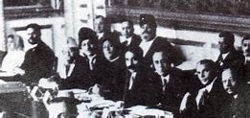
Come, observe and only then pass a judgement on what is going on. He has apparently said that I had agreed to attend a round table conference on the 10th of March. Did not I say a long time back: what is the point of another Round Table Conference?
Blood shed
Round table

Slide 23
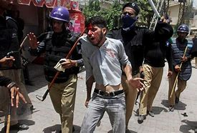
Who will I sit with? Should I sit with those who have shed the blood of my people? He has suddenly dissolved the assembly without carrying out any discussions with me after sitting in a secret meeting for five hours he gave a speech were he has put all the blame on me. He has even blamed the Bengali people!
Blood shed
pointing

Slide 24
Individual work
Fill in the blanks
been prorogued
After the Assembly’s session had (a)
the Bengalis protested. Bangabandhu told his countrymen (b) observe the strike (c) . People of east Bengal responded to (d) . A firm determination came from their side to (e) out his order. Then Sheikh Mujib had a (f) with Mr. Yahya Khan in which he requested Yahya Khan (g) observe the situation of East Bengal and her(h) with his own eyes. But the talk (i) no effect. Mr. Yahya Khan (j) the people of East Bengal.
peacefully
to
him
carry
talk
to
people
had
blamed

Slide 25
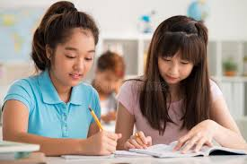
Pair work
Discuss about Bangabandhu’s Political life.

Slide 26
Choose the correct answer from the alternatives
Group work
1. What is the meaning of the word ‘slaughter’?
(a).sacrifice (b). Butcher (c). killer (d). oppressor
2. What does the word ‘downtrodden’ mean?
(a).oppressed (b).heartless (c). rich (d) aristrocratic
3. The word ‘force’ is an-
(a) Verb (b) adjective (c) noun (d) adverb
4. What does the word ‘massacre’ means?
(a)message (b) slaughter (c)sentence (d)exterminate
5.The word ‘prorogue’ refers to-
(a).reform (b). rapid (c). cancel (d). adjourn
√
√
√
√
√

Slide 27
Evaluation
Answer the questions
1.What was the response of the people to Bangabandhu for a general strike?
2.Why did Bangabandhu reject the call for sitting with the west Pakistan?
3.What was the result of the secret meeting ?
4.Who prorogued the Assembly and why?
5.Why do you think Bhutto didn’t take part in the Assembly?

Slide 28
Home work
Write a short paragraph on ‘Historical Speech of Sheikh Mujibur Rahman’.

Slide 29
Thank you so much
For watching

