Slide 1
Register & Counter
Prepared By:
Khandaker Tayef Shahriar
Lecturer (ICT)
Syeda Selima Quader Chowdhury Degree College

Slide 2
Flip-flop
Flip flop is a basic memory element in a digital computer. It is used to store One bit of information with a 0 or a 1.
Flip-flop has two outputs, One output is complement of other.
Sequential vs. Combinational Circuit
A sequential circuit uses flip flops. Unlike combinational logic, sequential circuits have state, which means basically, sequential circuits have memory. Combinational logic circuits implement Boolean functions, so they are functions only of their inputs, and are not based on clocks.

Slide 3

JK Flip-flop
LOGIC DIAGRAM:
TRUTH TABLE:
J | K | CP | Q
0 | 0 |  | Qo
0 | 1 |  | 0 (Always)
1 | 0 |  | 1(Always )
1 | 1 |  | Q’ (toggle)

Slide 4

D Flip-flop
Logic diagram:
TRUTH TABLE:
D | CLK | Q
0 |  | 0
1 |  | 1
D
Q
CLK
Q’

Slide 5

T Flip-flop
LOGIC DIAGRAM:
TRUTH TABLE:
T | Q
0 | Qo | No Change
1 | Q’o | Complement/Toggle

Slide 6
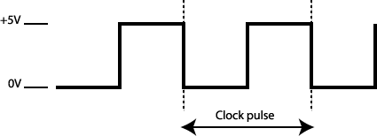
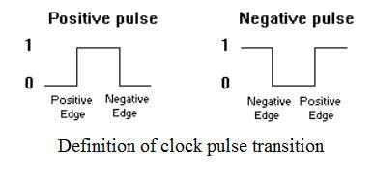
Clock Pulse
In electronics and digital circuits, a clock signal is a particular type of signal that oscillates between a high and a low state and is utilized to coordinate actions of digital circuits. A clock signal is produced by a clock generator.
In case of FLIP-FLOP the output change can occur only at the rising or falling edge of clock signal.

Slide 7
Register
Register is a type of digital circuit which consists of several Flip-flops that can store binary bits.
There are n Flip-flops in n bit register which can store n bit binary information.
It may have combinational gates that perform certain data processing tasks in addition to flip flops.
Hence, Register is a group of memory elements which acts as an unit.
Register is used for the temporary storage of information inside microprocessor before its operation.
Register is used as cache memory.

Slide 8
Types of Register
For various types of loading, register can have various structures:
  Parallel Load Register or Buffer Register
  Shift Register
According to uses, register can be classified in two ways:
  General Register: Which can be used for every work
  Special Register: Which is used in particular work
    For example: Accumulator Register, Count Register, Data Register, Base Register or Address Register, Flag Register etc…total fourteen 16 bit registers

Slide 9
Parallel Load Register or Buffer Register
(Figure on Board)
Registers which can only load or contain data is called load or buffer register.
Load Register which can load many binary bits simultaneously and provide output is called parallel load register.
After providing particular clock pulse we can get output data from input data in buffer register.
Buffer register is used to balance the speed of input device and CPU. Because the speed of input device is much slower than the speed of CPU.
Need to keep Clear input 1. To reset data, need to put 0 at Clear input.

Slide 10
Serial in Serial out Shift Register
(Figure on Board)
Register which can contain data and move data in left or right is called Shift Register.
In shift register a group of Flip-flops are connected in a chain format such that the output of one Flip-flop is connected with the input of another Flip-flop.
All Flip-flops get a common clock pulse which makes transition from one state to another state.
Each bit is moved by each pulse.

Slide 11
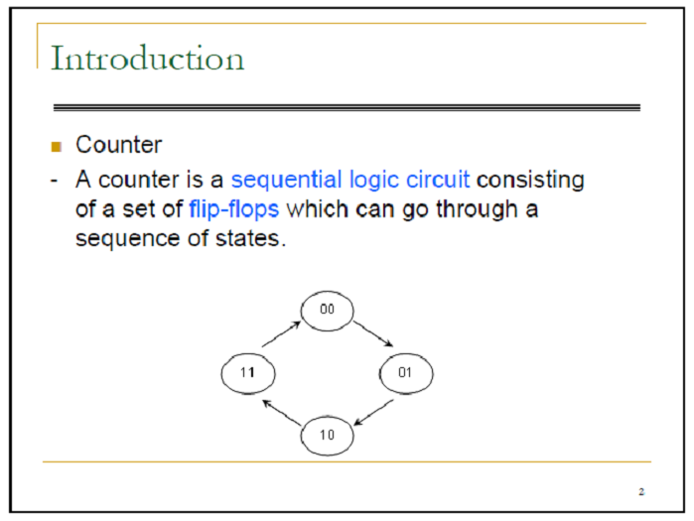

Slide 12
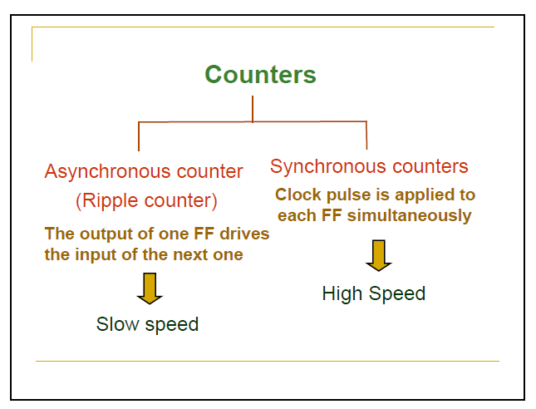

Slide 13
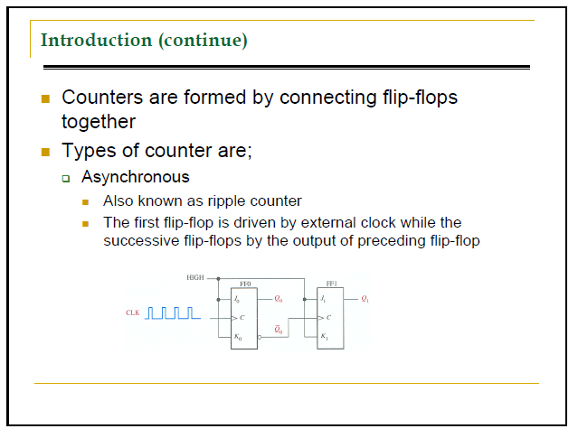

Slide 14
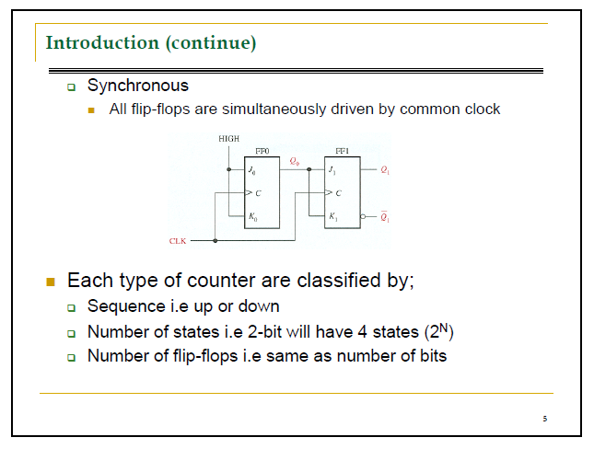

Slide 15
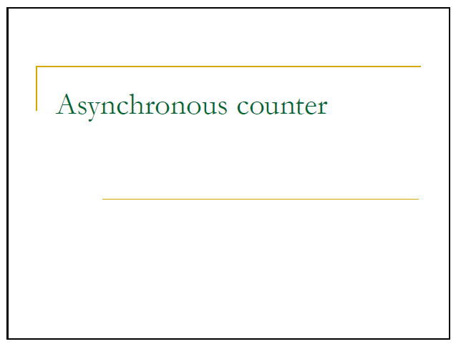

Slide 16
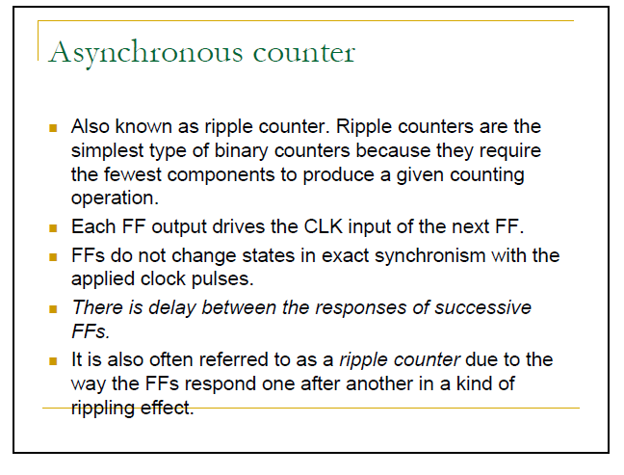

Slide 17
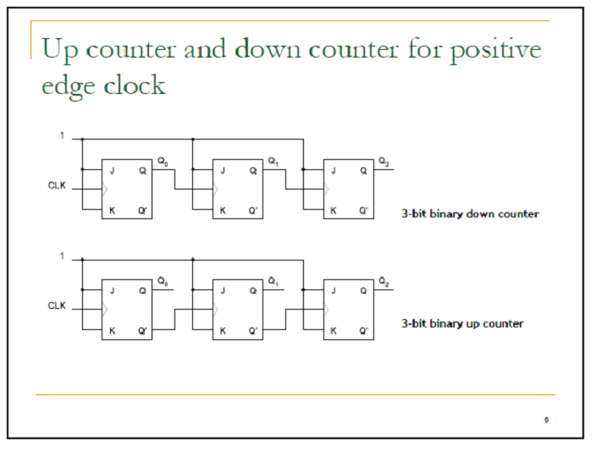

Slide 18
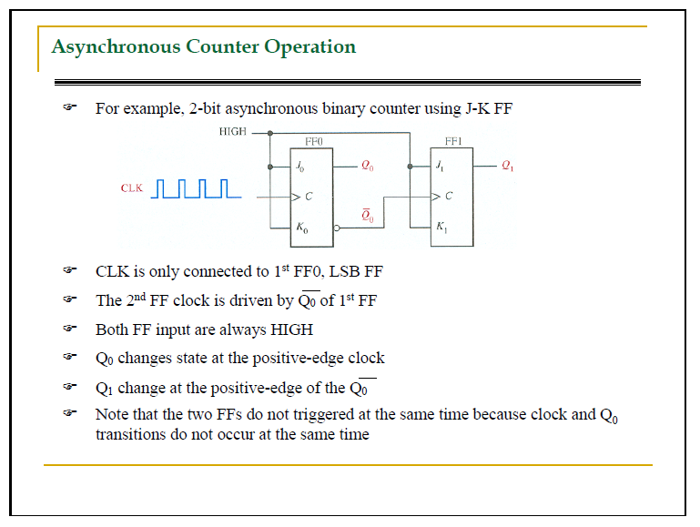

Slide 19
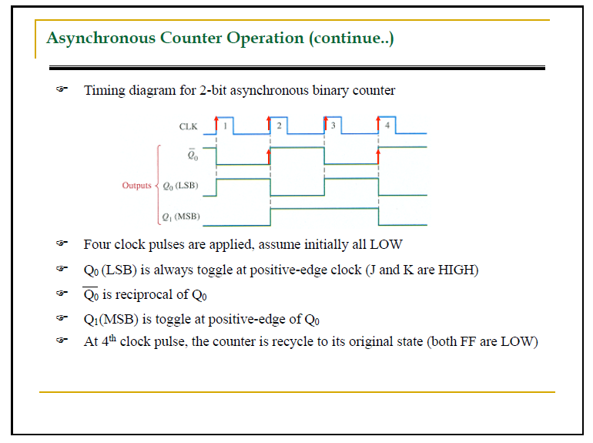

Slide 20
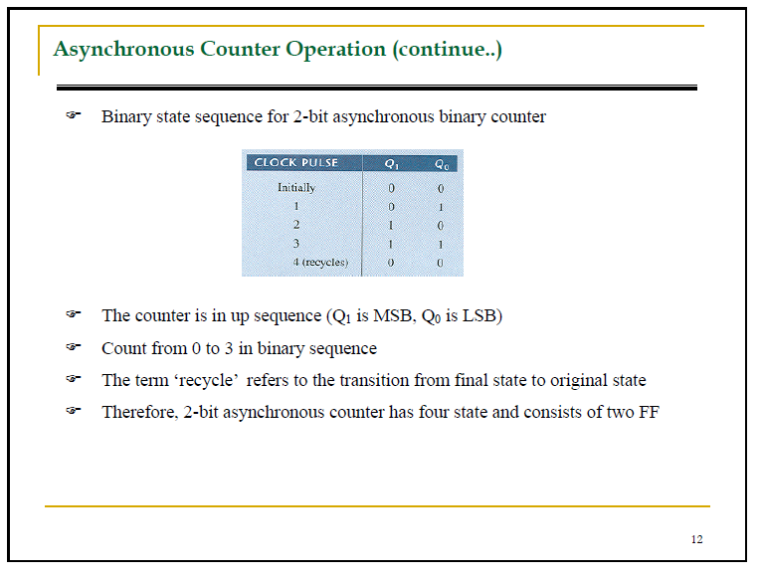

Slide 21
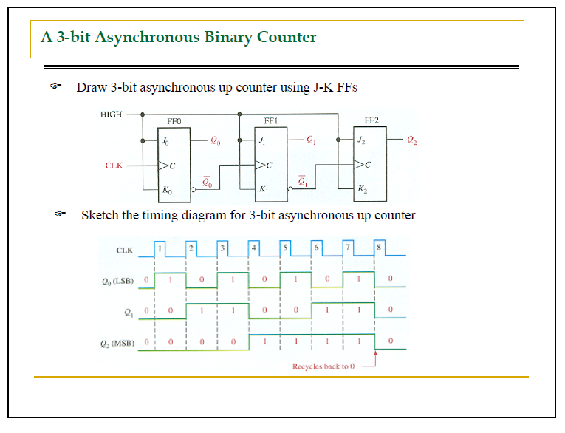

Slide 22
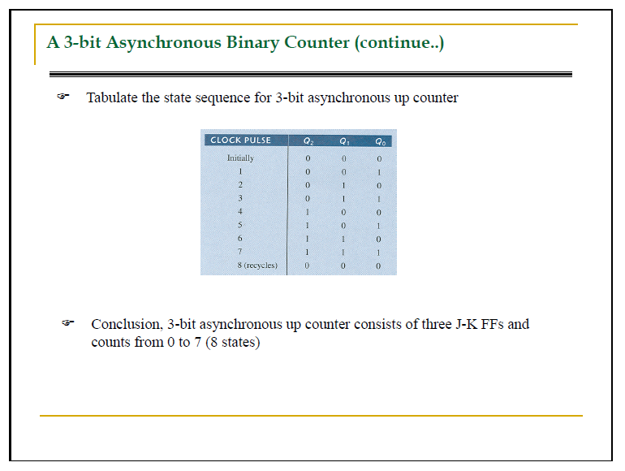

Slide 23
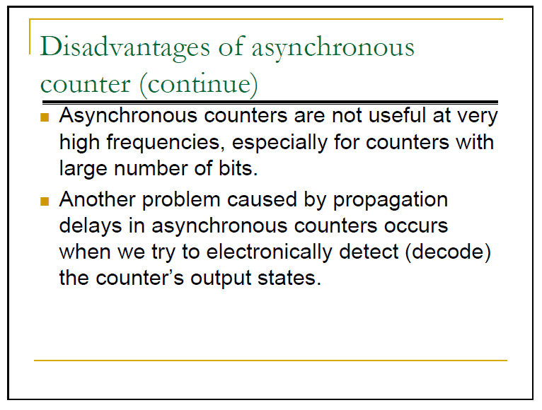

Slide 24
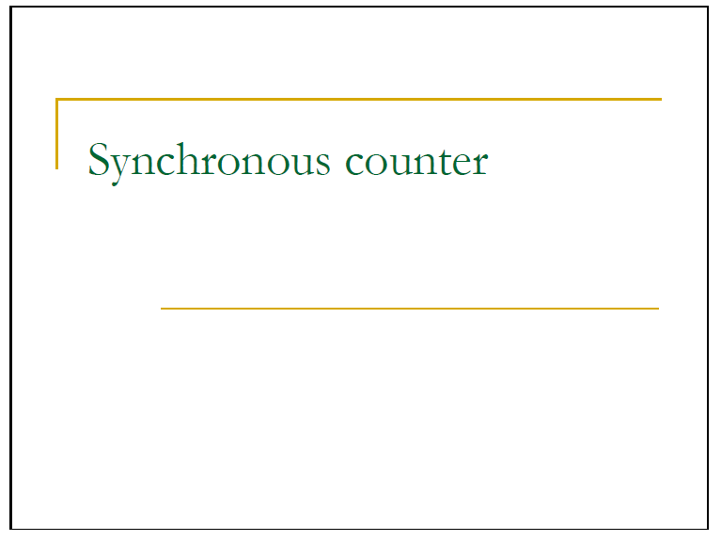

Slide 25
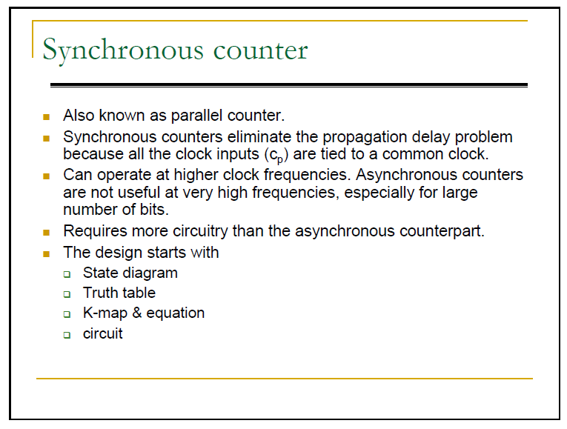

Slide 26
Thank You
Any Question?

