Slide 1
Welcome
Welcome

Slide 3
Class Identity
Class: Three
Sub:English
Unit:3
Lesson:1-3
Time:40m.

Slide 4
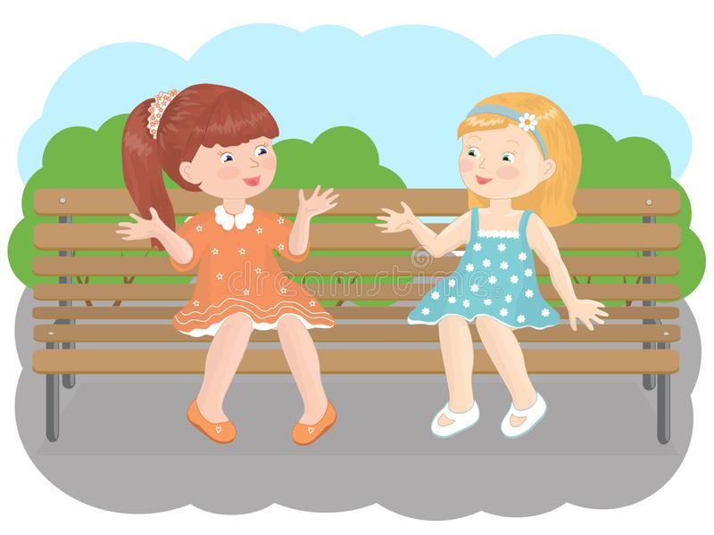
Let us see some pictures.
What do you mean by the pictures?

Slide 5
ToDay’s Lesson
Is
Dialogue

Slide 6
Learning Outcomes
After the lesson the students will be to
Take part in a simple conversation.
Share the feelings with other.
Make the dialogues in other situation.

Slide 7
I’m from Khulna.
And you?
Hello! Keya.I’m Mashuk. Where are you from?
I’m from Sylhet,and
so is Riya.
That’s Keya.She’s
a new Student.
Who’s that?

Slide 8
Pair work
Where are you from?
I’m from Dinajpur.
Thank you.
I’m from Rangpur.
And you?
Talk about where you are from.

Slide 9
Group work
That’s Rina.
She’s a new here.
I’m from Rajshahi.
And you?
Where are you from?
I’m from Bogura.
Hello!Rina.I’m Tomal.
Who’s that?

Slide 10
Evaluation
Calling two students in front of the class acting conversation between them about where they are from.

Slide 11
HOME WORK.
At home you and your brother talk about your new friend.

Slide 12
Thank you for watching.

