Slide 1
Welcome

Slide 2
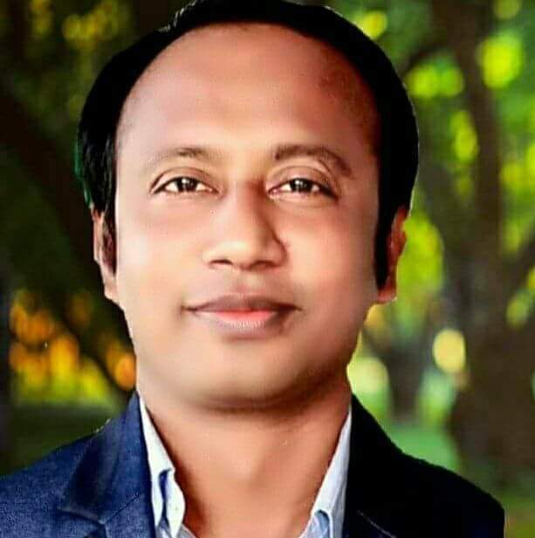
Identity
M. Abdul Aziz Shishir Senior Teacher(English) Hasan Ali Govt. High School
Chandpur.
Phone:01912220830

Slide 3
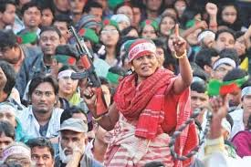
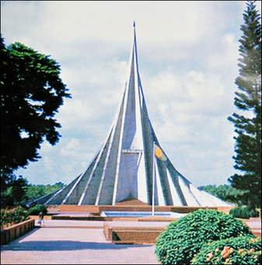
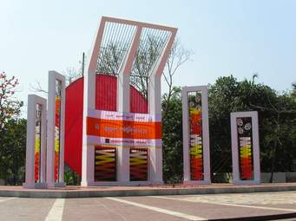
Let’s see some pictures

Slide 4
Can you imagine about our topic?
OUR PRIDE

Slide 5
Learning out comes:
After completing the lesson learners will be able to…
1.read and understand texts
2. ask and answer questions
3.write short paragraphs

Slide 6
Individual work
Read the text silently and choose the most suitable heading for the paragraph.

Slide 7
Group work
Make a group of five. The night of 25 March is called “The dark night” why?

Slide 8
Write a dialogue between you and your partner about the picture.

Slide 9
Evaluation
Fill in the gaps of the following text: 26th March is our a) ----------day. We b)--------it in1971.We celebrate annually c)--------and joy . It is a d)------- of proud . We should e)------- the day respectfully.

Slide 10
Home work
Write a paragraph on Our National Day

Slide 11
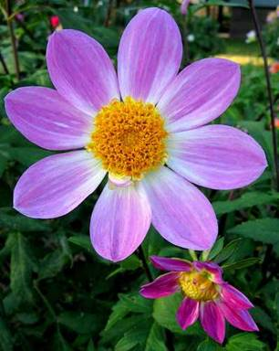
Thank you very much.

