Slide 3
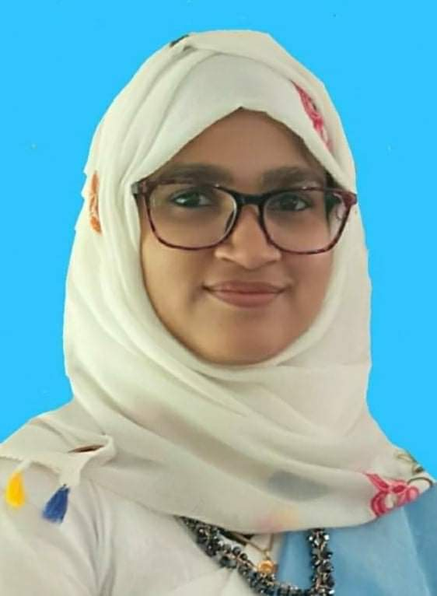
Presented bye
Umme Sarmin
Assistant Teacher
Chardicree Govt. Prrimary School
Muladi, Barishal.

Slide 4
Text Introduce
Class: Two
Subject: English
Unit: Ten
Lesson: 4-6

Slide 5
Learning outcomes

Slide 6
Creating emotion
Let’s enjoy a introduce song

Slide 7
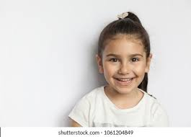
LOOK at these picture
He is Rana
Age: 8 Class: 3
She is Hena
Age: 7 Class: 2

Slide 8
Take your book

Slide 9
Open your book
Page no- 21

Slide 10
Look, listen and say
Name: Meena
Age: 8 Class:3

Slide 11
Draw and write

Slide 13
Write on your exercise book

Slide 14
Home work
Parts of the lesson will be practiced well at home

