Slide 1

Welcome to our English class

Slide 2
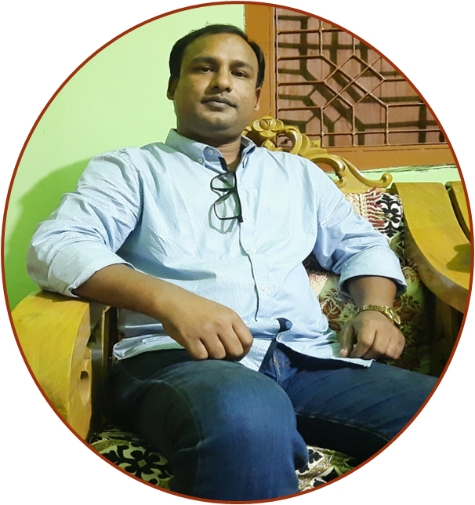
Presented By
Md.Azizur Rahman
Assistant Teacher
Kandigawn Govt.Primary School
Kamalgonj , Moulvibazar.

Slide 3
Lesson Introduction
Class: Five
Subjec:English
Unit:3
Lesson:3-4(D,E)
Saikat’s Family
Time:40 Minutes

Slide 4
Learning Outcomes
Listening :
1.4.1 recognize and use intonation patterns for Yes/ No and Wh questions.
Speaking:
1.1.2 Say sentences with proper Intonation.
3.1.1 ask and answer wh questions.
6.1.2 say what others are doing.
Reading:
1.6.1 recognize and read statements, commands, grettings, questions and answer.

Slide 5



Think and say about the picture
Sewing
Studying
Watching TV

Slide 6
Let’s try to ans some of the questions
that we practices in class 4 .
1. What time do you get up?
2. When do you have breakfast?
3. What time do you go to bed?

Slide 7

Today’s Lesson
Saikat`s Family

Slide 8
Let`s know some new words
Study
Dinner
পড়াশোনা
রাতের খাবার
Saikat is studying.
They are eating dinner.

Slide 9
More new words
Watch
Sewing
দেখা
সেলাই করা
They are watching TV.
Saikat’s mother is sewing at 8 o’clock.

Slide 10
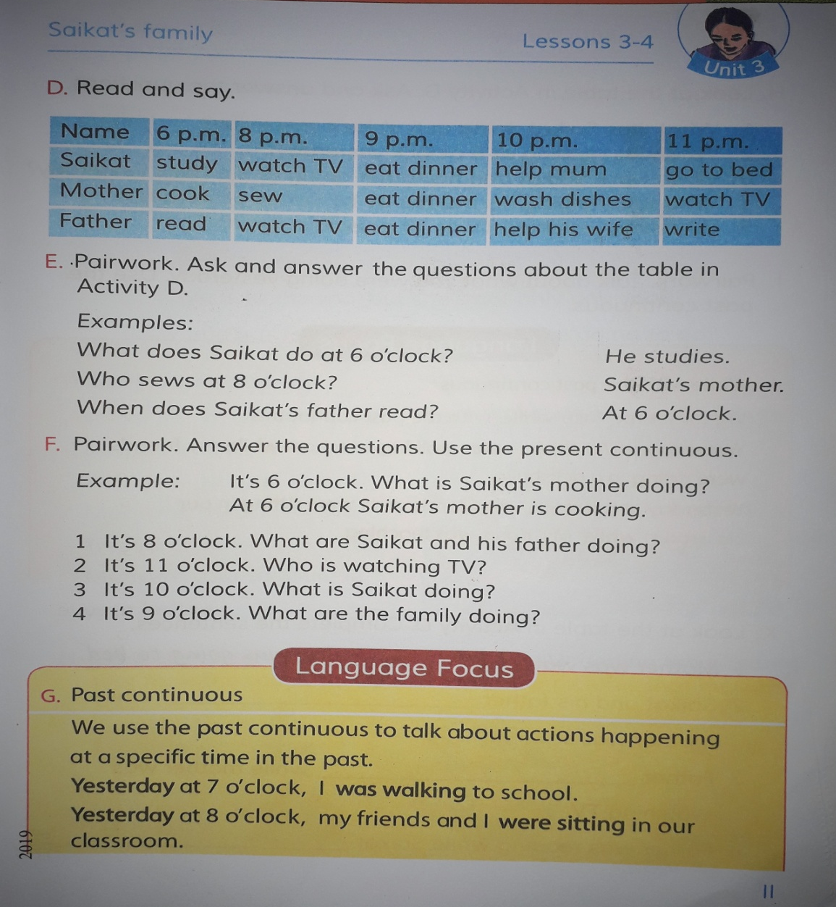
Teacher’s Reading

Slide 11
Student’s Reading

Slide 12
Saikat’s family
activities
Watching TV
Studying
Sewing
Writing/Reading
Eating dinner

Slide 13
Try to answer the questions
What does Saikat do at 8 pm?
Who wash dishes at 10 pm?
When does Saikat’s father write?

Slide 14
Try to answer the questions
What does Saikat do at 8 pm?
Ans: Saikat watches TV at 8 pm.
Who washes dish at 10 pm?
Ans: Saikat’s mother.
When does Saikat’s father write?
Ans: At 11 pm.

Slide 15
HOME WORK
You will write down at least 5 sentences about your daily activities.

Slide 16
One day One word
Wash
ধৌত করা

Slide 17

Thank you every body. Stay at home,
Stay Safe.

