Slide 1
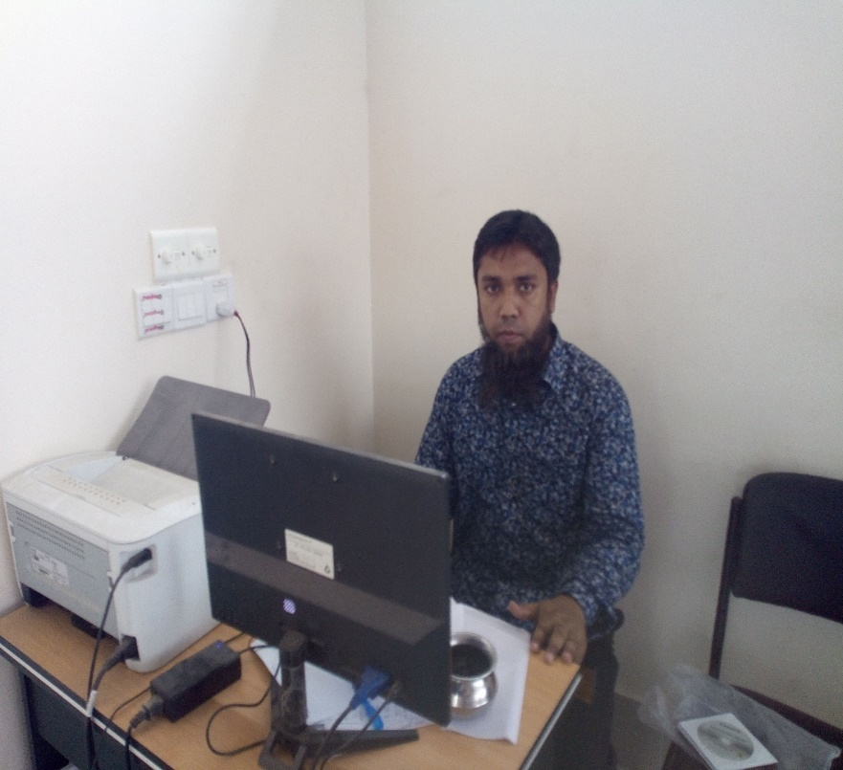
আজকের মাল্টিমিডিয়া ক্লাশে সবাইকে স্বাগত।

Slide 2
Adamdighi Balika Government Primary School Adamdighi, Bogura.
Welcome to my online class.
Stay home
Stay safe

Slide 3
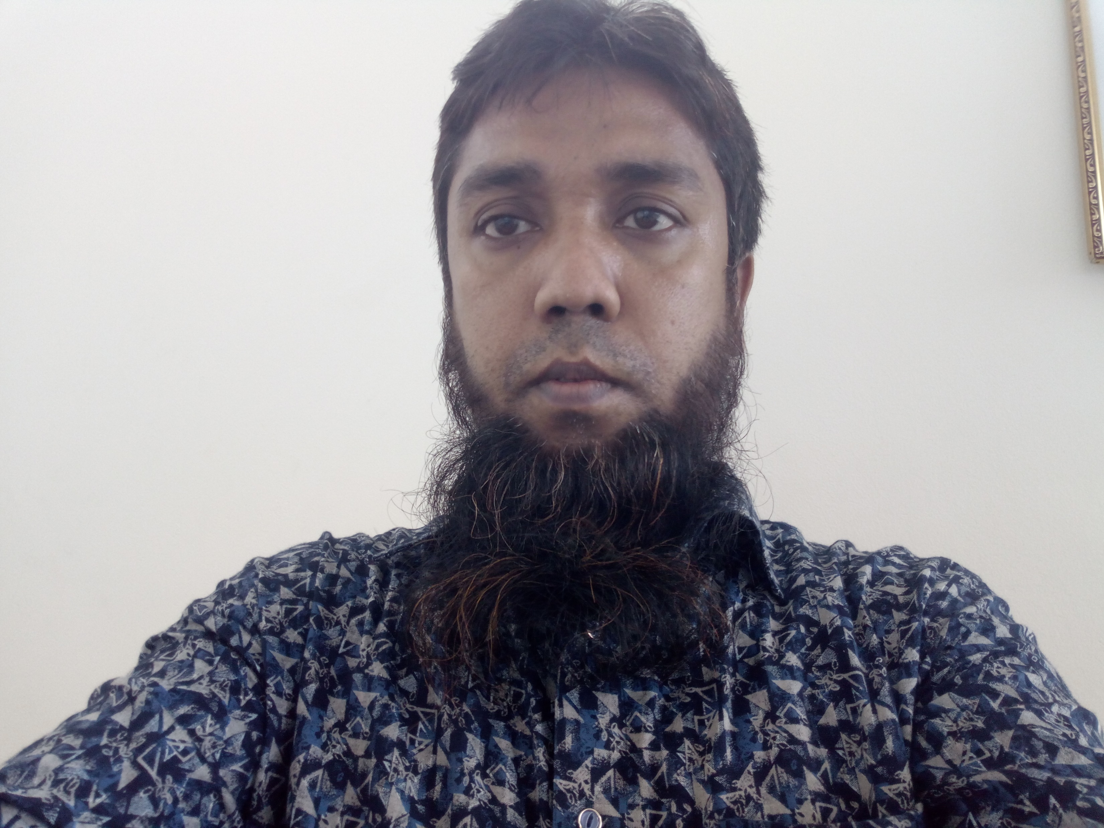
Teacher’s introduce:
M MOSTAB SIRA RUJDI
Assistant teacher
Adamdighi Balika Government Primary School
Adamdighi, Bogura

Slide 4
Lesson introduce:
Subject: English
Tropic: WH Question
Class: 3

Slide 5
Pair works
Do you know what is this?
Question mark..

Slide 6
Declaration of the lesson:
WH –Questions.
Notes:
Now we are going to know about occupations.

Slide 7
Learning Outcomes:
At the end of the lesson students will be able to----------
Speaking::
3.1.1-ask and answer WH questions.
Reading:
1.6.1-recognize and read statements commands greetings ,
questions and answers.
Writing:
8.1.1-make sentences using words and phrases given in the text book.

Slide 8
Group work 9. Make WH questions with underline words.
Tamim goes to Dhaka to play cricket on Monday.
1. Ans:Who goes to Dhaka to play cricket?
2.Where does Tamim go to play cricket?
3.Why does Tamim go to Dhaka?
4.When does Tamim go to Dhaka?

Slide 9
WH Question: What,Who,When,Why,Where,Which,Whose,How
Structure :
1. WH +verb +subject
2. WH +Helping verb +subject + main verb +object
Example:1.The pen is red.
ans:How is the pen?
2.He grows crops.
ans.What does he grow ?

Slide 10
TEST : 9.Make five WH question with underline words.
a.Riya gets up at 6.00 am.
b. She has breakfast .
c. She goes to school.
D . Riya is 9 years old.
e. Riya is in class 3.

Slide 11
Answer to the questions No.9:
a. When does Riya get up?
b.What has she ?
c. Where does she go ?
d. How old is Riya?
e. What class is in Riya?

Slide 12
Home Work:
9.Make five WH questions with underline words.
A Mahbub is in class 3.
b. He plays cricket.
c. He works in a bank.
d.Riya goes school at 9.00 am.
e. She is 9 years old.

Slide 13
End of the leson:

Slide 14
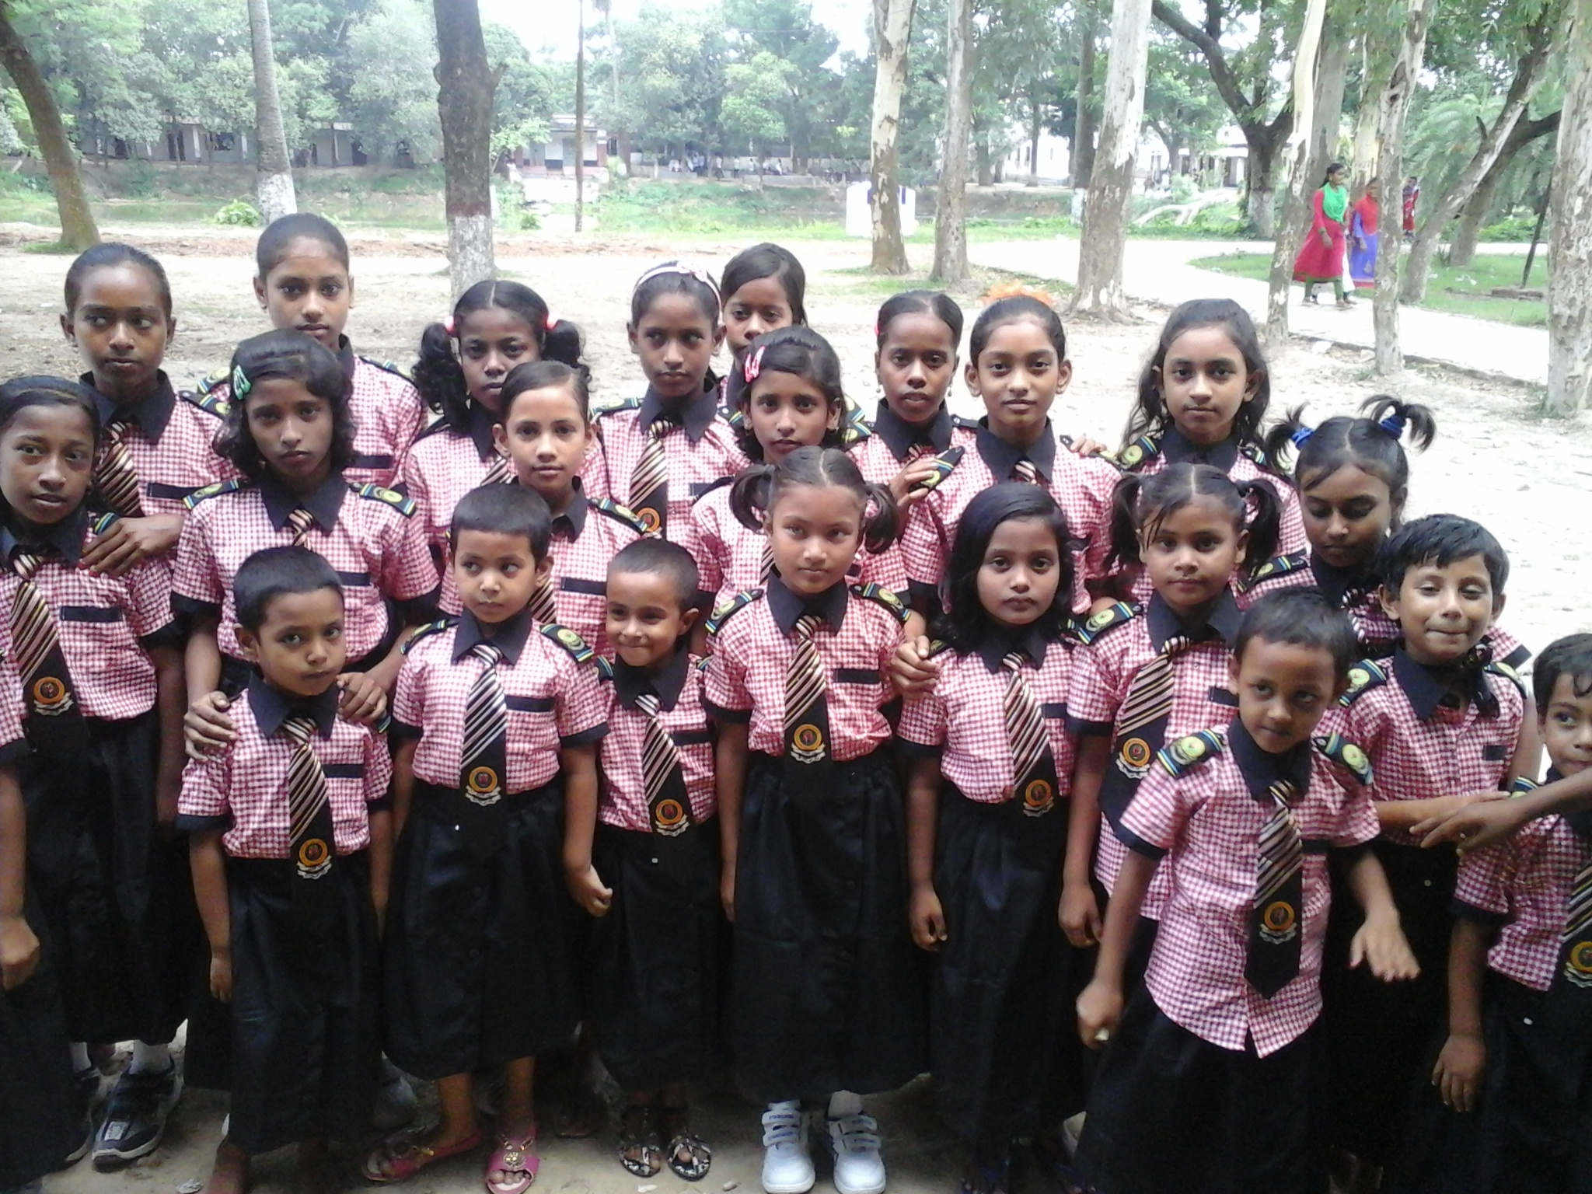
Good bye students!
Take my salam.
See you bye my next class !
_______ Presented by
M Mostab Sira Rujdi
Assistant Teacher at
Adamdighi Balika GPS
,Adamdighi ,Bogura.

