Slide 1
WELCOME TO ALL

Slide 2
PRESENTED BY
PAPI RANI CHAKRABARTY
ASSISTANT TEACHER
DOHALIA GOVT PRIMARY SCHOOL
E-MAIL ID : papichakrabarty@gmail.com
CLASS-TWO
SUB: ENGLISH
UNIT -13 ,LESSONS 1-3
TIME:40 MIN,

Slide 3
বলতো,আজ কী বার ?
শনিবার। বাংলা সাত দিনের নাম কি তোমরা সবাই জানো ? হ্যাঁ, আমরা সবাই জানি।
Do you know the name of the days of week in English ?
Today, We will know the name of seven days of week.

Slide 4
Learning outcomes: Students will be able to
Listening:
1.1.1 become familiar with English soundsby listening to English.
Speaking:
1.1.1 repeat after the teacher simple words and phrases with proper sounds and stress.
5.1.1 say the names of the days of the week.
Reading:
3.1.1 recognize and read the days of the week.

Slide 5
THE NAME OF SEVEN DAYS
বাংলা সাতদিনের নাম
SATURDAY
শনিবার
SUNDAY
রবিবার
MONDAY
সোমবার
TUESDAY
মঙ্গলবার
বুধবার
WEDNESDAY
THURSDAY
বৃহস্পতিবার
FRIDAY
শুক্রবার

Slide 6
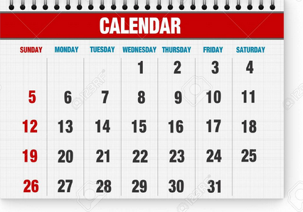
Let’s we see a calender
How many days are you seeing in a week?

Slide 7
Teachers reading loudly.

Slide 8
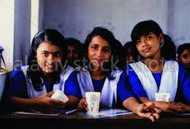
Student’s reading loudly. Everybody please open the book, page no-26.

Slide 9
PAIR WORK
Students will practise the name of seven days in pair. students will be able to say correctly the name of seven days.
Answer the simple QUESTIONS
When is your birthday?
What’s the next day of Sunday ?

Slide 10
GOODBYE EVERYBODY

