Slide 1
WELCOME

Slide 2
INTRODUCTION
Md. Afsar Ali
Assistant Teacher
Majhira Model High School
Shajahanpur, Bogura
English For Today
Class:9-10

Slide 3
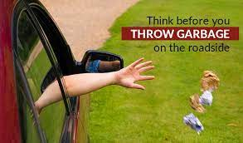
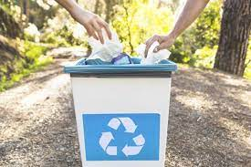
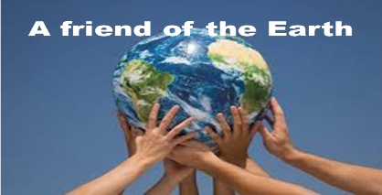
What will happen to the environment if we throw away our unnecessary things?
How can we overcome this problem?
So, what can we say to him?

Slide 4
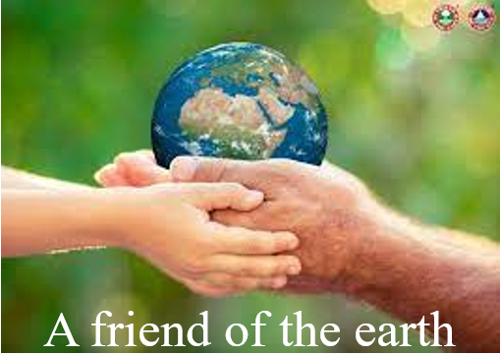
Our today’s lesson is
Unit-5, Lesson-5

Slide 5
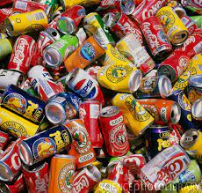
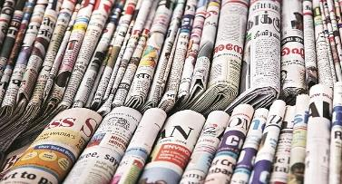
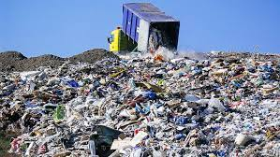
A. Discuss the questions in pairs
Do you throw away
empty cans and bottles?
2. What do you do with
your old newspapers?
3. What happens to the garbage
after you throw it away?

Slide 6
LEARNING OUTCOMES
By the end of the lesson, the learners will be able to…
understand how to save the planet
tell synonyms of some important words
ask and answer questions
complete the blanks in the table

Slide 7
Let’s introduce with some key words
Word | Image | Synonym
Reduce |  | Decrease, Lessen, Shrink, Condense
Crisis |  | Disaster, Calamity, Predicament, Predicament
Sustainable |  | Maintainable, Justifiable, Workable, Ecological
Disposed |  | Willing, Liable, Predisposed, Accountable
Durable |  | Tough, Sturdy, Strong, Robust,
Recycle |  | Reprocess, Salvage, Recover, Reutilize,
Facility |  | Ability, Capability, Talent, Competence,

Slide 8
B. Read the following text carefully to know about how we can save our environment.

Slide 9
LET’S SAVE OUR PLANET!
Everyone must play a part in protecting the environment. There are many things you can do on your own every day to help save the planet. Here are some suggestions.

Slide 10
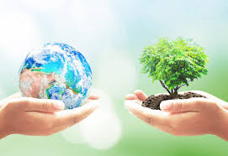
Really, the best thing we can do for the planet is to use its resources properly. Our consumer society is mainly responsible for the environmental crisis. Here are some questions you can ask yourself before buying something, “Do I really need this?” or “Is there another product which would do the same thing but more sustainable?” Or ask the question, “Will this last a long time?” Some other questions may be, “Do I know how this item was made, how it will be used and how it will be disposed of?”

Slide 11
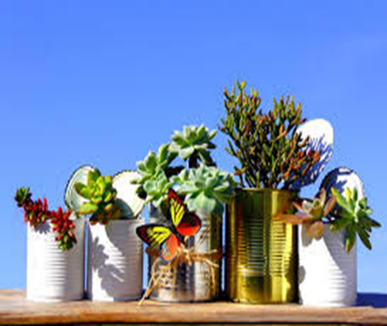
What do you think of using your own ceramic cup or mug at your school or local club? It means there are no plastic cups to throw away. You can wash it and reuse it every day. Unfortunately, we are encouraged to buy a new “improved” item even if the one we have can be repaired or reused. When we buy things, we should buy those that are durable; we should use them properly, and have them repaired when necessary.

Slide 12
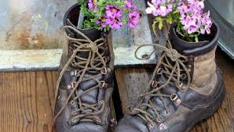
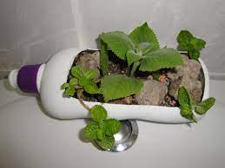
If we practice this, many things will not only last a life-time, but also be passed on for future use. However, If something is truly unusable for its original purposes, try to be more creative and think of how else it might be used. When you’re done with it, think of whether someone else might be able to use it. You can donate some of the things to the poor. You may also sell some of your used items through personal advertisements in a local newspaper or in a social media.

Slide 13
Rather than throwing an item out when neither you nor anyone else can make use of it, have it recycled. And if recycling is not possible, it is better to send goods to a landfill or have them burned up. Find out what types of materials can be recycled in your area. Clean and sort the materials before putting them out in the bin. Recycling your drink and food cans means there will be less trash in a resource recovery facility or landfill. Moreover, a company can use the old cans to make new ones.

Slide 14
Let’s enjoy a video

Slide 15
Now ask and answer these questions in pairs.
1. How can you cut down your shopping list?
Ans: The best way is to reuse things and reduce your demand.
2. What can you do to reuse things.
Ans: We can use old cans to keep or carry various kinds of liquid items.
3. What kind of household goods, clothes and toys, can be donated?
Ans: We can donate our clothes to the poor and we can sell our utensils for recycling. We can also sell our old toys.
4. How can you sell your used items?
Ans: You may sell some of your used items through personal advertisements in a local newspaper or in a social media.
5. How recycling may help save our environment?
Ans: If we recycle things, it will be useful to us in many ways. First of all it will benefit us economically and it will also help save our environment.

Slide 16
Complete the blank spaces in in the table below.

Slide 17
 | What is it | Examples
Reduce | To create less wastes, so that there is less items that must be recycled or ……………. away. | Using a towel for drying hair instead of using an electric hairdryer.
Reuse | To buy things that can be used again and again, or to find out another way of ………….. that item. | Using your own ceramic cup at your school or club means there are no ……………. cups to throw away. You can …………….. it and reuse it every day.
Recycle | Iinstead of throwing an item in the garbage, to give it to a person or company who will …………… it, or make something else with it. | Giving/selling used plastic bottles to someone to make something else from them.
thrown
using
plastic
wash
reuse

Slide 18
No more today
Goodbye

