Slide 1
English 2nd Paper Class
for
HSC/ Alim

Slide 2
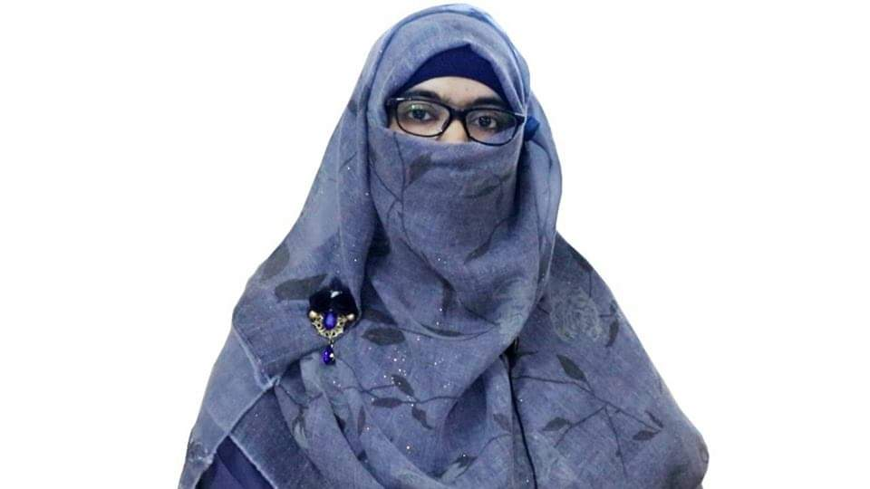
Identity
Sabina Yeasmin
Lecturer in English
Baridhara Nazmul Ulum Alim Madrasah
Badda, Dhaka

Slide 3
Narration Madrasah Board- 2016

Slide 4
Indirect: The old man asked the maid if she could give him some foods. He also added that he had been starving for two days.
Madrasah B- 2016
The old man said, “Can you give me some foods? I have been starving for two days.”

Slide 5
The maid said, “Why do you beg? Can’t you work?’ “No, I’m unable to work,” said the man.
The maid asked him why he begged. She also asked him if he could not work. The man replied in the negative and said that he was unable to work.

Slide 6
Narration Dhaka Board- 2016

Slide 7
Dhaka B.-2016
“Where do you come from?” I asked him. “From San Carlos,” he said, and smiled. “I was taking care of animals,”
Indirect: I asked him where he came from. He smiled and replied me that he came from San Carlos. He also added that he had been taking care of animals.

Slide 8
““Oh,” I said, not quite understanding. “Yes,” he said, “I stayed, you see, taking care of animals.
Not quite understanding I reacted to what he had said. He responded/replied in the affirmative and said that he had stayed, pointing to me, taking care of animals.

Slide 9
I was the last one to leave the town of San Carlos.”
He added that he had been the last one to leave the town of San Carols.

Slide 10
Narration Jashore Board- 2016

Slide 11
Jashore B-2016
I told the rickshaw puller that he had carried me a long way. Then I asked him how much I should pay him. I further asked him if fifty taka would do. He replied that anything was all right.
direct: I said to the rickshaw puller, “You have carried me a long way. How much should I pay you? Will fifty taka do?” He said, “Anything is all right.”

Slide 12
Narration Rajshahi Board- 2016

Slide 13
Rajshahi B- 2016
Have you cut your nails short?” The teacher said to Maruf. “No, I’ve forgotten, sir.” Said Maruf. ‘That’s very bad.
Indirect:The teacher asked Maruf if he had cut his nails short. Maruf respectfully, replied in the negative and said that he had forgotten. The teacher told him that, that was very bad.

Slide 14
You must be more careful about neatness and cleanliness. “By doing so, you can prevent diarrhoea and some other diseases too,” said the teacher.
He also added that he had to be more careful about neatness and cleanliness. By doing so, you can prevent diarrhoea and some other diseases too.

Slide 15
Narration Cumilla Board- 2016

Slide 16
Cumilla B -2016
One day Hazrat Omar (R) become shocked to see the sufferings of a woman and said, “Where do you live?”
Indirect: One day Hazrat Omar (R) became shocked to see the sufferings of a woman and asked her where she lived.

Slide 17
The woman said, “I live in a poor hut south end of this town. I’m hungry but there is no food in my house.
The woman replied him that she lived in a poor hut south end of that town. She added that she was hungry but there was no food in her house.

Slide 18
Will you give me something to eat?” Hazrat Omar (R) said, “Go back home. I’m coming with food and money for you.”
She also asked him if he would give her something to eat. Hazrat Omar (R) told her to go back home. He added that he was going with food and money for her.

Slide 19
Narration Sylhet Board- 2016

Slide 20
Sylhet B- 2016 Once I asked a little girl what her mother’s name was. She replied that she could remember her mother’s name but she would not tell me that
direct: Once I asked a little girl, “What’s your mother’s name?” She said, “I can remember my mother’s name but I will not tell you this.”

Slide 21
She added that she did not tell her mother’s name to anyone whom she did not know. I exclaimed with admiration that she was a very clever girl.
She said, “I don’t tell my mother’s name to anyone whom I do not know.” I said, “What a clever girl you are.”

Slide 22
Narration Chattogram Board- 2016

Slide 23
Chattogram B- 2016
“Why are your children crying, my daughter?” said the Caliph. “They have been starving,” said the woman
Indirect: Addressing the woman as his daughter, the Caliph asked her why her children were crying. The woman replied him that they had been starving

Slide 24
“Have you none else in the world?” “My husband died some months ago. He left them neither money nor any property.
Then the Caliph asked her if she had none else in the world. The woman replied him that her husband had died some months before. She added that he had left them neither money nor any property.

Slide 25
So, they are in great distress. They have to starve sometimes.” “Oh! Let me see, how I can help you?” said the Caliph.
She also added that so they were in great distress. She again added that they had to starve sometimes. The Caliph exclaimed with sorrow and told that he might see how he could help her.

Slide 26
Narration Barishal Board- 2016

Slide 27
Barishal B-2016
“Do you know Bangladesh Open University offers an English self- learning course?” Sejan said to Shawan.
Indirect: Seajn asked Shawan if he knew Bangladesh Open University offers an English self- learning course.

Slide 28
Shawan replied in the affirmative and said that he had heard it from his father who worked as a tutor of the course. He also added that it was a six month course known as CELP.
“Yes, I have heard it from my father who works as a tutor of the course. It is a six month course known as CELP,” said Shawan.

Slide 29
Thank you so much
For watching

