Slide 1
WELCOME
to Puran Bazar Girls’ High School online class
Notes:
Teacher can say it orally.

Slide 2
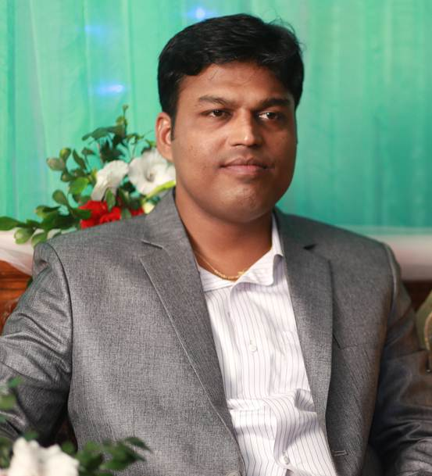
Introduction
Teacher
Lesson
Hirendra Debnath
MA(English),BEd
Senior Teacher (English)
Puran Bazar Girls’ High School
01789-916684
https://web.facebook.com/hirendra.debnath.37
hirendra0501@gmail.com
English For Today
Class : VI

Slide 3
Mind Set-up.
S: Sir, when any person acts, thinks and works good, we say -thank you.
T: Do you know when we say thank to any person ?
Notes:
This slide is only for mind set up. Teacher can ask another questions to arrange the class. After that teacher can declare the lesson.

Slide 4
Can you say what our today’s topic is?
Notes:
This slide is for taking out the lesson declaration from the students.

Slide 5
Today’s topic
Thanks for your work.
Lesson-5
Notes:
Teacher can give thanks to class.

Slide 6
Learning outcomes
After completing this lessons, students will be able to-
read and understand texts through silent reading.
infer meaning from context
listen for information.
ask and answer questions
write answers to questions and composition.

Slide 7
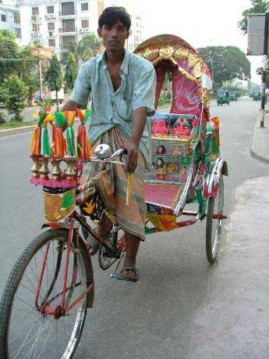
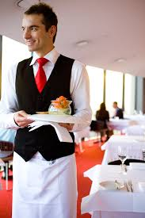
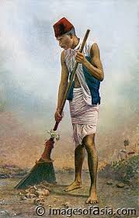
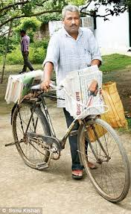
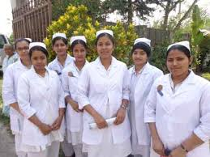
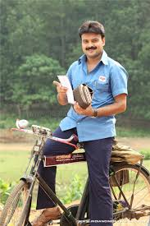
A. Look and say. Use suitable words from the box to describe the occupation of each person below.
Newspaper hawker
Rickshaw-puller
waiter
nurse
cleaner
postman
A waiter serves food at the restaurant.
A cleaner cleans our schools, offices and streets.
A rickshaw puller takes us from one place to another.
A postman delivers letters and other items to us.
A nurse cares for patients.
A newspaper hawker delivers newspapers every morning.
Notes:
Teacher may give some time to elicit correct answer, then he/she will give the feedback.

Slide 8
A1. Choose appropriate words from the box to complete the dialogue. Then act out the dialogue in pairs.
A cleaner cleans our schools, houses, office and streets.
What does a postman do?
A hawker gives us newspapers every morning.
What does a rickshaw puller do?
What does a cleaner do?
A rickshaw puller takes us from one place to another.
What does a waiter do?
A postman delivers letters and other items to us.
What does a newspaper hawker do?
A waiter serves food at the restaurant.

Slide 9
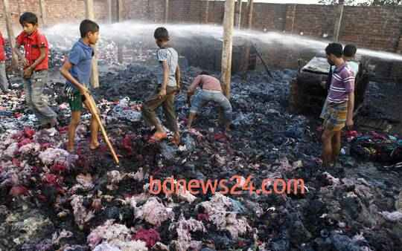
Collect
Key word
They are collecting waste material from the burn house.
Gather / accumulate
Notes:
First, the word can be shown. The SS can be asked to pronounce the word. If it is needed, teacher can help. Then the picture can be shown and asked to guess the meaning. For feedback click on meaning button.

Slide 10
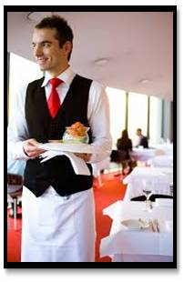
Waiter
Key word
The waiter is serving food at the restaurant.
A man who serves food in the hotel.
Notes:
First, the word can be shown. The SS can be asked to pronounce the word. If it is needed teacher can help. Then the picture can be shown and asked to guess the meaning. For feedback click on meaning button.

Slide 11
Sick
Key word
I am sick , so I can not go to school.
ill / unwell
Notes:
First, the word can be shown. The SS can be asked to pronounce the word. If it is needed teacher can help. Then the picture can be shown and asked to guess the meaning. For feedback click on meaning button.

Slide 12
Unhygienic
Key word
The varenda of this hospital is unhygienic.
Unhealthy / dirty
Notes:
First, the word can be shown. The SS can be asked to pronounce the word. If it is needed teacher can help. Then the picture can be shown and asked to guess the meaning. For feedback click on meaning button.

Slide 13
Now, read the text attentively then answer the following questions.
What time does Bulbul wake up?
Where do the people of Sankar put their rubbish?
Why does Bulbul think that all jobs are important?
What happened when Bulbul became sick?
What will happen if Bulbul falls sick again?
What will you say to Bulbul if you meet him?
Notes:
Teacher can elicit the answer by orally or written.

Slide 14
Bulbul collects rubbish from the Sankar area in Dhaka. Every morning, he wakes up at 5 o'clock and walks along the streets of Sankar to collect rubbish. People of Sankar put their rubbish in plastic bins and leave them in front of their houses.
Bulbul walks from door to door to collect them. Sometimes the bins are very dirty and they smell bad. But Bulbul does not mind. He takes out everything from the bins and puts them in his van. He believes that all jobs are important. He works hard every day to keep this area clean.
Last month Bulbul was sick for two days. So, he could not come to collect the rubbish. The people of Sankar were in great trouble. They got piles of rubbish waiting in front of their houses. The whole area became dirty and unhygienic. When Bulbul got well, he came back to Sanker. He collected everything from all the bins. Bulbul does not want to fall sick again. He realises, if he stops working even for a few days only, the whole area will turn into a big dustbin.

Slide 15
Check your answer
Bulbul wakes up at 5 o’clock in the morning.
The people of Sankar put their rubbish in front of their houses.
Bulbul thinks that all jobs are important because every jobs has its own value and purpose.
When Bulbul became sick, the whole Sankar area became dirty and unhygienic.
If Bulbul falls sick again, the whole Sankar area will become dirty and unhygienic again.
If I meet Bulbul, I will thank him for his work.

Slide 16
Grammar Focus
Simple Present Tense / Present Indefinite Tense
Structure : Sub + base form of verb + obj / ext.
Structure : Sub + S/es form of verb + obj / ext.
Bulbul + walks + from door to door.
He + takes out + everything from the bins.
We + respect + him very much.
In simple present tense, the verb takes a ‘s’ or ‘es’ if the subject is 3rd person singular number ( e.g he, she, it, Rahim, Karim etc).
Notes:
Teachers can discuss about simple present tense.

Slide 17
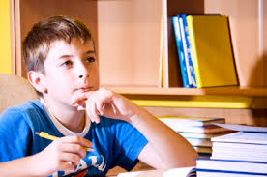
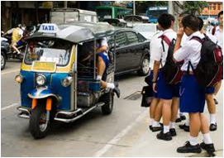
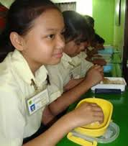
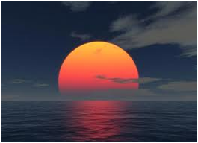
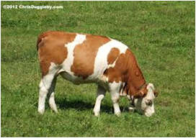
Individual Work
Now make five sentences in simple Present Tense about the following pictures. One is done for you :-
I am in class six.
Notes:
Teacher can use board for evaluation.

Slide 18
Grammar Focus
Simple Past Tense :
Structure : Sub + Past form of verb + obj / ext.
Bulbul + was + sick for + two days.
He + came + to Sankar.
They + were + in great trouble.
In simple Past Tense, the verb is always in its past form (e.g. got, became, worked, etc).
Notes:
Teacher can discuss simple past tense.

Slide 19
Pair works.
Now go to the text and find out all the verbs. If the verbs is in the present tense then turn them into past form.
One is done for you.
Present Tense | Past Tense
Wakes up | Woke up
Walks
Are
Does
Takes out
Notes:
Teacher can teach 20/25 strong and weak verbs.

Slide 20
Tick the best answer.
Feedback
The people of Sankar leave the rubbish --- their house.
a. behind ii. beside iii. at the corner of iv. before
(b) Bulbul comes of a ---
i. rich family ii. solvent family iii. wealthy family iv. poor family
(c) Bulbul collects rubbish from ---
i. Sankar ii. Mirpur iii. Dhanmondi iv. nowhere
(d) Bulbul could not come to collect rubbish for ---
i. indifference ii. negligence iii. illness iv. pre-occupation
(e) Bulbul collects rubbish from Sankar area in Dhaka. Here the word ‘collect’ is similar to -- i. leave ii. drop off iii. disperse iv. gather
$$$$
$$$$
$$$$
$$$$
$$$$

Slide 21
HOME WORK
Think of a person who works in your area to help you live well. Write a composition on this person .
Notes:
Teachers can give some instructions to do home work.

Slide 22
SEE YOU AGAIN

