Slide 1

WELCOME

Slide 2


Class Five
English For Today
Unit -3 , Lesson -1
Saikat’s Family.

Slide 3






Learning Outcomes
The students will be able to ……
L.3.4.1. understand statement made by the teacher and students.
S.1.1.1. say words and sentences with proper sound and stress.
R.1.5.1. read the sentences in the text with proper pronunciation stress and intonation.
W.8.1.1. make sentences using words, phrases given in the text book .

Slide 4

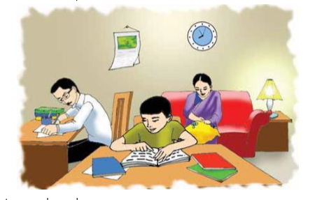
Look at the picture

Slide 5

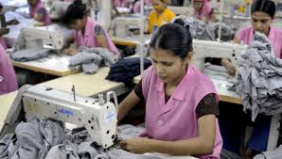

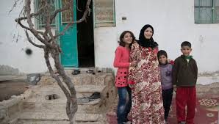
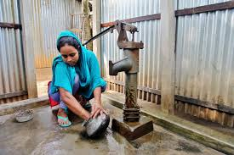
Parents
Sewing
Music
Neighbours
Housewife

Slide 6

Word meanings
Parents
Father and mother
Housewife
A married woman who works in a house
Sewing
Make cloths
Whom live beside my house
Neighbours

Slide 7
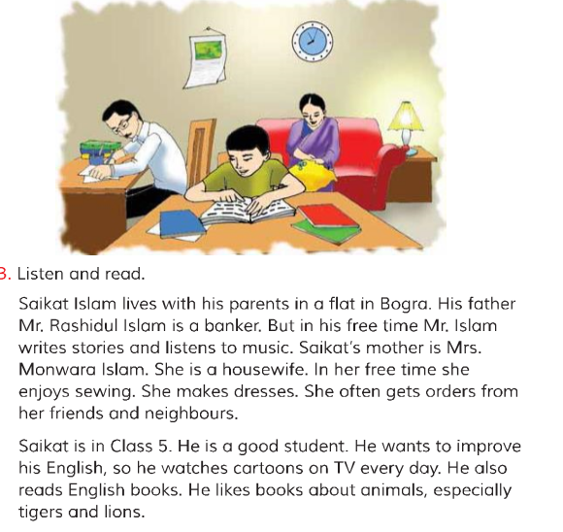

Slide 8



Parents
Saikat lives with his parents.
Music
I like music.
Housewife
My mother is a housewife .
Sewing
Reshma enjoys sewing .
Neighbours
Rahim likes her neighbours. .

Slide 9
Make sentences
Group No- 1
Parents
Music
Group No- 2
Housewife
Sewing
Group No- 3
Neighbours
Friends

Slide 10
Answer the questions:
1.What does Saikat’s father do?
2.What does Saikat’s mother do?
3.What does Saikat’s father do in his free time?
4.What does Saikat’s mother do in her free time?
5.What kind of books does Saikat like?

Slide 11
Home work
Write five sentences about your family.

Slide 12
Ataullah Md. Salim Uddin
Asstt Teacher
Kalauzan Khalachipara Govt. Primary School
Lohagara, Chittagong.

Slide 13


Thanks For All

