Slide 1
Good morning
ALL THE STUDENTS

Slide 2
IDENTITY
MD.Jahangir alam
Assistent Teacher
Vedvedi Govt.Primari School,
Rangamati, sadar.

Slide 3
LESSON IDENTITY
Class:1
Subject: English
Lesson : 4-5
Unit : 5,6,8 ( D.E.F Alphabet)
Time : 35 mn

Slide 4
Learning Outcomes:
Students will be able to -
1.1.1 –becomes familiar with English sound by listing to common English words.
1.1.1 – repeat after the teacher simple words and phrases.
1.1.2 – say simple words and phrases.
1.2.1 – recognize and read the alphabet both small and capital (non-cursive)
1.1.1-to practice letter shapes/ simple writing patterns etc.
1.2.1- write non-cursive capital letters small.

Slide 5
LOOK LISTEN AND SAY.
D
d
E
e
F
f

Slide 6
LOOK LISTEN AND SAY. TRACE IN THE AIR.
D
d
CAPITAL LETTER
SMALL LETTER

Slide 7
SAY AND READ. TRACE AND WRITE.
D
--------------------------------------------------------------------------------------------------------------------------------------------------------------------------------------------------------------------------------------------------------
-------------------------------------------------------------------------------------------------------------------------------------------------------------------------------------------
d

Slide 8
What is this ?
Dog

Slide 9
LOOK LISTEN AND SAY.
d
doll

Slide 10
LOOK LISTEN AND SAY.
D
Dog
d
doll

Slide 11
LOOK LISTEN AND SAY. TRACE IN THE AIR.
E
e
CAPITAL LETTER
SMALL LETTER

Slide 12
SAY AND READ. TRACE AND WRITE.
E
--------------------------------------------------------------------------------------------------------------------------------------------------------------------------------------------------------------------------------------------------------
e
-------------------------------------------------------------------------------------------------------------------------------------------------------------------------------------------

Slide 13
LOOK LISTEN AND SAY.
E
EGG

Slide 14
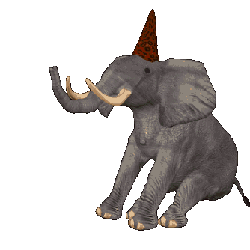
LOOK LISTEN AND SAY.
e
elephant

Slide 15
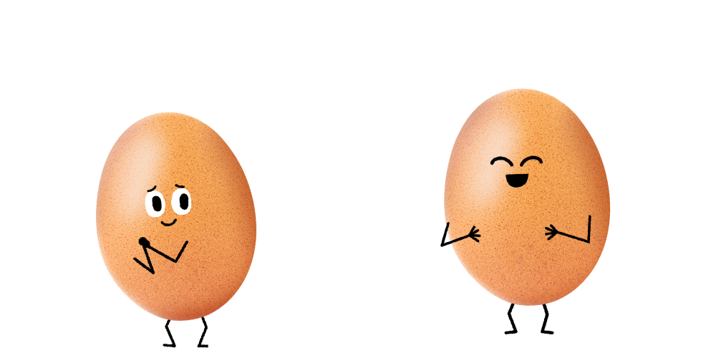
LOOK LISTEN AND SAY.
E
Elephant
e
egg

Slide 16
LOOK LISTEN AND SAY. TRACE IN THE AIR.
F
f
CAPITAL LETTER
SMALL LETTER

Slide 17
SAY AND READ. TRACE AND WRITE.
F
--------------------------------------------------------------------------------------------------------------------------------------------------------------------------------------------------------------------------------------------------------
-------------------------------------------------------------------------------------------------------------------------------------------------------------------------------------------
f

Slide 18
LOOK LISTEN AND SAY.
F
f
fan
FISH

Slide 19
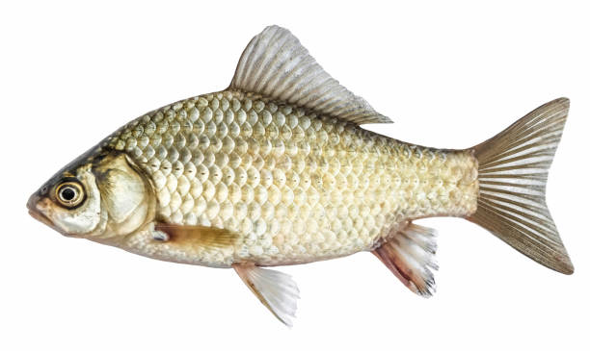
LOOK LISTEN AND SAY.
F
FAN
f
fish

Slide 20
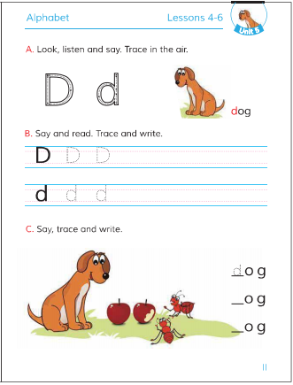
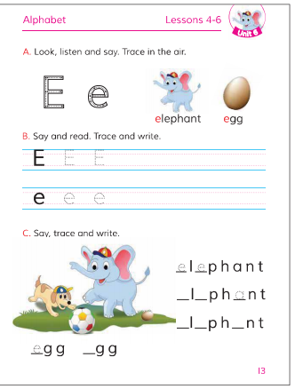
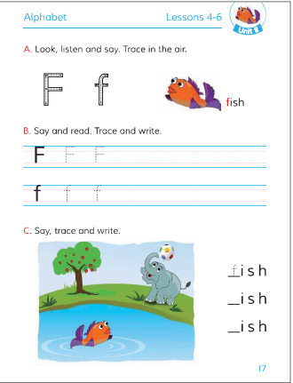
Open your Book at page-11,13,17.

Slide 21
Open your Book at page-11.

Slide 22
Open your Book at page-13.

Slide 23
Open your Book at page-17.

Slide 24
Write the missing letter.
l
__og
do__l
D
g
e
E__g
__lephant
a
__ish
f__n
F

Slide 25
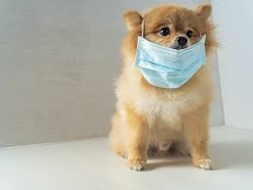
Match the letters with the pictures
f
e
d

Slide 26
SAY AND WRITE THE FIRST LETTER.

Slide 27
Thanks
All
the
students

