Slide 1
Welcome

Slide 2
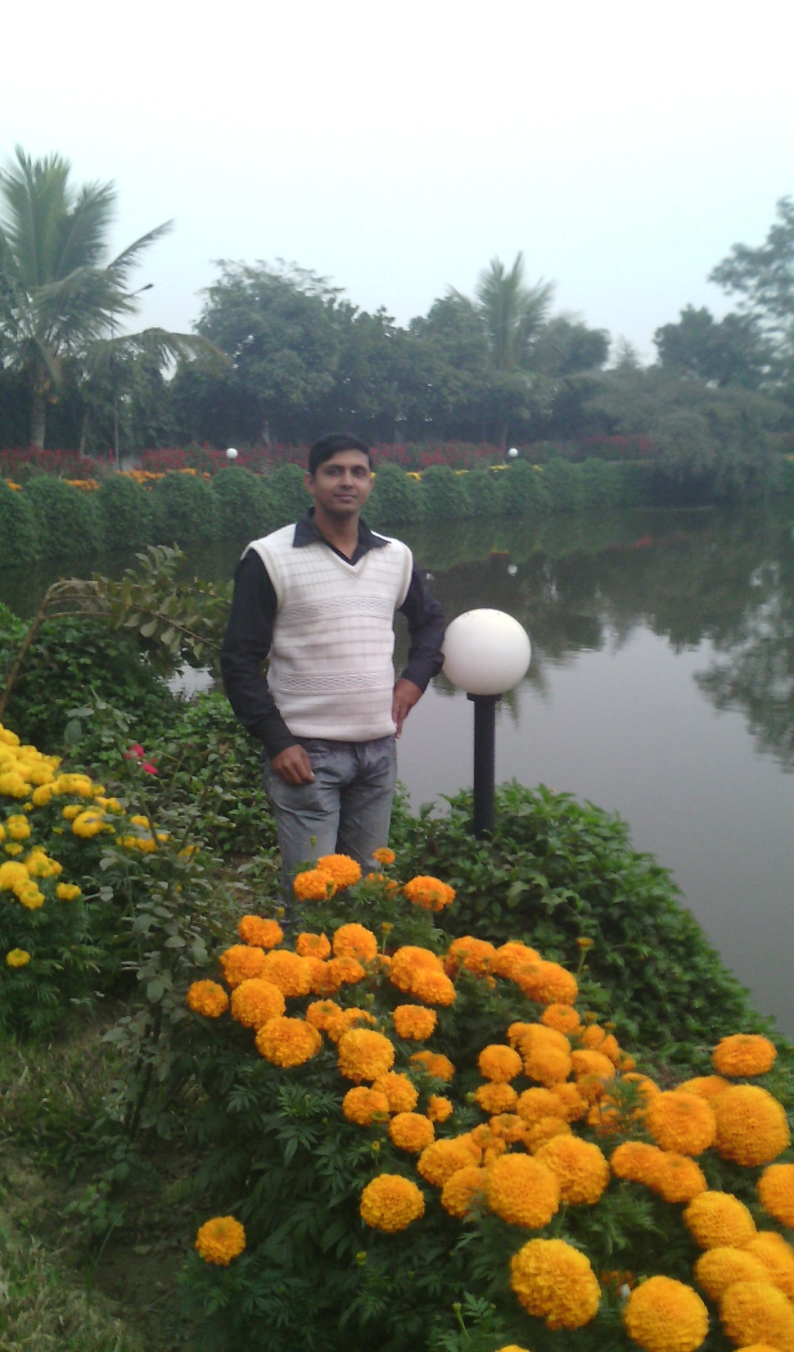
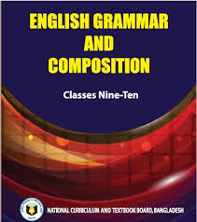
Ujjal Kumar Ghosh
Assistant Teacher (English)
Chuadanga Krishnanagor high school
Panjia,Keshabpur,Jassore

Slide 3
What is it?
It is question mark.

Slide 4
There are four types of question generally. They are-
1. General or Yes/No Questions
Do you like this country? –
2. Special or Wh-Questions
When did you come here? –
3. Choice Questions
Does she like ice cream or sweets?
4. Disjunctive or Tag Questions
She sent him an invitation, didn’t she?

Slide 5
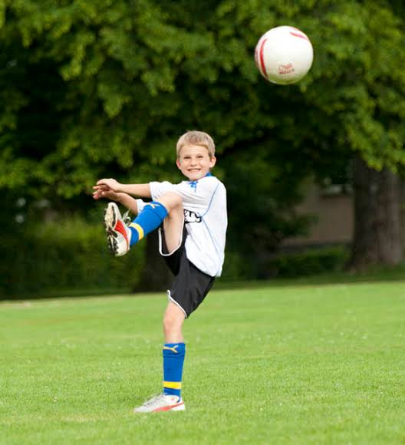
He likes football,
doesn't he?
He is a teacher,
isn't he?
What kind of question are these?
Can you say?

Slide 6
Yes, Today’s lesson is -------
Tag Question
Class : Nine-Ten
Subject: English grammar and Composition

Slide 7
Learning Outcome
By the end of the lesson-
the learners will be able to -
define tag question.
make tag question of present form of verb.
make tag question of past form of verb.
make tag question of helping verb.

Slide 8
Tag question is a type of question which we ask at the end of a statement or imperative sentence
There are two types of tag question:
1.Affirmative tag. 2.Negative tag.
We use auxiliary verb to make tag question . These are am, is , are , have ,has ,was , were ,had, shall, will, can, could, may, might ,must , ought(to) , use(to), dare, need , do , does, did. Above verbs help us to make affirmative tag.
For negative tag we use negative form of above verbs . Negative auxiliary and verbs in tags are usually in their contracted form(=n’t)
The basic structure of tag question:
positive statement will be negative tag and negative statement will be positive tag. Snow is white,isn’t it? You don’t like me, do you?

Slide 9
Full form of negative | Abbreviation of negative | Full form of negative | Abbreviation of negative
am not | aren’t | could not | Couldn’t
is not | isn’t | may not | mayn’t
are not | aren’t | might not | might n’t
was not | Wasn’t | must not | mustn’t
were not | Were not | ought not | oughtn’t
Shall not | Shan’t | usednot | usedn’t
will not | Won’t | dare not | daren’t
Should not | Shouldn’t | need not | needn’t
would not | Wouldn’t | do not | don’t
have not | haven’t | does not | doesn’t
has not | has n’t | did not | didn’t
had not | hadn’t | cannot | can’t

Slide 10
Some important rule of tag question :
1.Subject of tag question will be always pronoun.(according to person , number and gender)
Mr Haq is our English teacher , isn’t he?
Rina is dancing , isn’t she?
The dog is barking , isn’t it?
Birds can fly , can’t they?
2. “They” will be used instead of everybody ,everyone , somebody ,someone, anybody ,anyone ,either,(positive) nobody, no one , none, neither, nothing (negative).
Example: Every body liked you , didn’t they?
No one would do this , would they?
If the imperative statement begins with a verb and it means a request by tag question . “Can you” or “could you” will be use this tag question.
Help me , can you? Bring me an orange , could you?

Slide 11
4. If the imperative statement begins with a verb and it means the consent of the listener by tag question . “Will you” or won’t you” will be use this tag question.
Solve the problem ,will you/won ‘t you?
5. If the imperative statement begins with Don’t/Never. “Will you” is used in tag question. Don’t disturb me , will you?
If the imperative statement begins with let us/lets. “shall we” is used in tag question.
Let us have a party , shall we?
If the imperative statement begins with let him ,her , them. “will you” is used in tag question.
Let him go now , will you?
8.If the statement begins with introductory there. subject of this tag question will be there.
There is a school in our village , isn’t there?

Slide 12
9.If the sentence is complex sentence. The part of Principle clause will be tag question.
I know that he is honest , don’t I?
10.If the subject of any sentence is all of you/some of you/none of you/most of you/everyone of you. You will be the subject of this tag question.
All of you were playing them , weren’t you?
11.If the middle of the sentence have never/seldome/hardly/scarcely/few/little etc.Tag question will be positive tag.
A barking dog seldom bites, does it?

Slide 13
Lets practise-
Group work
1.Let us go home,----?
2.They are our best friends,----------?
3.There is little water in this pond,-----?
4.Fishes can swim,--------?
5. Everybody knows it,-----?

Slide 14
Individual work
a) I love the flag of Bangladesh,
don't I?
b) You like football,
don't you?
c) Trees give us oxygen,
don't they?
e) I eat rice,
don't I?
f) He works in the field,
doesn't he?
g) The sun gives us light,
doesn't he/it?

Slide 15
Pair work
1.Bangladesh became independent in 1971,
didn't she/it?
2.The scientists invented many wonderful inventions,
didn't they?
3.The freedom fighters fought very bravely,
didn't she?
4.They got admitted to Rajshahi University,
didn't they?
5. Meena was going to school,
wasn't she?

Slide 16
Homework
1.We ought to obey our parents.
2.We must submit to destiny,
3.Traffic jam is a great problem in our country.
4.She has a problem.
5.They will go home.
6.I went to sylhet yesterday.

Slide 17
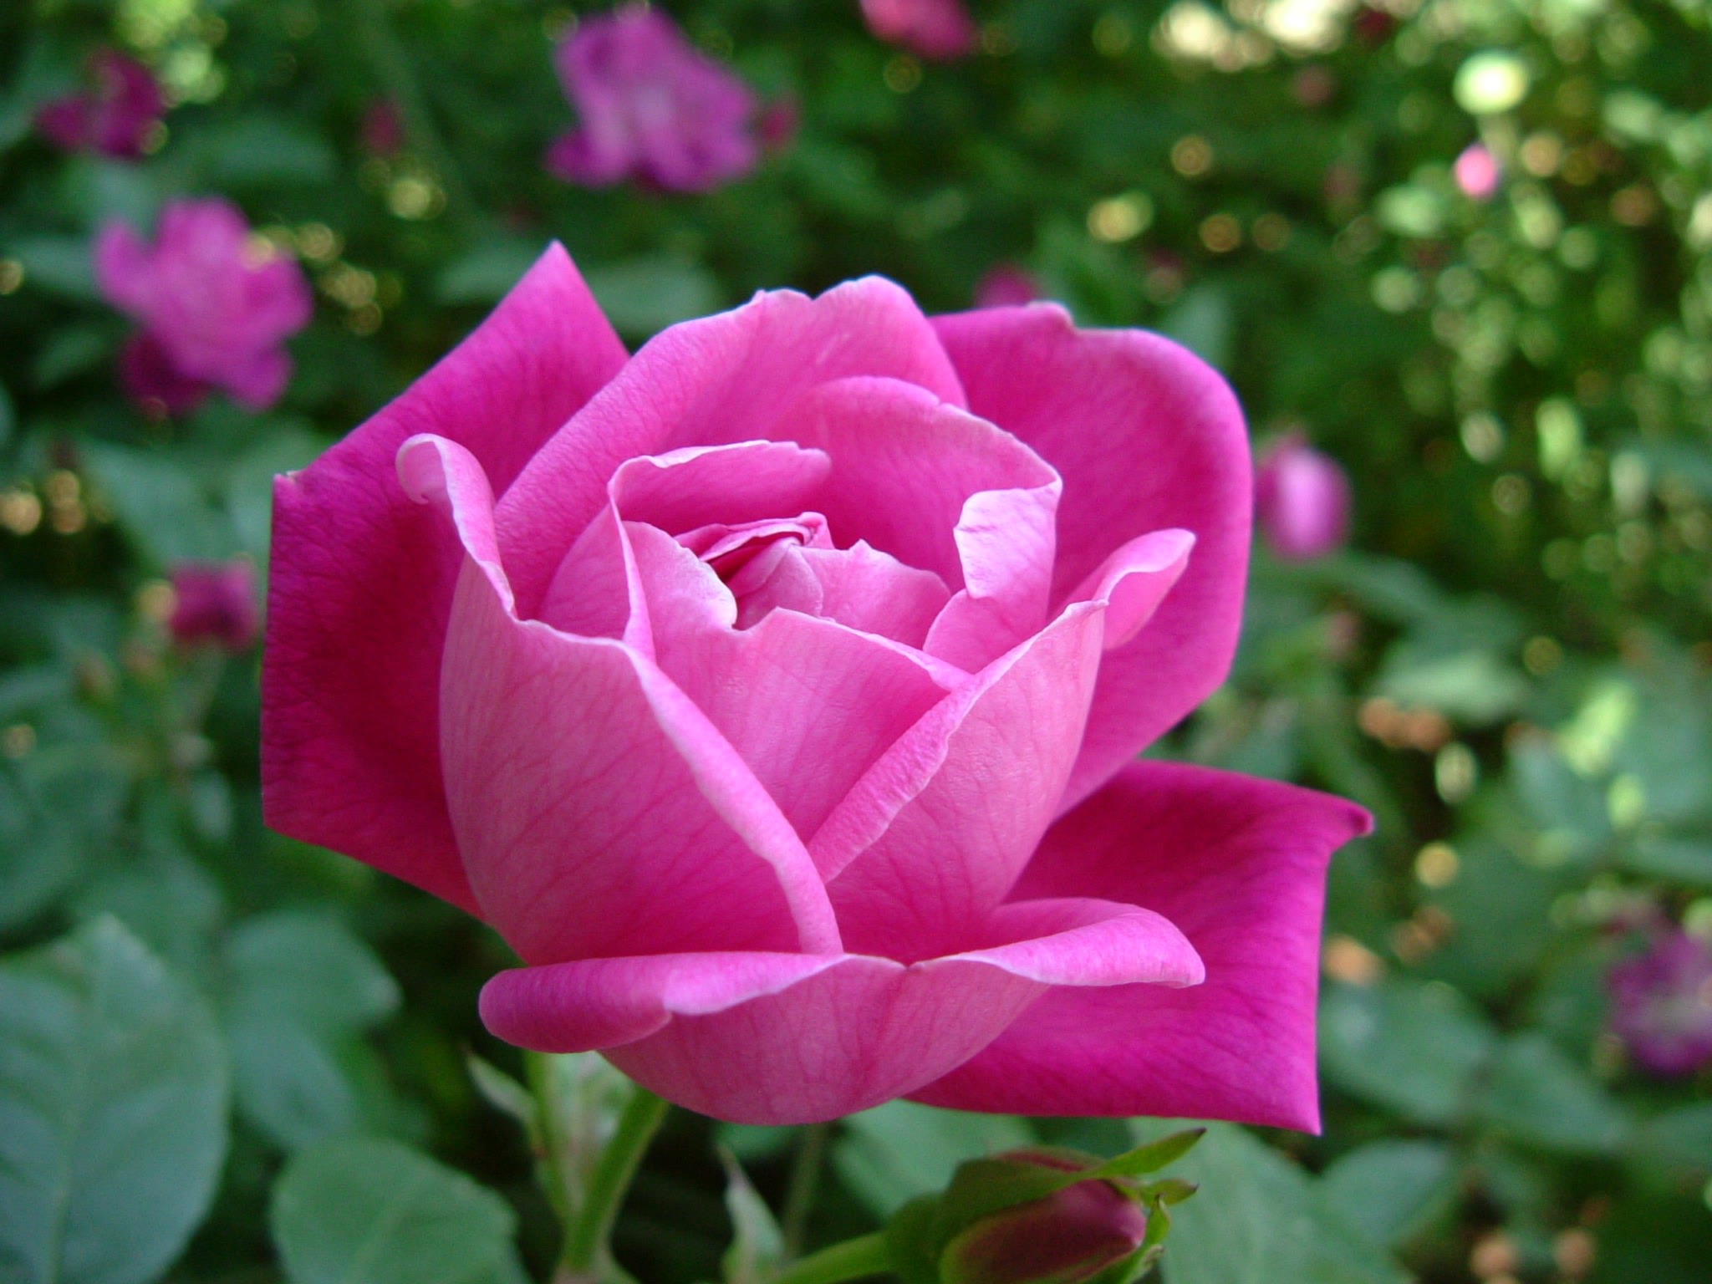
Goodbye

