Slide 1
WELCOME

Slide 2
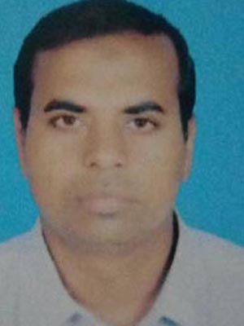
IDENTITY
Mohammad Shafiqul Islam
Lecturer in English
Sreechail Mohammad pur Islamia Alim Madrasha
Daudkandi,Cumilla
Sub-English Grammar and Composition
Class-Ten

Slide 3
WARMING UP
Read the following sentences-
I have made the content
The patient had died before the doctor came
I shall have finished the work before you come
Which types of tenses do indicate the above sentences?

Slide 4
So, today’s topic name is-
All Perfect Tense

Slide 5
In this lesson the students will be able:
-To write the example of all perfect tenses
-To use the write form of verb related to all perfect tenses
-To differentiate among the all perfect tenses
LEARNING OUTCOME:

Slide 6
Examples of present perfect tense-
He has sung the song
They have played cricket
Examples of past perfect tense-
I had entered the class before the bell rang
He reached the home after the sun had set
Examples of future perfect tense-
I shall have finished the content before you will come or you come
They will have completed the work before Iwill come or Icome

Slide 7
Tense name | Structure of tense
Present perfect tense | Sub+have/has+past participle of verb+object +extension
Past perfect tense | Sub+had+past participle of verb+object +extension
Future perfect tense | Sub+shall have/will have+past participle of verb+object +extension

Slide 8
Present perfect tense: Present perfect tense is that which has been completed just now,
but it’s result is existed till now.
Past perfect tense: Between the two action of past time, which action had been complet-
ed earlier is called past perfect tense and the other is called Past Indefinite.
Past Perfect will be placed before ‘before’ and after ‘after’.
Future Perfect tense: Between the action of future time, which action will have been com-
Pleted earlier is called Future Perfect tense and the other is called Future Indefinite or pre-
Sent Indefinite.

Slide 9
EVALUATION
*Write three examples for each perfect tense

Slide 10
HOME WORK
*Write the definition,structure and five examples for each perfect tense

Slide 11
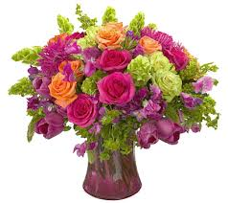
THANK YOU ALL

