Slide 1
Welcome
To My English Class

Slide 2
Identity
Md. Salim Reza
Lecturer(English)
01717515144
Ranisonkail BM College.
Subject – English 1st paper
Class –Eleven
Time – 45 mins

Slide 3
Look at the following logos.
Are you familiar with them ? Discuss with your partner.

Slide 4
Look at some another logos.
What they are and how they are related to the field of e-communication ?

Slide 5
Today we’ll read about-
Unit no -13
Social network
services
Lesson no -2

Slide 6
Learning outcomes
After studied this Lesson , we will be able to
Surf the internet ;
read and write e-mails;
Infer the word meanings
Ask and answer the questions

Slide 7
Vocabulary
Word | Meaning
Emerge | Move out of ,or away from something and become visible
Frequently | regularly or habitually
Interact | Act on one another
Upload | To copy or move information to a larger computer system or to the internet
Blog | A web page that is make up of information about a topic.
Measure | An official action
profile | A short biographical sketch.

Slide 8
Facebook , Twitter , Google + , LinkedIn etc. are some popular social networking websites, where your personal information is visible to all types of personalities that may be genuine or fake.

Slide 9
Social network services are web- based and hence , provide ways for the users to interact through the internet.

Slide 10
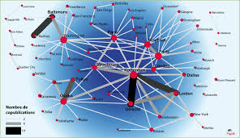
These services make it possible to connect people sharing interests and activities across the borders and thus have made the users feel that they really live in a global village.

Slide 11
Why are social networks expanding so fast ?

Slide 12
Firstly
Most of the social services are cost free.

Slide 13
Secondly
You can make your personal profile public before the entire online community.

Slide 14
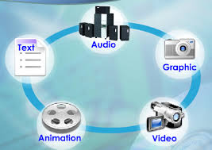
Thirdly
Social networks allow users to upload pictures, multimedia, contents and modify the profile.

Slide 15
Fourthly
Networks allow users to post blog entries.

Slide 16
Finally
There are privacy protection measures too.

Slide 17
Dear students, read the text silently for 10 minutes

Slide 18
Pair work
What do you understand by social networks ?
Write the Names of some social network services .
By using internet technology some people have made possible to carry on social relation among people around the world. It is called social networks.
– Facebook. This is easily the largest social networking site in the world and one of the most widely used.
– WhatsApp. ... WeChat. ... QZone. ...
– Tumblr. ... – Instagram. ... – Twitter. ... – Google+ ( No Longer Available )

Slide 19
Group work
Make a list of the arguments as to why social networks are expanding so fast ?
Most of the social network services are cost free.
One can upload one’s personal profile before the entire online community.
Social networks allow user to upload pictures, multimedia,contents and modify the profile
Networks allow users to post blog entries.
These are privacy protection measures too.

Slide 20
Evaluation
Choose the best answers .
The ------ technology has helped social networking sites to emerge
a. LinkedIn b. Google + c. Internet d. Twitter
User have to pay for
a. Social networks b. Their online connections c. multimedia contents d. Uploading pictures
3. User accounts have---------- protection measures.
a. Virus b. Identity c. Personal secrecy d. Network
4. User profiles have a section for
a. others’ remarks b. outsiders’ editing c. outsiders’ moderation d. outsiders’ uploading

Slide 21
Home work
‘Social network services have made the users feel that they really live in a global village’. Do you agree with this view ? Why / Why not ?

Slide 22
Thank you very much

