Slide 1

WELCOME MY
ENGLISH GRAMMAR CLASS.

Slide 2

INTRODUCTION
Class- Ten
Hasina Momotaj
Sub- English Grammar &
Composition
Unit-5
Lesson – 5
Time- 50 minutes
Assistant Head Teacher
Raja GC High School
Sylhet
Email-
hasinalovely76@gmail.com

Slide 3
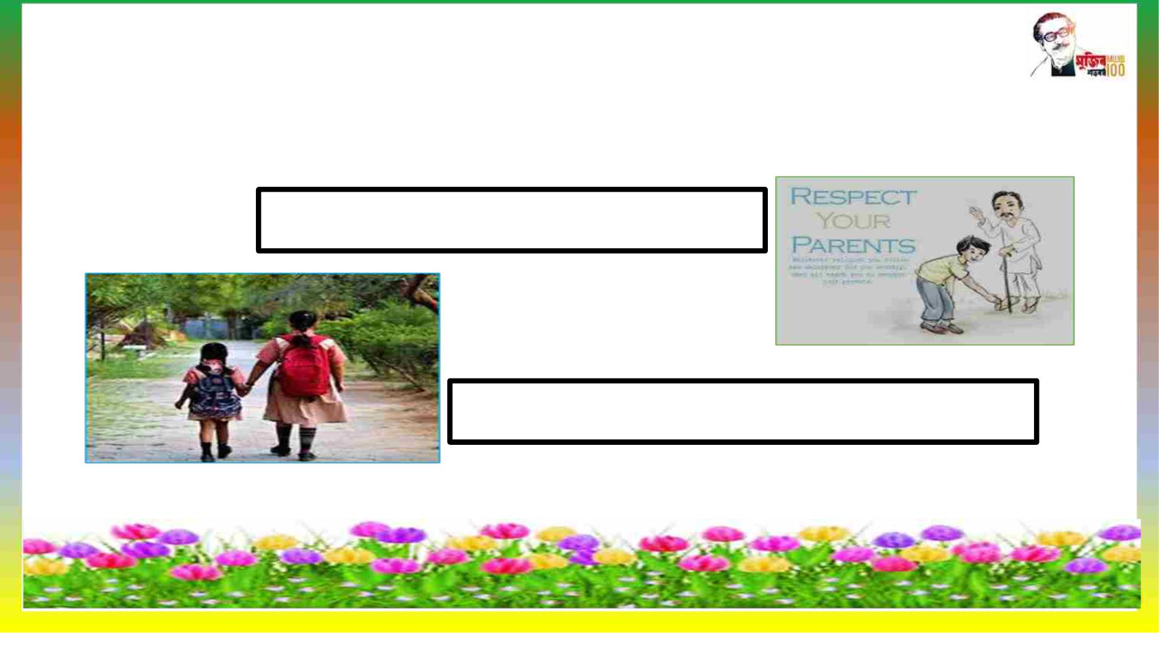
Look at the pictures & tell what do you
see in the pictures?
We must obey our elders.
We need go to school in time .
So ,can you guess what lesson today we learn ?

Slide 4

Today our topic
Is
Must. Must not/ need. Mustn’t

Slide 5

Learning outcomes
q At the end of the lesson students will be
able to say-
v What is modals & name of modals.
v Use of must ,need mustn’t .
v Making sentences with modals.

Slide 6
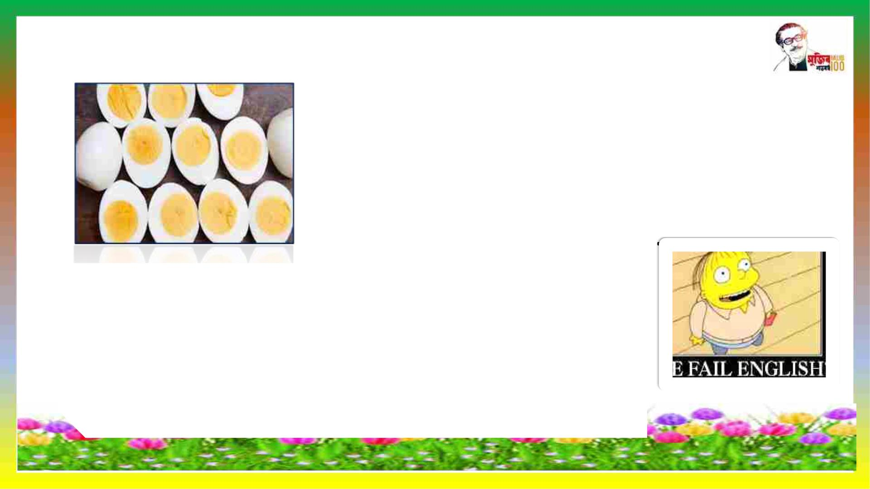
A. Read the following texts:
a. :He ate a dozen eggs at a time !
He must be crazy .
:You must be joking ! I don’t
believe you
b . My mark –sheet shows that I’ve failed
in English ! There must be some mistake .
English has always been my storng
subject . It simply can’t be !

Slide 7

c. The teacher says to her students ,”You must submit
your essays tomorrow . I won’t accept any after that.
And you must not copy from any book or from anyone
else’s writing

Slide 8

e.When you go for an interview you need to make a
good impression as soon as you enter the room.You
need to give the impression of being polite and at
the same time of being confident and pleasant .
Here are just a few things you should remember ;.
You mustn’t move about in your chair ,you must sit
still and relax;

Slide 9

You needn’t wear new or fashionable
clothes, but you must wear clean
and neat clothes;
You need to speak loudly and clearly ,
but mustn’t interrupt when they are
speaking .

Slide 10
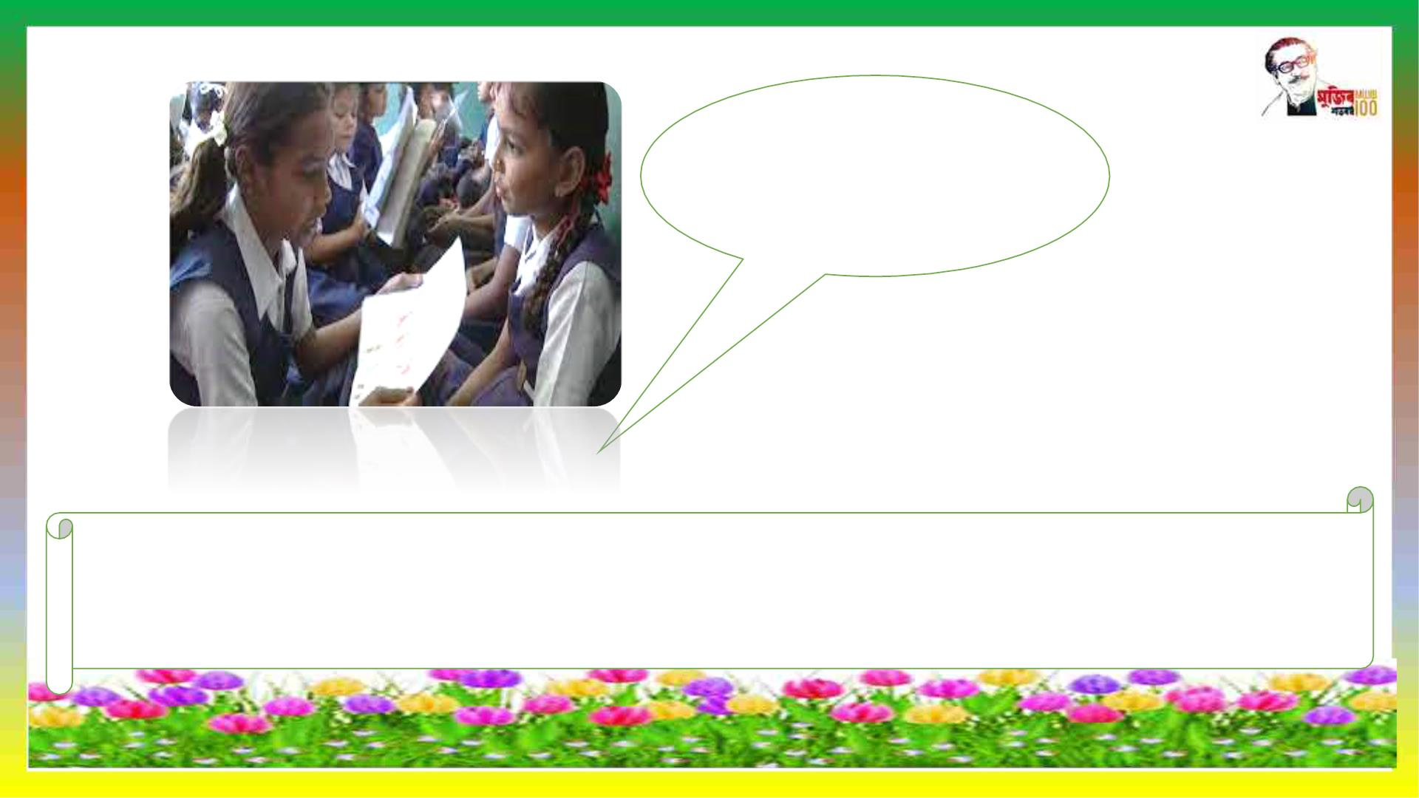
Pair work
Make ten sentences use must & mustn’t . Time 7 minutes

Slide 11

USE
We can use must and can’t to assert something that we infer or
conclude to be the most logical possibility of a situation or an
event.For example,
q He must be crazy to eat a dozen eggs at a time .
q as the examinee confident that he just cannot fail in English
since it is strong subject, he uses ‘can’t’ to express the most
logical possibility the situation :
q It simply can’t be.

Slide 12

We use must to express obligation and mustn’t to express
prohibition or something that is not allowed
Ø You must submit your essays tomorrow. (obligation)
Ø You must not copy from any book or anyone else’s writing.
(prohibition)
Ø You mustn’t move about in your chair (not allowed)

Slide 13

We use need to talk about something that is necessary:
v When you go for an interview ,you need to make a good
impression.(necessary)
We use need not or needn’t (without ‘to’) to talk about
something that is not necessary:
v You needn’t wear new or fashionable clothes.
v You needn’t smile all the time ,but you need to look relaxed
and confident.

Slide 14

Evaluation
Fill in blanks in the following sentences with must ,mustn’t can’t or
need/needn’t
a. Rita wants to go and live in Japan one oneday . But then she -----
-- learn to speak Japanese.
b. The doctor tells the patient that his heart condition is bad ,and
he ------ smoke at all.
c. One of the rules of hotels anywhere is that the guests ------ sign
the register immediately on arrival.

Slide 15

Homeworks
Write ten sentences use must ,mustn’t can’t or
need/needn’t.

Slide 16

Thank you all. Stay home stay safe.

